Slide 1
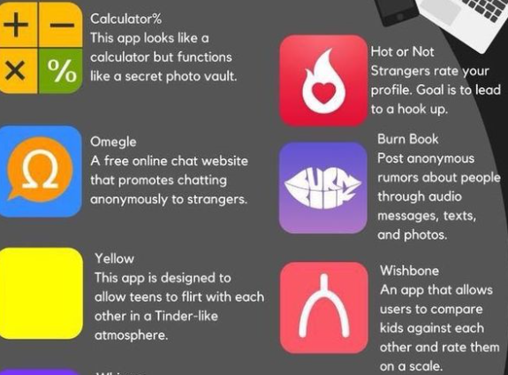
Apps that cause concern:
Notes:
Read
Calculator – promotes secrecy
Omegle – one of the most worrying ones, appeals to lonely children or to groups of children who want to ‘just see’
Yellow – younger dating app but nothing preventing older people pretending to be something they’re not.
Hot or Not – appeals to either very confident children or children who are very shy and want to know what people really think.
Burn book – well…..
Wishbone – another rating app. Promotes bullying, nasty comments etc.

Slide 2
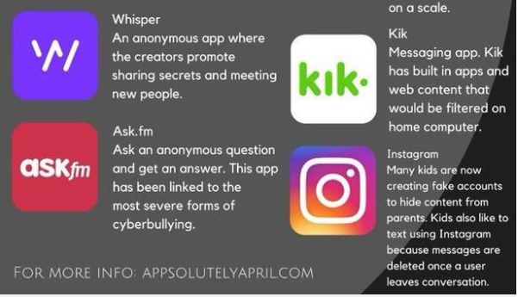
Notes:
Whisper – had some concerns about sharing secrets from parents and promoting having/sharing secrets with strangers
Ask FM – Some really awful cases of on line bullying with this app.
Kik – messaging app but concerns about lack of filters and on a phone
Instragram – so popular, but easy to set up a fake account and use for the wrong purposes. Also children like it because conversations are deleted.

Slide 3


TikTok app - users can easily create, edit and share video with friends
More popular than Snapchat and Twitter
Sexual exploitation of children as young as 8 via comments function being used to encourage children to engage in sexual activity online.
Huge during Covid19 lockdown for dance videos
Notes:
500 million regular users, TikTok ranks as one of the most popular social media apps around.
Half of the TikTok’s users aged between 13-24, there is growing concern youngsters are increasingly being targeted by sexual predators.
TikTok recently overtook both Snapchat and Twitter last year.
Thousands of UK youngsters who use the site to create and rate video clips are now the subject of safety concerns.
Children's charity Barnardo's has warned how children as young as eight risk being sexually exploited on TikTok and other similar sites
Sex pests reportedly use TikTok’s comments function to encourage children to engage in sexual activity online, the charity said.

