Slide 1
Thank you St. Catherine’s Hospital!

Slide 2
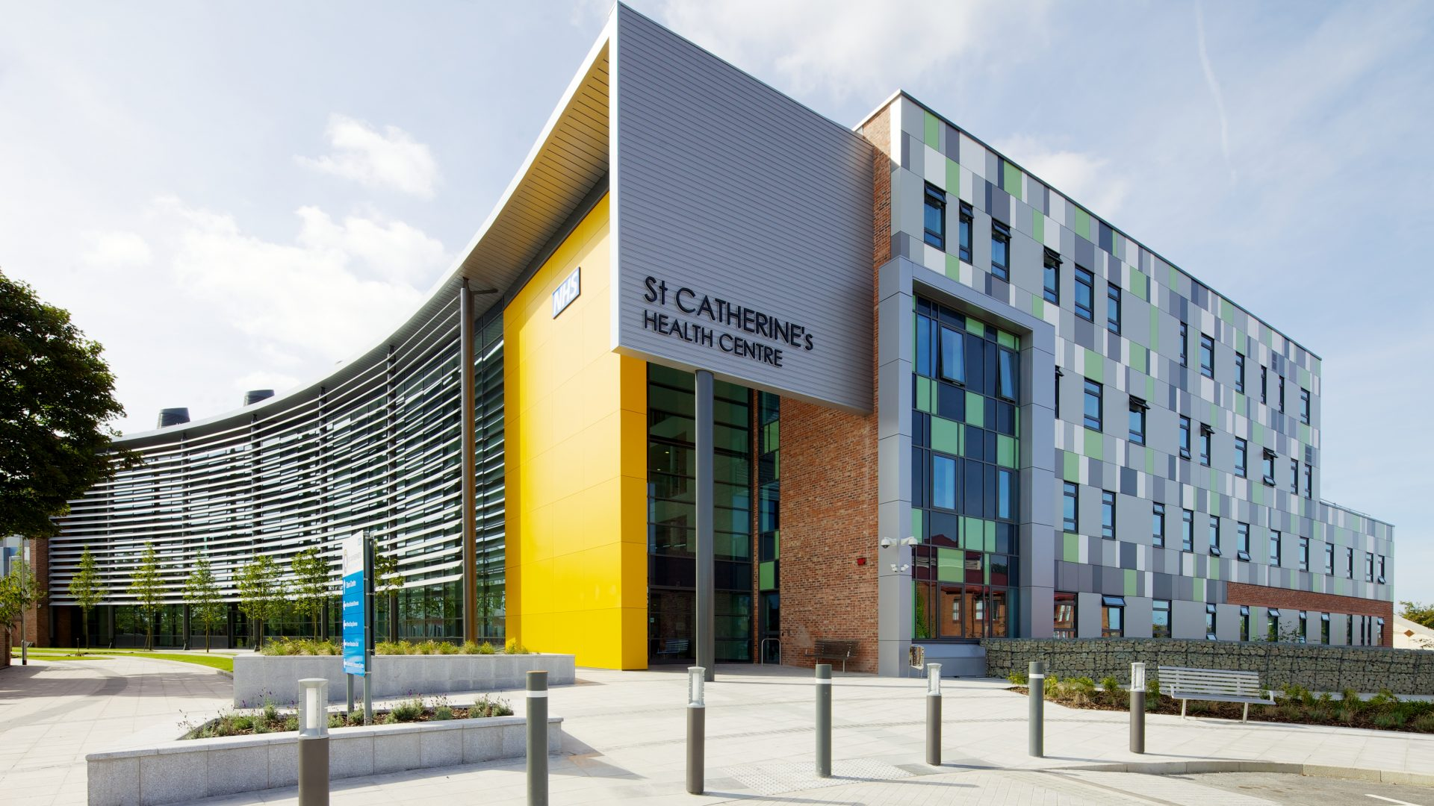
What is this place? And who works here?
Lots of people work there because there are lots of rooms! Has anyone ever been?
Did you see any real life heroes like nurses and doctors when you went?

Slide 3
We are going to write a letter to the people that work here to say thank you for all of the things they do to help us, and other children just like you, when we feel poorly or need a check up.
To start our letter’s today we are going to draw a picture. Can you think of something beautiful that a Dr or Nurse or other persons working in the hospital would like?
Maybe you would like to draw one of these…

Slide 4

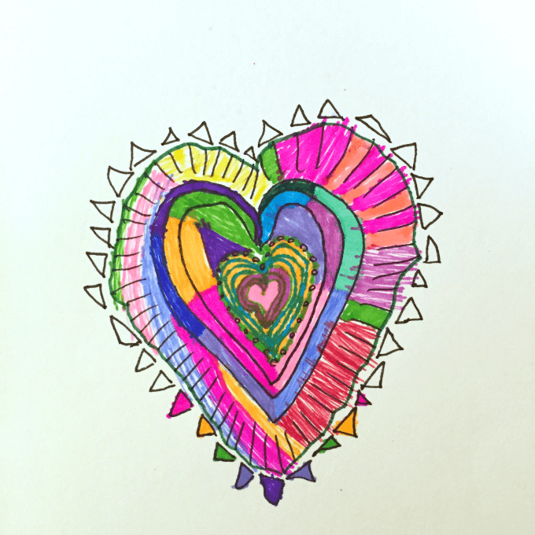
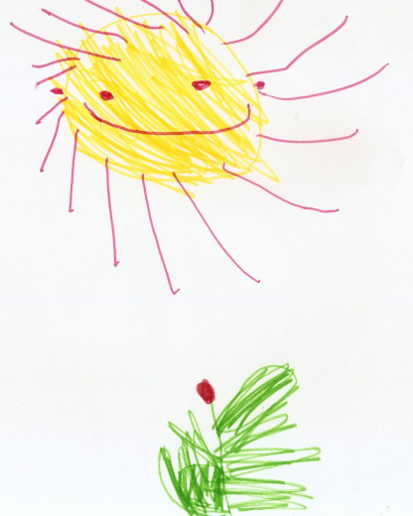

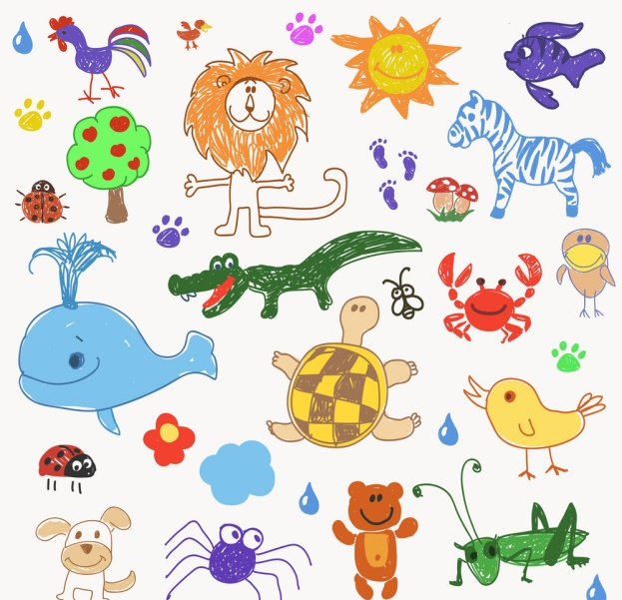
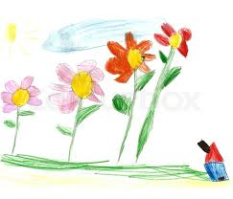

Slide 5
After you have drawn your picture you can write your letter. Can you remember how a letter starts?
That’s write ‘To’ or ‘Dear’
We are writing to our friends at the hospital so we could say ‘To our friends’ or ‘Dear Friends’ or you could change it to Doctors and Nurses if you like.
Then we will add a thank you message to let them know we think they are brilliant and real life heroes. Your letter could start like or be something like this one…
Adults: The children won’t know all of the words in the letter but you can scribe there ideas and ask them to write the sounds at the start / within the word or just words that they do know ☺

Slide 6
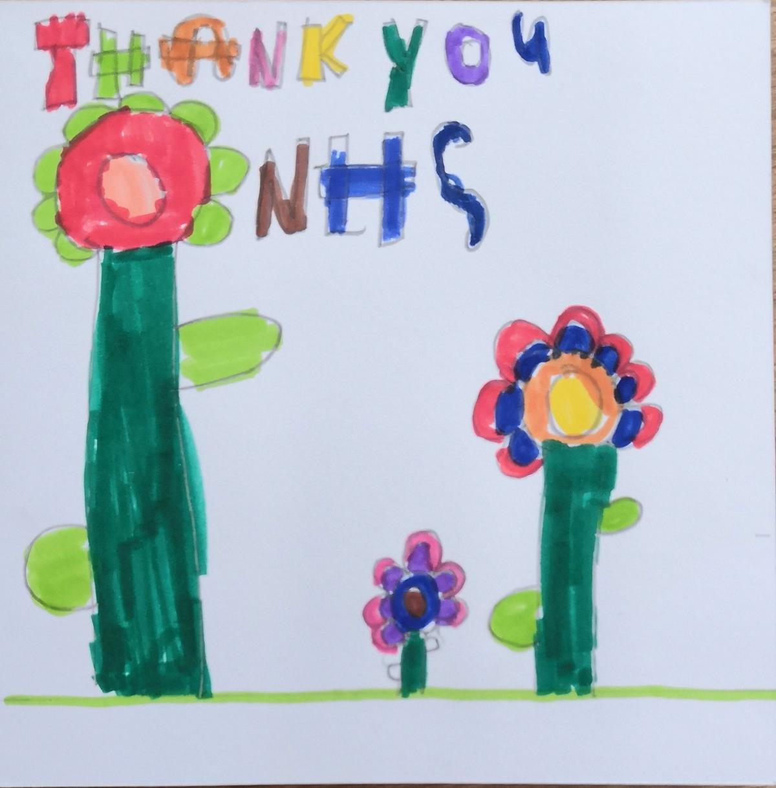
To the Doctors and Nurses,
Thank you for being kind and helping me if I am sick.
You are my real heroes,
Love from
Miss Barrett xxx

