Slide 1
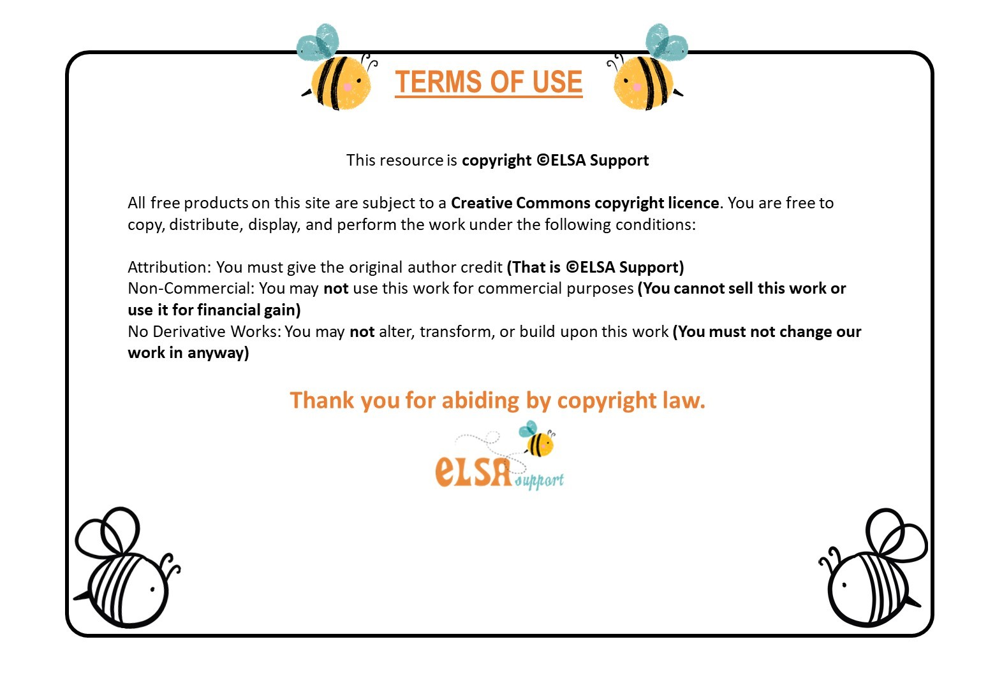
www.elsa-support.co.uk

Slide 2
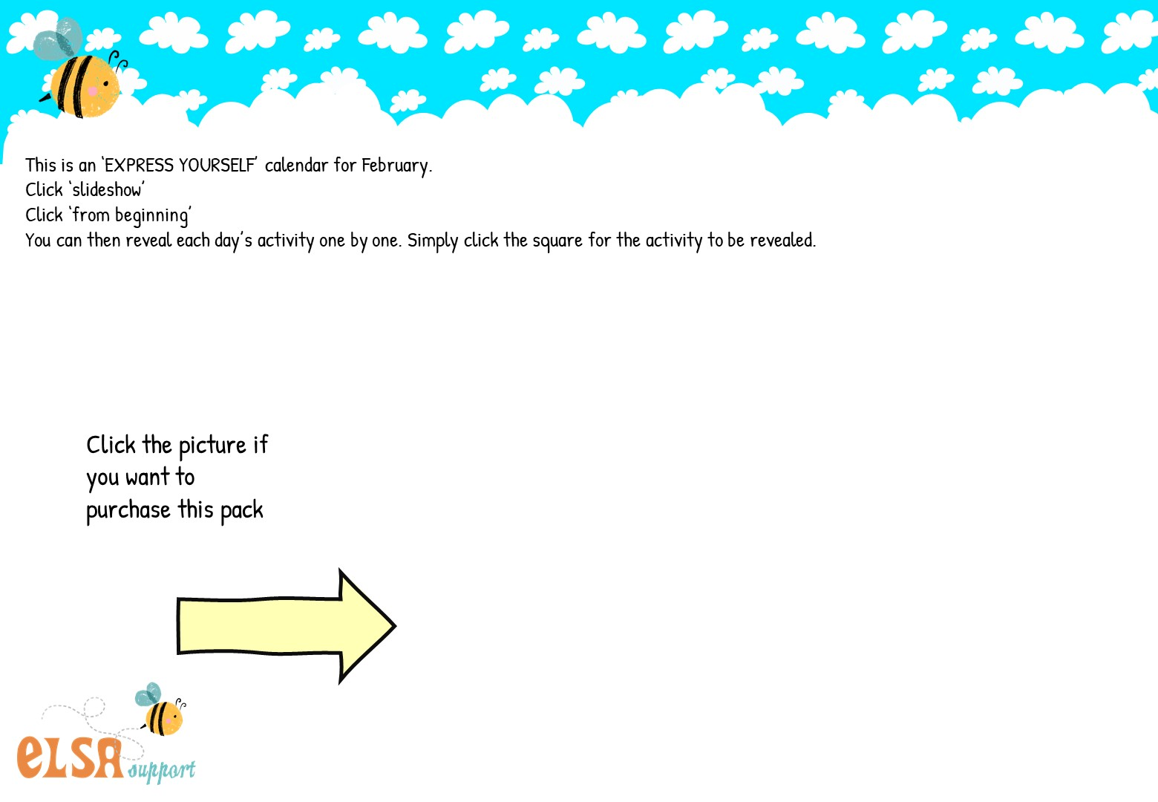


Slide 3
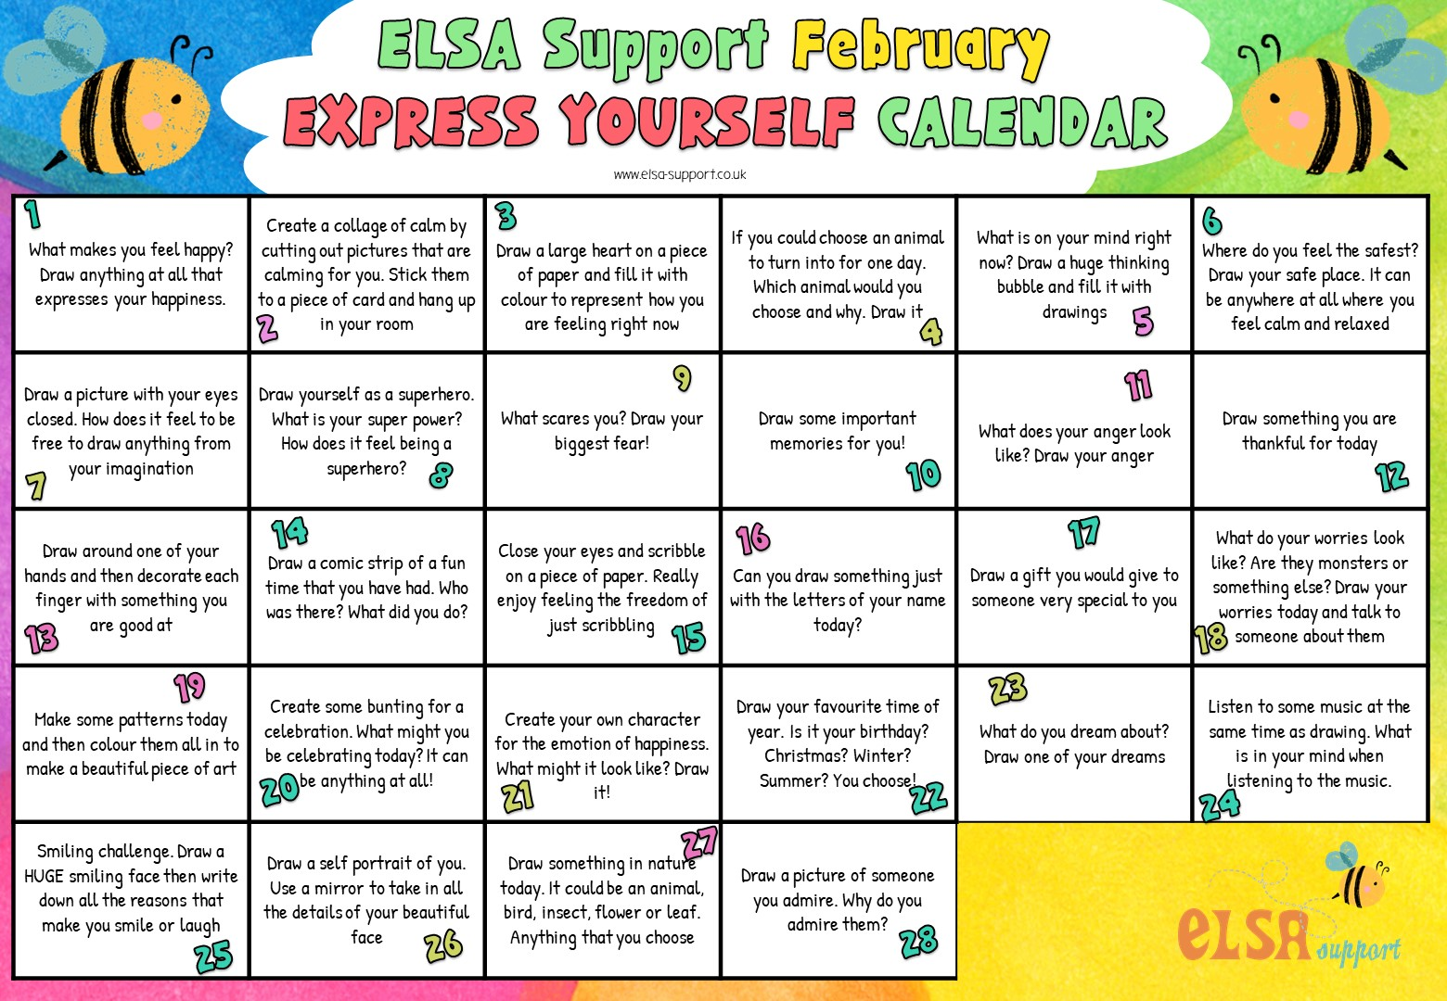
1
2
3
4
5
6
7
8
9
10
11
12
13
14
15
16
17
18
19
20
21
22
23
24
25
26
27
28

