Slide 1

FS2 WB: 01.2.21
Maths lessons

Slide 2
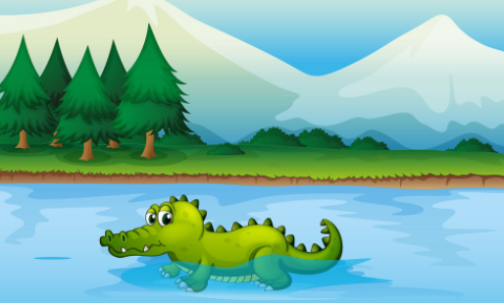
Lesson 1- starter Please Mr Crocodile can I cross the river?
Watch the uploaded teacher video on Tapestry and join in with the game!

Slide 3

https://www.bbc.co.uk/iplayer/episode/b08pgvmb/numberblocks-series-2-eight

Slide 4
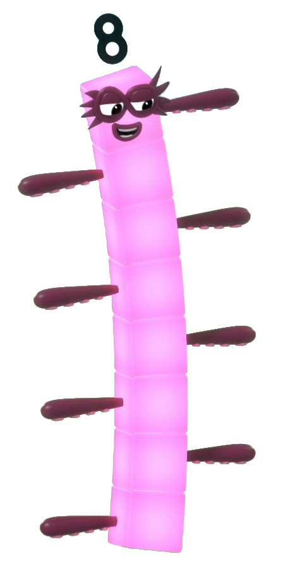
next
I am Octoblock! Let’s save the eights together!

Slide 5

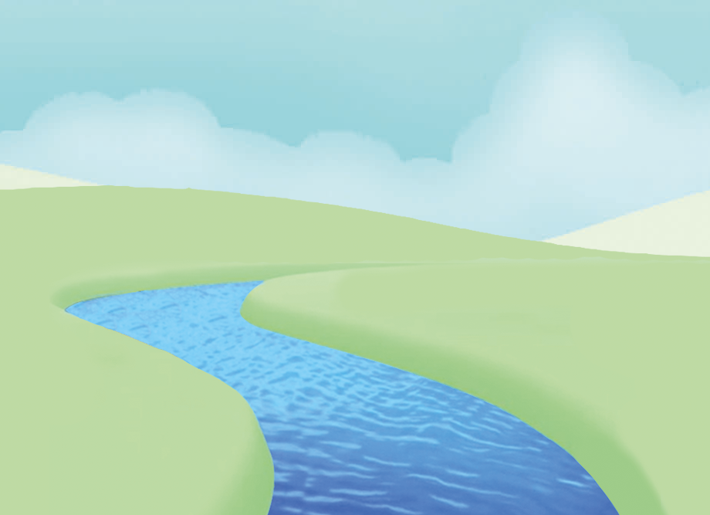
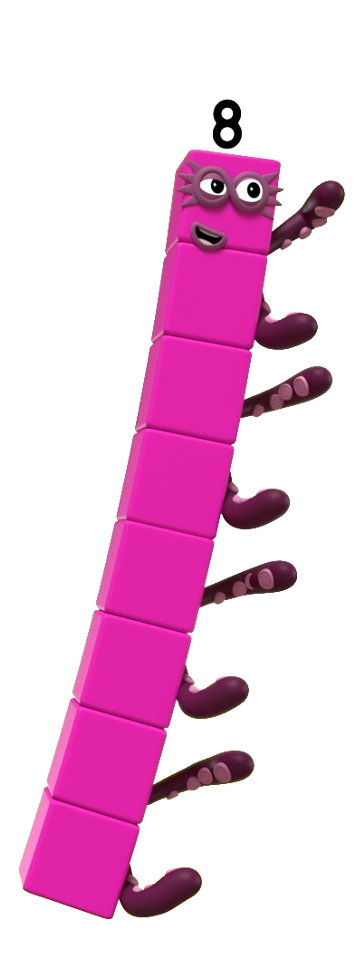
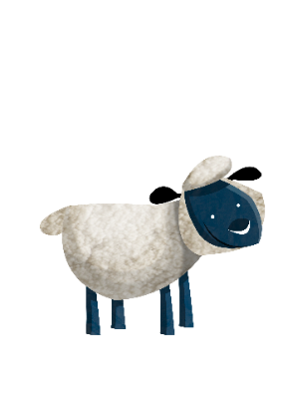
Is this 8?
Click me to find out.

Slide 6

next
Is this 8?
Should I save the sheep or leave them? How do you know?
Save
Well done! There are 8 sheep.
Try again.
Leave

Slide 7
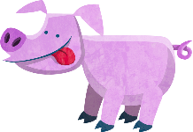
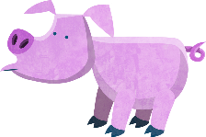
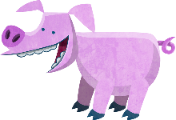
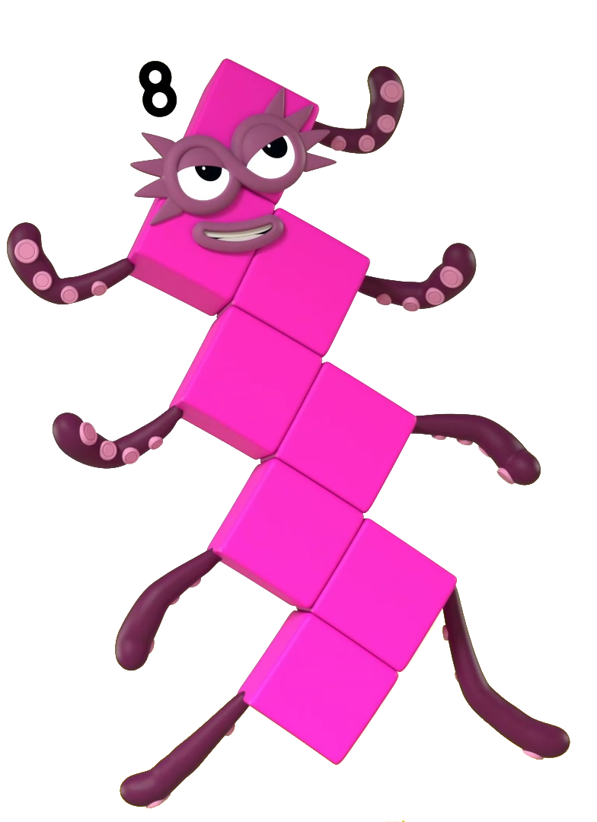
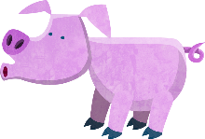
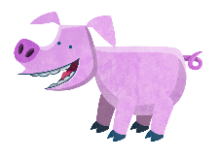
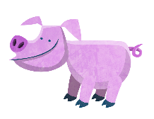
next
Is this 8?
Save
Should I save the pigs or leave them? How do you know?
Try again.
Well done! There are 8 pigs.
Leave

Slide 8

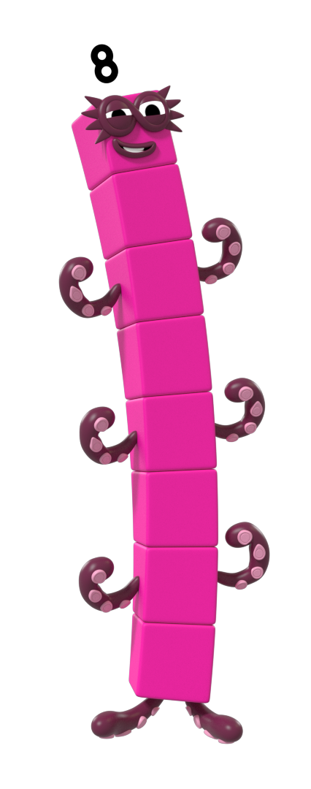
next
Is this 8?
Try again.
Well done! This is not 8.
Save
Should I save this shape? How many sides has it got? How can you check?
Leave

Slide 9

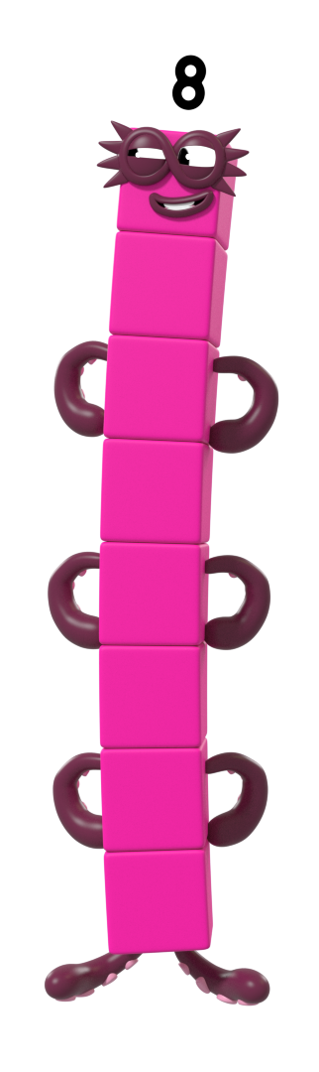
Is this 8?
7
7
Click me to find out.

Slide 10
Is this 8?
7
Click me to find out.

Slide 11
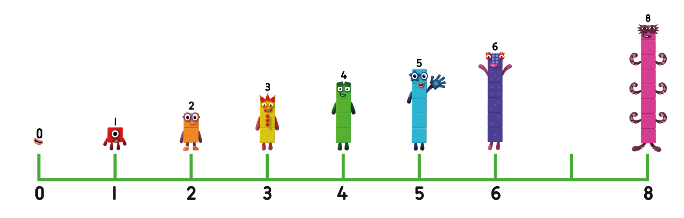
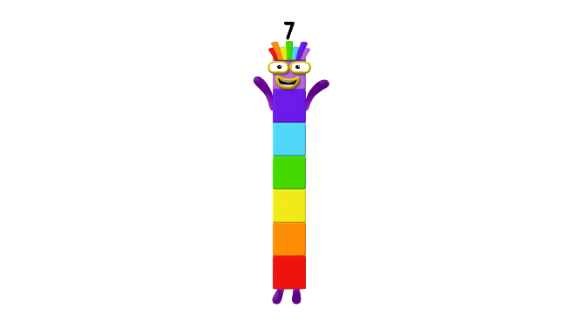
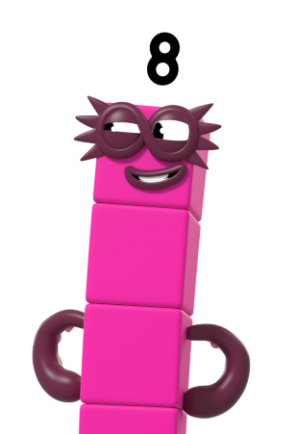
next
0
1
2
3
4
5
6
7
8
Save
Try again.
Well done! This is not 8.
Should I save this number? Can you show me on your fingers what number this is?
Leave

Slide 12

Is this 8?
Click me to find out.

Slide 13
next
Should I save this shape? How many sides has it got? How can you check?
Well done! This shape has 8 sides. Can you name my shape?
Try again.
Save
Leave

Slide 14
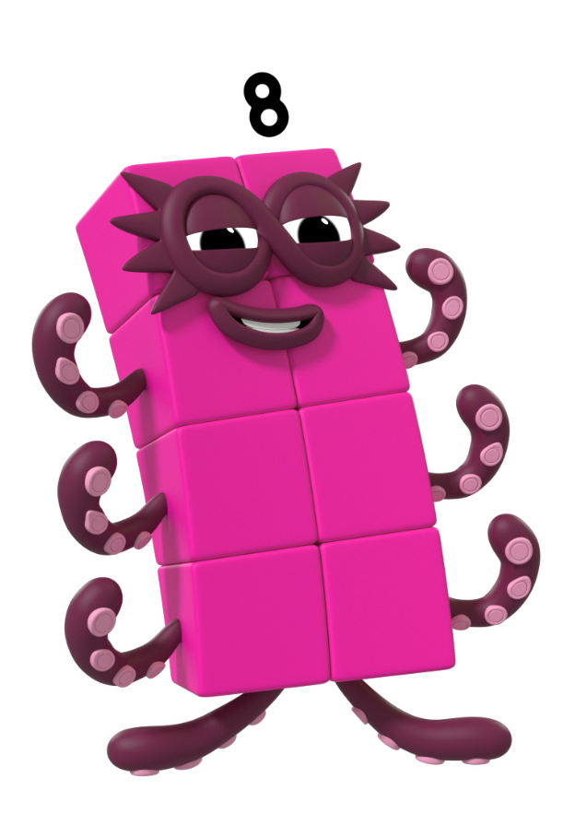
Is this 8?
8
8
Click me to find out.

Slide 15
Is this 8?
8
Click me to find out.

Slide 16
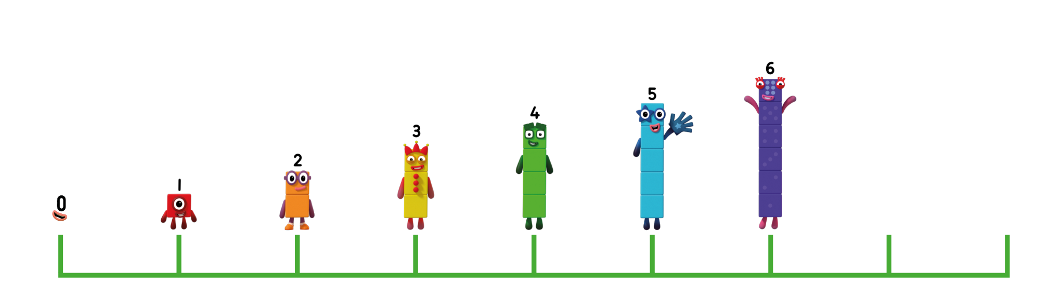

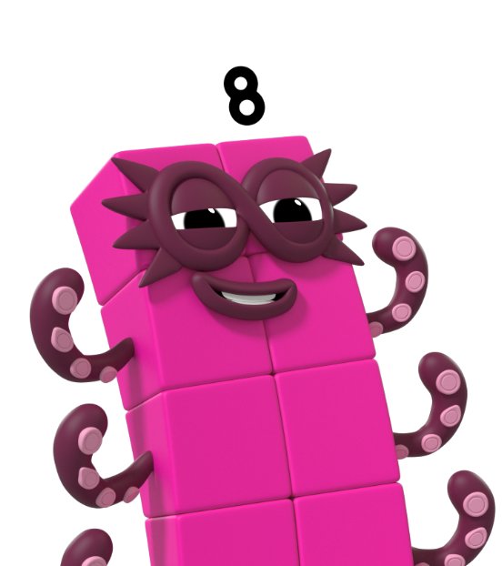
next
0
1
2
3
4
5
6
7
8
Save
Try again.
Well done! This is 8.
Should I save this number? Can you show me on your fingers what number this is?
Leave

Slide 17




Which building should I hide in? Click the one I should choose.
Try again.

Slide 18
Which building should I hide in? Click the one I should choose.

Slide 19

next
Can you count the windows to check? Click the building and count with the Numberblocks.

Slide 20
next
Can you remember all the
ways we saw number 8?

Slide 21
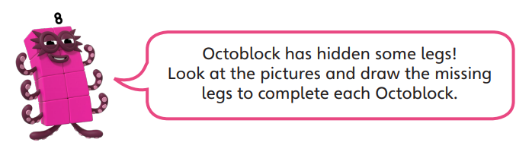

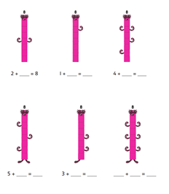
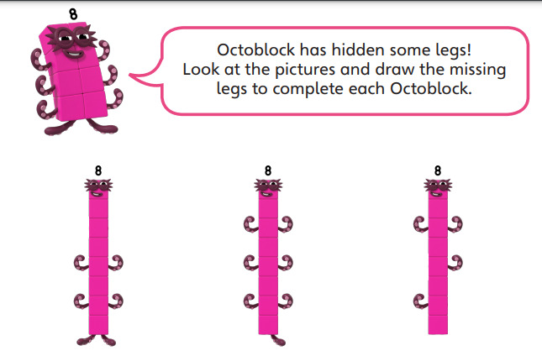
Activity time!
The worksheet is uploaded on the Home Learning 2020/21 page
OR

Slide 22
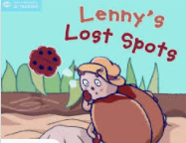
Lesson 2- Starting with a story
See Tapestry for recorded lesson

Slide 23
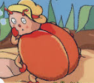
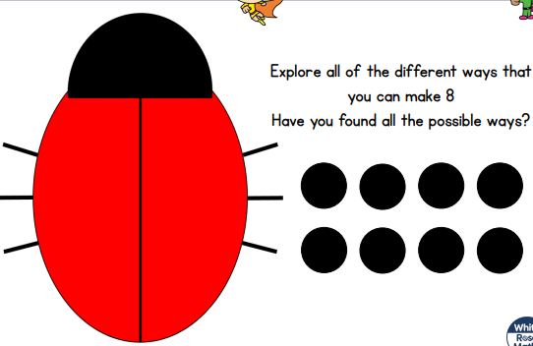
We need to help Lenny put 8 spots back on his body.

Slide 24
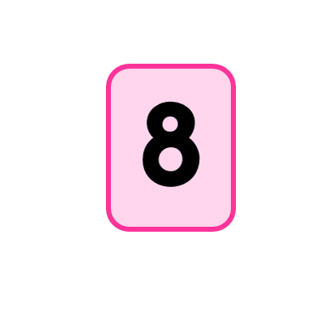
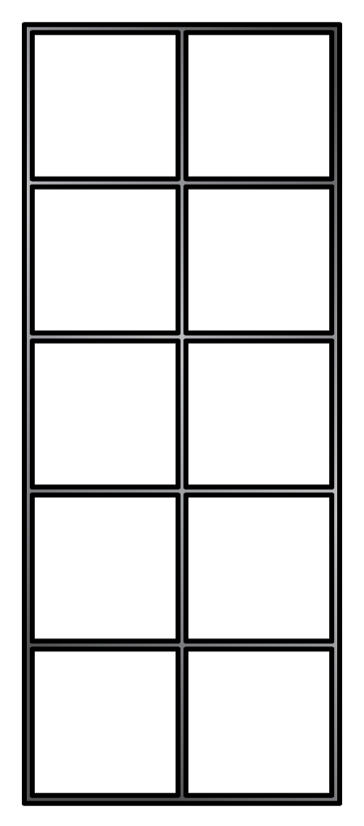
Let’s do a few together!

Slide 27

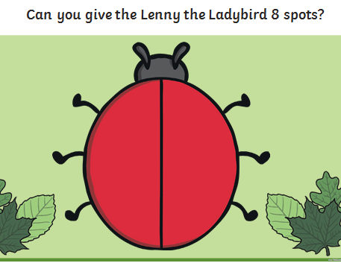
Your turn- Activity time!
The worksheet is uploaded on the Home Learning 2020/21 page
Choice 1
Choose objects to represent 8 spots on Lenny the Ladybird. How many ways can you find?

Slide 28
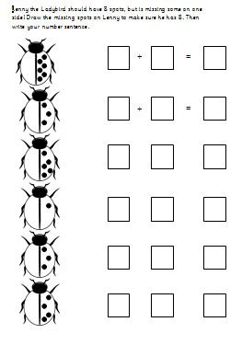
Your turn- Activity time!
The worksheet is uploaded on the Home Learning 2020/21 page
Choice 2

Slide 29

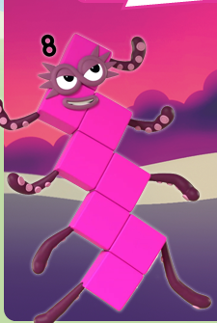
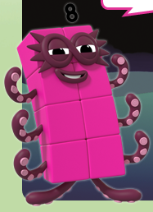
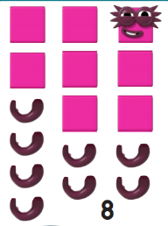
Lesson 3- Can you make Octoblock?
Can you show me with your cubes?
Or
Use objects that you have in your house. E.g lego, blocks. You will find a Make an Octoblock sheet attached if you would like to cut out the blocks to use.

Slide 30

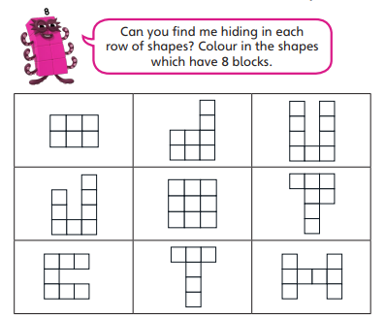
Activity time!
The worksheet is uploaded on the Home Learning 2020/21 page

Slide 31


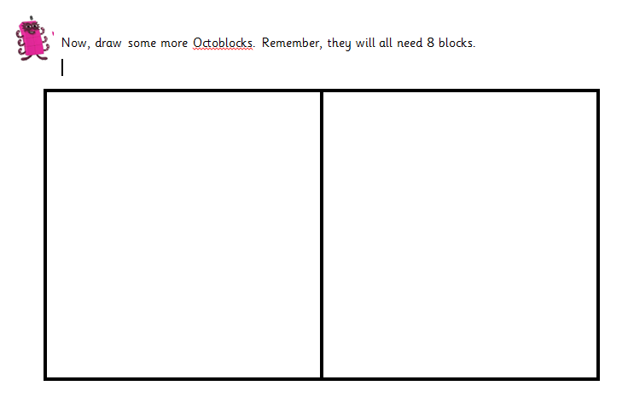

Slide 32
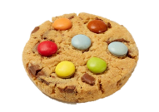

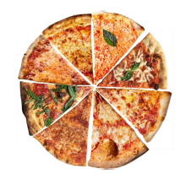

Lesson 4
8 or Not 8 game
video uploaded on Tapestry.
If you would like to play along at the same time, you will need the ‘8 or not 8’ pictures uploaded on the Home Learning page.

Slide 33

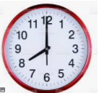
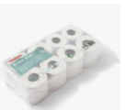
8 not 8 hunt
Can you find objects in your house that represent 8 and not 8?

Slide 34
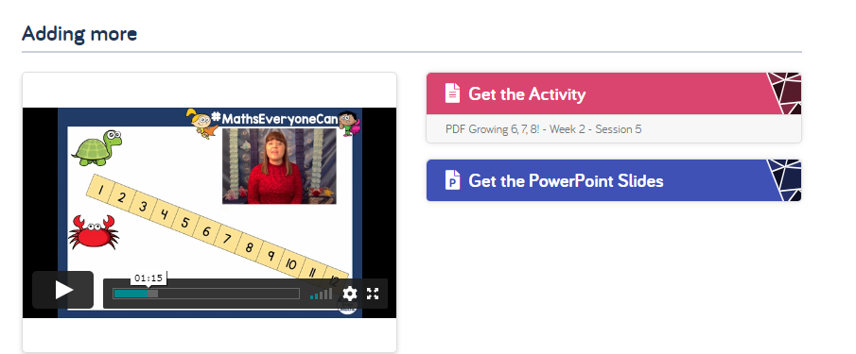
Lesson 5- Today we are following White Rose- Growing 6,7,8- week 2- session 5
https://whiterosemaths.com/homelearning/early-years/growing-6-7-8-week-2/

Slide 35
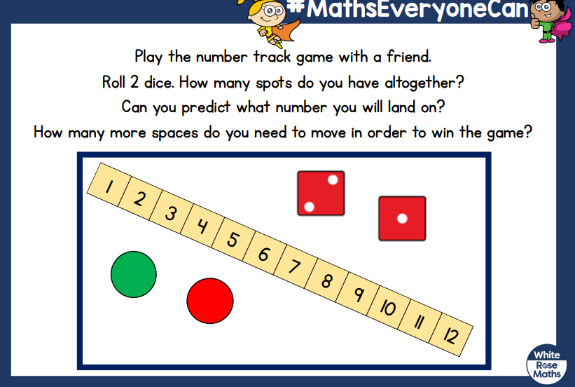
Activity time!

