Slide 1
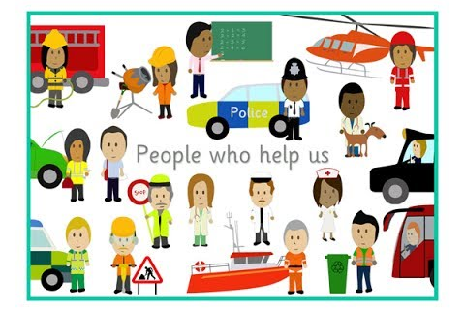
People who help us
What job would you like to do?

Slide 2
People who help us
Think about people who help us in real life
Understand what it means to have a job
Suggest a job of a real life hero
Think about what your dream job is
Draw a picture of your dream job
Write a sentence saying ‘I want to be a…’
Challenge: write a sentence saying ‘I can help…’

Slide 3

A superhero like you
In today's lesson, we're going to understand what it means to have a job. You might recognise the author of this story- DR. Ranj.
What do you notice on the front cover?
What do the people on the front cover do?

Slide 4
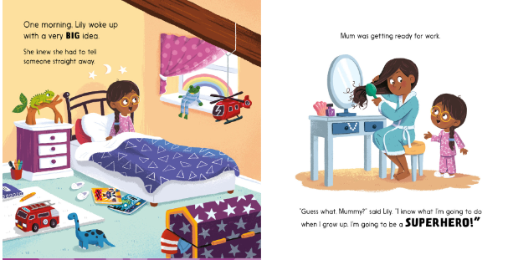
A superhero like you - page 1

Slide 5


A superhero like you - page 2
What do you think Lily will be when she is a real superhero? Maybe a nurse? Or a vet? Or a Waste Collector?
Tell your adult some more ideas…

Slide 6
Off to the Job Centre
Watch the video together to think and learn about having a job, different types of job and then choose your dream job for your activity.
https://classroom.thenational.academy/lessons/to-understand-what-it-means-to-have-a-job-c5hpad?activity=video&step

