Slide 1

FS2 WB: 25.1.21
Maths lessons

Slide 2


Lesson 1- starter
You will see some lines very quickly.
Then they will be hidden.
How many lines?
Tell your partner
Show it on your fingers
Write the numeral
Notes:
Super subitiser! It's the ability to look at a small number of objects and instantly recognise how many objects there are without needing to count.

Slide 3

SHAPE PATTERNS: QUANTITIES TO 5
EARLY NUMBER SENSE

Slide 4
You will see some dots very quickly.
Then they will be hidden.
Whisper to tell your partner:
How many lines?
There are 3 pictures.
SHAPE PATTERNS: QUANTITIES TO 5
EARLY NUMBER SENSE

Slide 5
SHAPE PATTERNS: QUANTITIES TO 5
EARLY NUMBER SENSE

Slide 6
You will see some dots very quickly.
Then they will be hidden.
Whisper to tell your partner:
How many lines?
There are 3 pictures.
SHAPE PATTERNS: QUANTITIES TO 5
EARLY NUMBER SENSE

Slide 7
SHAPE PATTERNS: QUANTITIES TO 5
EARLY NUMBER SENSE

Slide 8
You will see some dots very quickly.
Then they will be hidden.
Whisper to tell your partner:
How many lines?
There are 3 pictures.
SHAPE PATTERNS: QUANTITIES TO 5
EARLY NUMBER SENSE

Slide 9
SHAPE PATTERNS: QUANTITIES TO 6
EARLY NUMBER SENSE

Slide 10
You will see some dots very quickly.
Then they will be hidden.
Whisper to tell your partner:
How many lines?
There are 3 pictures.
SHAPE PATTERNS: QUANTITIES TO 5
EARLY NUMBER SENSE

Slide 11
SHAPE PATTERNS: QUANTITIES TO 6
EARLY NUMBER SENSE

Slide 12
You will see some dots very quickly.
Then they will be hidden.
Whisper to tell your partner:
How many lines?
There are 3 pictures.
SHAPE PATTERNS: QUANTITIES TO 5
EARLY NUMBER SENSE

Slide 13
SHAPE PATTERNS: QUANTITIES TO 6
EARLY NUMBER SENSE

Slide 14
You will see some dots very quickly.
Then they will be hidden.
Whisper to tell your partner:
How many lines?
There are 3 pictures.
SHAPE PATTERNS: QUANTITIES TO 5
EARLY NUMBER SENSE

Slide 15
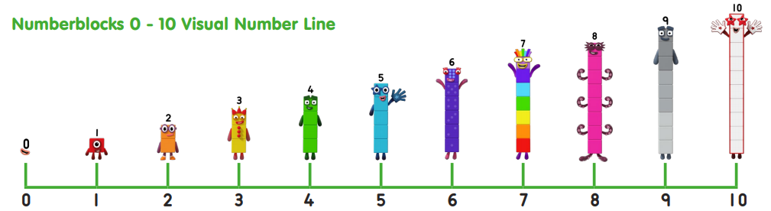
Number of the week is…….
1 more than 6
1 less than 8
Can you write a number sentence?
Notes:
You could try this with Lego!

Slide 16

https://www.bbc.co.uk/iplayer/episode/b08pgqt4/numberblocks-series-2-seven

Slide 17
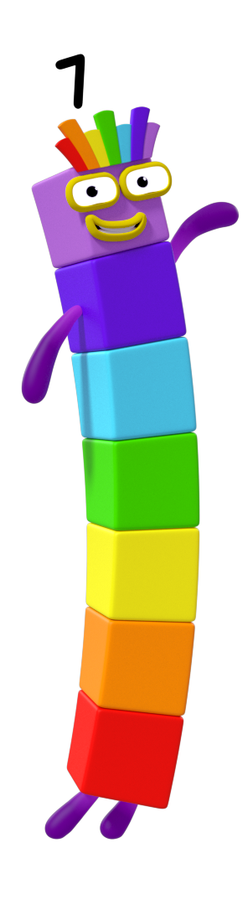
Seven has had a busy and very lucky week!
Do you know how many days there are in a week?
Can you name them?
Take a peek inside the diary to see what adventures Seven has been up to.

Slide 18







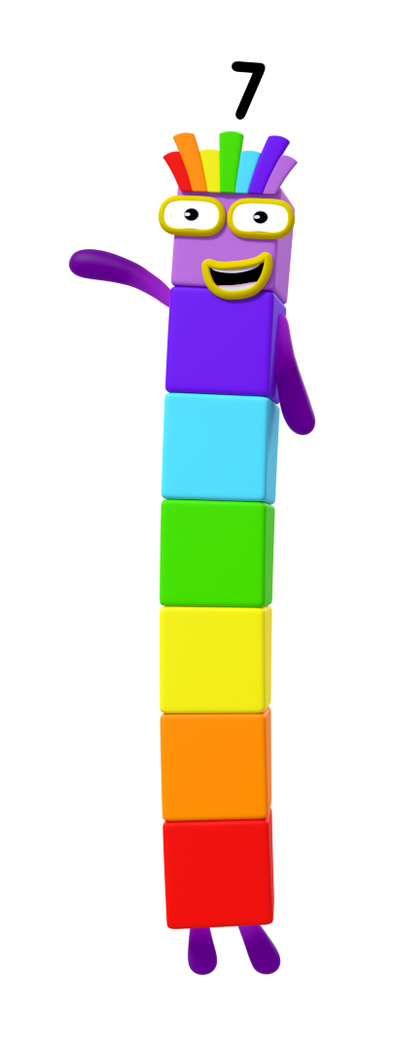
Monday
On Monday, I saw some birds in the sky! How many do you think I saw? How can you check?

Slide 19
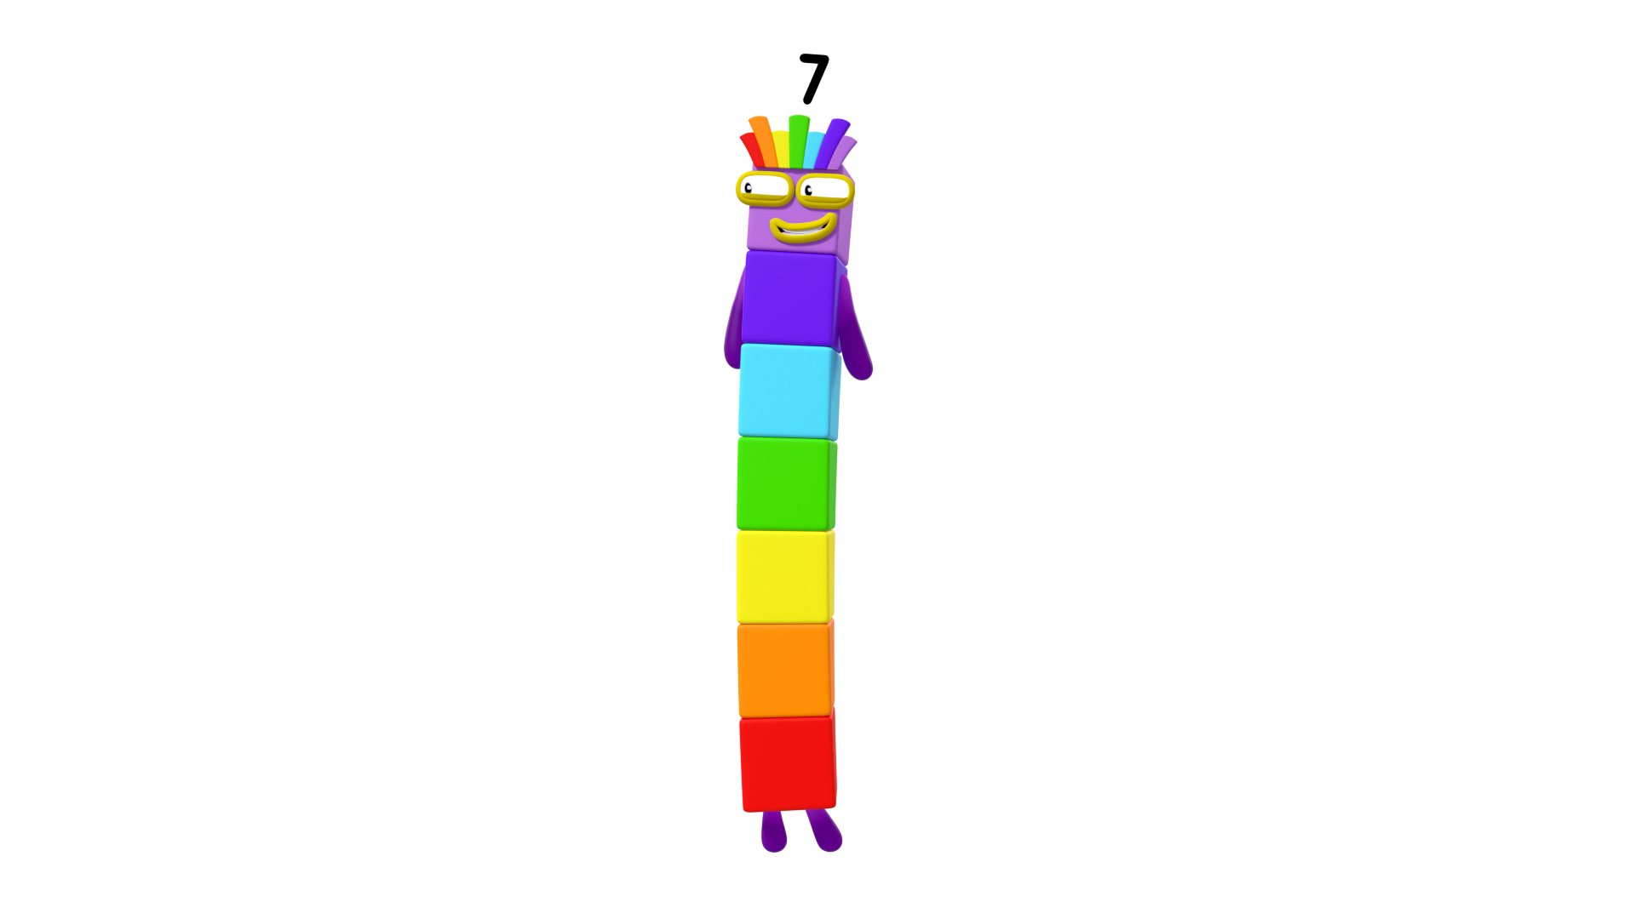
Let’s check!
There are 7 birds.
Can you help me count the birds? Click me to count them.

Slide 20

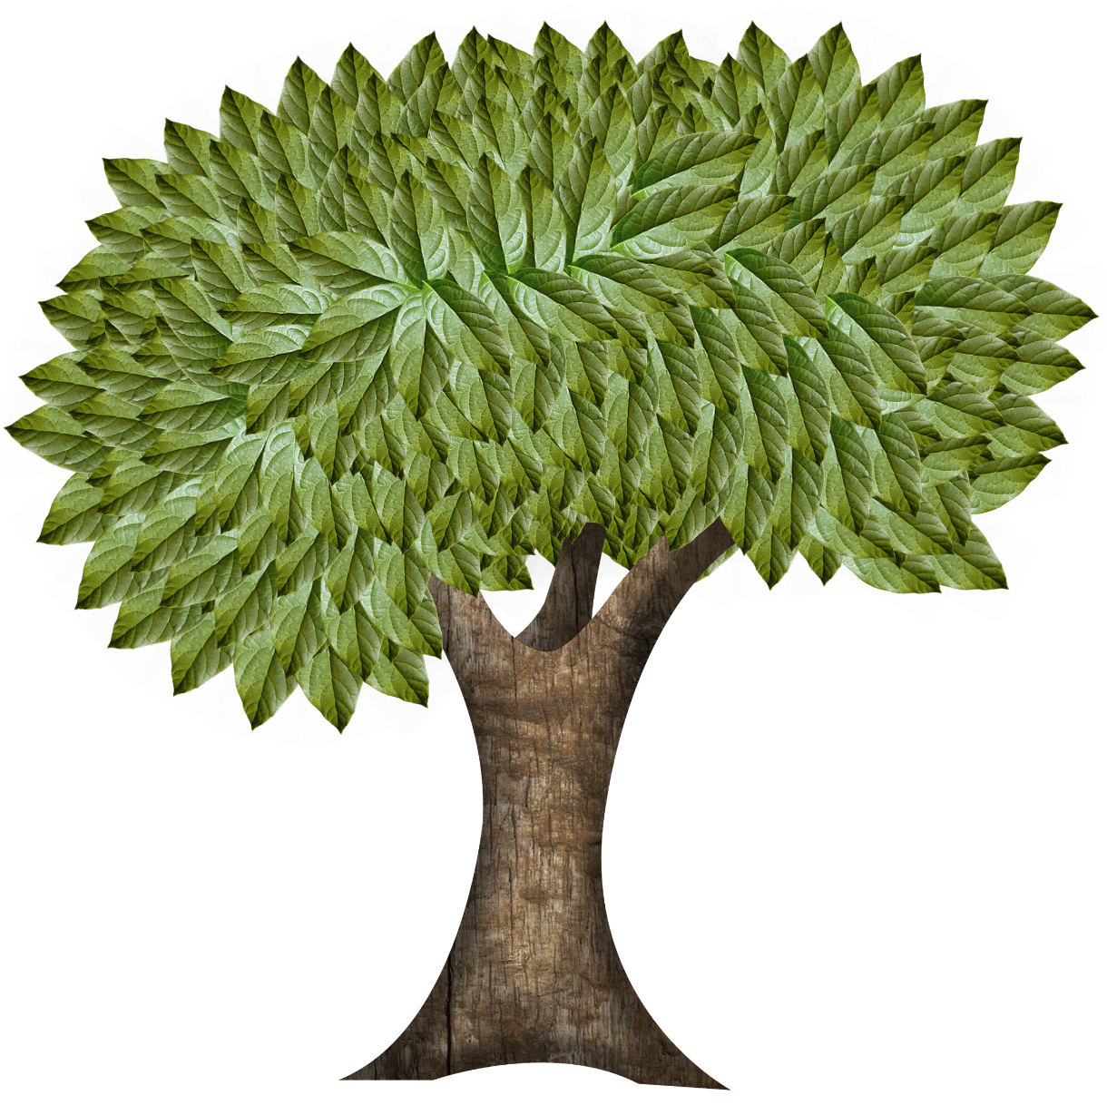
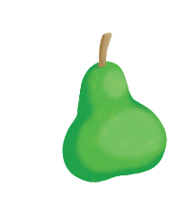
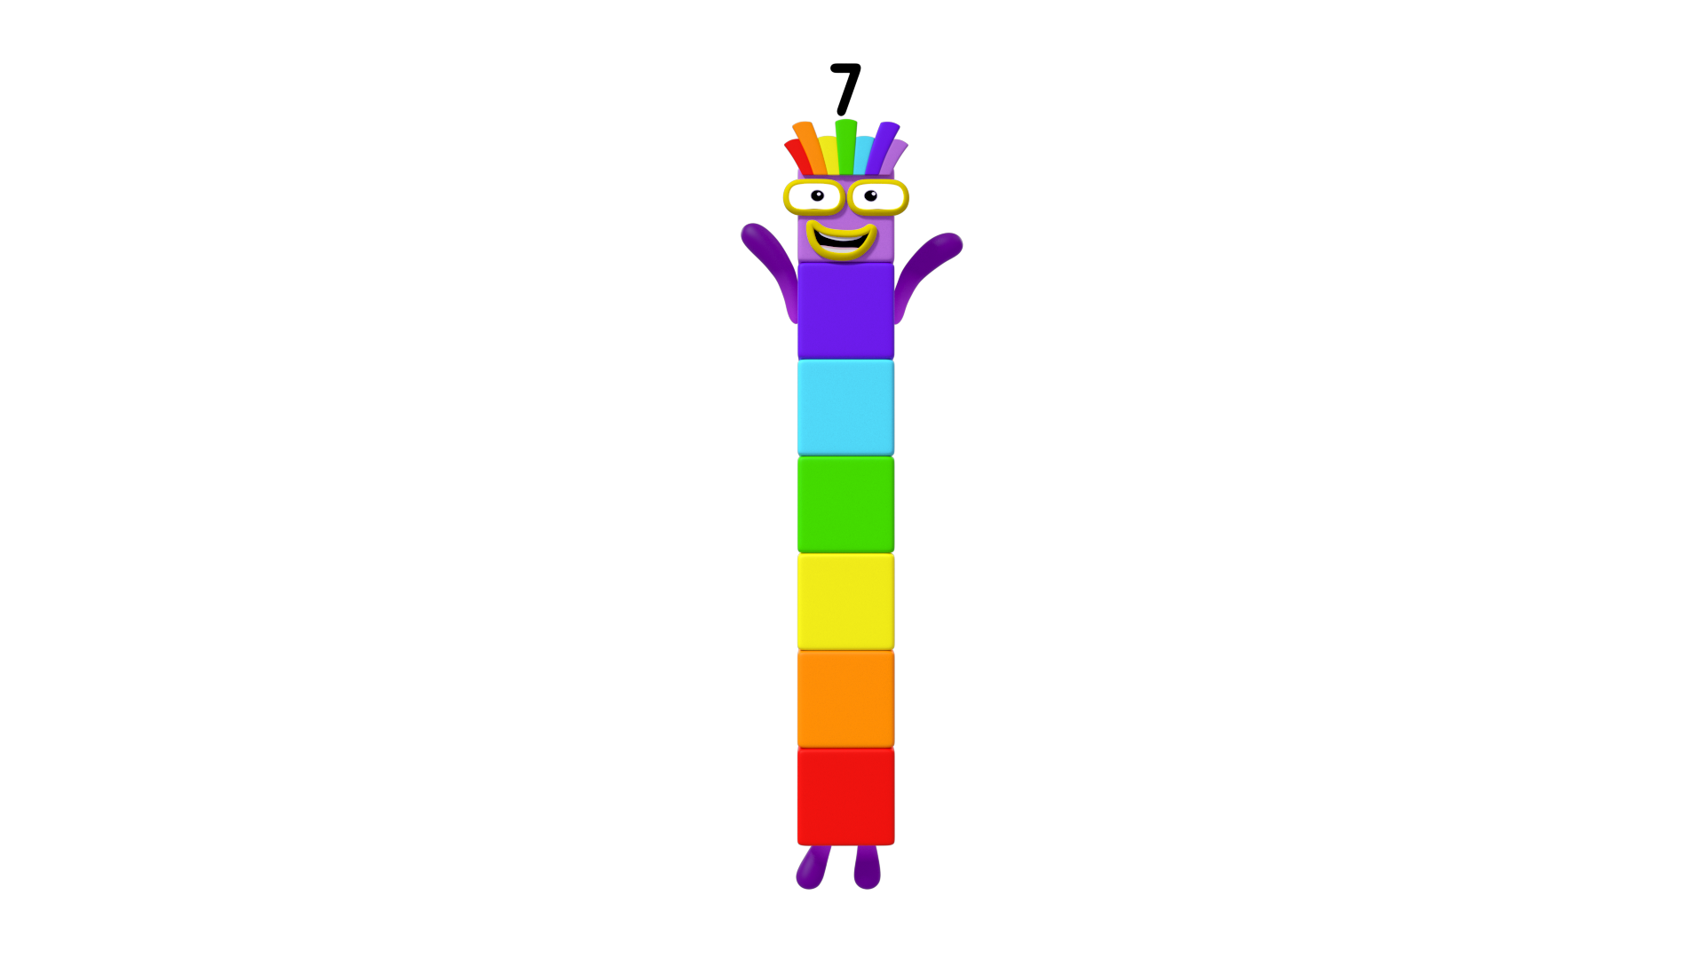
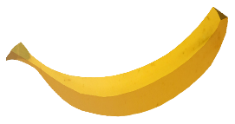




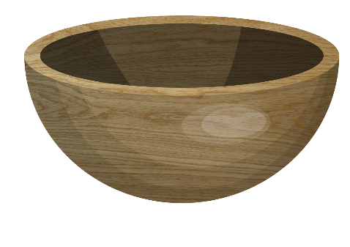
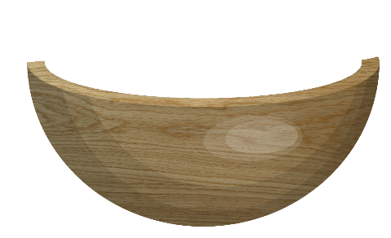
Tuesday
On Tuesday, I collected some fruit. Click on the fruit to help me count them into my bowl.
How many did you count?

Slide 21







Let’s check!
There are 7 pieces of fruit in my bowl.
Can you help me count my fruit? Click me to count them.

Slide 22
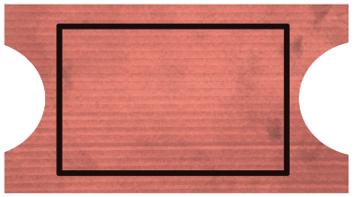
Wednesday
On Wednesday, I won the raffle. Can you guess what number was on my ticket?
Click the raffle tickets. Can you find my ticket?
4
7
Try again.
2
3
1
6
5

Slide 23

That’s right! I had lucky number 7.
7

Slide 24



Thursday
On Thursday, I helped One cross the river.
How many blocks long is my bridge?
How can you check?

Slide 25
Let’s check!
That’s right! There are 7 blocks.
Can you show me 7 on your fingers?
Can you count my blocks? Click me to see if you were right.

Slide 26
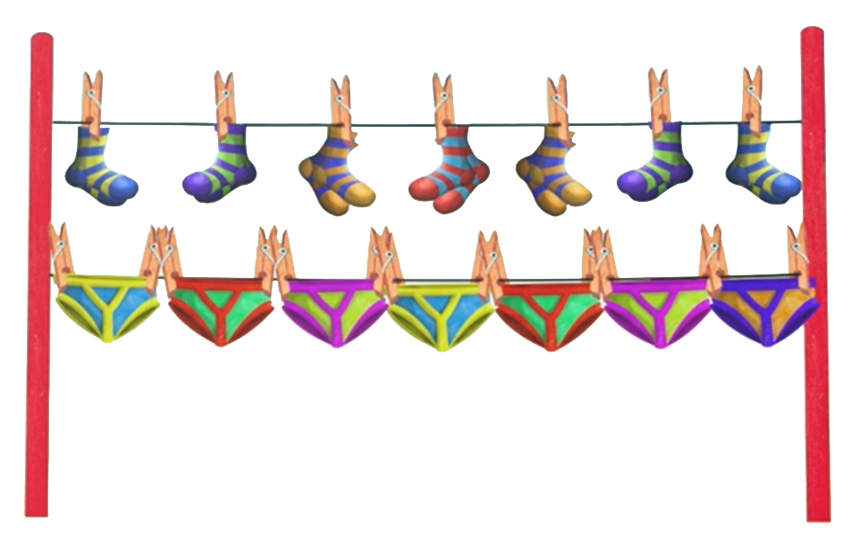
Friday
On Friday, I did my washing.
How many pairs of socks have I got?
How many pairs of pants?
Have I got enough for every day of the week? How do you know?

Slide 27

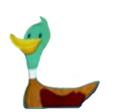
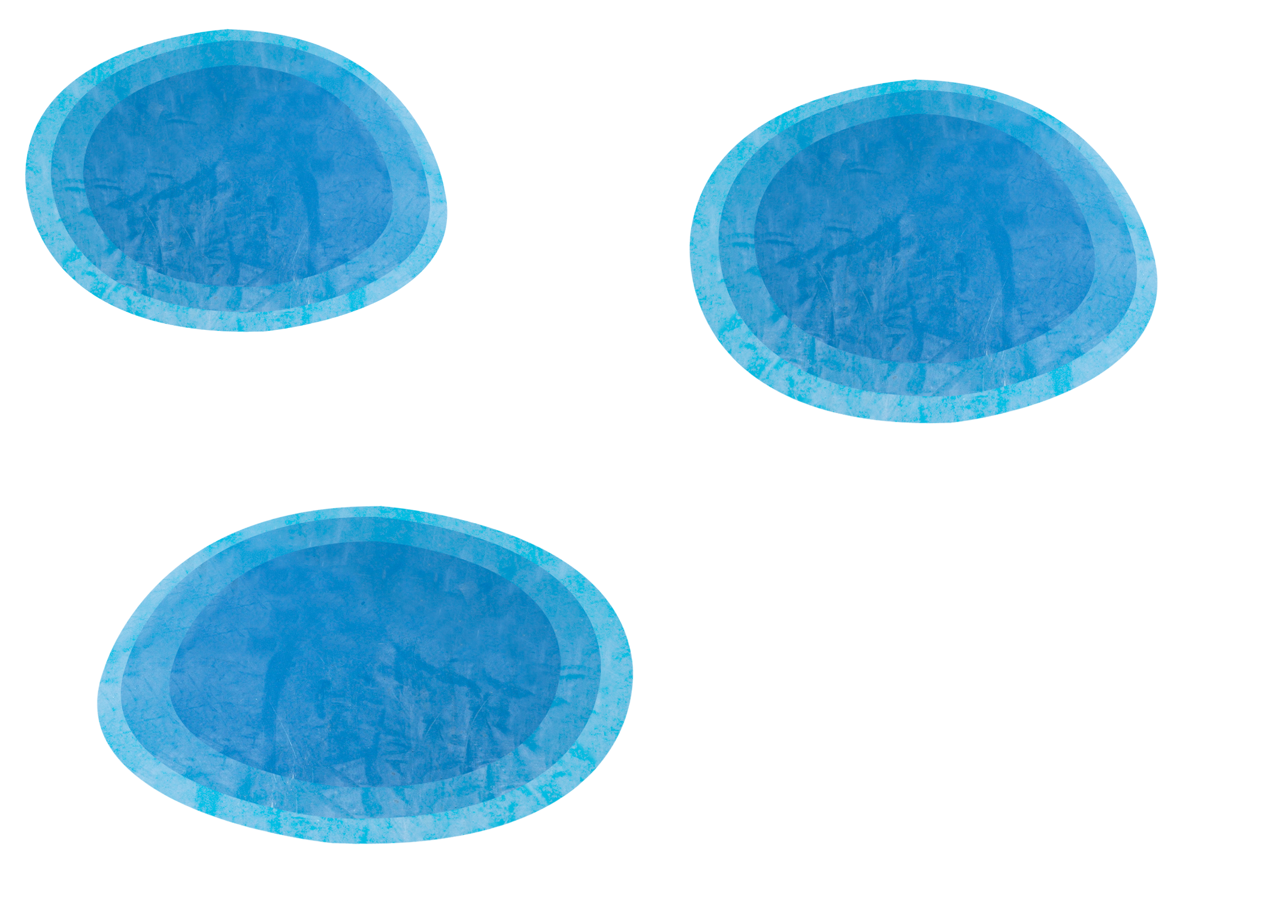



Saturday
Try again.
On Saturday, I went to see the ducks. Click the pond with the number of ducks you think I saw.
Why do you think that?

Slide 28
Let’s check!
That’s right! I saw 7 ducks.
1
2
3
4
5
6
7

Slide 29

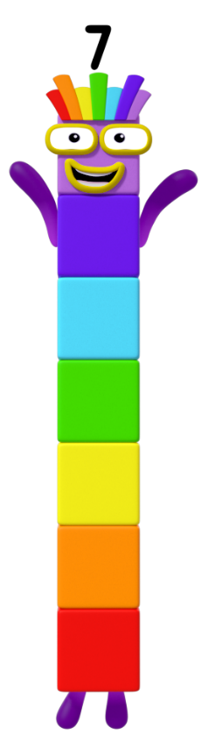
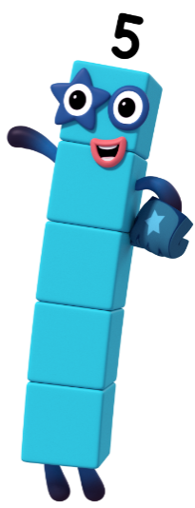
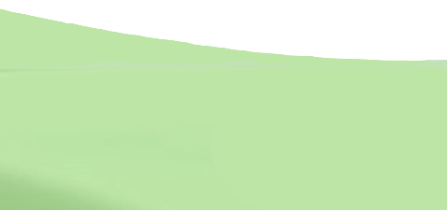
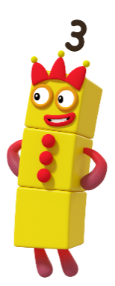
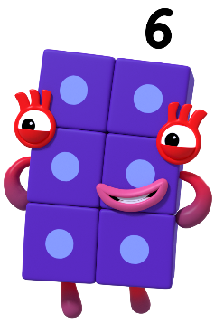
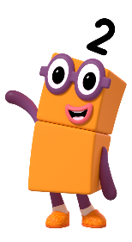
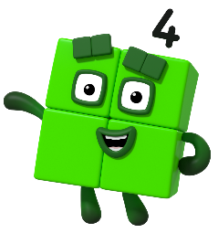






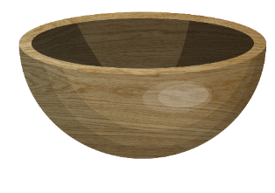
Sunday
On Sunday, I had a picnic with my friends. Click the food you think I had at the picnic.
Try again.

Slide 30



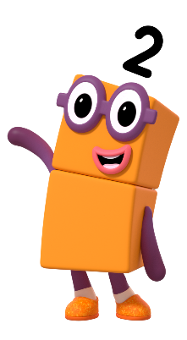
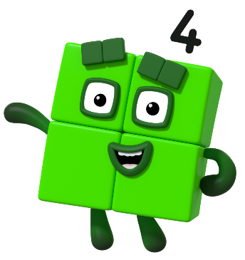

Let’s check!
That’s right! I had 7 rainbow cupcakes. Do I have enough cupcakes to share with all my Numberblock friends? Click me to find out.

Slide 31
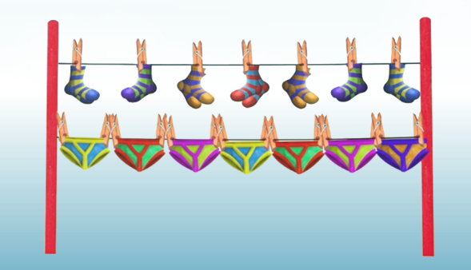
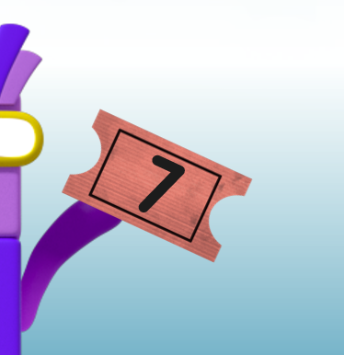
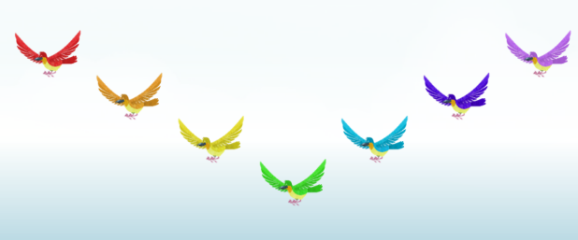
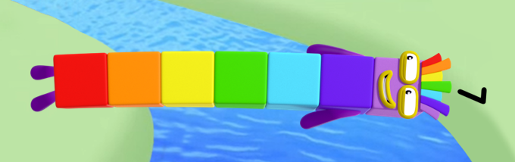
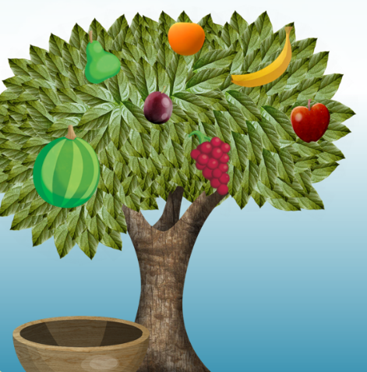
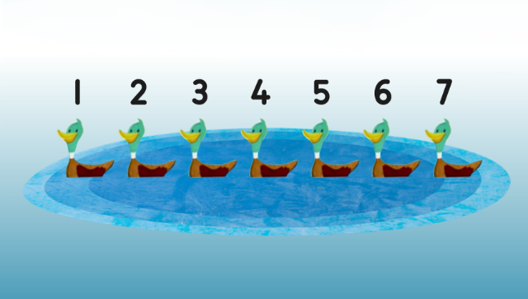

Can you remember all the different ways you saw number 7?
Which one is your favourite?
7 pairs of socks and pants
ticket number 7
7 birds
7 blocks
7 rainbow cupcakes
7 ducks
7 pieces of fruit

Slide 32
Goodbye!
Now its Activity time!
Try your best!

Slide 33

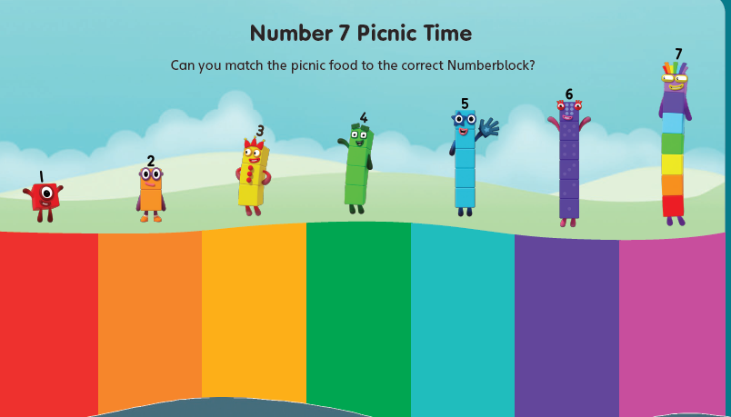
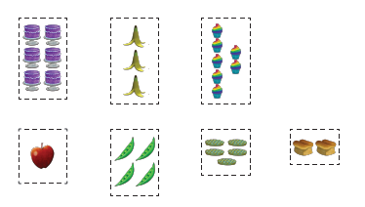
Activity time!
The sheets below are uploaded on the Home Learning page.
There is a choice between two activities
Choice 1- cut and stick activity

Slide 34
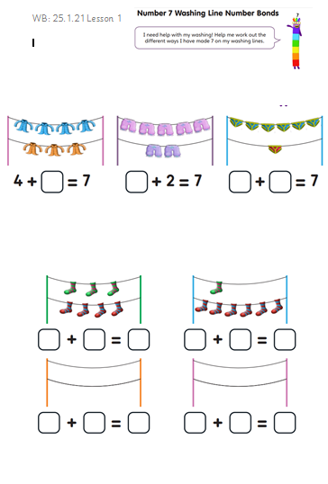
Activity time!
Choice 2 – number bonds to 7

Slide 35






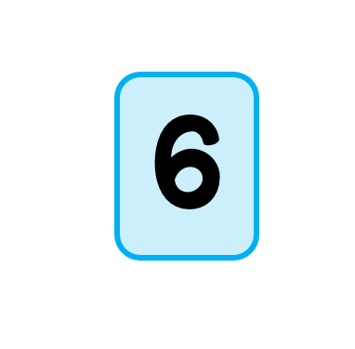
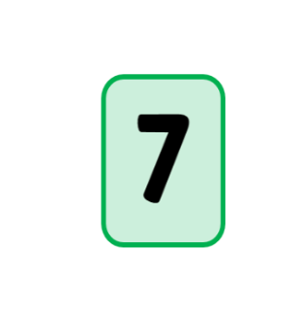
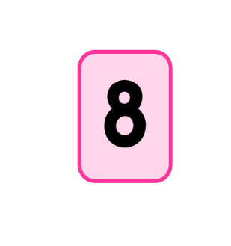
Lesson 2- starter Can you sort the dominos?

Slide 36


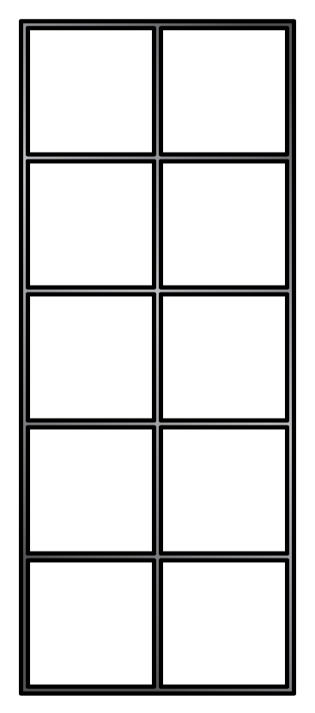
Making 7 on a domino

Slide 37
Making 7 on a domino
Can you show it on your part part whole model?
Or
Write a number sentence

Slide 38
Making 7 on a domino

Slide 39
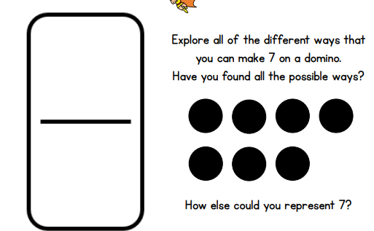
Activity time!

Slide 40
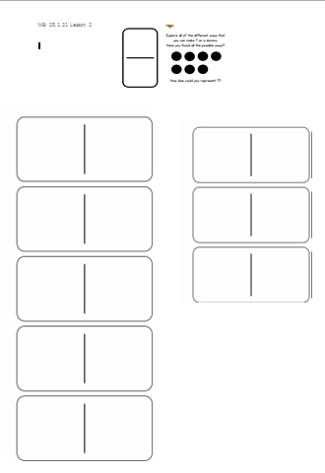
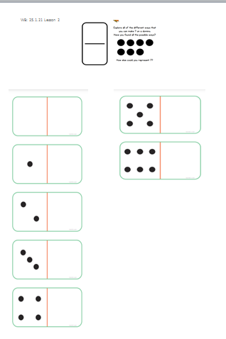
Activity time!
The sheets below are uploaded on the Home Learning page.
OR

Slide 41
Lesson 3- starter
You will see some dominos very quickly. Then they will be hidden.
How many dots on the domino?
Tell your partner
Show it on your fingers
Write the numeral

Slide 42




Slide 43








Memory game!

Slide 44

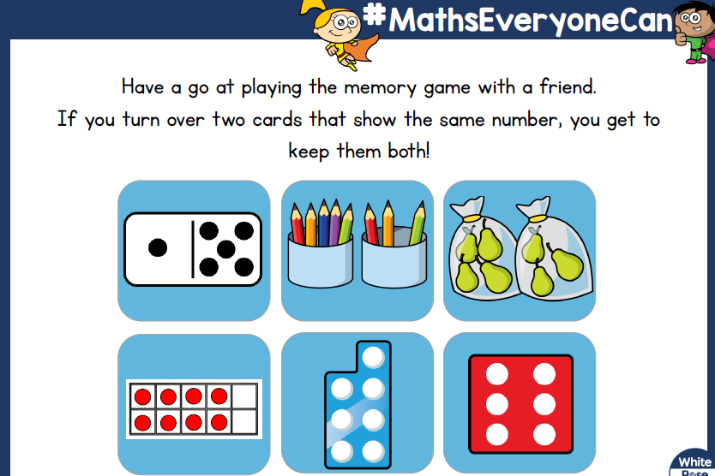
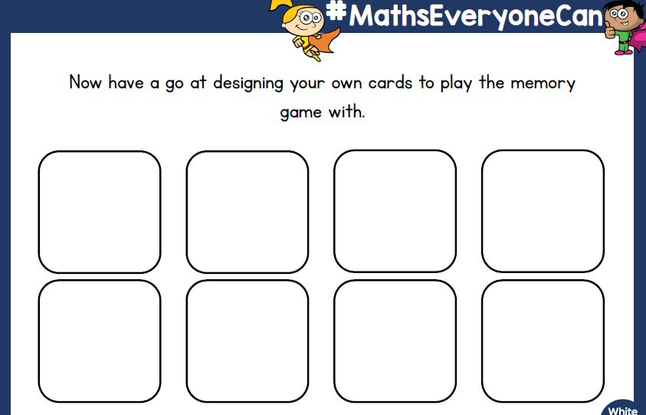
Activity time!
The sheets below are uploaded on the Home Learning page.

Slide 45

Lesson 4- starting with a story
(The story PowerPoint is uploaded on the Home Learning Page or watch the teacher video on Tapestry)
In this story two mice nibble a hole in Kipper’s Toy box and they run off with one of his toys!
Kipper has to work out which toy is missing.
We are going to play a game like this today.

Slide 46

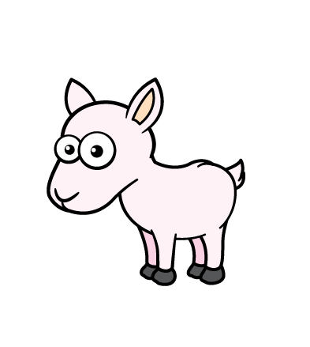


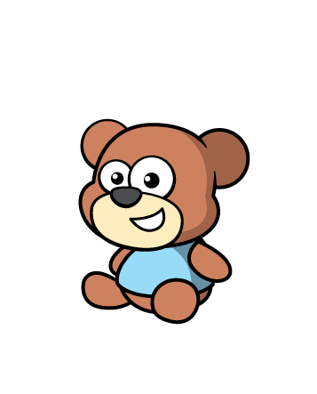

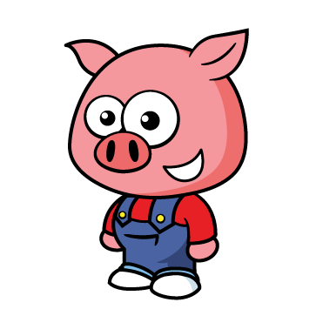


Slide 47

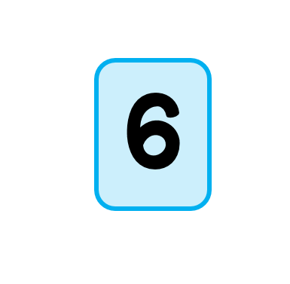


Slide 48


Slide 50
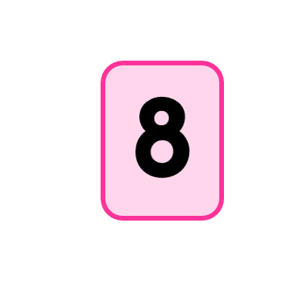

Slide 51

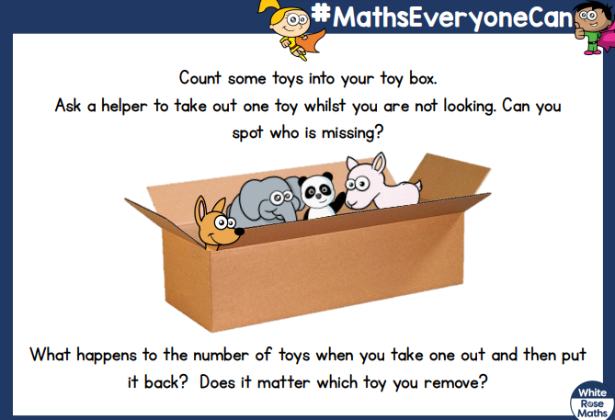
Activity time!
Write a number sentence!

Slide 52


Lesson 5- starter song
https://www.youtube.com/watch?v=PfEqSjgW4tk

Slide 53
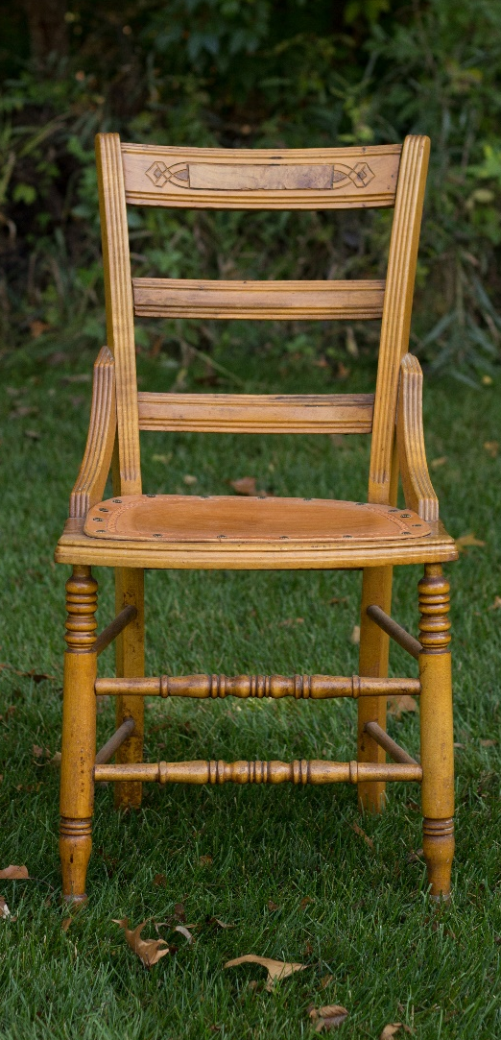
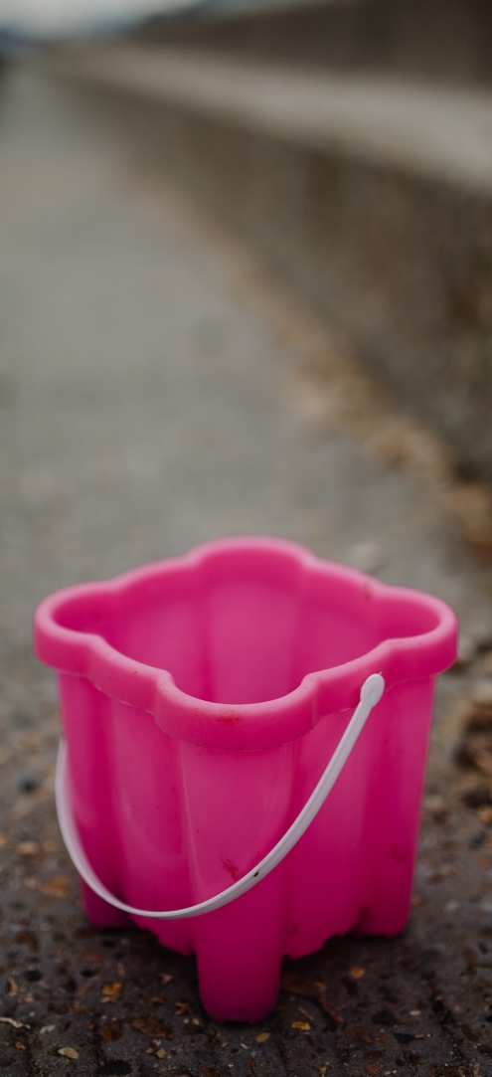


How many objects can you see in these pictures?
1
next

Slide 54







Click the pencil to make the number.
1
A downward stroke, my that’s fun.
Now I’ve made the number one.
next

Slide 55




How many objects can you see in these pictures?
2
next

Slide 56



Click the pencil to make the number.
2
2
Half a heart says “I love you”.
Add a line. Now I’ve made the number two.
next

Slide 57




How many objects can you see in these pictures?
3
next

Slide 58



Click the pencil to make the number.
3
3
Around the tree, around the tree.
Now I’ve made the number three.
next

Slide 59




How many objects can you see in these pictures?
4
next

Slide 60




Click the pencil to make the number.
4
Down and across and down once more.
Now I’ve made the number four.
next

Slide 61




How many objects can you see in these pictures?
5
next

Slide 62




Click the pencil to make the number.
5
Draw the hat, the back and the belly. It’s a five.
Watch out, it might come alive!
end

Slide 63




How many objects can you see in these pictures?
6
next

Slide 64



Click the pencil to make the number.
6
6
Bend down low to pick up sticks.
Now I’ve made the number six.
next

Slide 65




How many objects can you see in these pictures?
7
next

Slide 66



Click the pencil to make the number.
7
7
Across the sky and down from heaven.
Now I’ve made the number seven.
next

Slide 67


Activity time!
This worksheet is uploaded on the Home Learning 2020/21 page

