Slide 1

Let’s Make a trap!
Catching the Evil Pea

Slide 2

Listen to my SUPER MESSAGE!

Slide 3

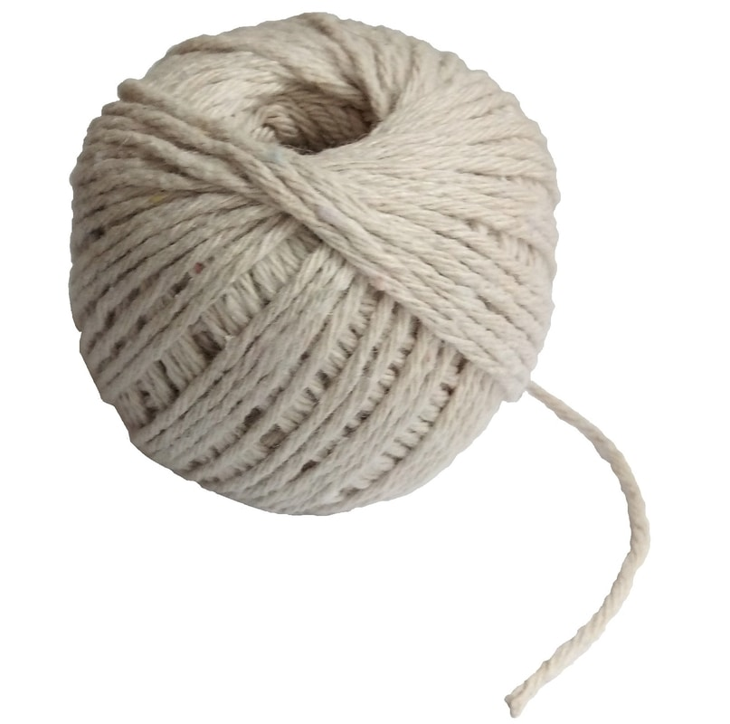
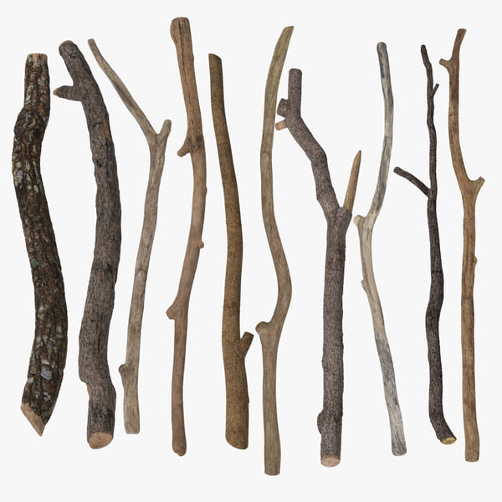


Supertato’s ideas for making traps!
Resources including tape, string, twigs and leaves and boxes

Slide 4
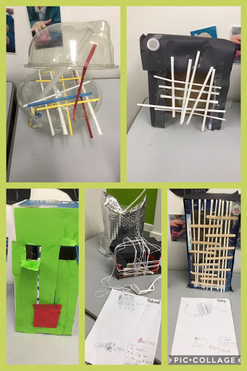
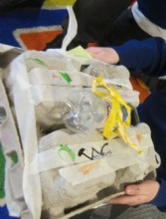
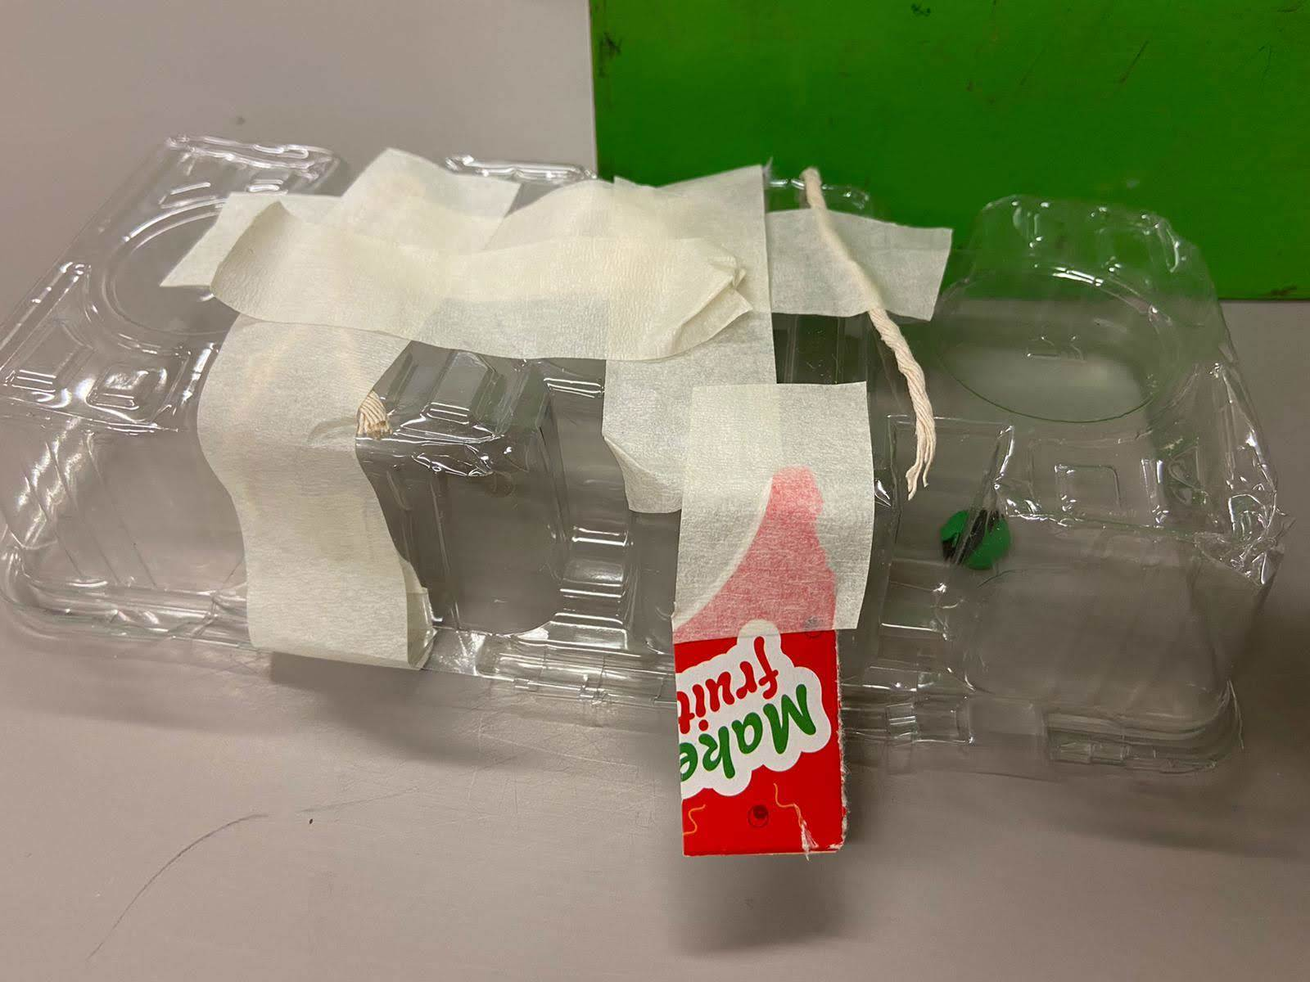
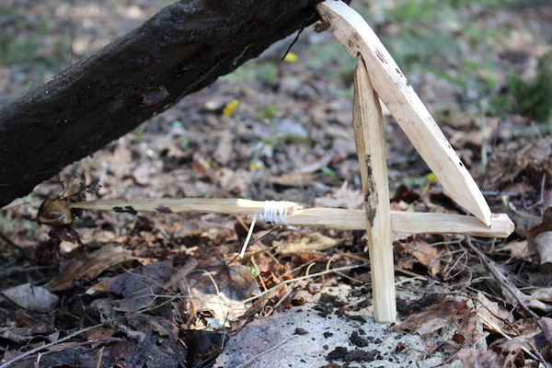
Example Traps

Slide 5
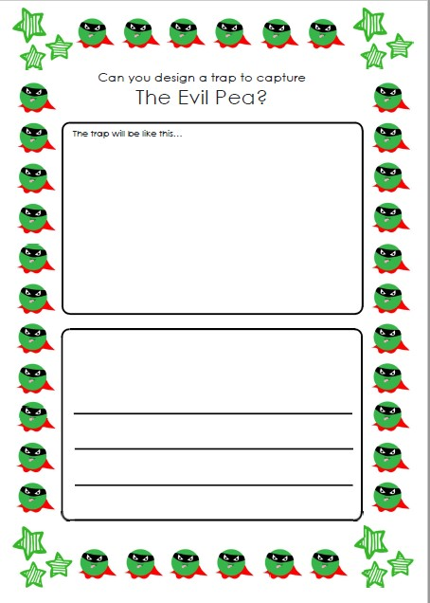
Show your design
Draw it
Write a sentence about it

Slide 6
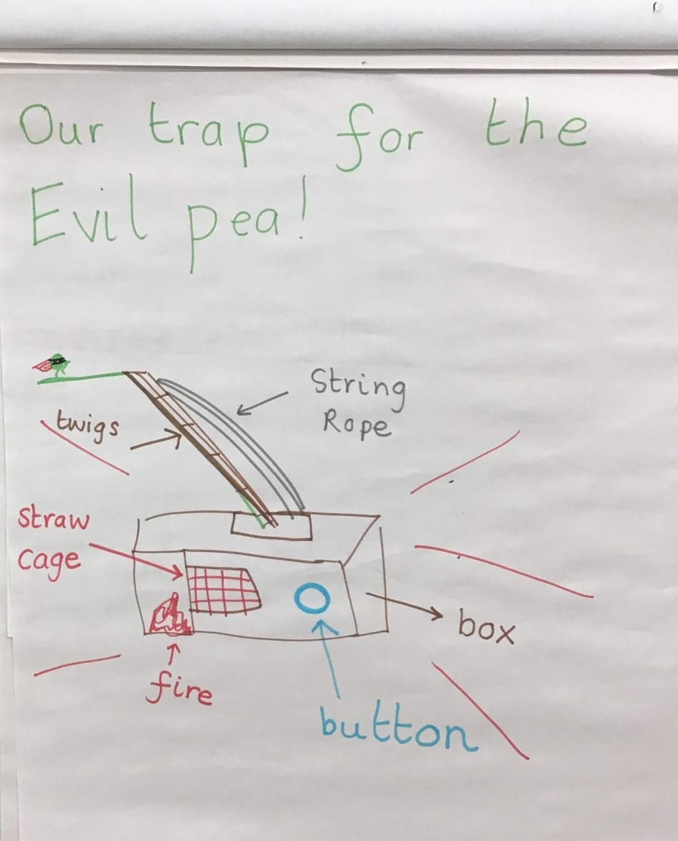
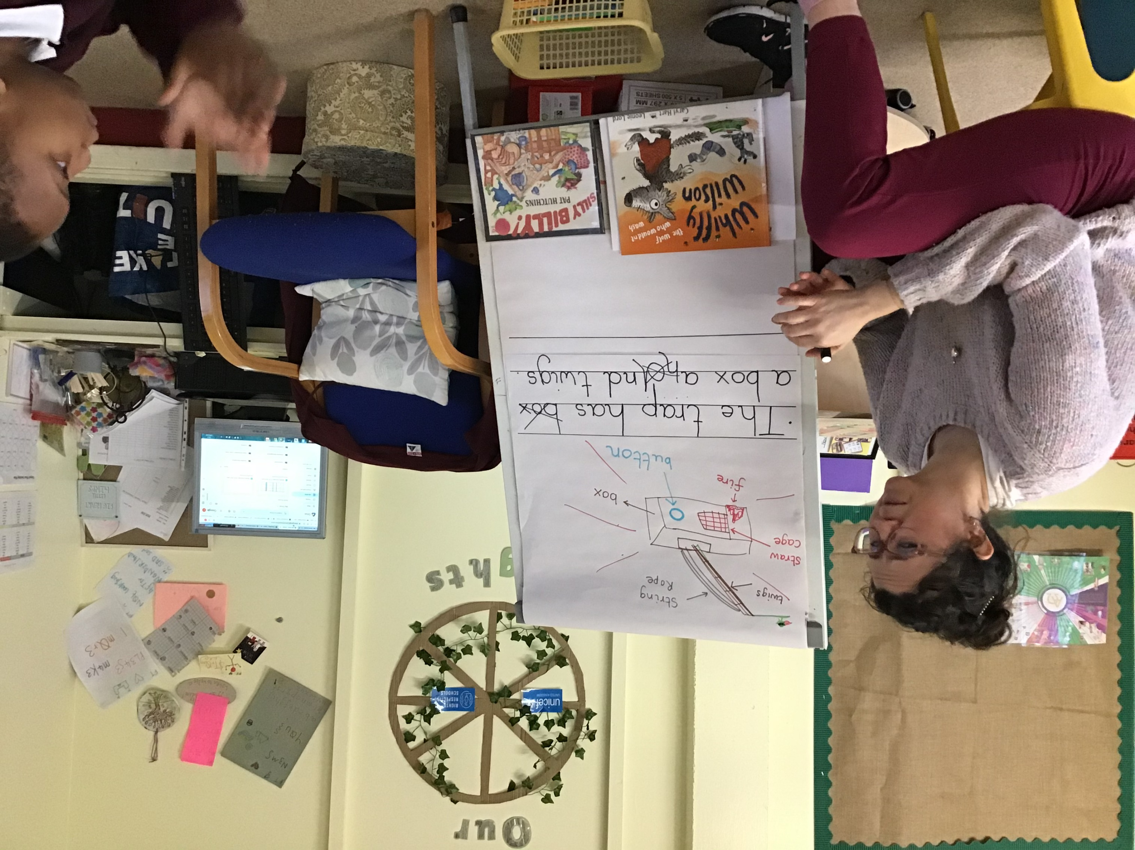
Miss Barrett’s design
Draw it
Write a sentence about it (remember marvellous mistakes are Ok! Look at mine!)

Slide 7

Make your trap!
Well done FS2 Superheroes! I am sure you have amazing designs.
Set out your trap somewhere in your home or garden and then take a picture for Supertato and upload to Tapestry. We are going to send him our traps and please let us know if you catch that pesky Evil Pea!!!

