Slide 1

FS2
WB: 18.1.21
Maths lessons

Slide 2


Lesson 1- starter
You will see some dots very quickly.
Then they will be hidden.
How many dots?
Tell your partner
Show it on your fingers
Write the numeral
Notes:
Super subitiser! It's the ability to look at a small number of objects and instantly recognise how many objects there are without needing to count.

Slide 3
IRREGULAR PATTERNS: QUANTITIES TO 3
EARLY NUMBER SENSE

Slide 4
You will see some dots very quickly.
Then they will be hidden.
Whisper to tell your partner:
How many dots?
There are 3 pictures.
EARLY NUMBER SENSE

Slide 5
IRREGULAR PATTERNS: QUANTITIES TO 3
EARLY NUMBER SENSE

Slide 6
You will see some dots very quickly.
Then they will be hidden.
Whisper to tell your partner:
How many dots?
There are 3 pictures.
EARLY NUMBER SENSE

Slide 7
IRREGULAR PATTERNS: QUANTITIES TO 5
EARLY NUMBER SENSE

Slide 8
You will see some dots very quickly.
Then they will be hidden.
Whisper to tell your partner:
How many dots?
There are 3 pictures.
EARLY NUMBER SENSE

Slide 9
IRREGULAR PATTERNS: QUANTITIES TO 3
EARLY NUMBER SENSE

Slide 10
You will see some dots very quickly.
Then they will be hidden.
Whisper to tell your partner:
How many dots?
There are 3 pictures.
EARLY NUMBER SENSE

Slide 11
IRREGULAR PATTERNS: QUANTITIES TO 5
EARLY NUMBER SENSE

Slide 12
You will see some dots very quickly.
Then they will be hidden.
Whisper to tell your partner:
How many dots?
There are 3 pictures.
EARLY NUMBER SENSE

Slide 13



Lesson 1 Number of the week

Slide 14
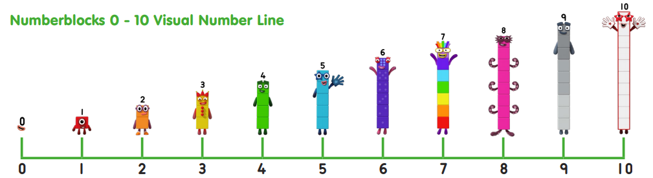
1 more than 5
1 less than 7
Can you write a number sentence?
Notes:
You could try this with Lego!

Slide 15

https://www.youtube.com/watch?v=H5s2A_p3ZsU

Slide 16
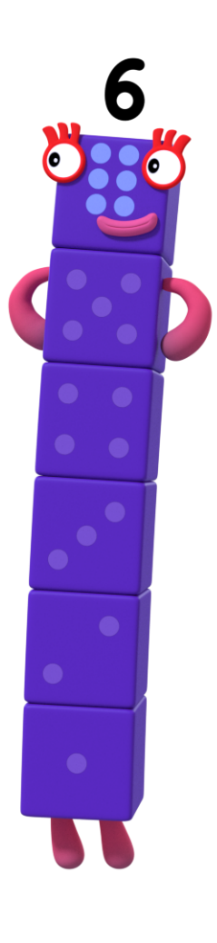

Number Six has something special!
Can you remember what it is?
What can we see on the dice?

Slide 17
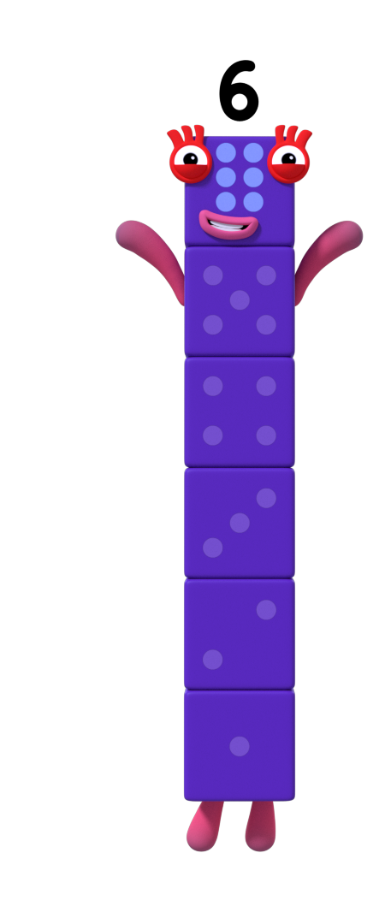

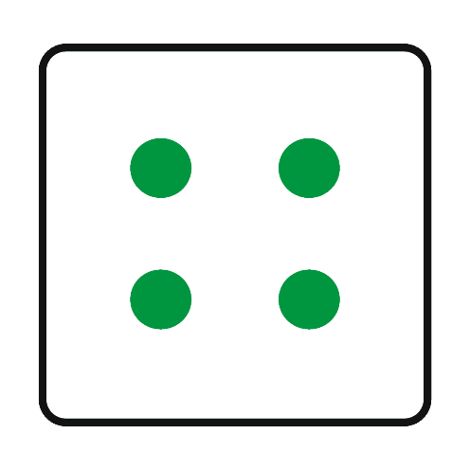
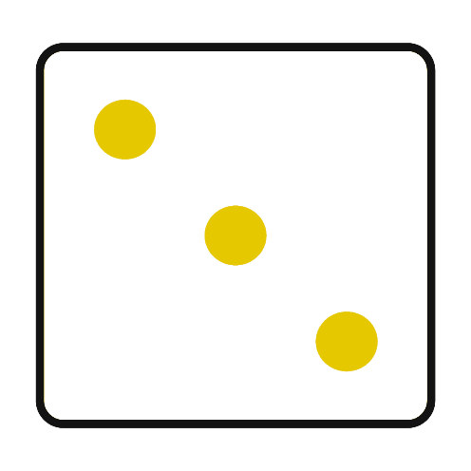
Number Six looked at the dice.
Which pattern shows 6 on the dice? Can you tell a partner how you know it is 6?
Try again.
Try again.

Slide 18

That’s right! It is 6.
Can you count to 6?

Slide 19

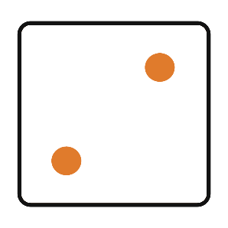
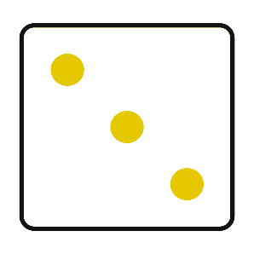
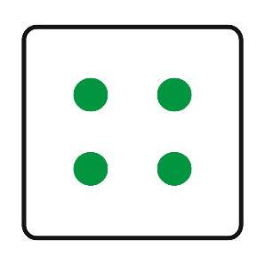
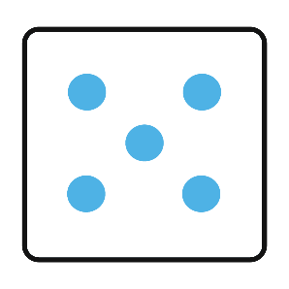

Can you use the dice to help you count to 6?
What do you notice about the dots on the dice?

Slide 20

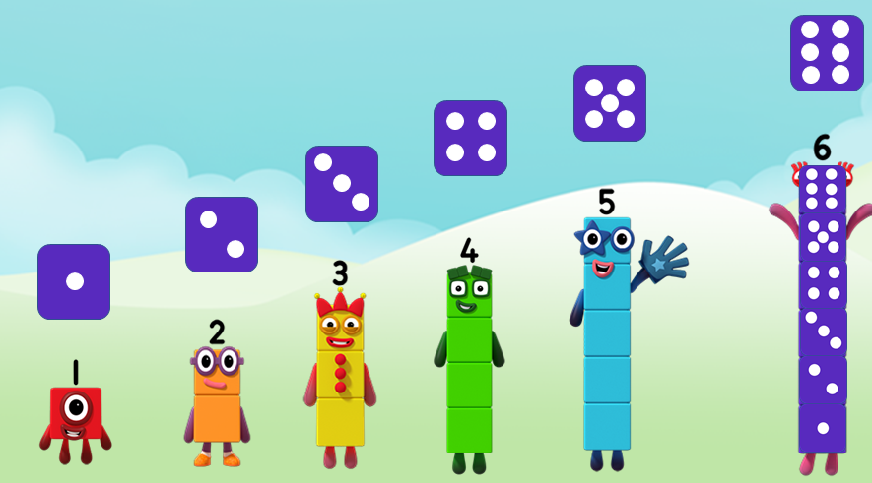
What do you notice?

Slide 21
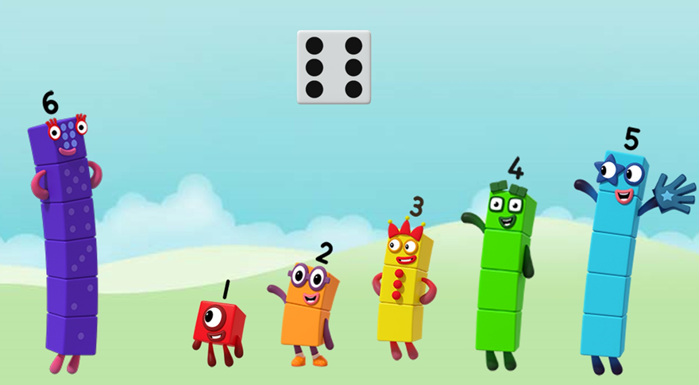
When have you used a dice?

Slide 22
Goodbye!
Now its Activity time!
Try your best!
For more number fun, head on down to learningblocks.tv!

Slide 23

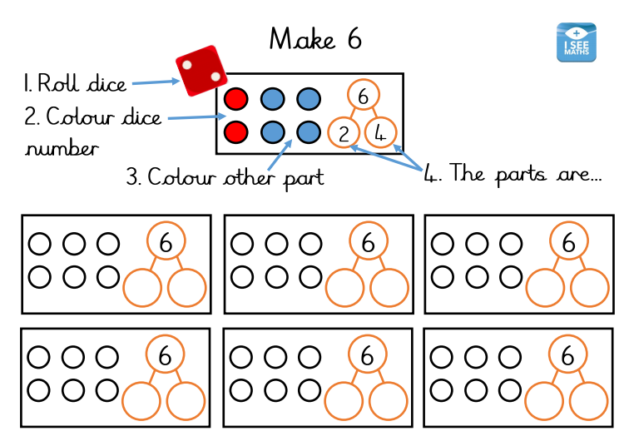
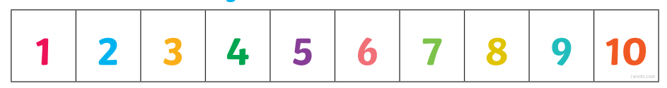
Activity time!

Slide 24
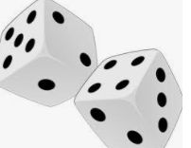
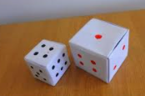
Online Dice
https://www.teacherled.com/iresources/tools/dice/
Or make your own dice!

Slide 25

Lesson 2- starter
What number is it?
Please see the short uploaded video on Tapestry -Maths lesson 2- What number is it?
Write the numeral on your whiteboard or paper.

Slide 26


Lesson 2 Starting with a story
https://www.youtube.com/watch?v=3XAdTJCtgTs
Listen to the story
Challenge: Look out for as many things
as you can that represent the number 6.

Slide 27

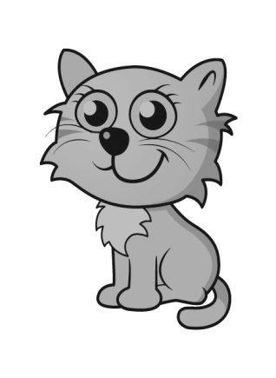

1
3
5
2
4
6

Slide 28


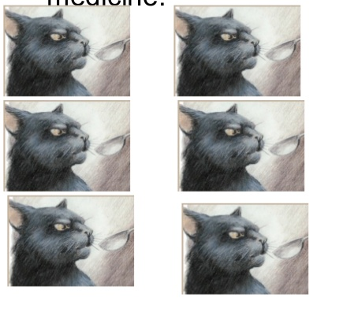
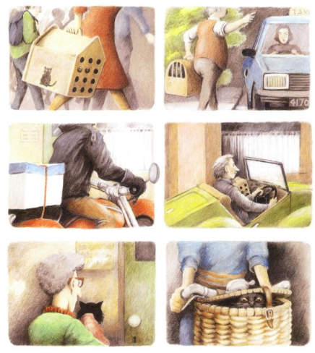
What did you find that represents the number 6?
I noticed Sid had 6 spoons of medicine!
I noticed 6 different ways Sid was taken to the vet!

Slide 29


Are you ready to become…..
Remember- Marvellous mistakes make our brains grow bigger!

Slide 30

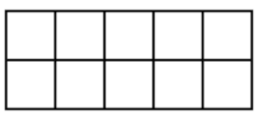
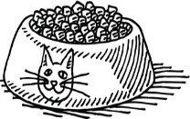

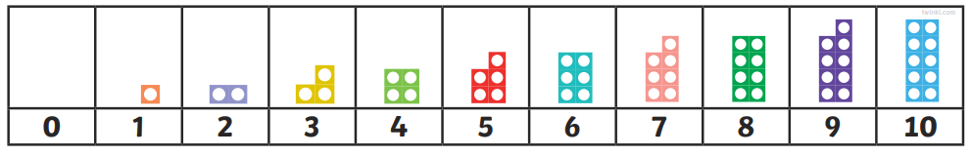
Sid’s problem
Sid eats 2 dinners then eats 1 more. How many dinners does Sid eat altogether?
Notes:
Interactive dinner bowls

Slide 31

Sid’s problem
Sid eats 5 dinners then eats 1 more. How many dinners does Sid eat altogether?

Slide 32
Sid’s problem
Sid eats 1 less than 6 dinners. How many dinners does Sid eat altogether?

Slide 33
Sid eats 6 dinners a day. How many dinners does Sid eat in 2 days?
You can draw a picture to help you
Can you write a number sentence?
Notes:
Extend 3 days etc.

Slide 34
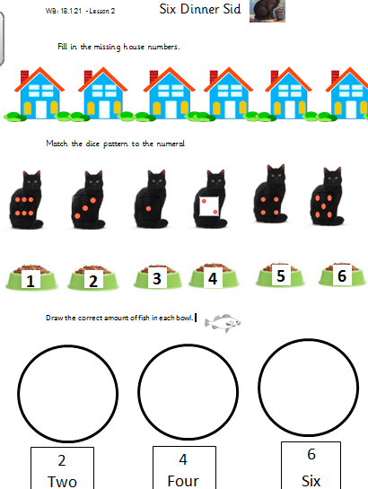
Your turn- Activity Time!
(This sheet is uploaded on the Home Learning page)

Slide 35

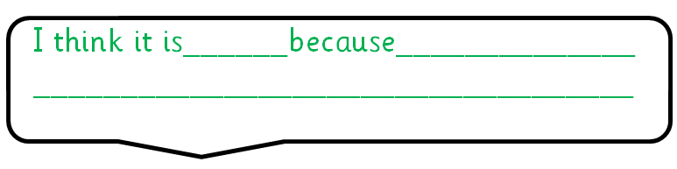
Lesson 3-starter Which one doesn’t belong?

Slide 36
Which one doesn’t belong?

Slide 37

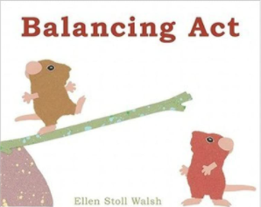
Lesson 3- new learning Starting with a story
Listen to the uploaded video of the story on Tapestry
What do you notice?

Slide 38

What do you notice?
I notice ______________________________
_____________________________________

Slide 39
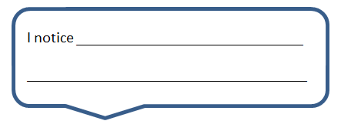
What do you notice?

Slide 40


What do you notice?

Slide 41


What do you notice?

Slide 42


What do you notice?

Slide 43


What do you notice?

Slide 44


What do you notice?

Slide 45
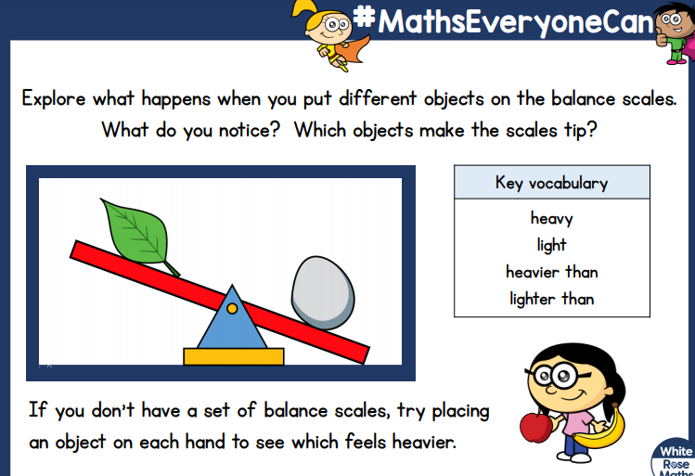
Your turn- Activity time!

Slide 46
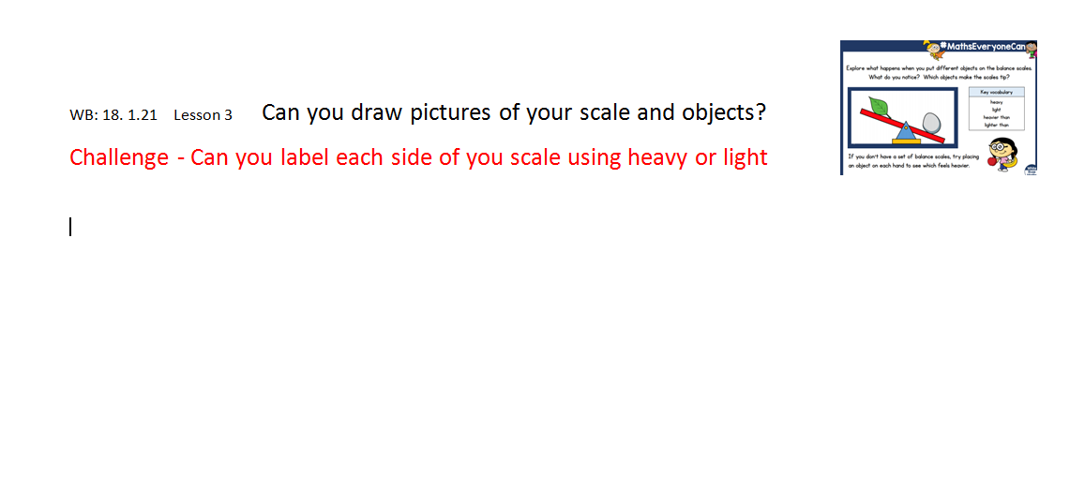
(This sheet is uploaded on the Home Learning page)

Slide 47


Slide 48
Lesson 4- starter Which one doesn’t belong?

Slide 49


Lesson 4- New learning Measuring Capacity
Who has the empty glass?

Slide 50
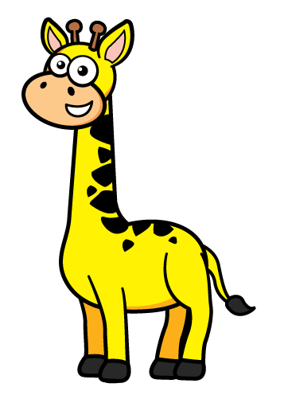

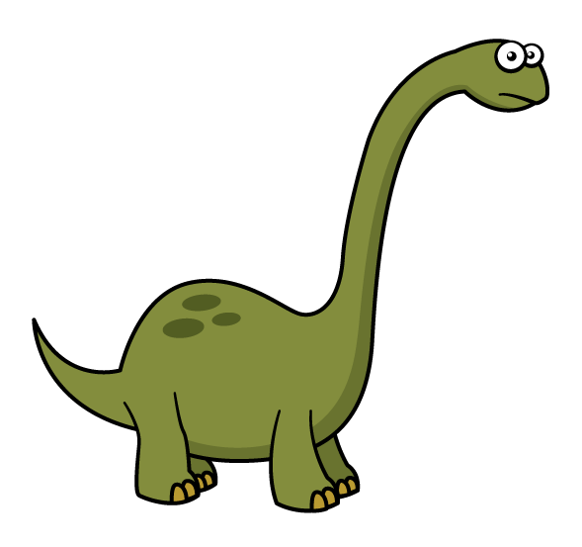


What do you notice this time?

Slide 51


Point to the glass that is nearly full. Explain why?

Slide 52
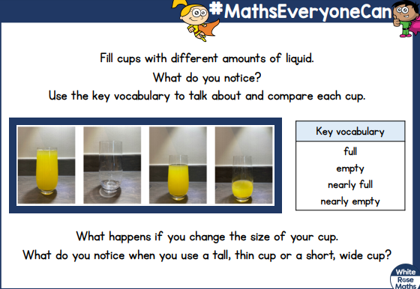
Activity time!

Slide 53
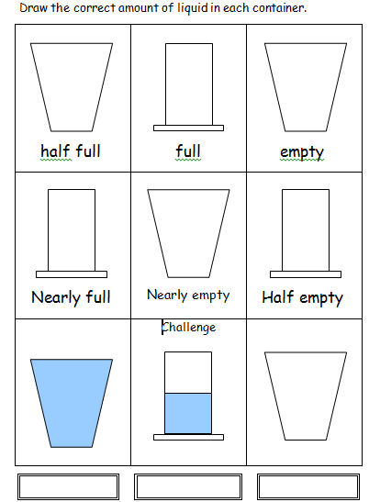
(This sheet is uploaded on the Home Learning page)

Slide 54

Lesson 5- Measuring ingredients
Today you have a very exciting job. You are going to make your own play dough. You need to measure the ingredients carefully.
Click on the link below to watch the video- find lesson 5
https://whiterosemaths.com/homelearning/early-years/alive-in-5-week-3/

Slide 55
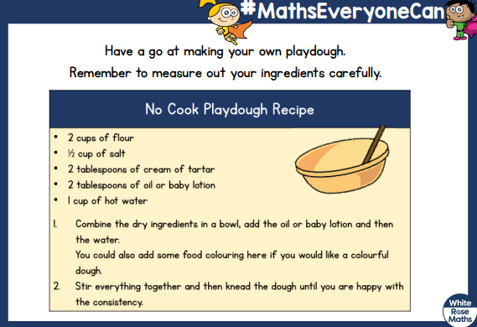
Your turn- Activity time!

Slide 56
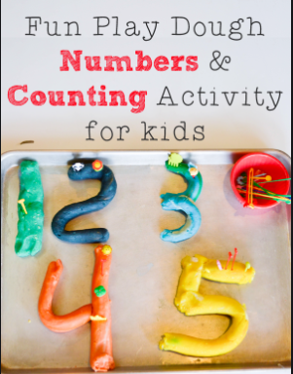
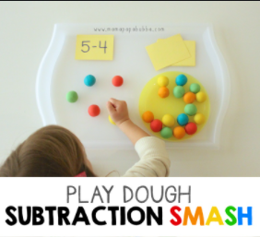
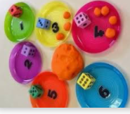
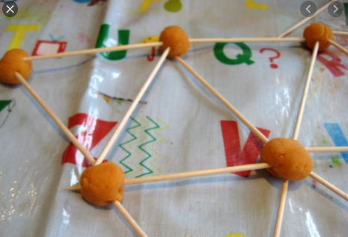
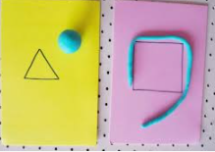
Maths play dough ideas
Miss Montgomery & Miss Barrett’s top pick ☺

