Slide 1
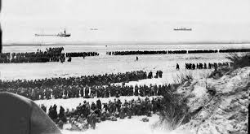
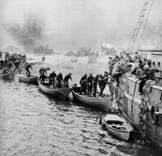
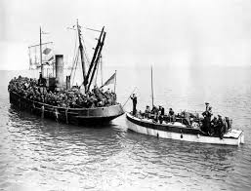
Dunkirk – success or failure?

Slide 2
Successes:
Over 338,000 men were rescued from Dunkirk
933 ‘little’ ships took part
Other allies – France, Norway, Belgium, Holland – assisted with the rescue
Positive propaganda boosted the spirit of the British people
Failures:
Over 80,000 vehicles were left behind
Stores and ammunition were left behind
Over 100,000 men were killed or captured
The destroyer ‘Wakeful’ was torpedoed and sank
Over 600 RAF planes were lost

Slide 3
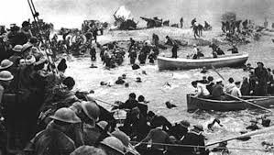
Introduction:
Explain to your reader what Dunkirk involved and why it happened. E.G…..
During late May and early June 1940, the British army and allies found themselves trapped on the beach at Dunkirk in northern France. They had been taken by surprise at the speed of the German ‘Blitzkrieg’ and were surrounded on three sides by the German army. On the fourth side, lay the sea. Winston Churchill, who had only been Prime Minister for eighteen days, launched a rescue mission; he called on owners of boats of all sizes to sail to France, in order to save the soldiers trapped on the beach.

Slide 4
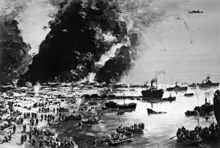
Success:
Make a point in favour of the discussion.
Consequently, over 900 ‘little’ ships sailed across the English Channel. Churchill thought that approximately 30,000 soldiers could be rescued with this plan; however, the ‘little’ ships eventually managed to save over 338,000 soldiers, including men from the French and Polish armies, who were fighting alongside the British. This was an extraordinary achievement as most of the boat owners were civilians and were risking their own lives in order to help.

Slide 5
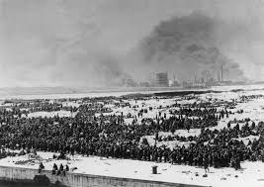
Failure:
Make an opposing point, giving the opposite view.
On the other hand, Dunkirk can be viewed as a failure as more than 100,000 men were either killed or captured by the Germans, reducing Britain’s fighting power significantly. During the evacuation, men were forced to wait in long queues on the open beach, meaning that they were ‘sitting duck’ targets for the German soldiers. Whilst waiting for their turn to board a boat, they were fired upon by soldiers with machine guns and were also subject to aeroplanes firing at them from the sky. Private R Rymer from the Cheshire Division said, ‘You’ve got to remember that we’re running across the beach and you’re jumping over blokes, you know, that are no longer with us, and dodging and diving because they’re coming down machine-gunning you and everything else.’ With no shelter, it is little wonder that so many died.

Slide 6
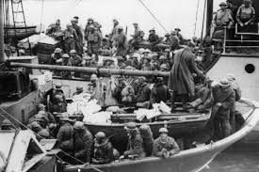
Success:
Make a second point, in favour.
Meanwhile, in Britain, hearing the news of the huge number of men who had been rescued, the morale of the British public could not have been higher. They were encouraged to believe that it was entirely due to the British spirit and the bravery shown by the boat owners. Dunkirk was hailed as a successful plan, inspired by Churchill.

Slide 7
Failure:
Make a second point showing a different view.
Many people, however, view Dunkirk as a failure because, although many thousands of soldiers were saved to fight again, an incredible amount of supplies were left behind and could be used by the Germans. These included over 80,000 vehicles, ammunition, weapons and many tons of food, which the British could ill-afford to lose.

Slide 8
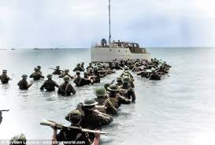
Conclusion:
Here, you can give your own opinion, stating a reason for it.
Personally, I believe that Dunkirk was a success for Britain. Without the large numbers of returning soldiers, who could return to the war and continue fighting, Britain would have been left almost defenceless and open to invasion by the Germans.

