Slide 1

FS2 WB: 11.1.21
Maths lessons

Slide 2
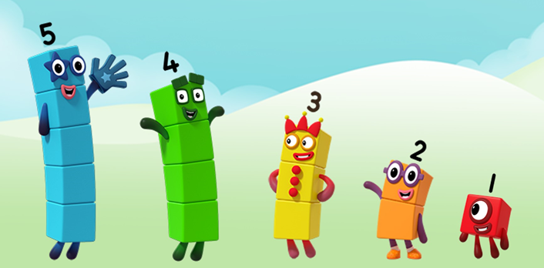
Lesson 1 Starting with a story-
Numberblocks- ‘The Whole of Me’ https://www.bbc.co.uk/iplayer/episode/b08dr1l3/numberblocks-series-1-the-whole-of-me
What do you notice?

Slide 3


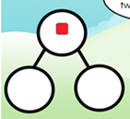
Sing along!
I’m Number 1 and this is fun, I’ve got 1 block to play with and the whole of me is One.
Notes:
Sing song

Slide 4


I’m number 2. How do you do? I’ve got 2 blocks to play with and the whole of me is Two. 1 is a part of me and 1 is a part of me and the whole of me is Two

Slide 5


I’m number 3, now look at me, I’ve got 3 blocks to play with and the whole of me is 3. 1 is a part of me and 2 is a part of me and the whole of me is 3.

Slide 6


I’m number 4, and I am sure that I’ve got 4 blocks to play with and the whole of me is 4. 1 is a part of me and 3 is a part of me and the whole of me is 4.

Slide 7
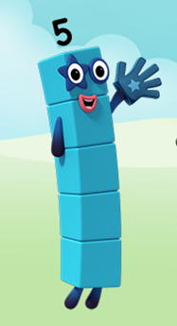
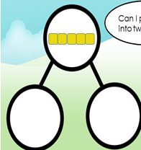
I’m number 5, I am alive, I’ve got 5 blocks to play with and the whole of me is 5. 1 is a part of me and 4 is a part of me and the whole of me is 5.

Slide 8

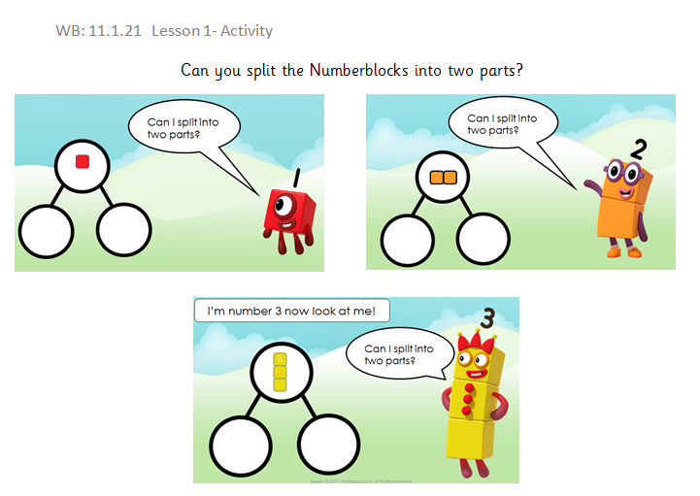
Your turn- Activity time!
Notes:
This is also uploaded as a worksheet.

Slide 9
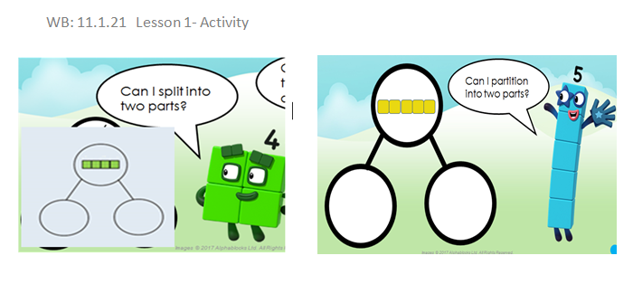

Slide 10

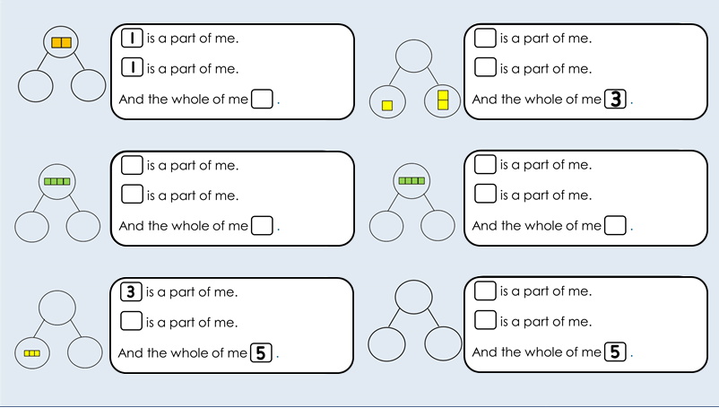

Slide 11
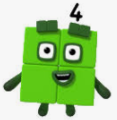


Lesson 2 The Evil Pea has trapped Numberblock 4! You need to stop him!
Help!
Notes:
I have trapped your Numberblock friend Four! To get him back you need to find 4 different ways to make the number 4. Once you have found all the different ways, send them to your teacher and she will check if Numberblock 4 can be released.
You need to be quick before I put him in the freezer Mowhwhahah!

Slide 12

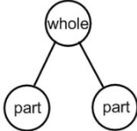
The Evil Pea challenge
The Evil Pea has trapped Numberblock 4. To get him back you need to find 4 different ways to make the number 4. Once you have found all the different ways, send them to your teacher and she will check if Numberblock 4 can be released.
You can use a Part- Whole model to help you!

Slide 13
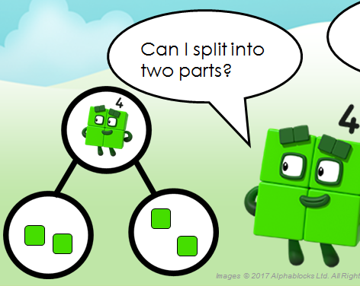

Lets do one together!
The whole is 4
2 is a part
2 is a part
Can you write a number sentence?
+ = 4 2 + 2 = 4

Slide 14
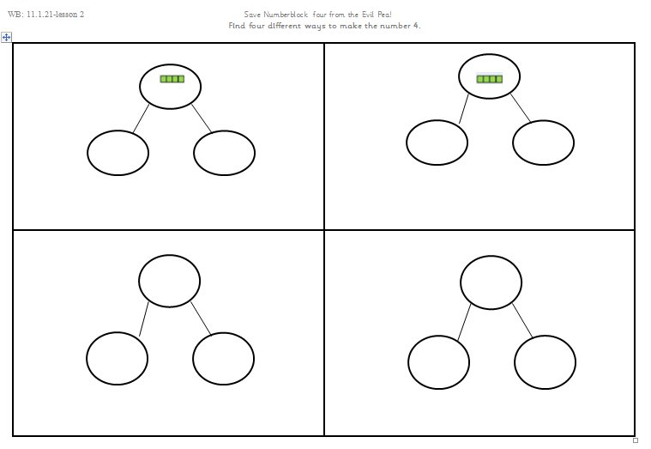
Activity time!
Can you write a number sentence?
Notes:
This is uploaded separately as a worksheet

Slide 15
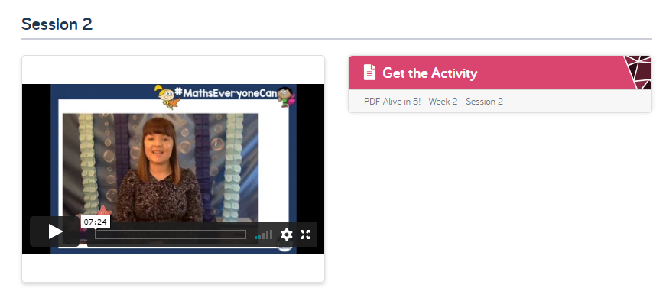

Lesson 3
Today we will follow White Rose Maths Home Learning- Alive in 5!- week 2- session 2.
Click on the link below to watch the video
https://whiterosemaths.com/homelearning/early-years/alive-in-5-week-2/

Slide 16
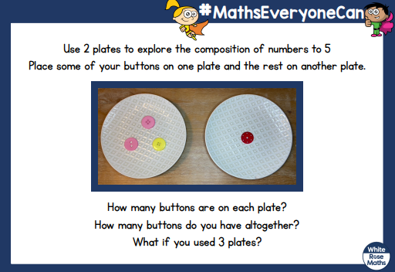
Activity Time!
After watching the video complete the activity (this is uploaded on Home Learning Page 2020/21)
If you don’t have buttons, you can use stones, shells or peas!

Slide 17
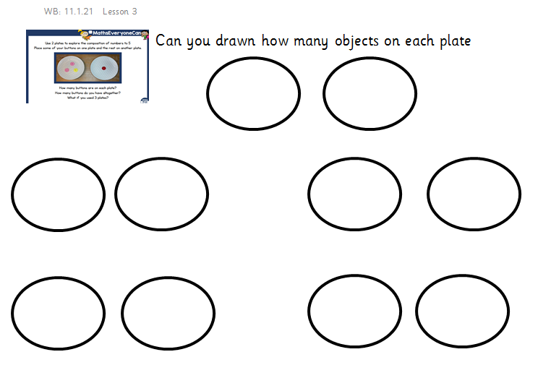
Notes:
Uploaded on Home Learning Page 2020/21 WB 1.11.21 Lesson 3- activity sheet

Slide 18

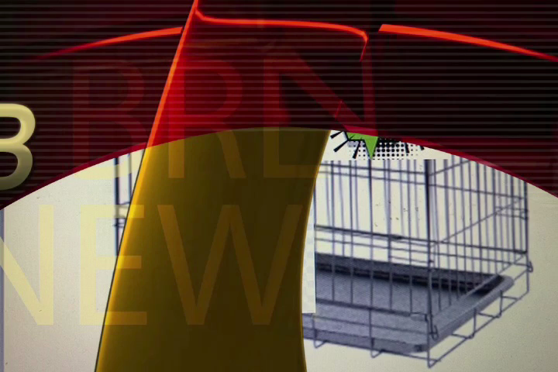
Lesson 4
The Evil Pea has trapped Numberblock 5!

Slide 19
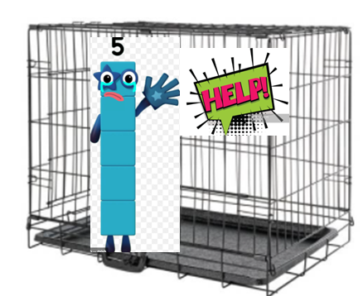


I am sure you have watched the news!
I am back! Mowhahahah!
This time you need to find 5 different ways to make the number 5. Send your work to your teacher and she will release Numberblock 5 from the trap! This time can you use a five frame!

Slide 20



Lets do one together!
One part is 1 One part is 4
Number sentence 1 + 4 = 5

Slide 21
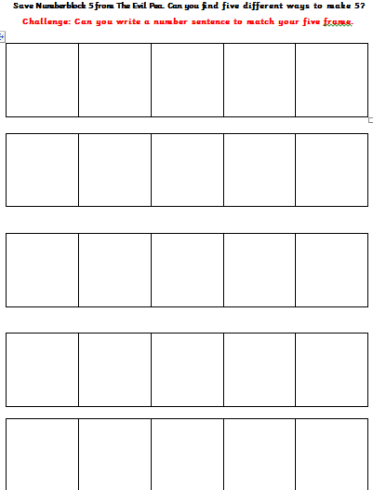
Your turn- Activity time!
(This sheet is uploaded on the Home Learning page)
To complete this activity you can use two different colouring pencils or different objects.

Slide 22

Lesson 5
Active starter- counting to 20
Click on the link below to watch the video
https://www.bbc.co.uk/teach/supermovers/ks1-maths-counting-with-john-farnworth/zbct8xs

Slide 23
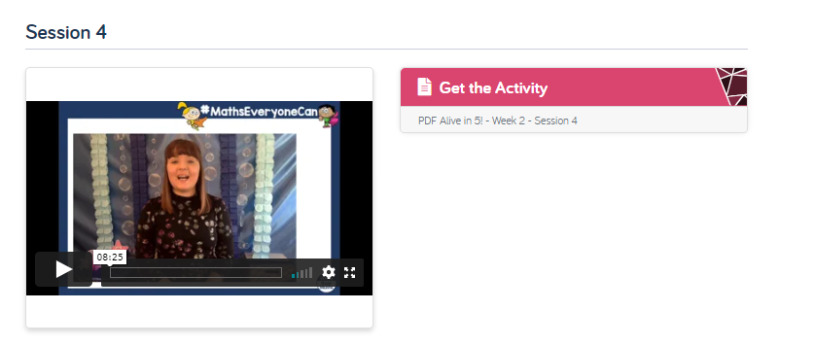
Lesson 5
Today we will follow White Rose Maths Home Learning- Alive in 5!- week 2- session 4.
Click on the link below to watch the video
https://whiterosemaths.com/homelearning/early-years/alive-in-5-week-2/

Slide 24
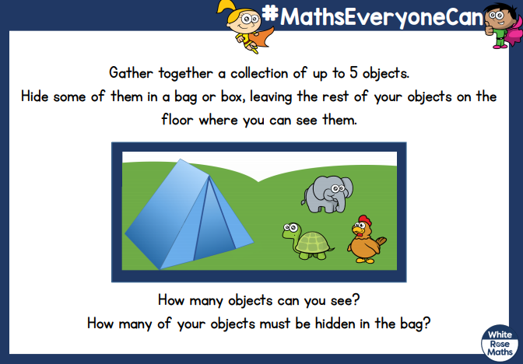
Activity time!

