Slide 1
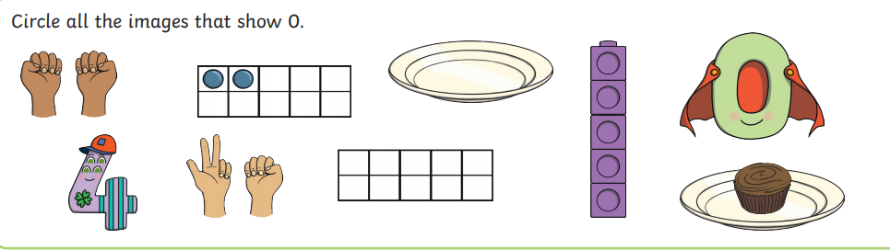
Notes:
Lesson 1- Tuesday

Slide 2
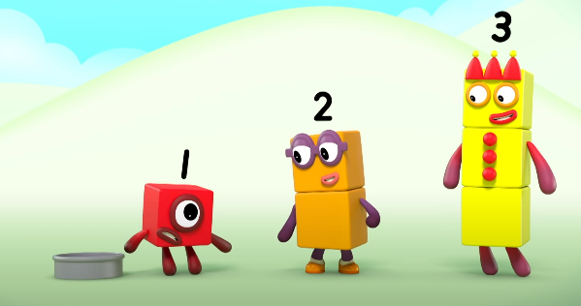
Notes:
Lesson 1- Tuesday

Slide 3

Notes:
Lesson 1- Tuesday

Slide 4


Evil Pea problem
If there were 3 peas in a pod and they all fell out. How many peas would be left in the pod?
Notes:
Lesson 2- Wednesday

Slide 5
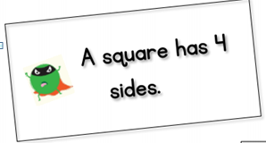
Prove it!
Notes:
Lesson 3-Thursday

Slide 6
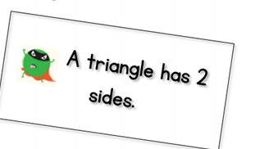
Prove it!
Notes:
Lesson 3-Thursday

Slide 7
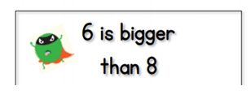
Prove it!
Notes:
Lesson 3-Thursday

Slide 8
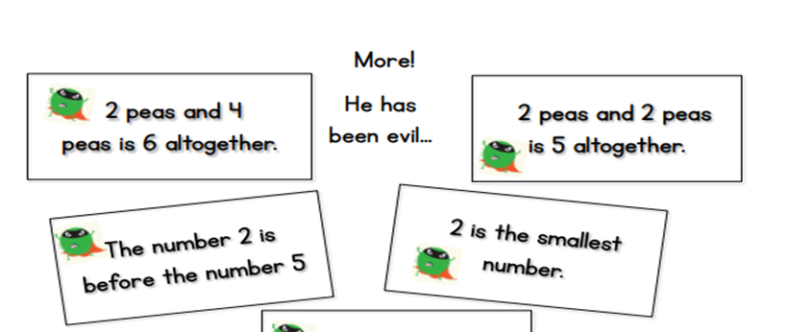
Notes:
Lesson 3-Thursday
MA/HA

Slide 9

Notes:
Lesson 3-Thursday

