Slide 1


Christ the King
Catholic Primary School

Slide 2
Evidencing the Impact of Primary PE and Sport Premium
Department for Education Vision for the Primary PE and Sport Premium
ALL pupils leaving primary school physically literate and with the knowledge, skills and motivation necessary to equip them for a healthy, active lifestyle and lifelong participation in physical activity and sport.
The funding has been provided to ensure impact against the following OBJECTIVE:
To achieve self-sustaining improvement in the quality of PE and sport in primary schools. It is important to emphasise that the focus of
spending must
lead to long lasting impact against the vision (above) that will live on well beyond the Primary PE and Sport Premium funding.
It is expected that schools will see an improvement against the following 5 key indicators:
the engagement of all pupils in regular physical activity – kick-starting healthy active lifestyles
the profile of PE and sport being raised across the school as a tool for whole school improvement
increased confidence, knowledge and skills of all staff in teaching PE and sport
broader experience of a range of sports and activities offered to all pupils
increased participation in competitive sport
Under the new Inspection Framework, Ofsted inspectors will assess how effectively leaders use the Primary PE and Sport Premium
and measure its impact on outcomes for pupils, and how effectively governors hold them to account for this. Improvements should
enhance, rather than maintain existing provision. For example, where schools are using their funding to employ specialist coaches, these should be
deployed alongside class teachers rather than displacing them, in order for their impact to be sustainable and to enable the upskilling of
existing teachers.

Slide 3
Evidencing the Impact of Primary PE and Sport Premium
You should ensure that information about your use of the premium is available on your school website in order to keep parents and others informed. This should be clear and easily accessible and we recommend that you upload the following template to your website for this purpose.
Primary Physical Education and Sport premium planning and actions should show how use of funding contributes to this vision through identified school priorities which can be measured through reference to key outcome indicators. It is important that the main drivers for improvement are those identified by the school through their self-review. Each school should aim to achieve the following objective:
OBJECTIVE: To achieve self-sustaining improvement in the quality of PE and sport in primary schools.
Please see Figure 1 (next page): A process model to support your thinking:

Slide 4
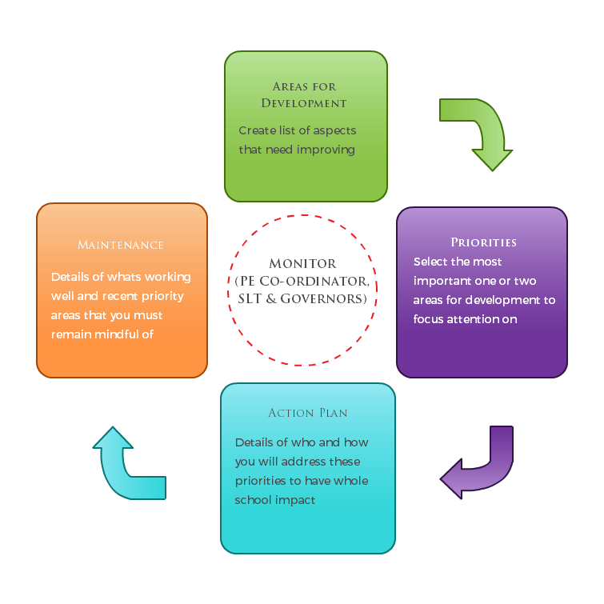

Slide 5
How to use the Primary PE
and Sport Premium
Schools must use the funding to make additional and sustainable improvements to the quality of PE and sport they offer.
This means that you should use the premium to:
develop or add to the PE and sport activities that your school already offers
make improvements now that will benefit pupils joining the school in future years
For example, you can use your funding to:
hire qualified sports coaches to work with teachers
provide existing staff with training or resources to help them teach PE and sport more effectively
introduce new sports or activities and encourage more pupils to take up sport
support and involve the least active children by running or extending school sports clubs, holiday clubs and
Change for Life clubs
run sport competitions
increase pupils’ participation in the School Games
run sports activities with other schools
You should not use your funding to:
employ coaches or specialist teachers to cover planning preparation and assessment (PPA) arrangements –
these should come out of your core staffing budgets
teach the minimum requirements of the national curriculum – including those specified for swimming.

Slide 6
Evaluation of Impact/
Learning to Date
In previous years, have you completed a self-review of PE, physical activity and school sport? YES
Have you completed a PE, physical activity and sport action plan/ plan for the Primary PE and Sport Premium spend? YES
Are your PE and sport premium spend and priorities included on your school website? YES

Slide 7

Academic Year: 2025-2026 | Total fund allocated 2024-25 = £19322 Carried over from 2023-24 = £ 4866 Total to spend 2024-25 = £ 26621.06
PE and Sport Premium Key Outcome Indicator | School Focus/ planned Impact on pupils | Actions to Achieve | Planned Funding | Evidence | Actual Impact (following review) on pupils | Sustainability/ Next Steps REVIEW 09/26
The engagement of all pupils in regular physical activity - Chief Medical Officer guidelines recommend that primary school pupils undertake at least 30 minutes of physical activity a day in school. | To provide a broad and balanced curriculum and a related extra curriculum. | To ensure equipment is available and in good working condition for lessons in hall, playground, field and for active play. To ensure halls are safe to use, floors to be treated if needed | £1,500 to replace/new equipment

Slide 8
PE and Sport Premium Key Outcome Indicator | School Focus/ planned Impact on pupils | Actions to Achieve | Planned Funding | Evidence | Actual Impact (following review) on pupils | Sustainability/ Next Steps REVIEW 09/26
1. The engagement of all pupils in regular physical activity - Chief Medical Officer guidelines recommend that primary school pupils undertake at least 30 minutes of physical activity a day in school. | Encourage children to take on leadership roles that support physical and mental health activities within school – Continue with Play Leaders Increase amount of activity during both lunch and playtimes - provide opportunities for all abilities/needs with rotation for each class/year group. | Play leaders from Y5 to be trained by FOB Play leaders to plan and set up areas during playtimes. (Each day a different year group.) Creating PB areas so children can gain confidence in being competitive. | Full of Beans staff to aid running - £2,250 (£30 x20 weeks)

Slide 9
PE and Sport Premium Key Outcome Indicator | School Focus/ planned Impact on pupils | Actions to Achieve | Planned Funding | Evidence | Actual Impact (following review) on pupils | Sustainability/ Next Steps REVIEW 09/26
1. The engagement of all pupils in regular physical activity - Chief Medical Officer guidelines recommend that primary school pupils undertake at least 30 minutes of physical activity a day in school. | To continue monitor uptake of pupils in regular activities and look to support those who are not engaging. | PE lead to survey pupils and monitor uptake of pupils in activities – thinking of possible ways to increase participation? VIP Clubs for targeted children who have not previously engaged. Funded before school clubs identified through school clubs spreadsheet. PE Lead and Play Leaders to promote and encourage the use of both boards through lunchtime games and potential competitions. | Included in SL time out (£200) |  | .

Slide 10
PE and Sport Premium Key Outcome Indicator | School Focus/ planned Impact on pupils | Actions to Achieve | Planned Funding | Evidence | Actual Impact (following review) on pupils | Sustainability/ Next Steps REVIEW 09/26
2. The profile of PE and sport is raised across school. | Celebration of sports within school - termly newsletter on school website/hall noticeboard to be updated (SGV)/Instagram/end of year sports awards. | PE/Sport achievements to be celebrated in assemblies/lessons (SGV) Celebrate swimming success/attainment with certificates once block has been completed Celebrate PBs from half-termly intra comps through certificates. | £500 – medals/cup/certificates end of year sports assembly Subject Leader time £360 (3 x SL afternoons)

Slide 11


PE and Sport Premium Key Outcome Indicator | School Focus/ planned Impact on pupils | Actions to Achieve | Planned Funding | Evidence | Actual Impact (following review) on pupils | Sustainability/ Next Steps REVIEW 09/26
2. The profile of PE and sport is raised across school. | To continue to raise the profile of PESSPA through continuing to work towards the Primary School Games Gold Award and building towards Platinum. To ensure the Daily Mile competition within school has engagement with regular physical activity. Continue working with WSG leaders 2025-26. | Subject lead to meet with SGM support to build case for Platinum. Subject co-ordinator to ensure Daily Mile is actively promoted within the school and all classes take part. Ensure profile raised in class, assemblies, Instagram and newsletter. | SL time out (£200) Subject Leader time £300 (3 x SL afternoons)

Slide 12
PE and Sport Premium Key Outcome Indicator | School Focus/ planned Impact on pupils | Actions to Achieve | Planned Funding | Evidence | Actual Impact (following review) on pupils | Sustainability/ Next Steps REVIEW 09/26
3. Increased confidence, knowledge and skills of all staff in the teaching of PE and sport. | Staff continue to have access to Get set 4 PE planning and media resources. To access relevant PE training/CPD that supports staff in the effective teaching of P.E and the health and safety | PE lead to ensure staff are confident in using the Get Set 4 PE site and assessment/clubs are complete accurately. Continue with cricket CPD with Cheshire Cricket –2023-24, (FS2-Y6) Continue with Beth Tweddle Gymnastics to work with specified year groups (x4 over spring term). | Get Set 4 PE subscription (£1778) £2,500 £1,300 |  | . .

Slide 13
PE and Sport Premium Key Outcome Indicator | School Focus/ planned Impact on pupils | Actions to Achieve | Planned Funding | Evidence | Actual Impact (following review) on pupils | Sustainability/ Next Steps REVIEW 09/26
3. Increased confidence, knowledge and skills of all staff in the teaching of PE and sport. | To access relevant PE training/CPD that supports staff in the effective teaching of P.E and the health and safety. | Continue rugby CDP with Will Gardener from Rugby Tots for Years 1 and 2 in Spring/Summer. Continue with Port Sunlight Tennis Coaching with Bill Connell. Create Dance Wirral – Hayley Rooney FOB used to give CPD to class TA’s year 4, 5 and 6 | £1,800 (10 weeks) £600 £400 £3658.20 per term (total £10,947)

Slide 14
PE and Sport Premium Key Outcome Indicator | School Focus/ planned Impact on pupils | Actions to Achieve | Planned Funding | Evidence | Actual Impact (following review) on pupils | Sustainability/ Next Steps REVIEW 09/26
3. Increased confidence, knowledge and skills of all staff in the teaching of PE and sport. | Teachers fully trained to lead a group of swimmers during swimming their lessons. (Use of trained instructors to teach non-swimmer groups) | Any staff new to Y3/4/5 who do not hold the swimming certificate or require retraining, to be sent on next course. | £168 for staff training.

Slide 15
PE and Sport Premium Key Outcome Indicator | School Focus/ planned Impact on pupils | Actions to Achieve | Planned Funding | Evidence | Actual Impact (following review) on pupils | Sustainability/ Next Steps REVIEW 09/26
4. Broader experience of a range of sports and activities offered to all pupils | To strengthen the link between physical and mental health and support the well-being of our children. | To reintroduce a wider range of extra-curricular sports clubs to encourage pupils to experience a wider range of sports and activities both in school and outside of school. PE lead to reach out to local clubs to try arrange taster sessions, lunchtime/before or after school clubs. Staff to record club participants on Get set 4 PE, tracking progress. PE lead to keep track ensuring all children have the opportunity to take part. | £500 potential coaching charge Potential coaching fees.

Slide 16
PE and Sport Premium Key Outcome Indicator | School Focus/ planned Impact on pupils | Actions to Achieve | Planned Funding | Evidence | Actual Impact (following review) on pupils | Sustainability/ Next Steps REVIEW 09/26
4. Broader experience of a range of sports and activities offered to all pupils | Children have the opportunity to attend a variety of extra-curricular sports clubs- varying sports for age groups across school year based on pupil voice. | To review the curriculum and extra curriculum opportunities and ensure they meet the needs of the pupils to ensure all pupils have the opportunity to be active in and out of school. (Pupil voice) Afterschool clubs such as FoB to run an extra-curricular for KS1 and KS2 each half term based off pupil voice through school council Lunchtime clubs to be added for FOB for KS1 and KS2 | Estimate £2,000 for after school clubs such as Full of Beans clubs x2 each half term (1 for KS1 and 1 for KS2). (Lunch time clubs paid for by parents)

Slide 17
PE and Sport Premium Key Outcome Indicator | School Focus/ planned Impact on pupils | Actions to Achieve | Planned Funding | Evidence | Actual Impact (following review) on pupils | Sustainability/ Next Steps REVIEW 09/26
4. Broader experience of a range of sports and activities offered to all pupils | To increase focus and support of pupils who do not partake in sporting or active opportunities. | PE lead and SENDCo to consider % of pupils accessing extra-curricular clubs and removing barriers where possible – 1:1 support, or specific needs requiring specific catering for use of whole school spreadsheet for clubs to help identify. | SL time out. |  | .

Slide 18
PE and Sport Premium Key Outcome Indicator | School Focus/ planned Impact on pupils | Actions to Achieve | Planned Funding | Evidence | Actual Impact (following review) on pupils | Sustainability/ Next Steps REVIEW 09/26
5. Increased participation in competitive sport. | To increase participation levels in inter and intra school sporting opportunities - promote wider participating amongst all children Continue to increase and promote team competitions and matches | To introduce intra school competitions once each half term with help from SGC To encourage intra school competition during PE lessons highlighting SGV Use pupil voice to get children’s views on what they would like to help encourage participation and enjoyment. Potentially skills based to link to new learning. Participate in a variety of Wirral School Games and outside competitions/festivals | Supply cover to release PE lead to organise PESSPA events/ competitions/ courses (£200)

Slide 19
PE and Sport Premium Key Outcome Indicator | School Focus/ planned Impact on pupils | Actions to Achieve | Planned Funding | Evidence | Actual Impact (following review) on pupils | Sustainability/ Next Steps REVIEW 09/26
5. Increased participation in competitive sport. | To increase participation levels in inter and intra school sporting opportunities - promote wider participating amongst all children Continue to increase and promote team competitions and matches | Continue with register to identify and highlight ensuring vulnerable and least active children using Get Set 4 PE each half term. Enter into football/futsal competitions/tournaments organised each year in Wirral. Organise/participate in friendlies with local primary schools/cluster in a variety of sports | Staff release cover (£200) Free through WSG Staff release time potential charge x1 afternoon (£120)

Slide 20
PE and Sport Premium Key Outcome Indicator | School Focus/ planned Impact on pupils | Actions to Achieve | Planned Funding | Evidence | Actual Impact (following review) on pupils | Sustainability/ Next Steps REVIEW 09/26
5. Increased participation in competitive sport. | Transport to/from festivals/ competitions in various locations in Wirral/Liverpool - Pupils to take part in festivals and competitions made available to school through Wirral School Games and cluster events. | Transport (coach/minibus) to take children to/from events. Ensure that there is enough kit for KS2 pupils to wear to sporting events when representing our school. Monitor its return | Potential £1,000 Potential £400

Slide 21
PE and Sport Premium Key Outcome Indicator | School Focus/ planned Impact on pupils | Actions to Achieve | Planned Funding | Evidence | Actual Impact (following review) on pupils | Sustainability/ Next Steps REVIEW 09/26
5. Increased participation in competitive sport. | Cover for PE Lead/staff to attend sporting events during the school day - ratios of adult/child for the age group attending. | Staff released from class. Continue participating with WSG and encouraging children of all abilities to attend festivals and events. | £1,000 for supply cover if events should fall within the school day.

Slide 22
Meeting National Curriculum Requirements for Swimming and Water Safety
What percentage of your current Year 6 cohort swim competently, confidently and proficiently over a distance of at least 25 metres? | 80%
What percentage of your current Year 6 cohort use a range of strokes effectively [for example, front crawl, backstroke and breaststroke]? | 85%
What percentage of your current Year 6 cohort perform safe self-rescue in different water-based situations? | 80%
What percentage of your current Y6 cohort have achieved National Curriculum standard in swimming? Schools can choose to use the Primary PE and Sport Premium to provide additional provision for swimming but this must be for activity over and above the national curriculum requirements. Have you used it in this way? | 80% No

