Slide 1

KQ4
How do we know about Grace’s actions which happened so long ago?

Slide 2
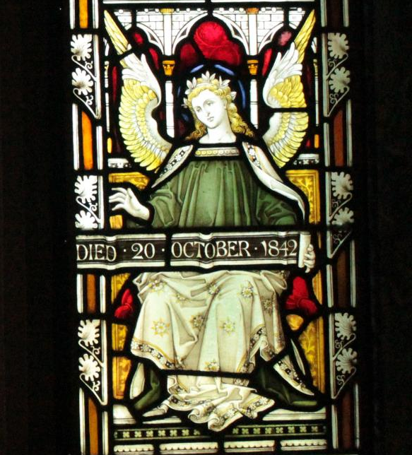
A
A stained glass window from the local church

Slide 3
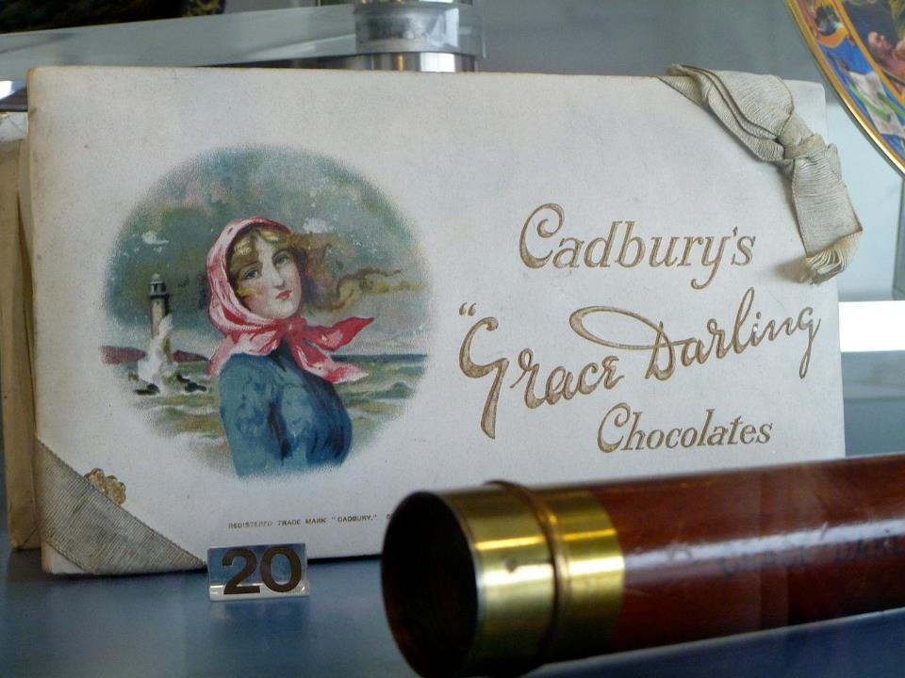
B
https://upload.wikimedia.org/wikipedia/commons/thumb/b/b4/Grace_Darling_Chocolate_Bar.JPG/1280px-Grace_Darling_Chocolate_Bar.JPG

Slide 4
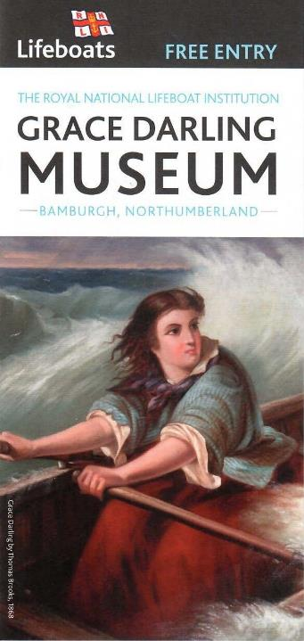
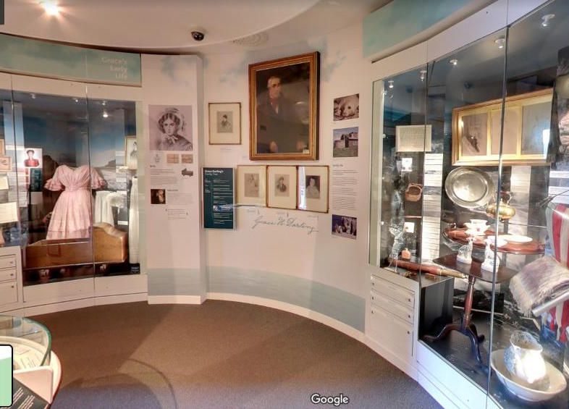
C

Slide 5
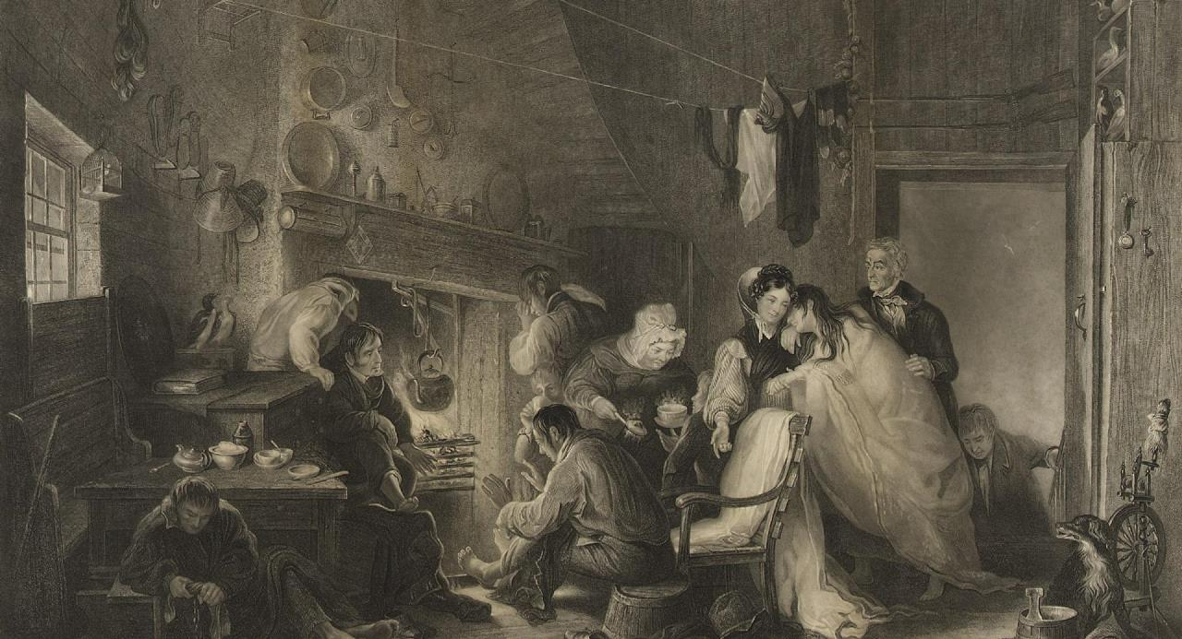
D

Slide 6
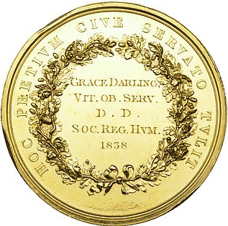
E
https://www.dailymail.co.uk/news/article-6433259/First-bravery-medal-given-woman-Grace-Darling-saving-shipwreck-survivors-sale.html

Slide 7
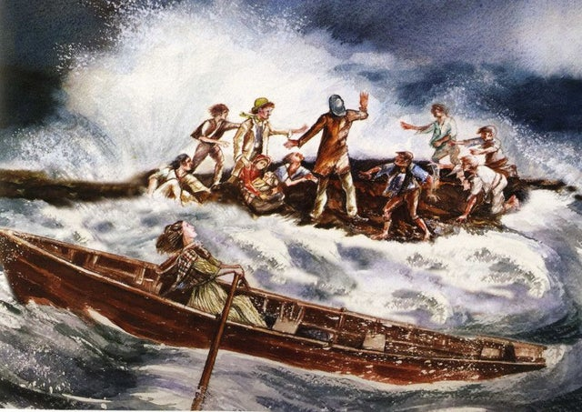
F

Slide 8
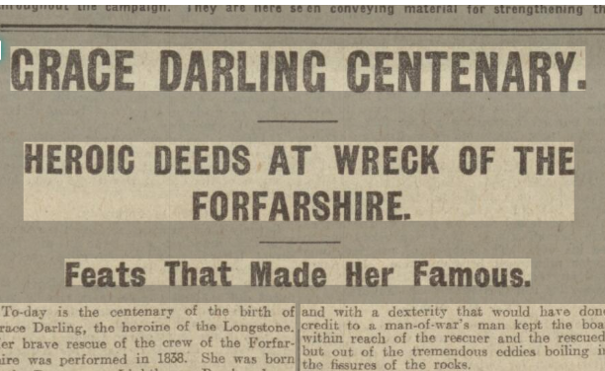
G
Cutting from a newspaper produced in 1915.
Grace Darling was born in 1815

Slide 9
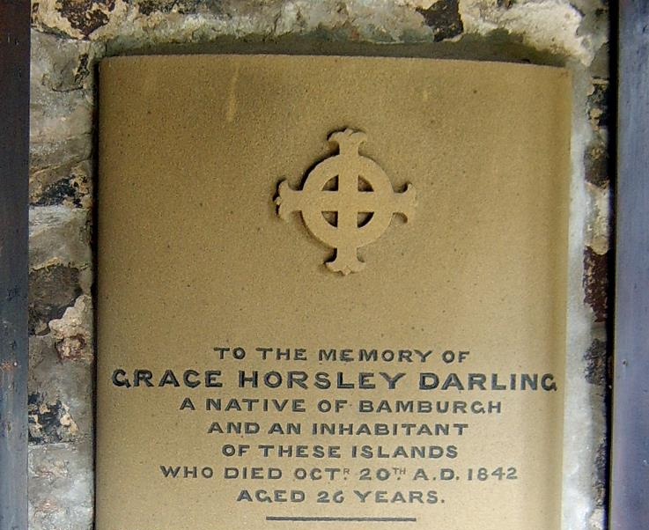
H

Slide 10
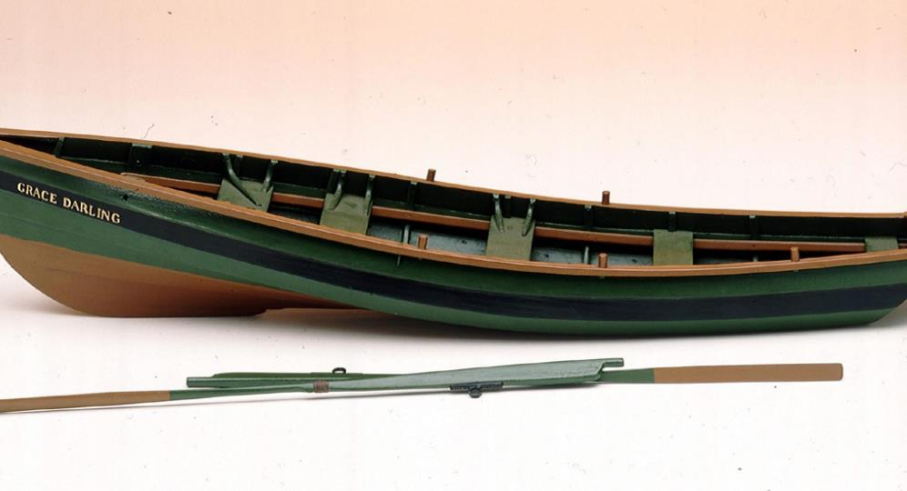
I
https://auth-rmg.axis12.com/sites/default/files/styles/rmg_landscape_medium/public/Grace.jpg?itok=FvaiMtM9

Slide 11
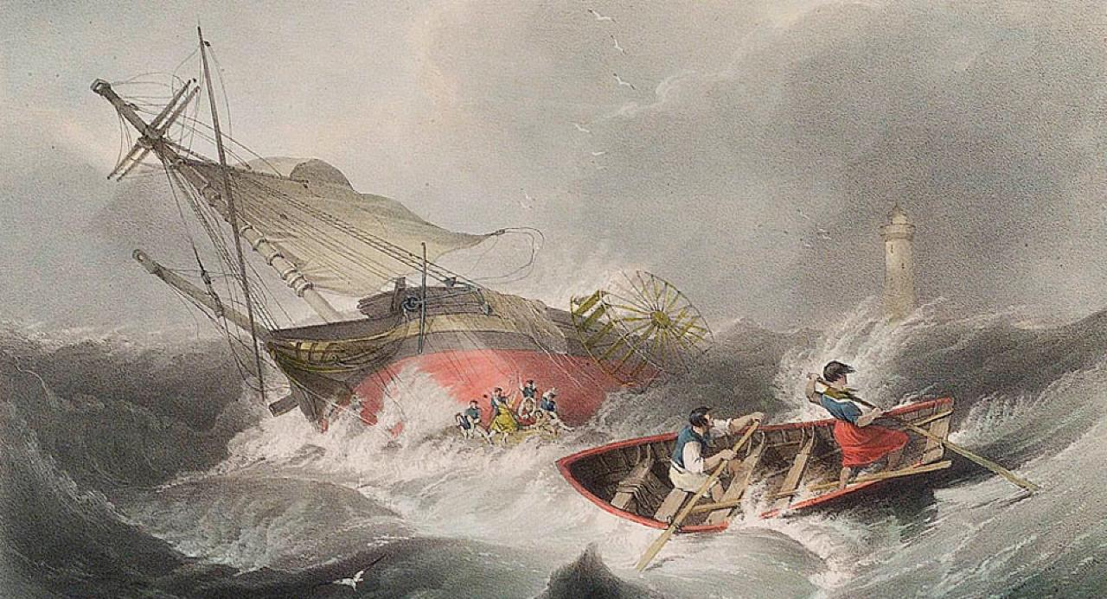
J

Slide 12
Credits
Slide 2 and 3 Wikipedia
Slide 4 RNLI
Slide 5 rmg.uk Royal Military Museum Greenwich
Slide 6 shown on slide
Slide 7 Amazon.com
Slide 8 British newspapers .com
Slide 9 Wikipedia
Slide 10 on slide
Slide 11 rmg.co.uk

