Slide 1


Slide 3
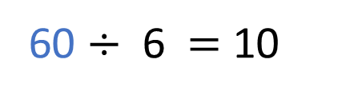
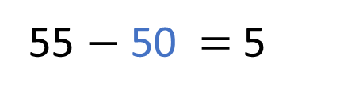
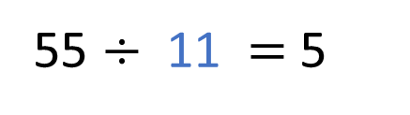

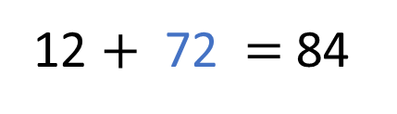
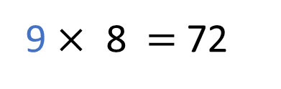
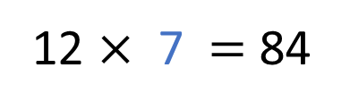
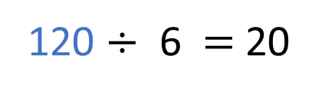
1)
2)
3)
4)
12 $×$ 7 $=$ 84
12 $+$ 72 $=$ 84
55 $÷$ 11 $=$ 5
55 $−$ 50 $=$ 5
60 $÷$ 6 $=$ 10
120 $÷$ 6 $=$ 20
9 $×$ 8 $=$ 72
8 $×$ 9 $=$ 72

Slide 4
1)
2)
3)
4)
12 $×$ 7 $=$ 84
12 $+$ 72 $=$ 84
55 $÷$ 11 $=$ 5
55 $−$ 50 $=$ 5
60 $÷$ 6 $=$ 10
120 $÷$ 6 $=$ 20
9 $×$ 8 $=$ 72
8 $×$ 9 $=$ 72

Slide 6

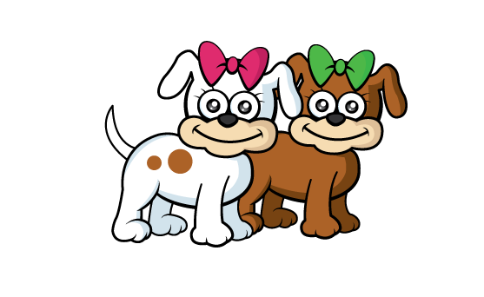

Dora is completing the table.
She’s trying to find a rule to help her find the number of legs 60 dogs would have altogether.
Number of dogs | 1 | 2 | 3 | 4 | 5 | 10 | 60
Number of legs
Can you help her?
Have a think

Slide 7







Dora is completing the table.
She’s trying to find a rule to help her find the number of legs 60 dogs would have altogether.
Number of dogs | 1 | 2 | 3 | 4 | 5 | 10 | 60
Number of legs
$×$4
$×$4
$×$4
$×$4
$×$4
$×$4
$×$4
4
8
12
16
20
24
40
240
Can you help her?

Slide 8
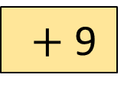

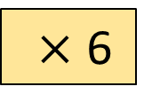
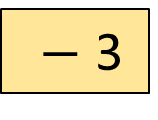
Input
Output
5
$×$ 6
?
30
5 $×$ 6
27
$+$ 9
?
?
$−$ 3
46
Have a think

Slide 9
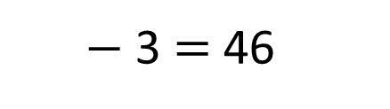
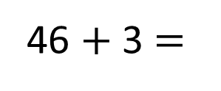
Input
Output
5
$×$ 6
30
27
?
$+$ 9
36
?
49
$−$ 3
46
$−$ 3 $=$ 46
46 $+$ 3 $=$

Slide 10
Have a go at questions
1 - 4 on the worksheet

Slide 11


What do you think the rule might be?
I’m thinking of a rule. Give me a number!
6
5
The answer is 11
Dexter
OK, the answer is 10
Rosie
What! That wasn’t what I was expecting!
I wonder if he’s doubling it. Let’s try another!
Have a think

Slide 12

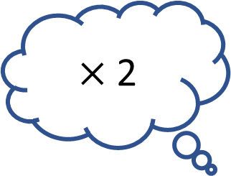




Rosie’s number
(input)
Dexter’s answer (output)
Dexter’s rule
$×$2
?
$+$ 5
5
10
You got it!
$×$2
?
$+$ 5
6
11
$+$ 5
$×$2
?
1
6

Slide 13

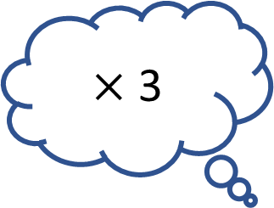



Have a think
Input
Rule
Output
$×$ 3
$+$ 2
?
1
3
$×$ 3
$+$ 2
?
5
15
$×$ 3
?
6
18

Slide 14
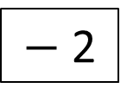
Input
Output
$−$ 2
13
60
75
112
127
What is the input if the output is 32?
Have a think

Slide 15
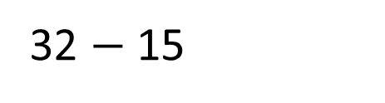
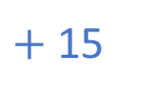

Input
Output
$−$ 2
13
60
$+$ 15
75
112
127
17
$+$ 15
32
What is the input if the output is 32?
32 $−$ 15

Slide 16

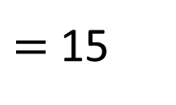
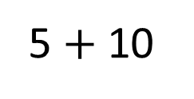
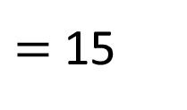
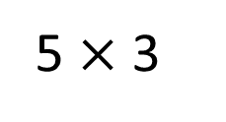
Input
Output
5
15
I think the rule is add 10
5 $+$ 10
$=$ 15
5 $×$ 3
$=$ 15
Have a think

Slide 17
Have a go at the rest of the questions on the worksheet

