Slide 1
Alma
https://www.youtube.com/watch?v=fLDEM_9JNsw

Slide 2
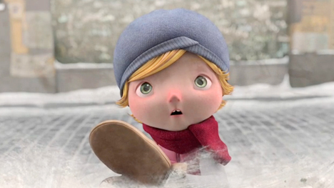
Alma
Why do you think the town is so quiet?
Why does Alma go into the shop?
What do you think will happen when she goes inside? Will something funny happen? Or something frightening? Explain your thoughts.

Slide 3
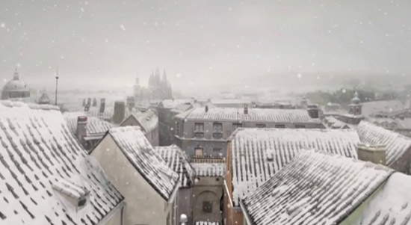
Imagine you are a little boy or girl visiting the village.
Describe the scene, using at least one simile: The town rested like an old woman under a soft white sheet.
Describe how you wander around, using at least one adverb: Joyfully, I slid along the pavement. SHARE!

Slide 4
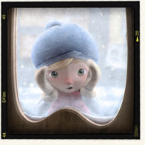
Now you reach the shop. What do you see? How does the doll make you feel? Try varying your sentence starters. Try starting with a preposition ‘At the front of the shop, under the faded sign, stood a china doll, staring out at me.’

Slide 5
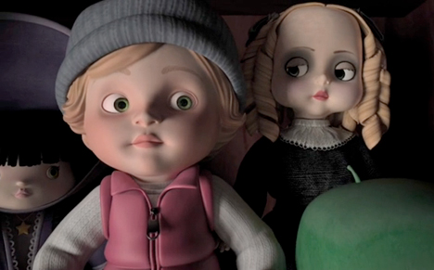
Imagine you are entering the shop. Describe what you see inside. How do you feel about the dolls? What do you do? What happens next?
Did you know that the word Alma in Spanish means ‘soul’?

Slide 6
Plenary
If you could create a sequel to this story, what would you write about?
Write at least three sentences. Think of reasons for the type of conclusion you’d write.
Write your ideas under the heading:
Alma Sequel.

