Slide 1
Alma
LO – To use figurative language to convey mood and atmosphere

Slide 2
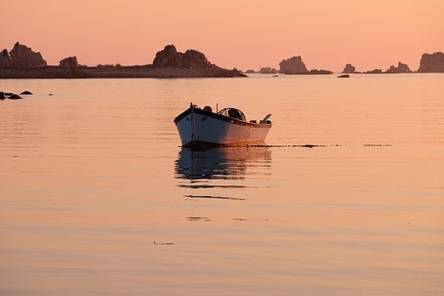
Study the image below, what’s happening? Genre?
Think of an expanded noun phrase for this image.
How does the weather affect your perception of what could be happening?
How does it make you feel?

Slide 3
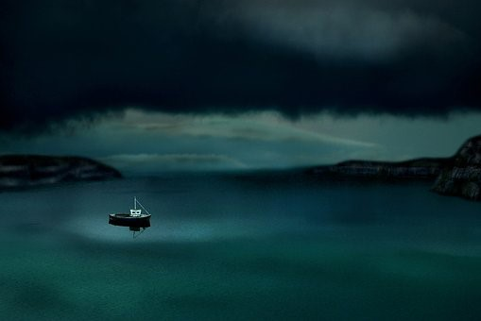
Study the image below, what’s happening? Genre?
Think of an expanded noun phrase for this image.
How does the weather affect your perception of what could be happening?
How does it make you feel?

Slide 4
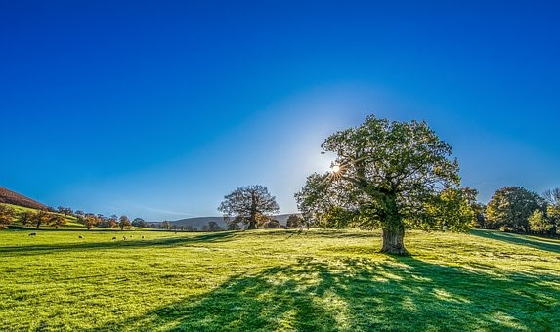
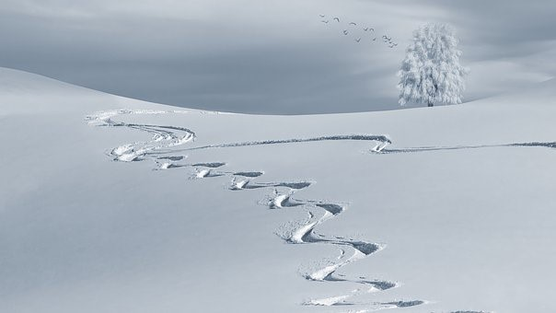
Think of an emotion for each image below and give a reason or opinion why you have chosen it.

Slide 5
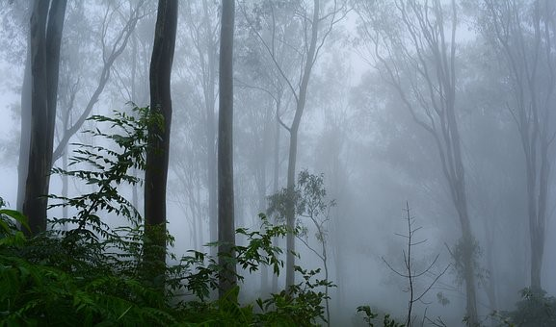
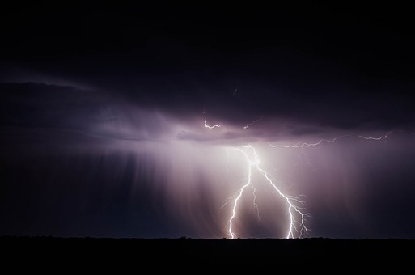

Slide 6
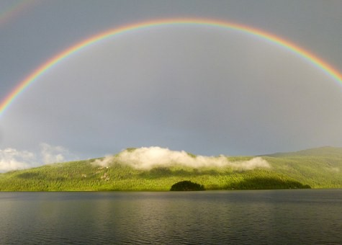
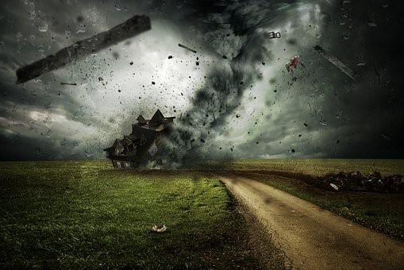

Slide 7
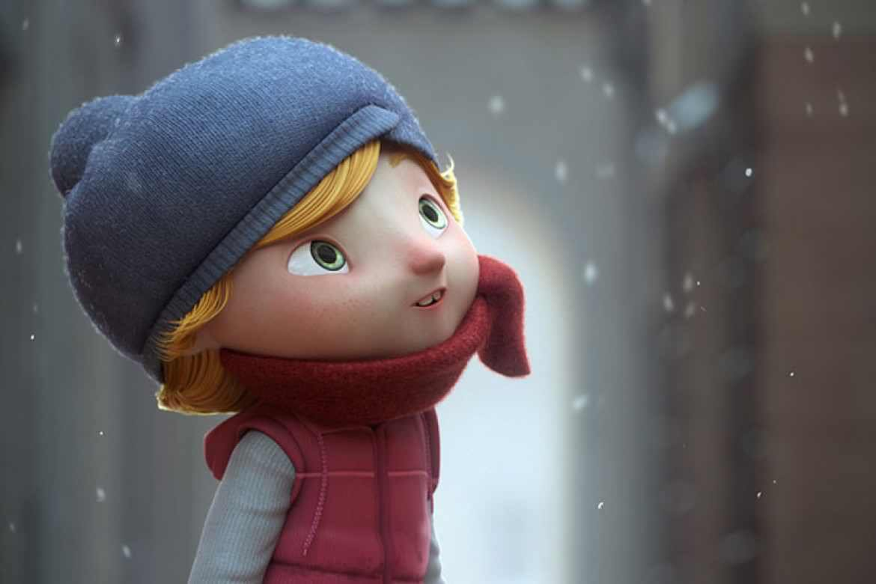
At the beginning of Alma, what’s the weather doing? How is the snow falling? Does this impact mood?
Would the story alter if it was a hot summer’s day? Why/why not?
Think of as many words as you can to describe snow and how it makes you feel. You have one minute.

Slide 8
Vocab Builder
adverbs
What is each word class? Let’s recap…
verbs
adjectives
Fill in the vocab builder, try to add similes to describe the snow around the outside of the circle.
snow
Use the vocab builder to write sentences describing the weather in the clip. To extend, write an answer to this question - how does the weather in Alma reflect what happens in the story? Explain your answer.

Slide 9
