Slide 1
Date: 15.6.21
BIDMAS
Starter
3474 x 9
6321 ÷ 4
7456 - 1200
1236 x 17
4512 x 100

Slide 2
Vocabulary
Brackets
Indices
Division
Multiplication
Addition
Subtraction

Slide 3

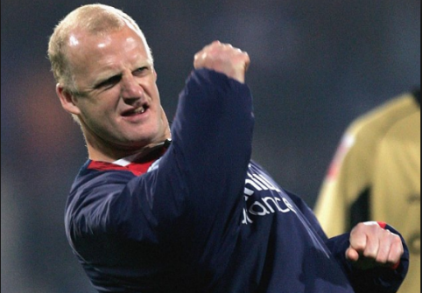


Who do you agree with?
5 + 5 x 5 – 5 ÷ 5 = ?
I’m Alan and the answer is 9.
A
C
Fellas, the answer is 29.
B
D
No chance son, the answer is 0.
Nope! The answer is 49.

Slide 4
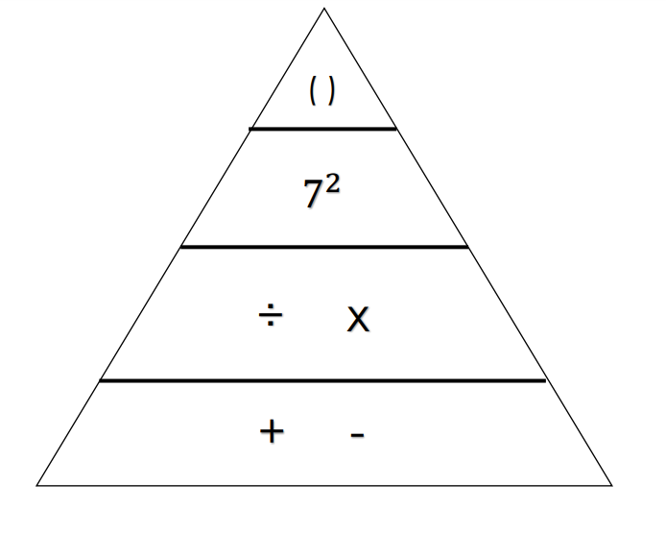
Brackets
Indices
Division
Multiplication
Addition
Subtraction
What does the triangle tell us about the order of operations?

Slide 5

( )
$$7^{2}$$
÷ x
+ -
If we are operating within the same section, then we can just work from left to right.
e.g.
5 + 10 – 7 + 3
5 + 10 = 15 – 7 = 8 + 3 = 11

Slide 6

Brackets
Indices
Division
Multiplication
Addition
Subtraction
( )
$$7^{2}$$
÷ x
+ -
If we are operating within different sections, we work from the higher end downwards.
e.g. 7 + 5 x 5
5 x 5 = 25 + 7 = 32

Slide 7
Practice:
30 – 2 x 6
5 x 6 ÷ 2
5 x 5 – 12 x 2
What mistake might people make on the final question? Why does this matter?
BIDMAS
Use your triangle to support you in the order

Slide 8
Practice 2:
5 + (10 – 3) x 5
16 + (4 + 7) x 3
Why is the placement of brackets important?
BIDMAS
Use your triangle to support you in the order

Slide 9
Practice 3:
33 ÷ (4 + 11)
30 ÷ 3 x 4
How could you make the answer to question 2 become 2.5?
BIDMAS
Use your triangle to support you in the order

Slide 10
Activity

Slide 11
Date
BIDMAS
Starter
4125 x 7
5874 ÷ 8
4215 - 204
5148 x 19
2374 ÷ 15

Slide 12
Vocabulary
Brackets
Indices
Division
Multiplication
Addition
Subtraction

Slide 13
Brackets
Indices
Division
Multiplication
Addition
Subtraction

Slide 14
( )
$$7^{2}$$
÷ x
+ -
If we are operating within the same section, then we can just work from left to right.
e.g.
5 + 10 – 7 + 3
5 + 10 = 15 – 7 = 8 + 3 = 11

Slide 15
Brackets
Indices
Division
Multiplication
Addition
Subtraction
( )
$$7^{2}$$
÷ x
+ -
If we are operating within different sections, we work from the higher end downwards.
e.g. 7 + 5 x 5
5 x 5 = 25 + 7 = 32

Slide 16
Practice:
2 x 3 + 4 - 5
27 ÷ (3 + 6)
10 + 2 x 9
John gets the answer 15 for question 2. Explain his mistake.
BIDMAS
Use your triangle to support you in the order

Slide 17
Practice 2:
12 ÷ 2 + 4 x 3
9 + 8 – 7 + 6
Place brackets in question 2 to create the answer 4
BIDMAS
Use your triangle to support you in the order

Slide 18
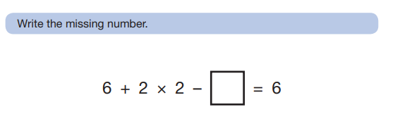
Variation:
Does it make a difference if we change the order of operations? Why/ why not?
BIDMAS
Use your triangle to support you in the order

Slide 19
Activity

