Slide 1

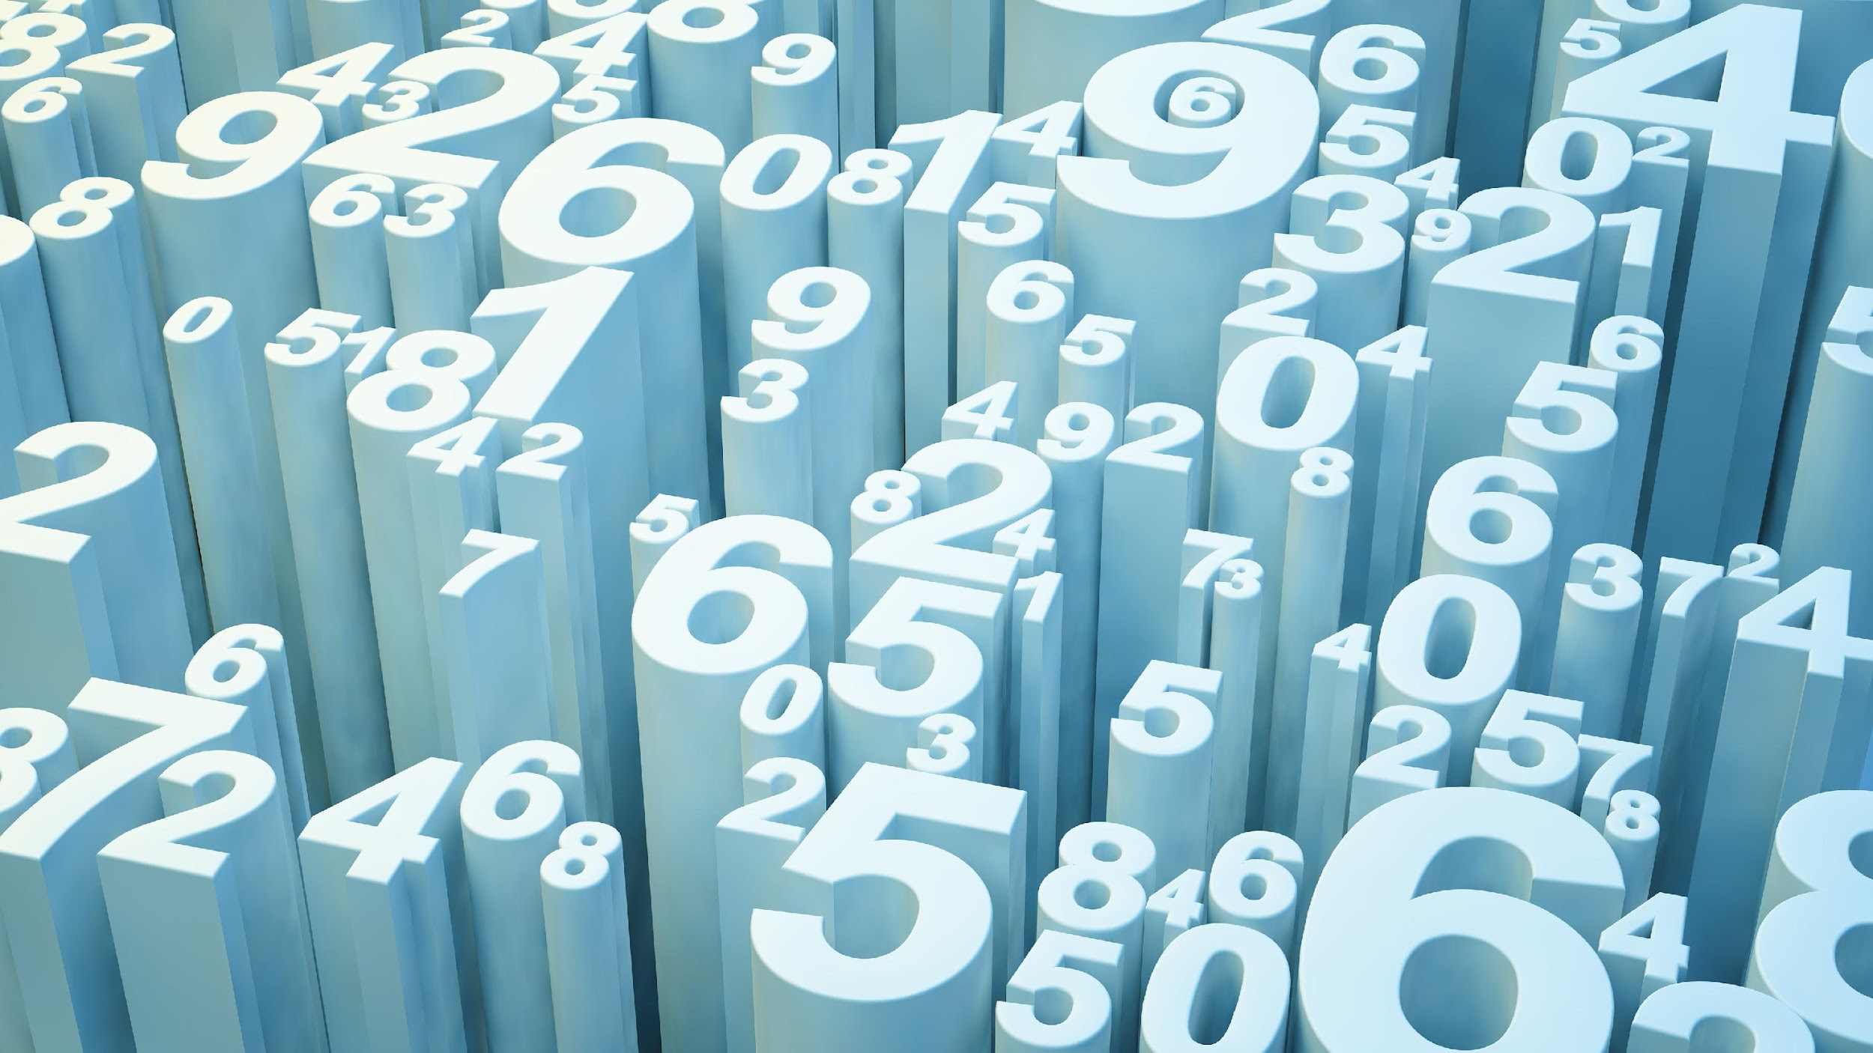
Maths at CTK
Year 3

Slide 2
Aims of the meeting
Share expectations of Maths in year 3
Model examples of how we teach addition and subtraction/ multiplication and division
Share visual representations we use in maths to support learning

Slide 3
Maths at CTK
What do we want from our young mathematicians?
•To enjoy maths
•To demonstrate resilience and keep trying at problem solving
•To speak using mathematical sentences, justify their reasoning and use precise maths vocabulary
•To be factually fluent (+ - x ÷ ) so that they have the facts they need and can concentrate on solving problems or using a procedure
What can parents do?
•Be positive about maths!
•Help children learn their facts- games, songs, TT rockstars,

Slide 4
Year 3 Expectations
The principal focus of mathematics teaching in key stage 1 is to ensure that pupils develop confidence and mental fluency with whole numbers, counting and place value.
Addition and Subtraction NC
Add and subtract numbers mentally, including:
a three-digit number and ones
a three-digit number and tens
a three-digit number and hundreds
add and subtract numbers with up to three digits, using formal written methods of columnar addition and subtraction
estimate the answer to a calculation and use inverse operations to check answers
solve problems, including missing number problems, using number facts, place value, and more complex addition and subtraction.

Slide 5
Year 3 Expectations
The principal focus of mathematics teaching in key stage 1 is to ensure that pupils develop confidence and mental fluency with whole numbers, counting and place value.
Multiplication and Division NC
recall and use multiplication and division facts for the 3, 4 and 8 multiplication tables
write and calculate mathematical statements for multiplication and division using the multiplication tables that they know, including for two-digit numbers times one-digit numbers, using mental and progressing to formal written methods
solve problems, including missing number problems, involving multiplication and division, including positive integer scaling problems and correspondence problems in which n objects are connected to m objects.

Slide 6
Key vocabulary
Place value
- Partition (up to 1,000)
- Hundreds, tens, ones
- Estimate on number lines
Addition and subtraction
- part whole models
- bar models
- Column subtraction/ column addition
- Exchanging
Multiplication and division
-times tables – multiples, repeated addition, doubling and halving
-grouping/ sharing
- product
- Exchanging
- array
Fractions
- Numerators and denominators
- Unit and non-unit fractions

Slide 7
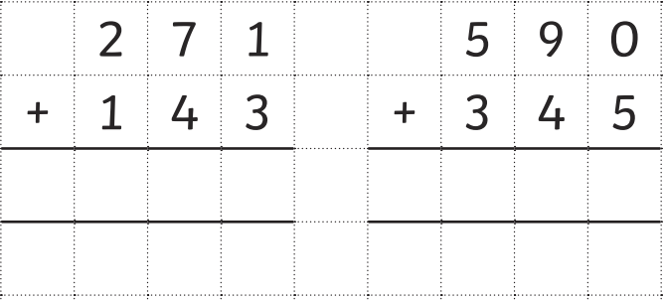
Addition
Here is an example of column addition method:
H
T
O
H
T
O

Slide 8
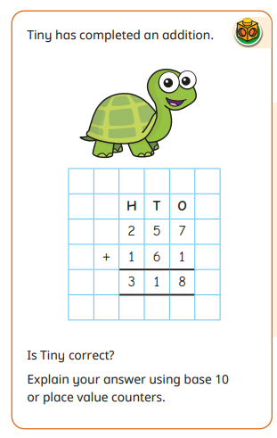
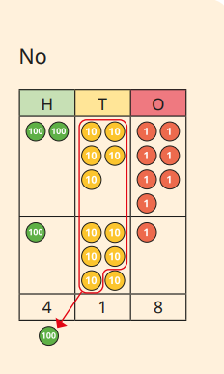
Addition

Slide 9
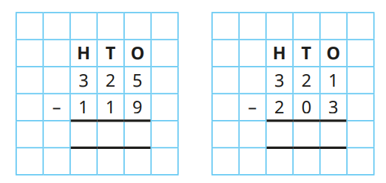
Subtraction

Slide 10
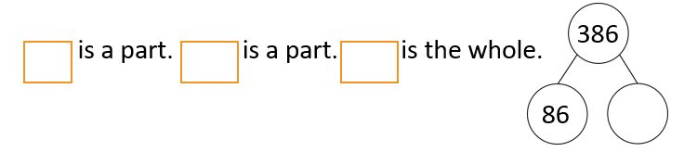
Subtraction
What is the difference between 471 and 219?

Slide 11
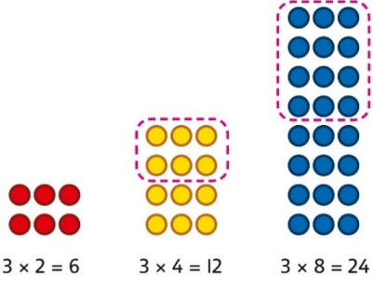
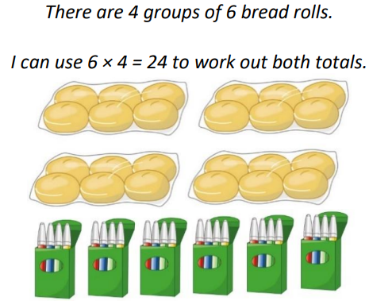
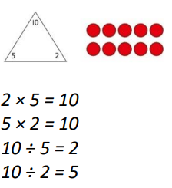
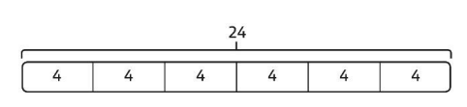
Multiplication

Slide 12
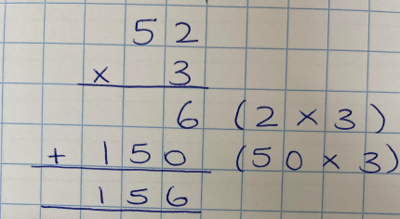
Formal written methods

Slide 13
Area of focus
2, 5 and 10 times tables
3, 4 and 8 times tables

