Slide 1


Maths at CTK
Year 1

Slide 2
Aims of the meeting
Mastery approach at CTK
Share expectations of Maths in year 1 (addition/ subtraction focus)
Share visual representations we use in maths to support learning
Model examples of how we teach addition and subtraction

Slide 3
Maths at CTK
At CTK, our aim is to provide a solid foundation in mathematical understanding, positive habits of mind and a sense of curiosity and enjoyment in the subject and its application.
In line with the expectations of the National Curriculum and a mastery approach, we believe that that the majority of pupils will move through the programmes of study at broadly the same pace. Pupils who grasp concepts rapidly, will be challenged through being presented with a variety of in- depth or novel problems rather than acceleration through new content.
To help pupils develop a thorough understanding of concepts, we aim to use concrete and pictorial representations alongside abstract number sentences and computation methods. Integral to our curriculum is problem solving and reasoning. Emphasis is also placed upon developing students’ mathematical vocabulary and presenting mathematical justification.

Slide 4
What do we want from our young mathematicians?
•To enjoy maths
•To demonstrate resilience and keep trying at problem solving
•To speak using mathematical sentences, justify their reasoning and use precise maths vocabulary
•To be factually fluent (+ - x ÷ ) so that they have the facts they need and can concentrate on solving problems or using a procedure
What can parents do?
•Be positive about maths!
•Help children learn their facts- games, songs

Slide 5
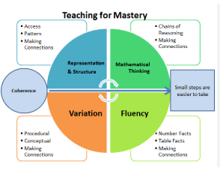

Slide 6
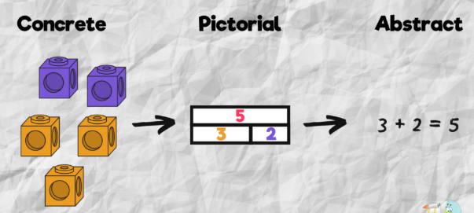

Slide 7
Year 1 Expectations
The principal focus of mathematics teaching in key stage 1 is to ensure that pupils develop confidence and mental fluency with whole numbers, counting and place value.
Addition and Subtraction NC
read, write and interpret mathematical statements involving addition (+), subtraction (–) and equals (=) signs
represent and use number bonds and related subtraction facts within 20
add and subtract one-digit and two-digit numbers to 20, including zero
solve one-step problems that involve addition and subtraction, using concrete objects and pictorial representations, and missing number problems such as 7 = – 9.

Slide 8
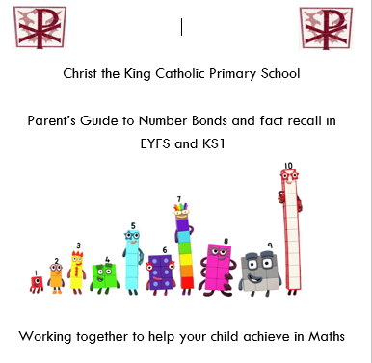
Fluency/ fact recall
Information in Parent’s guide

Slide 9
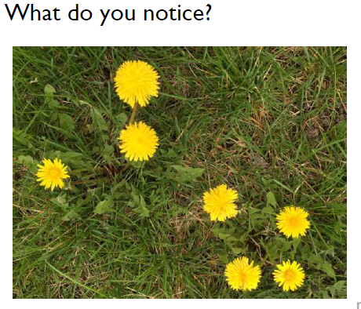
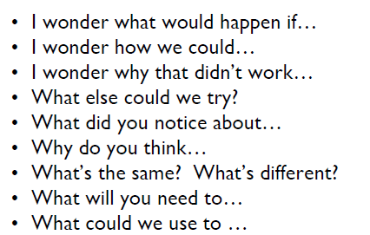
Mathematical talk

Slide 10
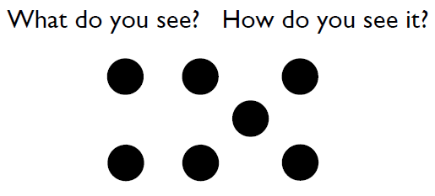
Mathematical talk

Slide 11
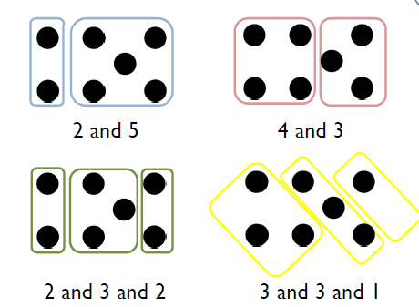

Slide 12
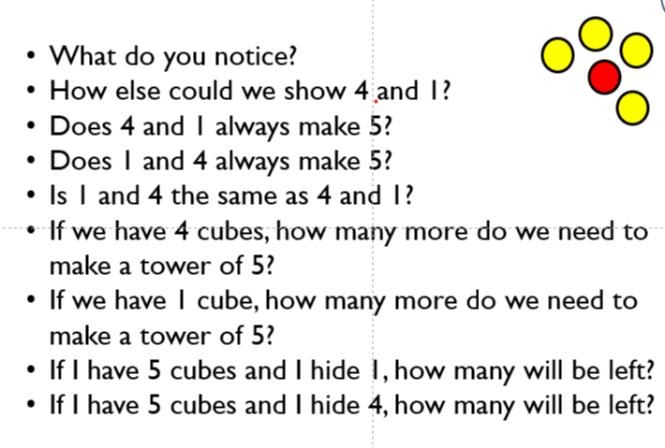
Mathematical talk

Slide 13
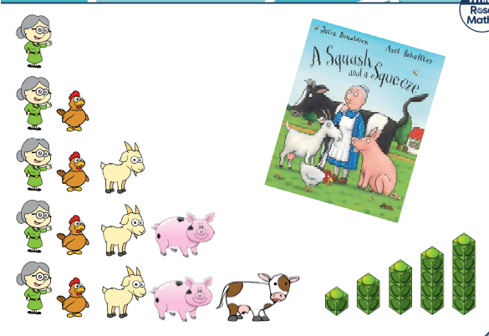
Representing numbers (place value)
Squash and a Squeeze story to show how pictures represent amounts

Slide 14
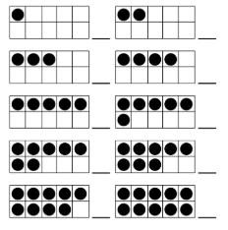
Visual representations used in year 1
Ten Frame – support understanding of the different structures of addition and subtraction
Make 8
Show parts that make 8 using colours on counters
Working systematically

Slide 15
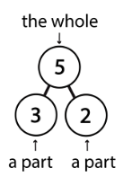
Visual representations used in year 1
Part Whole model – understanding aggregation and partitioning.
When parts are complete and whole is empty, children use aggregation to add parts together to find the total
When the whole is complete and at least one of the parts is empty, children use partitioning (a form of subtracting) to find the missing part

Slide 16

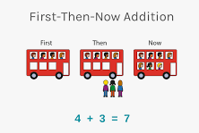
Modelled examples of addition/subtraction
First, then, now stories

Slide 17
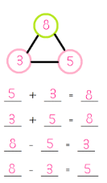
Modelled examples of addition/subtraction
Fact families add part whole

Slide 18
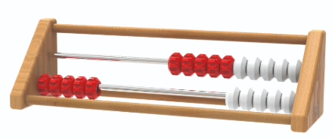
Visual representations used in year 1
Rekenrek – Mastering Number
Subitising using red and white beads
Bench marking to 5 and 10
Composition of numbers 6-9 as ‘5 and a bit’
Push beads all at once rather than one at a time
Teens as ‘ten and some ones’
https://apps.mathlearningcenter.org/number-rack/

Slide 19
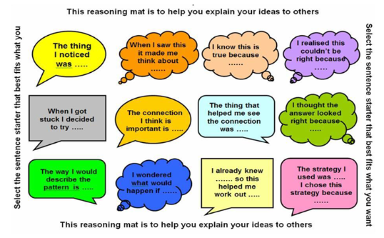
Reasoning
The bridge from fluency – problem solving
True or False
Which one does not belong
If I know…then I know

Slide 20
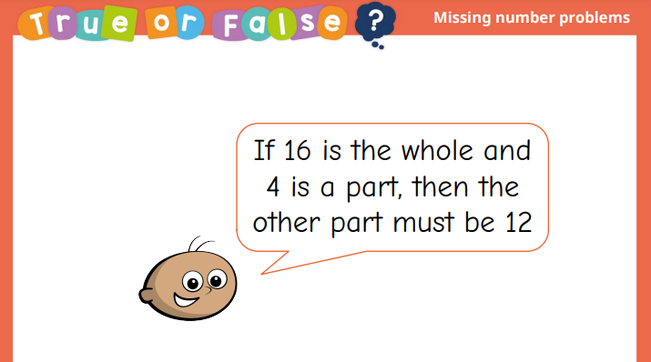
True or False

Slide 21
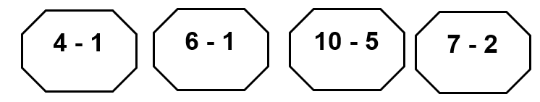
Which one does not belong?

Slide 22
If I know….then I know
If you know….
5 + 3 = 8
What else do you know?

Slide 23
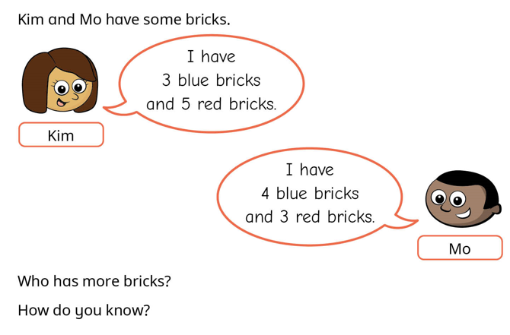
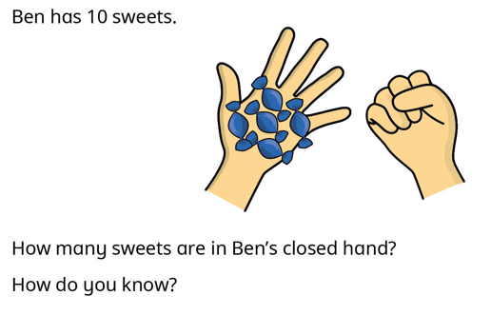
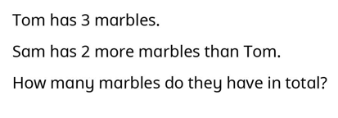
Problem Solving
Notes:
Link Ben problem to missing number equations

