Slide 1


Maths at CTK
Year 2

Slide 2
Aims of the meeting
- Build familiarity with techniques used in class
- Recap on key year 2 mathematical vocabulary

Slide 3
Maths at CTK
At CTK, our aim is to provide a solid foundation in mathematical understanding, positive habits of mind and a sense of curiosity and enjoyment in the subject and its application.
In line with the expectations of the National Curriculum and a mastery approach, we believe that that the majority of pupils will move through the programmes of study at broadly the same pace. Pupils who grasp concepts rapidly, will be challenged through being presented with a variety of in- depth or novel problems rather than acceleration through new content.
To help pupils develop a thorough understanding of concepts, we aim to use concrete and pictorial representations alongside abstract number sentences and computation methods. Integral to our curriculum is problem solving and reasoning. Emphasis is also placed upon developing students’ mathematical vocabulary and presenting mathematical justification.

Slide 4
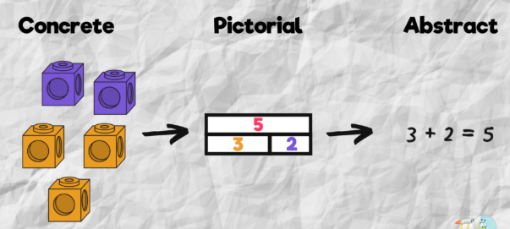

Slide 5
Year 2 Expectations
The principal focus of mathematics teaching in key stage 1 is to ensure that pupils develop confidence and mental fluency with whole numbers, counting and place value.
Addition and Subtraction NC
solve problems with addition and subtraction: using concrete objects and pictorial representations, including those involving numbers, quantities and measures
applying their increasing knowledge of mental and written methods
recall and use addition and subtraction facts to 20 fluently, and derive and use related facts up to 100
add and subtract numbers using concrete objects, pictorial representations, and mentally, including: a two-digit number and ones, a two-digit number and tens, two two-digit numbers, adding three one-digit numbers
show that addition of two numbers can be done in any order (commutative) and subtraction of one number from another cannot
recognise and use the inverse relationship between addition and subtraction and use this to check calculations and solve missing number problems.

Slide 6
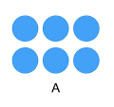


Oracy
A key throughout the school and moving forwards will be on children’s oracy cross circularly.
We will be focusing on the children’s ability to express oneself clearly and communicate effectively through spoken language. This can be supported through the use of key vocabulary and effective questioning.
I can see that you have written 2 lots of 3 are 6. Can you show me how you know/ can you explain how you know?
I know because I know 2 times 2 is 4 and if I am jumping in twos the next one is 6.

Slide 7
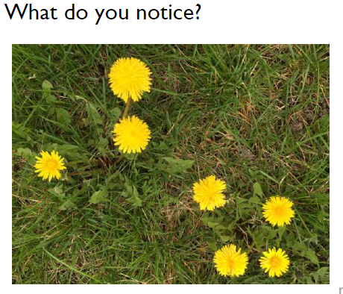
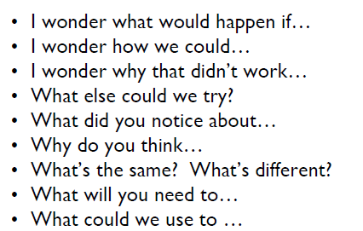
Mathematical talk

Slide 8
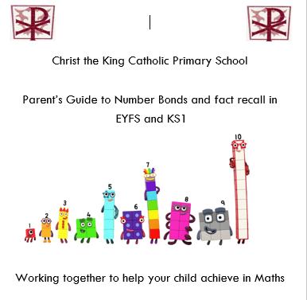
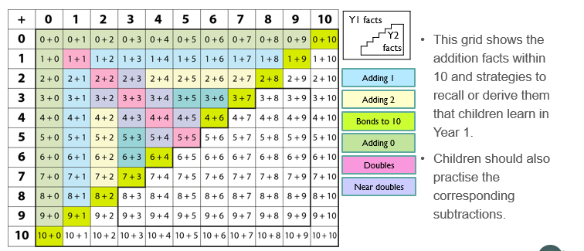
Fluency/ fact recall
Information in Parent’s guide
Secure fluency in addition and subtraction facts within 10 (that have been learned in year 1).
This grid shows number facts children should be secure in recalling from year 1
Those highlighted in the stair formation are the facts children should be developing confidence in during year one

Slide 9
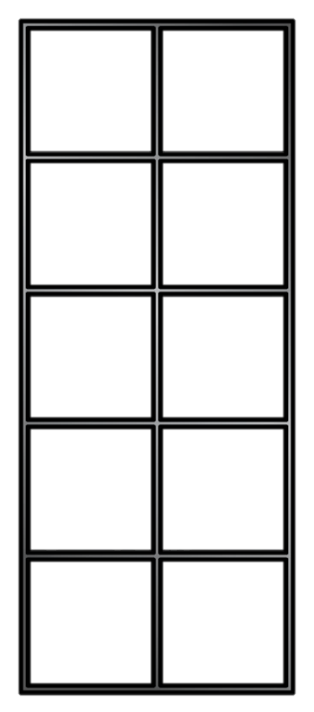
Fluency/ fact recall
Apply number bond knowledge to bridge 10 in two-digit addition and subtraction calculations e.g 15 + 7. If I split the 7 into a 5 and 2, I know 15 + 5 will get me to 20 then I will need 2 more.
Information in Parent’s guide
The final answer is 22.
Ten Frame – supporting understanding of the different structures of addition and subtraction

Slide 10
Fluency/ fact recall
Secure fluency facts within 20, often using knowledge of bonds to 10
Information in Parent’s guide
If I know…6 + 3=
Then I know…
16 + 3 =

Slide 11
Fluency/ fact recall
Recall doubles to 10+10 and near doubles e.g.
If I know…5 + 5=
Then I know…
5 + 6 =
How do you know?

Slide 12
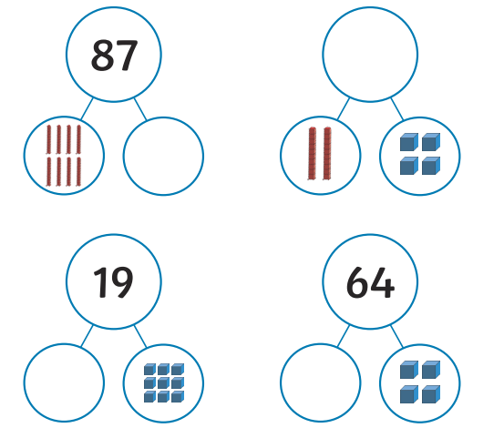
Visual representations used in year 2
Part Whole model – understanding aggregation and partitioning.
When parts are complete and whole is empty, children use aggregation to add parts together to find the total
When the whole is complete and at least one of the parts is empty, children use partitioning (a form of subtracting) to find the missing part

Slide 13


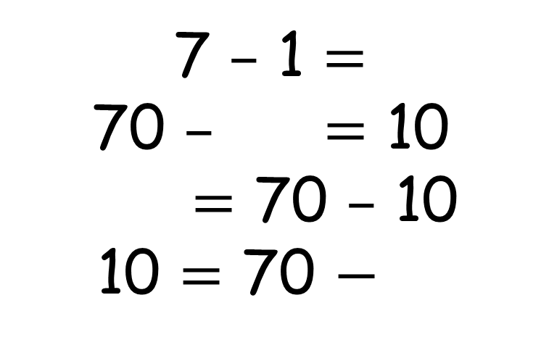
Fact families
What is the same? What is different?
7
7
5
2
1
6
5 $+$ 2 $=$
50 $+$ $=$ 70
$=$ 50 $+$ 20
70 $=$ 20 $+$
6
7
7 $–$ 1 $=$
70 $–$ $=$ 10
$=$ 70 $–$ 10
10 $=$ 70 $−$
20
60
70
60
50
60

Slide 14

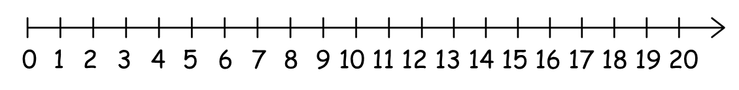



Visual representations used in year 2
Labelled Number line – support understanding of addition as augmentation and subtraction as reduction.
Partition the smaller number into 2 separate jumps to make 10
14 $–$ 6 $=$ 8
14 $–$ 4 $=$ 10
10 $–$ 2 $=$ 8
4
2
2
4
1
5
0
I can partition 6 into ___ and ___
6
Add/ Subtract numbers by jumping to the nearest 10, then jumping the rest

Slide 15
Visual representations used in year 2
10
Bar Model –
Compare quantities
Finding the difference
Similar to part whole model, sections represent parts and whole of a number
Useful for problem solving in older year groups
4
6
100
40
?

Slide 16
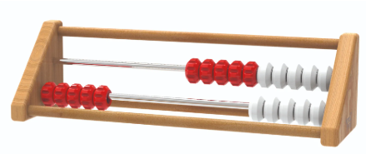
Visual representations used in year 2
Rekenrek – Mastering Number
Subitising using red and white beads
Bench marking to 5 and 10
Composition of numbers 6-9 as ‘5 and a bit’
Push beads all at once rather than one at a time
Teens as ‘ten and some ones’
https://apps.mathlearningcenter.org/number-rack/

Slide 17
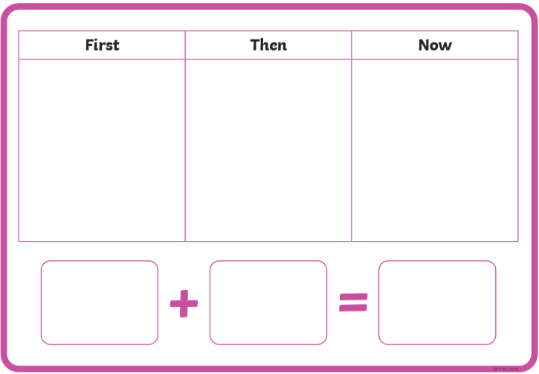

Modelled examples of addition/subtraction
First, then, now stories

Slide 18
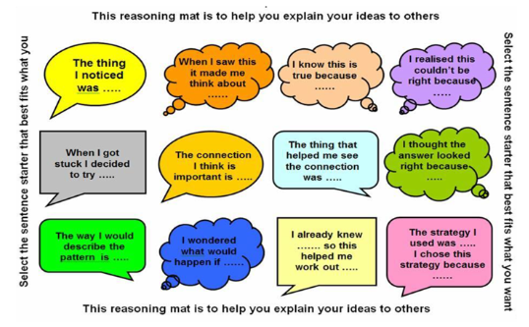
Reasoning
The bridge from fluency – problem solving
True or False
Which one does not belong
If I know…then I know

Slide 19



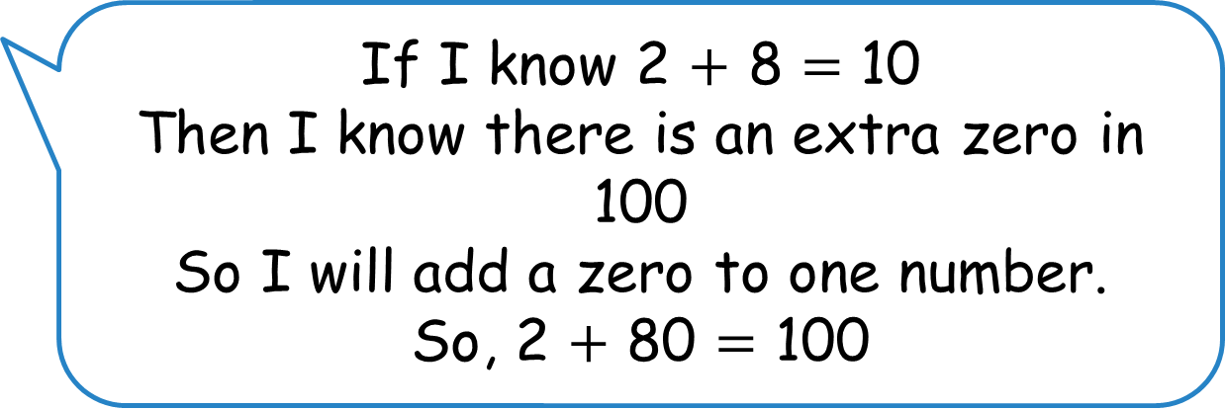


Tiny is finding bonds to 100
___ $+$ 8 $=$ 10
___ $+$ 80 $=$100
If I know 2 $+$ 8 $=$ 10
Then I know there is an extra zero in 100
So I will add a zero to one number.
So, 2 $+$ 80 $=$ 100
Do you agree with Tiny?
Tiny is incorrect. 20 $+$ 80 $=$ 100
Have a think

Slide 20
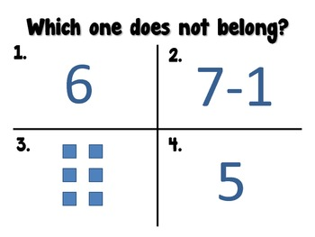
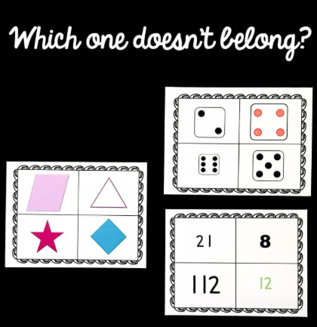

Slide 21

Any questions?

Slide 22

.

