Slide 1


Christ the King Catholic Primary School

Slide 2
Welcome to Year 3
The staff working in our year group this year are:
Class Teachers - Mrs Williams and Miss Hassan
Teaching Assistants - Mrs Lockhart, Mrs Martin and Mrs Hancock.
Mrs Stevenson will take 3KH on a Friday afternoon.
Mrs Martin will take 3AY on a Friday afternoon.

Slide 3

Purpose of this meeting
To help you have an insight into your child’s school day
To become aware of the routines and expectations of this year

Slide 4



Our School Rules

Slide 5
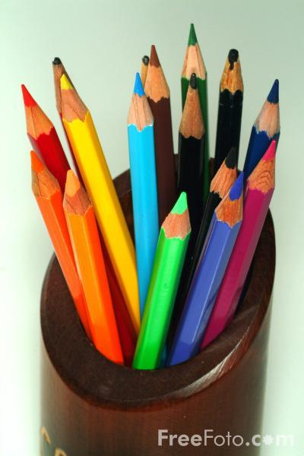
New Year, New Expectations
We are focusing on having high expectations of all the children at CTK.
Uniform
P.E Kit
Presentation of Work
Punctuality
Homework

Slide 6

Uniform
All children are expected to wear CTK uniform on non PE days.
On PE days they may come to school in the school PE kit. School cardigan/jumper or hoodie can be worn and black leggings or jogging pants in cooler weather.
Earrings are not permitted for safety reasons. Please use plastic spacers.
School shoes should be worn at all times (except on PE days).

Slide 7
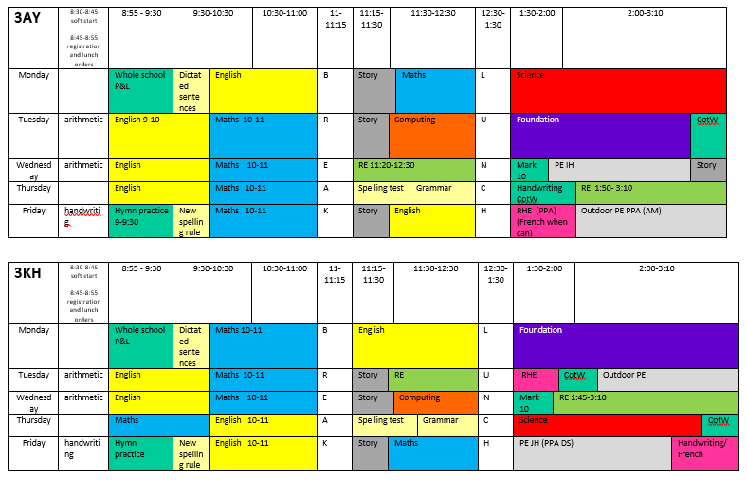
Class Timetable

Slide 8
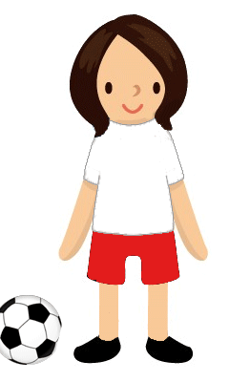
P.E days
P.E kits need to be worn to school on:
3KH - Tuesday and Friday
3AW - Wednesday and Friday
Trainers can only be worn on these days. (Children will be going out to play and wearing these all day so please do not send them in pumps.)

Slide 9

Punctuality
Children should be in school by 8:45am when the gates close.
This allows time for children to settle, sort reading books and place their dinner order.

Slide 10

Catholic Life
As a Catholic School, celebrating and living out our faith is central to everything we do here at CTK.
During the year, children will have the opportunity to bring home travelling rosary beads and advent bags to share their prayers with you.
We value your support throughout the year in our fundraising efforts which enables the children to realise that not everyone is as fortunate as they are.

Slide 11
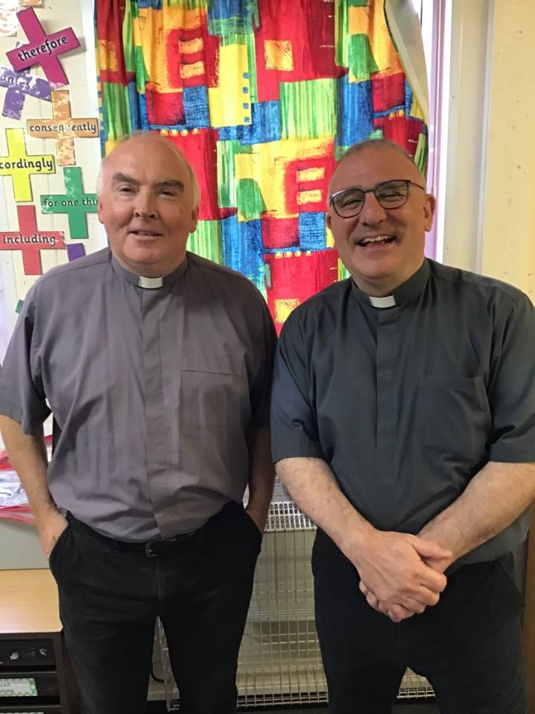
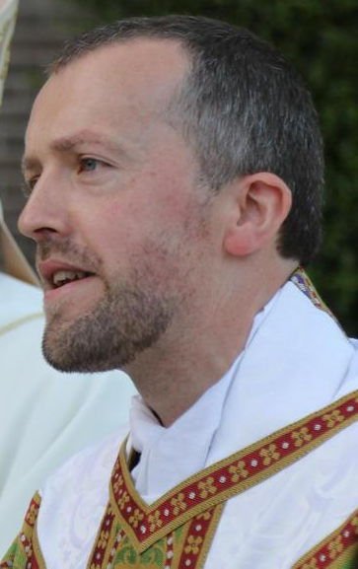
Father Louis, Fr Humphrey and Deacon Tony
Notes:
NOTE: To change images on this slide, select a picture and delete it. Then click the Insert Picture icon
in the placeholder to insert your own image.
‹#›

Slide 12

Preparation for Sacraments
This is an important year for your children as they will be continuing on their Sacramental Journey in Year 3.
Please try and attend Mass as regularly as you can.
First Reconciliation will take place in spring term (possibly Thursday March 12th) and First Holy Communion will potentially be on the first Sunday in June - waiting for confirmation.
Notes:
Liz
‹#›

Slide 13
Preparation for Sacraments
The preparation and the way it is organised has changed from previous years but we will be holding a meeting for parents and give you all the information in plenty of time.
There will be an expectation that the children attend all the sessions that are held out of school hours – we have listened to feedback and have tried to plan them for different nights.
Only those who have been baptised in the Catholic church will be able to make their first Sacraments – speak to Fr Louis if you have any issues.
Notes:
Liz
‹#›

Slide 14
Topic Homework
Homework will be set on Friday and is to be completed by the following Wednesday.
Homework will either be completed and returned or uploaded to Seesaw via a task.
Children will get a list of spellings to learn and either a piece of maths or a piece of English homework each week.
Sometimes they may be given a small project or some research to do;
Practising of multiplication facts (times tables) is also important.
Your child should have login details for Mathletics / Spelling Shed / TT Rockstars – which can be accessed frequently for practice.

Slide 15

Reading
Please ensure that your child has a bag and their book in school EVERY DAY, even if they haven’t finished it.
Children may borrow books from the library to read for pleasure. Please ensure all books are returned.
3 times per week, recorded on Seesaw/blue book.
Children will continue the school reading scheme and will move onto the Accelerated Reading programme throughout Y3.
Children are asked to read 3 times each week and must hand their book in (3KH) or upload their entry onto Seesaw (3AW) each time they have read.

Slide 16
Seesaw
Let’s have a look…

Slide 17
Presentation of Work
We will be encouraging all children to take great pride in their work.
Homework should be presented as though it is a piece of class work.
Again this year we will have curriculum afternoons when parents/carers can come into the classroom and sit with your child to look at books.

Slide 18

Communication
Please read the school newsletter that is emailed every Friday to find out about school events, clubs and news.
Seesaw can be used to communicate with class teachers but please allow for response time.
Instagram is now used to communicate events during the week - @ctkprimarywirral

Slide 19
Reminders
Children should have a water bottle (with their name on it) in school every day – please do not put these in book bags as they leak on reading books.
Please put names on uniform – especially jumpers and cardigans.
Send a healthy snack in daily for break time as fruit is not provided in KS2.

Slide 20

Any Questions?

Slide 21

Thank You for Coming
We really appreciate you giving up your time to find out more about what we do at CTK.

