Slide 1

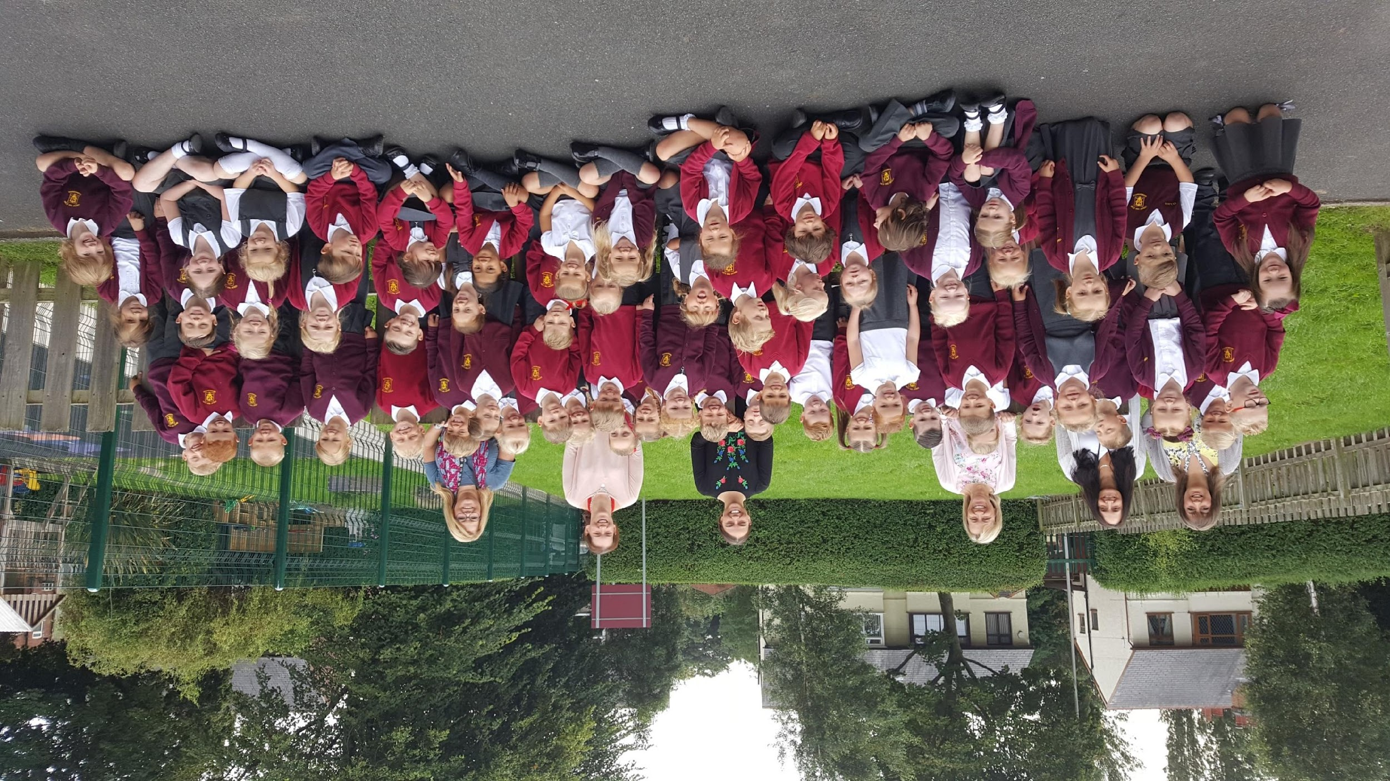
Christ the King Catholic Primary School

Slide 2
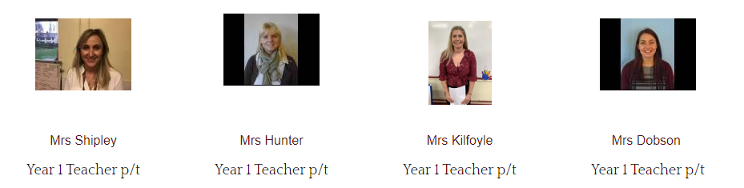

Welcome to Year 1
The staff working in our year group this year are:
1AD
Mrs A Dobson
1SS
Mrs S Shipley

Slide 3
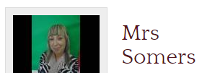
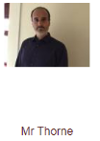
Welcome to Year 1
1AD
1SS

Slide 4

Purpose of this meeting
To help you have an insight into your child’s school day
To become aware of the routines and expectations of this year

Slide 5



Our School Rules

Slide 6

Uniform
All children are expected to wear CTK uniform on non PE days.
On PE days they may come to school in the school PE kit. School cardigan/jumper or hoody can be worn and black leggings or jogging pants in cooler weather.
Earrings are not permitted for safety reasons. Please use plastic spacers.
School shoes should be worn at all times (except on PE days).

Slide 7
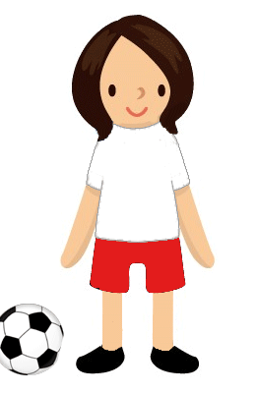
P.E days
1SS - Tuesdays and Wednesdays.
1DH - Mondays and Fridays (with the exception of next week when it will be on Tuesday and Friday)

Slide 8

Punctuality and attendance
Gates open at 8:30am and close at 8:45am
This allows time for children to settle, sort reading books and place their dinner order.
School day ends at 3.15.
We have high expectations for attendance as every day absent is a day lost learning.

Slide 9
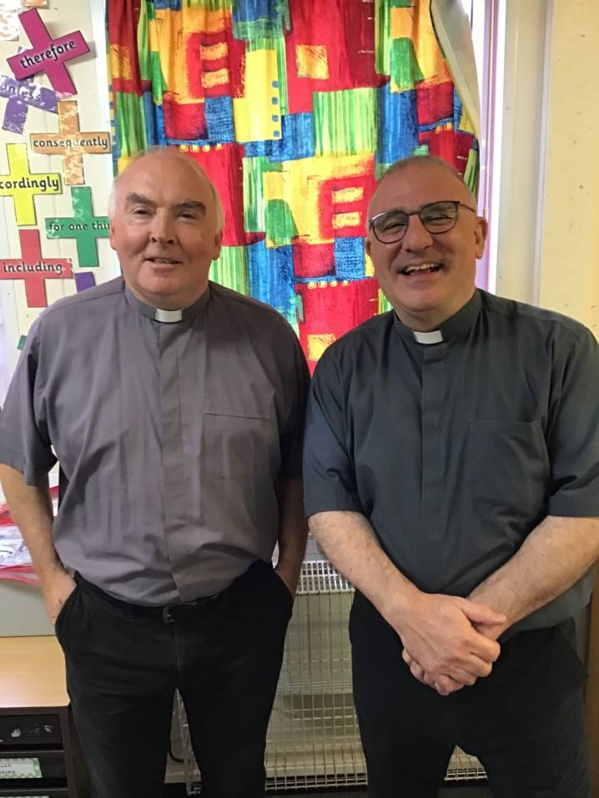
Father Louis and Deacon Tony
Notes:
NOTE: To change images on this slide, select a picture and delete it. Then click the Insert Picture icon
in the placeholder to insert your own image.
9

Slide 10

Catholic Life
As a Catholic School, celebrating and living out our faith is central to everything we do here at CTK.
During the year, children will have the opportunity to bring home travelling rosary beads and advent bags to share their prayers with you.
We value your support throughout the year in our fundraising efforts which enables the children to realise that not everyone is as fortunate as they are.

Slide 11
Homework
Homework will be set on Fridays on Seesaw.
Seesaw log ins are in blue reading record books.
Children will get either a piece of maths or English/phonics each week.
Please complete and upload homework by the following Thursday. Add a response to the homework.
Mathletics will be set every few weeks in accordance with the unit that has been taught
Your child should have login details for Oxford Owl and Mathletics – which can be accessed frequently for practice.

Slide 12
Homework
How to access Seesaw

Slide 13

Phonics and reading
Your child is expected to read a minimum of two reading books at home each week. One will be sent home on FRIDAY and another should be read from Oxford Owl (eBook).
These decodable reading books are matched to your child’s phonic ability.
Children should read each of these books twice at home, this is to help develop fluency.
Use the sound mat to review sounds already taught.
We will communicate any new sounds taught through Seesaw.
Please return all books by THURSDAY

Slide 14
How to access Oxford Owl

Slide 15
Reading for pleasure
Research has shown that children who read for pleasure become efficient and confident readers.
Children will choose a reading book from the class library every Friday to enjoy at home with an adult.
Recommended reader bags, mystery readers, reading café, reading newsletter, school library, book swaps
Notes:
15

Slide 16
Presentation of Work
We will be encouraging all children to take great pride in their work.
Homework should be presented as though it is a piece of class work.
It will be marked by teachers on Seesaw
This year we will have curriculum afternoons when parents/carers can come into the classroom and sit with their child to look at books.

Slide 17

Communication
Please read the school newsletter that is emailed every Friday to find out about school events, clubs and news.
Please check Seesaw regularly, class teachers will post messages and updates on here.
Seesaw can be used to communicate with class teachers but please allow for response time. Anything urgent should be communicated via the office
Instagram is also used to celebrate school events - details have been sent via Seesaw.
Blue book for recording reading.

Slide 18
Reminders
Children should have a named water bottle in school every day – please do not put these in book bags as they leak on reading books.
Please put names in uniform – especially jumpers and cardigans.
Please provide spare pants and socks, if needed.

Slide 19

Any Questions?

Slide 20

Thank You for Coming
We really appreciate you giving up your time to find out more about what we do at CTK.

