Slide 1
Christ the King Catholic Primary School
Welcome Back!

Slide 2
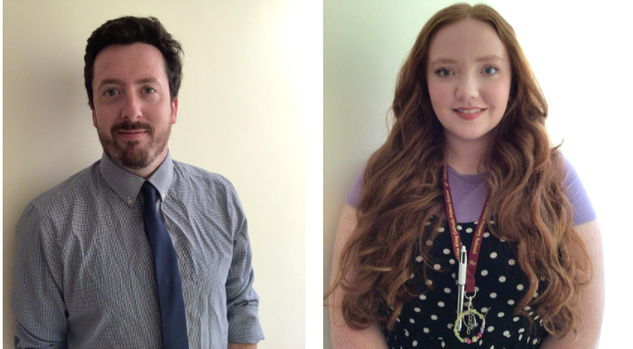
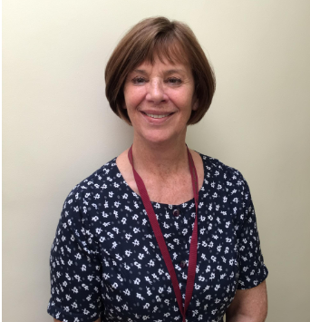
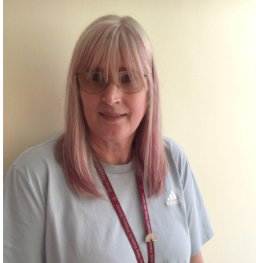
Welcome to Year 5
The staff working in our year group this year are:
Miss Roberts
Mr James
Mrs Ravenscroft
Mrs McCann
PPA cover will take place on a Thursday afternoon

Slide 3

Purpose of this meeting
To meet the staff working with your child;
To become aware of the routines and expectations of this year.

Slide 4



Our School Rules

Slide 5
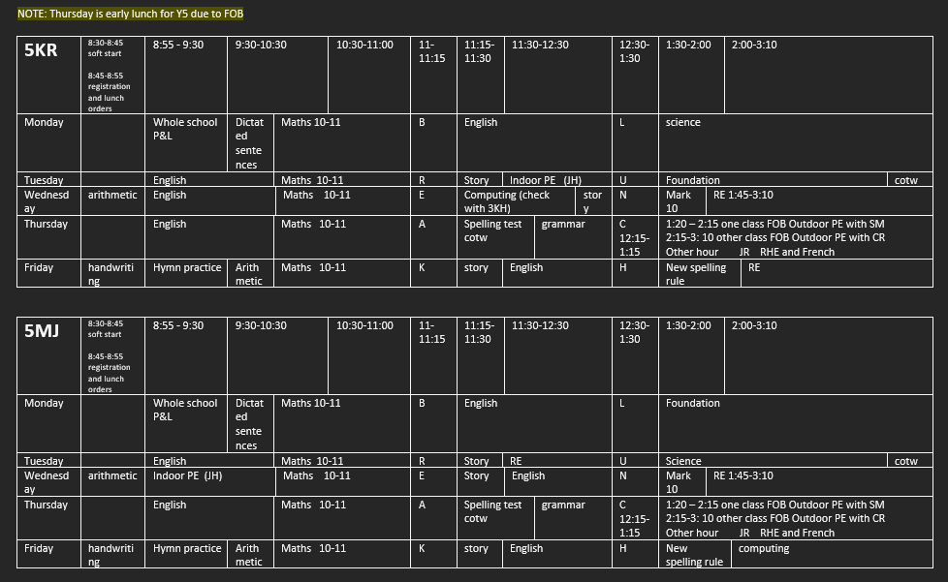
Time Table

Slide 6
Presentation of Work
We will be encouraging all children to take great pride in their work.
Homework should be presented as though it is a piece of class work.
This year we will have curriculum afternoons when parents/carers can come into the classroom and sit with their child to look at books.

Slide 7
New Year - Expectations
This year, we are continuing to focusing on having high expectations of all the children at CtK.
Uniform: no jewellery (spacers allowed), black school shoes please, labelled coats/jumpers
P.E Kit: correct PE shorts (not cycling shorts), black joggers or leggings for winter
Presentation of Work: including work submitted for homework and online (encourage correct punctuation and spelling)
Punctuality and attendance: gates close at 8:45. Holidays during term time are not permitted as this can mean your child misses a great deal of work and will then have to work hard to catch up.

Slide 8

The importance of reading
4 times per week, recorded on Seesaw
Children may borrow
books from the library
to read for please. Please
ensure all books are
returned.

Slide 9
Homework
Homework will be set on Friday
Spellings will be set every week ready to be tested on Thursday. We will then alternate between maths and English. It needs to be returned/uploaded no later than Thursday.
We encourage you to support your child in completing their homework but please make sure that you don’t do it for them.
If your child finds something difficult, please make sure you let their teacher know.

Slide 10
Curriculum
Autumn | Spring | Summer
Victorians (Victorian day in school - date tbc Trip – Port sunlight | Africa Fairtrade | Ancient Greeks Greek day in school Mountains
English text – Street Child Macbeth A Christmas Carol | English text – Journey to Jo’burg Nelson Mandela’s Long Walk to Freedom | English text – Shackleton Kensuke’s Kingdom Myths
Science – Space and Forces | Science – Animals including Humans Living Things and their Habitats | Science – Materials

Slide 11
Educational Visits
Visits really enhance your child’s understanding of the topic and are an opportunity to learn outside the classroom.
Visit to Port Sunlight
Liverpool World Museum
Swimming
Bike Ability

Slide 12
Other things to think about…
Walking Home – Y5/6 Children must bring in written permission from parent/carer to walk home.
Mobile phones- in Y5/6, children can bring in mobiles if it is seen as necessary (usually if they are walking home alone). These will be taken off them during school hours and kept locked away to be returned at the end of the day.

Slide 13
Communication
School newsletter emailed weekly with important dates and news
Seesaw – curriculum pictures, homework, messaging
X – pictures/updates for class and whole school (especially if on residential)
School spider app – notifications are sent through this

Slide 14
Reminders
Children should have a water bottle in school every day – please do not put these in book bags as they leak on reading books.
Please write/label names in uniform – especially jumpers and cardigans.
Please encourage children to return reading books, so that we can arrange a new book to be taken home. Children may also borrow books from the school library to read for pleasure. These should also be returned.
Walking home signed note, email or Seesaw message.

Slide 15
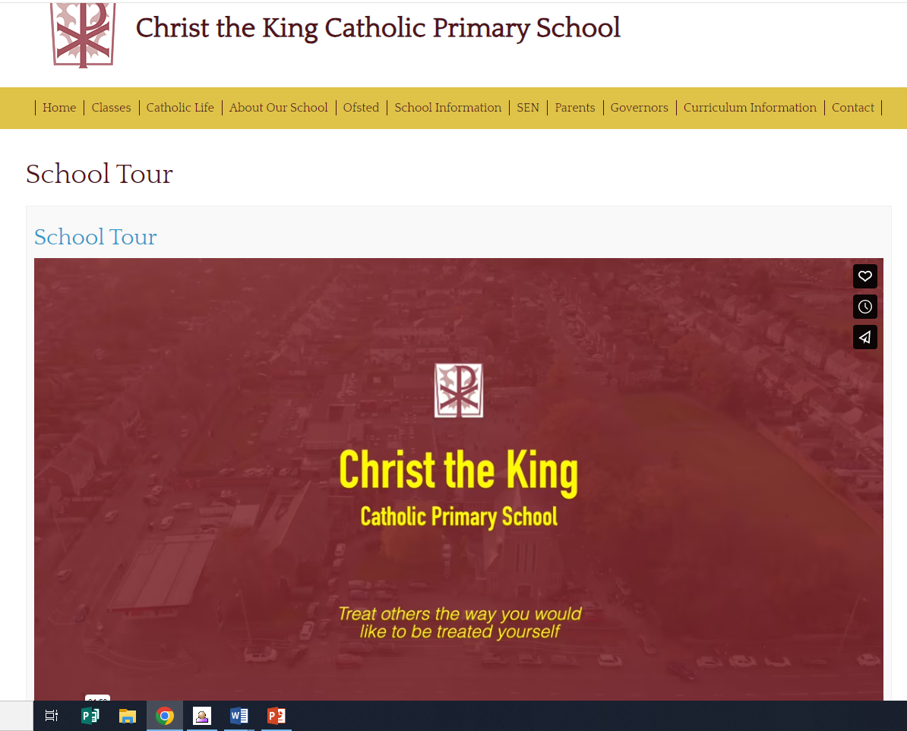
School website
https://www.christtheking.wirral.sch.uk/

Slide 16

Thank You for Coming
We really appreciate you giving up your time and we look forward to working with you this year.

