Slide 1
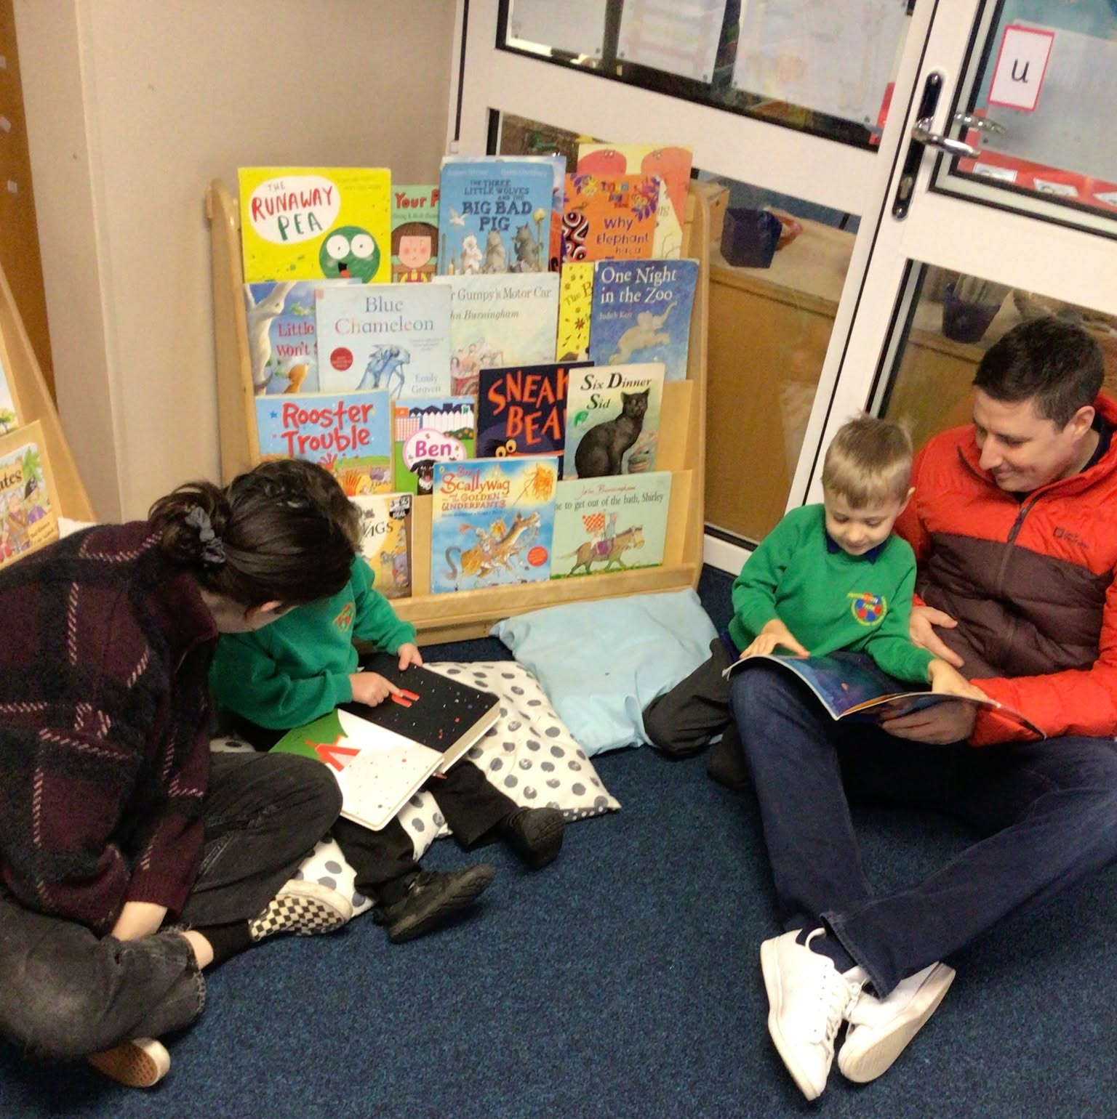
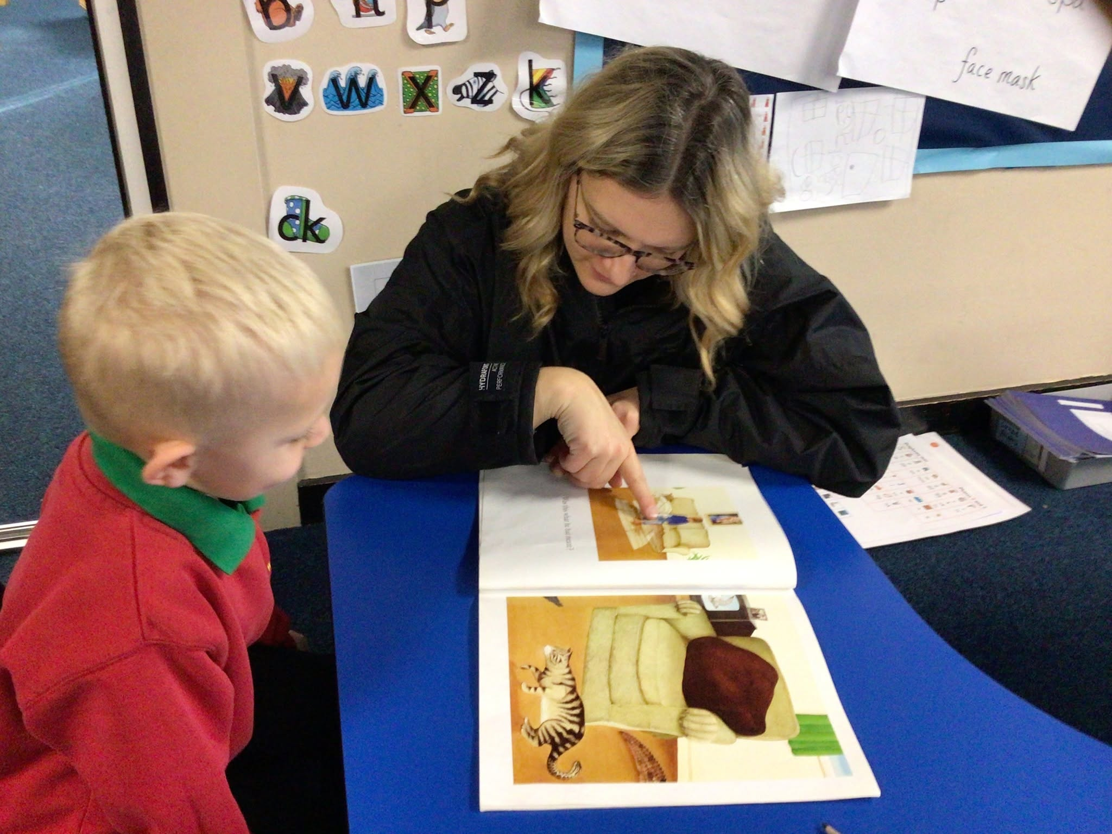
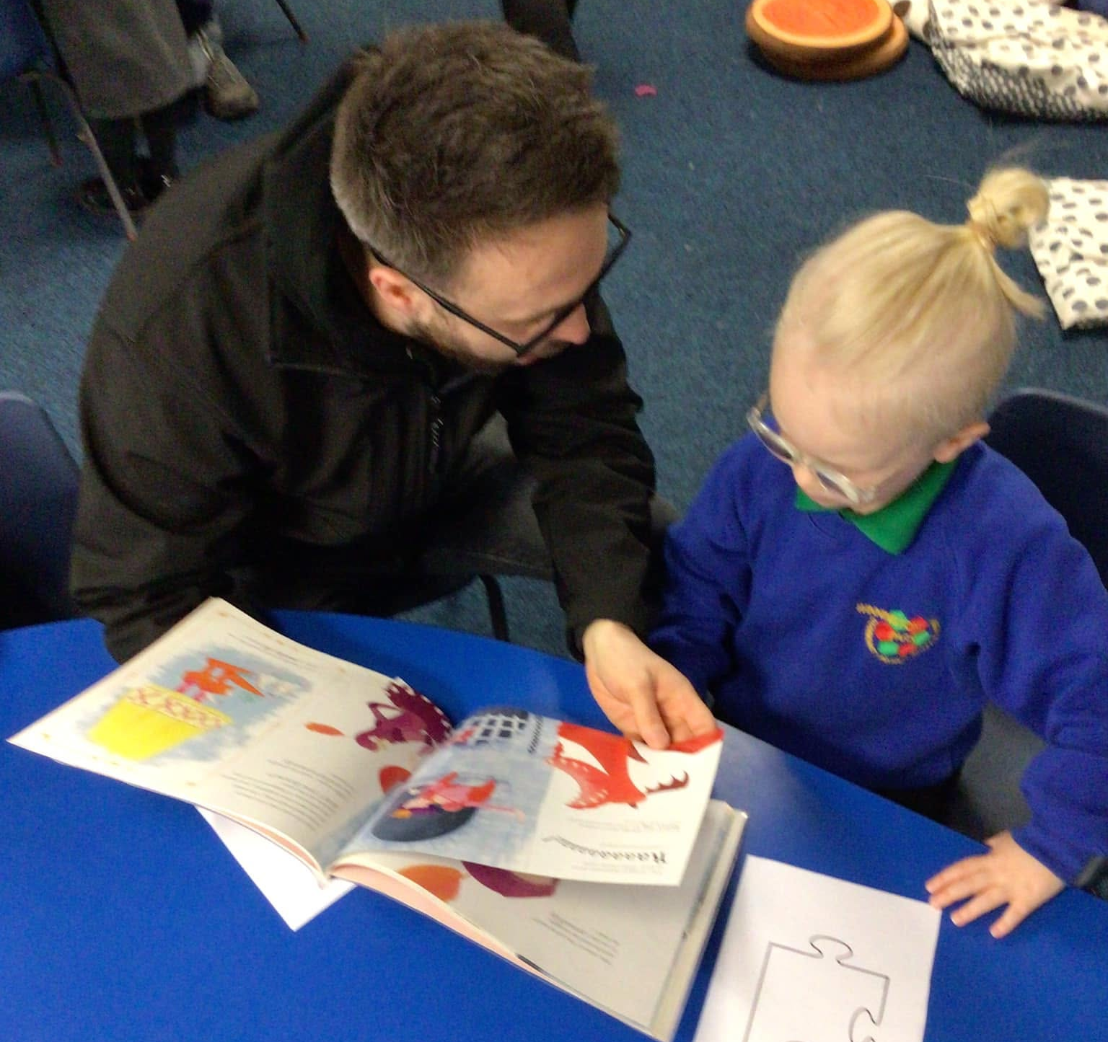

Reading and Phonics in Reception

Slide 2
To provide you with a greater insight into what Phonics is and how we teach Phonics.
To provide you with a deeper understanding of what reading is and how we teach reading.
To provide you with some information on how to help at home.

Slide 3
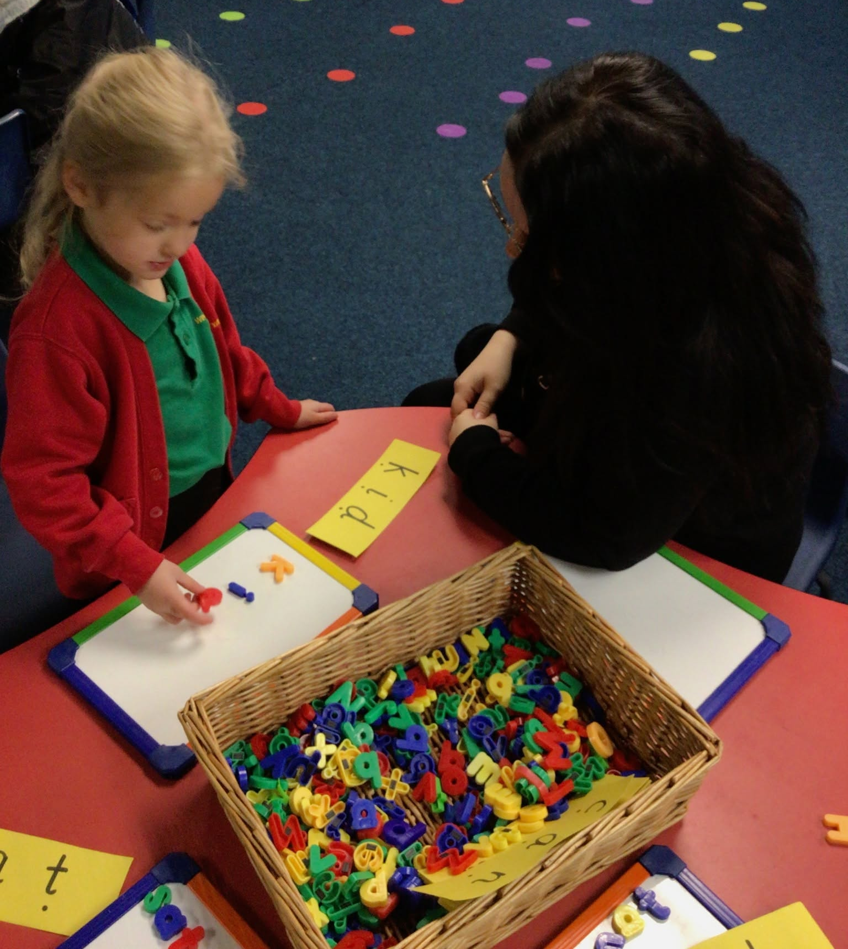

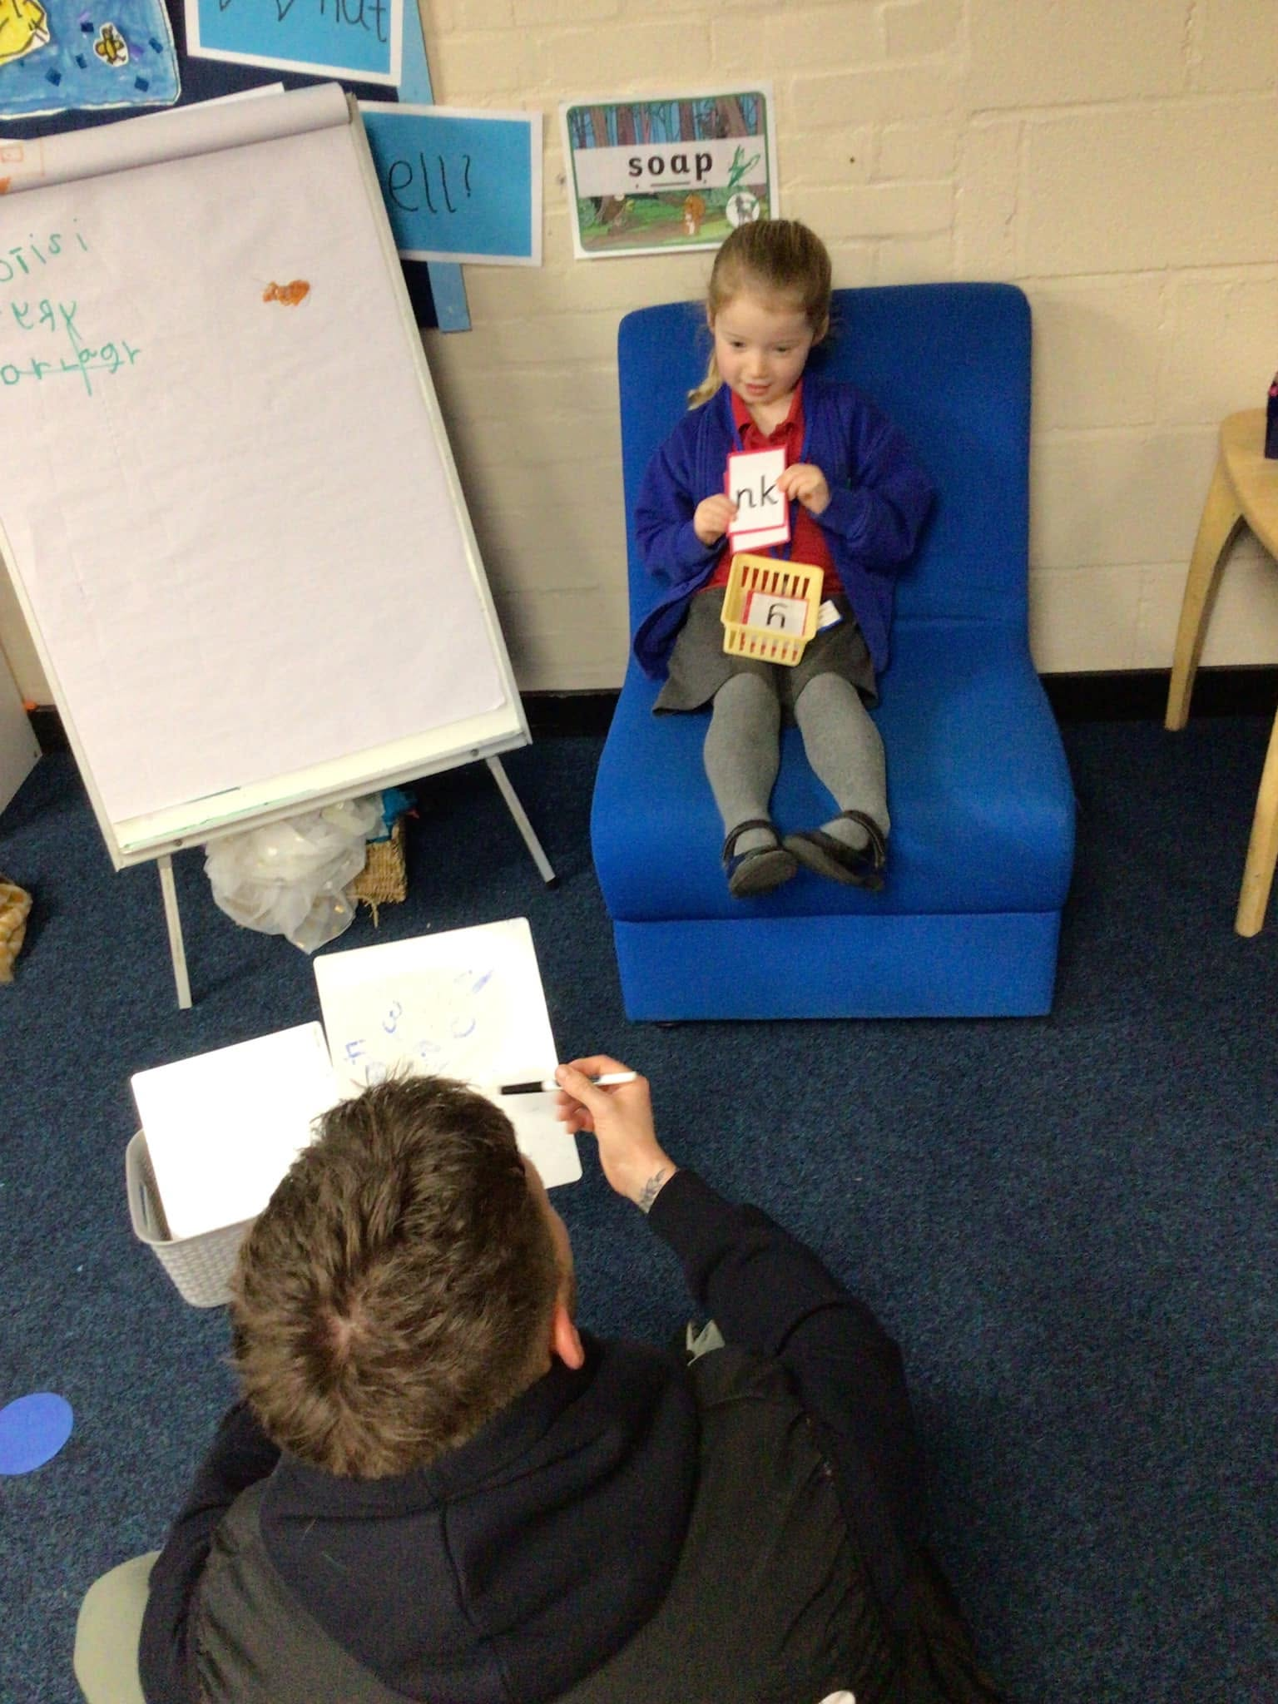

Slide 4
What is Phonics?
A method of teaching beginners to read and pronounce words by learning to associate letters or letter groups with the sounds they represent.
It helps children hear, identify and use different sounds that distinguish one word from another in the English language.
Children learn the sounds of individual letters and how they sound when they’re combined.
Understanding phonics will also help children know which letters to use when they are writing words.

Slide 5
What is Phonics?
Phonics involves matching the sounds of spoken English with individual letters or groups of letters. For example, the sound k can be spelled
as c, k, ck or ch (cook, chick, school).
Teaching children to blend the sounds of letters together helps them decode unfamiliar or unknown words by sounding them out. For example, when a child is taught the sounds for the letters t, p, a and s, they can start to build up the words: “tap”, “taps”, “pat”, “pats” and “sat”.

Slide 6
Phrases you might hear
Phoneme: the smallest single identifiable sound in a word.
For example, in the word 'cat' there are three phonemes c/a/t.
Grapheme: the written representation of a sound (the letter/letters that make the sound).
Digraph: two letters making one sound. For example, /sh/ in the word 'shop'.
Trigraph: three letters making one sound. For example, /igh/ in the word 'night'.
Split digraph: two vowel letters split but are split by one or more consonants. For example, /a-e/ in the word 'cake'.

Slide 7
Decode or segment: the skill of breaking down written words into sounds.
Blend: pushing individual sounds (phonemes) together to make a word.
For example, by blending the sounds /c/, /a/, and /t/, a child learns to say the word "cat".
This skill is crucial for reading, where children decode words by sounding
them out and then blending those sounds together fluidly.

Slide 8
How we teach Phonics
We use a simple, consistent approach to teaching phonics.
Daily Phonics lessons following Little Wandle
Revisit and Review
Teach and Practise
Practise and Apply

Slide 9
Revisit and Review
During this time we revisit and review the sounds we have
previously taught.
Each sound has a pronunciation phrase and a formation phrase.
We review sounds continually.

Slide 10
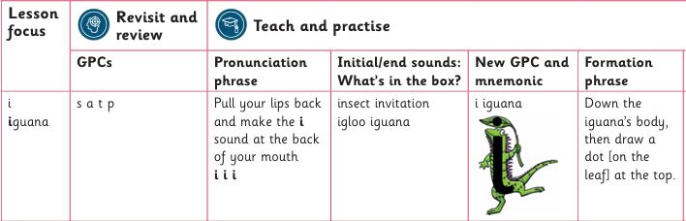
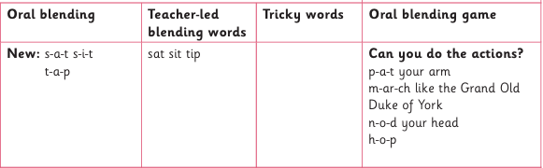
Teach and Practise
During this time we introduce a new sound and practise it.

Slide 11
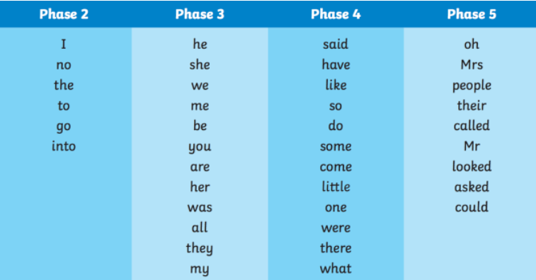
Tricky Words
Tricky words are words that cannot be fully sounded out using standard phonics rules because they have irregular spellings, unusual sounds, or complex letter sound parts.

Slide 12
Practise and Apply
During this time we practise and apply our new teaching.
Can you touch your… l – i – p ?
Can you do the actions? c – l – a - p
What’s that noise? What sounds does a b – u – s make?
Writing a word / phrase / sentence

Slide 13
Pronunciation is key!
https://www.littlewandle.org.uk/resources/for-parents/#tabnametabSupportForPhonics
https://www.littlewandle.org.uk/resources/for-parents/#tabnametabSupportForPhonics
https://www.littlewandle.org.uk/resources/for-parents/#tabnametabSupportForPhonics

Slide 14

Reading

Slide 15
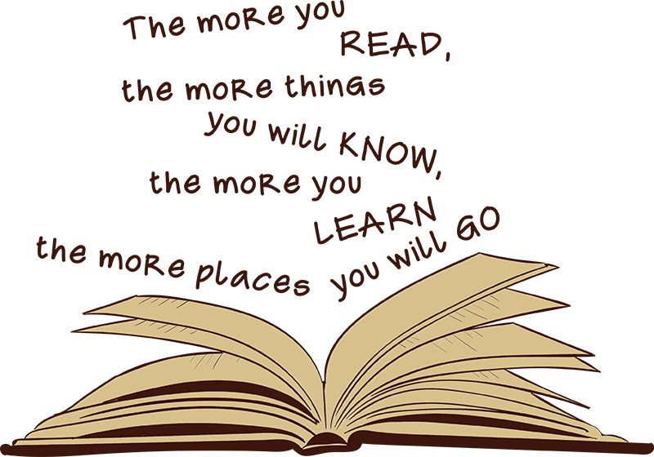
We want to encourage a love of reading.
Reading underpins
children’s access
to the curriculum
and clearly impacts
on their achievements.
We want children to read for
pleasure and be life long
readers.

Slide 16
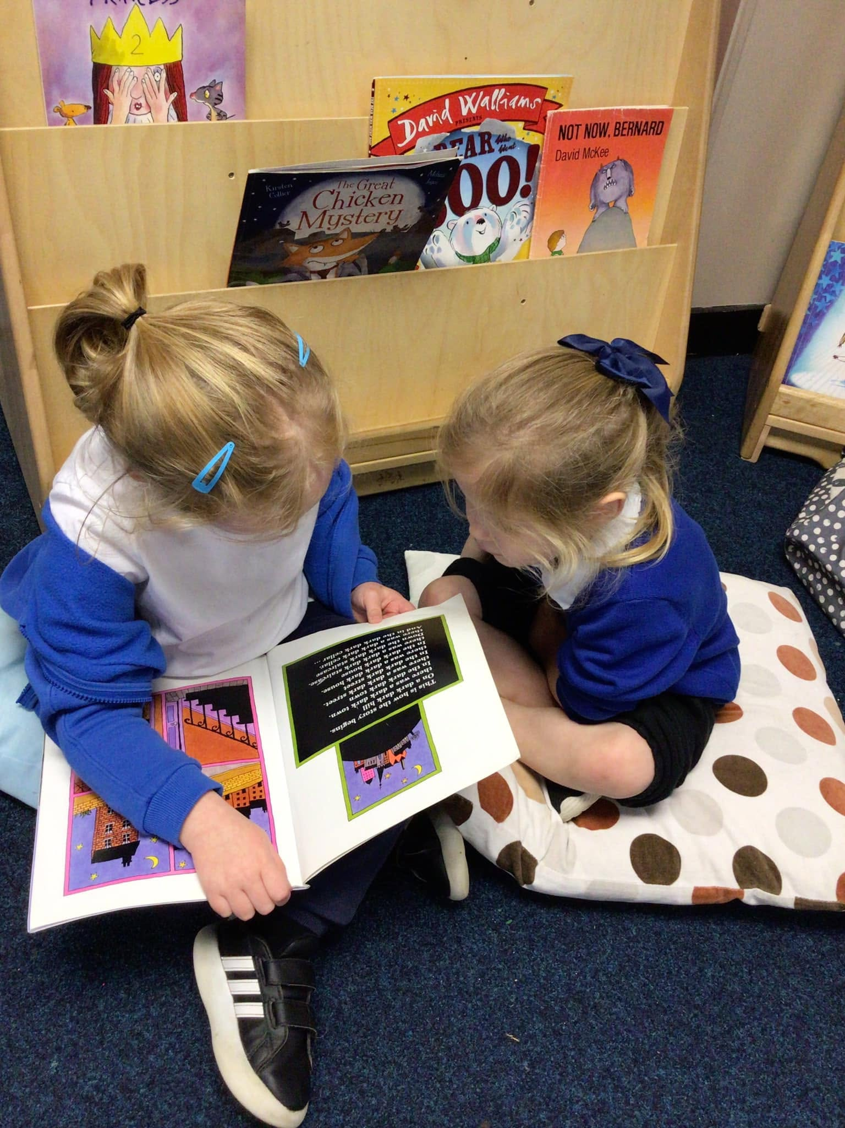
Reading
After around 4 weeks of Phonics teaching we introduce decodable Phonics books.
If a child is not yet ready to blend the adult will model blending with them.
In school we will read the book three times. This is
to develop fluency, expression and comprehension.

Slide 17




Books
Match children’s phonics knowledge.
Shouldn’t be too challenging.
Please keep books in book bags so we can change them.

Slide 18
Reading at home
Phonics book
We will read this book at school as part of whole class reading and practise reading groups. This will then go home on a Friday and be changed the following Friday. We will not write this in children’s diaries but please record every time you read. Please read the book three times in the week. This should not be challenging and children will become fluent from so much exposure.
Tips: Share the front cover page before reading and make predictions about what might happen or what we might learn. The inside cover has the sounds and words contained in the book – review these at the beginning.
Allow your child to sound out and blend the words together.
Celebrate and praise their achievements: ‘I love the way you sounded out that word’. ‘I loved listening to you reading.’ ‘Listening to you reading is my favourite thing to do’.

Slide 19
Top Tips!
Model following the text with your finger when you read so your children get into the habit of doing this!
Take turns – one page each!
Find the ‘right time’ in the evening.
‘Argue’ who hears your child read.
Make mistakes and let your child correct you (not too many!).
Speak to school if your child is struggling.
Be positive and have fun.

Slide 20



Reading at home
Pleasure for reading book
This is to promote a love of reading and literature.
Children will not be able to read these books but they will be able to talk about them and learn new vocabulary from them.
Reading the same book several times will promote a rich vocabulary and develop their ability to hear rhyme and rhythm.
Be a reading role model at home and allow them to see you reading for pleasure.
Children will choose a Pleasure for Reading book on a Friday and it will be changed the following Friday.

Slide 21
Reading at home
Some useful links:
https://www.littlewandle.org.uk/resources/for-parents/
https://www.youtube.com/channel/UCP_FbjYUP_UtldV2K_-niWw
https://literacytrust.org.uk/information/what-is-literacy/what-phonics/
https://schoolreadinglist.co.uk/reading-lists-for-ks1-school-pupils/100-best-picture-books-to-read-before-you-are-5-years-old/

Slide 22
Thank you

