Slide 1

Reading and Phonics in Reception

Slide 2
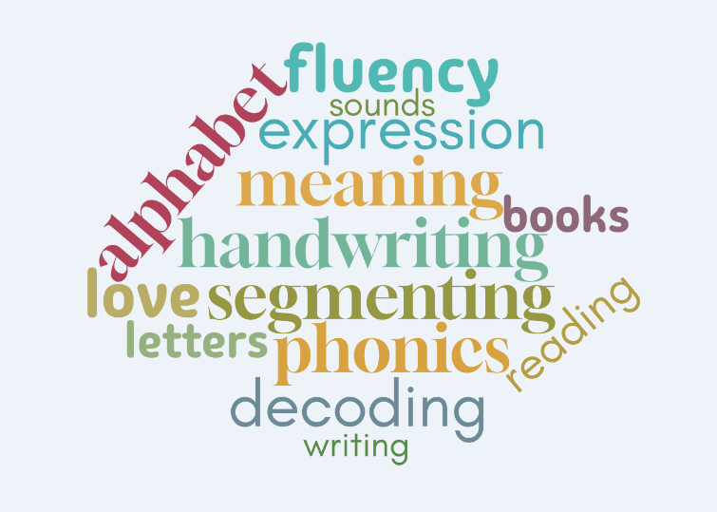
Welcome

Slide 3
Aims of today
To provide you with a greater insight into what Phonics is and how we teach Phonics.
To provide you with a greater insight into what reading is and how we teach reading.
To provide you with some information for how to help at home.

Slide 4


Slide 5
What is Phonics?
Phonics is a way of teaching children how to read and write. It helps children hear, identify
and use different sounds that distinguish one word from another in the English language.
Written language can be compared to a code, so knowing the sounds of individual letters
and how those letters sound when they’re combined will help children decode words as
they read.
Understanding phonics will also help children know which letters to use when they
are writing words.
Phonics involves matching the sounds of spoken English with individual letters or groups
of letters. For example, the sound k can be spelled as c, k, ck or ch.
Teaching children to blend the sounds of letters together helps them decode unfamiliar or
unknown words by sounding them out. For example, when a child is taught the sounds for the
letters t, p, a and s, they can start to build up the words: “tap”, “taps”, “pat”, “pats” and “sat”.

Slide 6
Some words you might hear
Phoneme: A phoneme is the smallest unit of sound made by a
letter or group of letters. Words are made up of phonemes but it’s
important that we distinguish between phonemes and graphemes.
A phoneme is the sound, rather than the letter. You cannot see a
phoneme but you can hear it or say it. Although there are just 26
letters in the English language, there are approximately 44 phonemes.
Digraph: two letters that make one sound
Trigraph: three letters that make one sound
Grapheme: a grapheme is the written form of a sound (called a phoneme)
in a word, which can be a single letter or a group of letters, such as in
the word "cat" where 'c', 'a', and 't' are single-letter graphemes,
or the word "rain," where 'ai' is a two-letter grapheme for the 'ai' sound.

Slide 7
Some words you might hear
Decode: the skill of breaking down written words into sounds
Blend: pushing individual sounds (phonemes) together to make a word.
For example, by blending the sounds /c/, /a/, and /t/,
a child learns to say the word "cat".
This skill is crucial for reading, where children decode words by sounding
them out and then blending those sounds together fluidly.

Slide 8
How we teach Phonics at WP
Daily Phonics lessons following Little Wandle
Lessons follow the same order
Revisit and Review
Teach and Practise
Practise and Apply

Slide 9
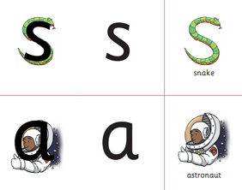
Revisit and Review
During this time we revisit and review the sounds we have previously taught.
Each sound has a pronunciation
phrase and a formation phrase.
We review sounds continually.
We adapt the review part of the
lesson depending on need.

Slide 10
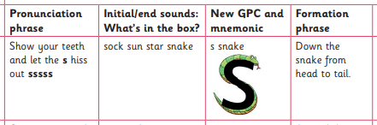
Teach and Practise
During this time we introduce a new sound and practise it.

Slide 11
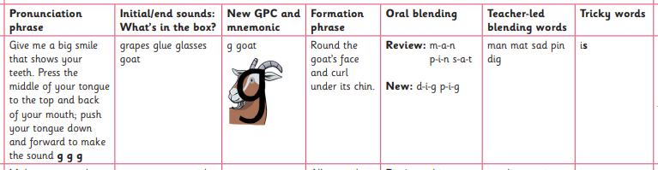
Teach and Practise
During this time we introduce a new sound and practise it.

Slide 12
Practise and Apply
During this time we practise and apply our new teaching.
Can you touch your… l – i – p ?
Can you do the actions? c – l – a - p
What’s that noise? What sounds does a b – u – s make?
Writing a word / phrase / sentence

Slide 13
Pronunciation is key!
https://www.littlewandle.org.uk/resources/for-parents/#tabnametabSupportForPhonics
https://www.littlewandle.org.uk/resources/for-parents/#tabnametabSupportForPhonics
https://www.littlewandle.org.uk/resources/for-parents/#tabnametabSupportForPhonics

Slide 14

Reading

Slide 15

We want to encourage a love of reading.
Reading underpins
children’s access
to the curriculum
and clearly impacts
on their achievements.
We want children to read for
pleasure and be life long
readers.

Slide 16
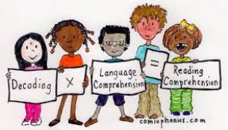
Reading
After around 4 weeks of Phonics teaching we introduce decodable Phonics books
If a child is not yet ready to blend the adult will model blending with them.
In school we will read the book three times. This is
to develop fluency, prosody (expression) and comprehension.

Slide 17




Books
Match children’s secure phonics knowledge
Shouldn’t be too challenging

Slide 18
Reading at home
Phonics book
We will read this book at school as part of whole class reading and practise reading groups. This will then go home on a Friday and changed the following Friday. We will not write this in their diaries but please record every time you read. Please read the book three times in the week. This should not be challenging and children will become fluent from so much exposure.
Tips: Share the front cover page before reading – make predictions about what might happen or what we might learn. The inside cover has the sounds and words contained in the book – review these at the beginning.
Allow your child to sound out and blend the words together
Celebrate and praise their achievements – I love the way you sounded out that word. I loved listening to you reading. Listening to you reading is my favourite thing to do.
Read EVERY day – mixture of Phonics books and Pleasure for reading books

Slide 19



Reading at home
Pleasure for reading book
This is to promote a love of reading and literature
Children will not be able to read these books but they will be able to talk about them and learn new vocabulary from them
Reading the same book several times will promote a rich vocabulary and develop their ability to hear rhyme and rhythm
Be a reading role model at home and allow them to see you reading for pleasure
Children will choose a Pleasure for Reading book on a Friday
and it will be changed the following Friday.

Slide 20
Reading at home
Some useful links:
https://www.littlewandle.org.uk/resources/for-parents/
https://www.youtube.com/channel/UCP_FbjYUP_UtldV2K_-niWw
https://literacytrust.org.uk/information/what-is-literacy/what-phonics/
https://schoolreadinglist.co.uk/reading-lists-for-ks1-school-pupils/100-best-picture-books-to-read-before-you-are-5-years-old/

Slide 21
Thank you

