Slide 1
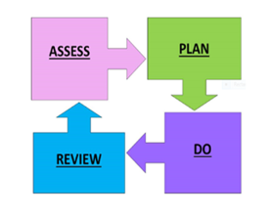
The Roebuck School Graduated Approach 2026
Universal Offer
with specialist Support
EHCP
Equals Curriculum SEND provision
Universal Offer with Targeted Support
Class Provision Map - Group interventions, 1-1 support
EDR – Everyday Reading Programme (Y1-6)
1-1 speech & language plans with TA
SaLT half termly visits
NELI & Talk Boost (EYFS)
Daily reading for SEND & lowest 20%
SEN SUPPORT – TLP / TBP (Target Learning or Behaviour Plans)
Thrive team support- Individual Thrive Action Plan, A Confident Me, ELSA
Counsellor, specialist teacher, SaLT, EAL tutor, EP
Universal Offer - Inclusive Classrooms
High Quality Inclusive Teaching : adaptive teaching providing immediate feedback to individuals or small groups during a lesson addressing misconceptions or learning gaps, targeted scaffolding & feedback, flexible seating, tailored questioning & responses.
Typical classroom environment: visual timetable, display for routine/class responsibilities, inclusive visual prompts (learning & expectations), peer mentoring e.g. language buddies for EAL, fridge words clearly displayed on learning walls with a visual / graphic, visual aids e.g. confusing letters, spelling key words, math vocab, interactive/language rich displays, thrive action plan, allocated ‘safe space’ in class, emotional check ins, teaching breathing techniques, wow sheet, flexible seating, dyslexia friendly resources, strong links with parents, high expectations & aspirational learning environment, sensory movement breaks/water breaks, resources easily accessible & labelled, use of additional aids as required e.g.fidget object, wobble seats, tinted overlays, reading rulers etc.
For pupils who need above what can be provided at SEN Support.
Additional targeted support when needed using assess, plan, do, review cycle.

