Slide 2
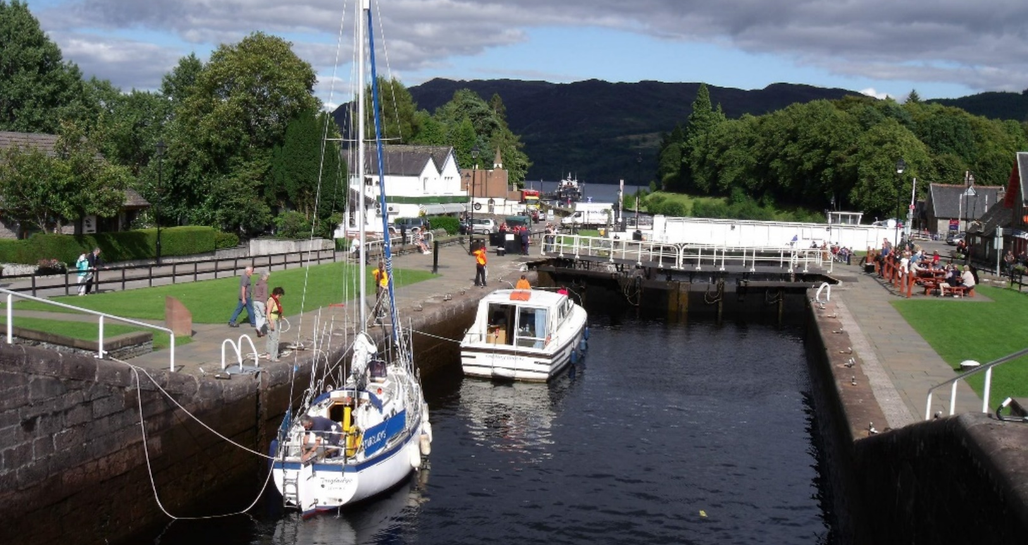
What Is a Canal?
A canal is a waterway or channel of water. They were built to allow boats to travel across land.
“Caledonian Canal and Loch Ness - Fort Augustus Scotland” by [Dave Conner] is licensed under CC BY 2.0

Slide 3
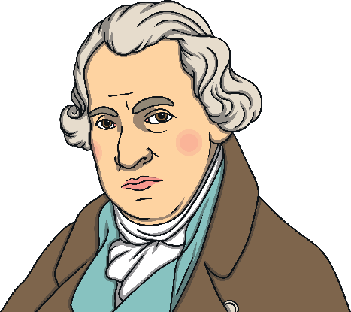
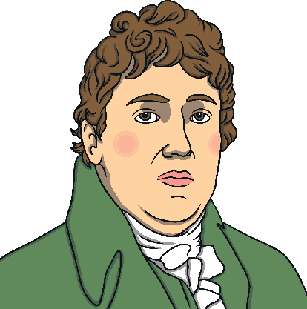



Who Built the Canals?
Engineers like Thomas Telford and James Watt designed these waterways.
Canals were known as ‘navigations’ and the workers who worked on them became known as ‘navigators’ which was shortened to navvies.
Navvies were the men who moved huge amounts of earth and rock.
Many of these men came from Ireland or from the Highlands of Scotland.

Slide 4


Canals in the Past
Canals were once very important.
They were used to transport goods and people, in the same way our roads and railways are used now.
The demand for goods grew during the 18th century. Canals were seen as being an easy way of moving goods.
Canal boats were once pulled by horses who walked along the tow path at the side of the canals.

Slide 5




How Are Canals Used Today?
Today, canals are mostly used for leisure trips.
Parts of the Monkland canal were closed to make way for a motorway.

Slide 6


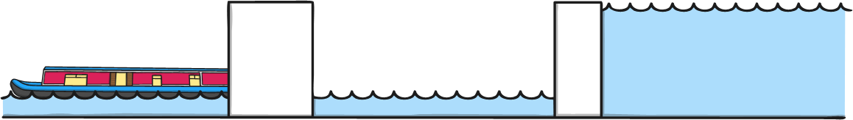
How Do Boats Travel up and down on a Canal?
Canals also allow boats to travel up and down. Some canals join up but are a different heights. A system of locks helps them to meet.
Locks are watertight chambers where a boat can enter and be locked in.
Water flows into the chamber or is drained away. This raises or lowers the level the boat.
Once it is at the right level for the next part of its journey, the boat can leave the lock and sail on.

Slide 7
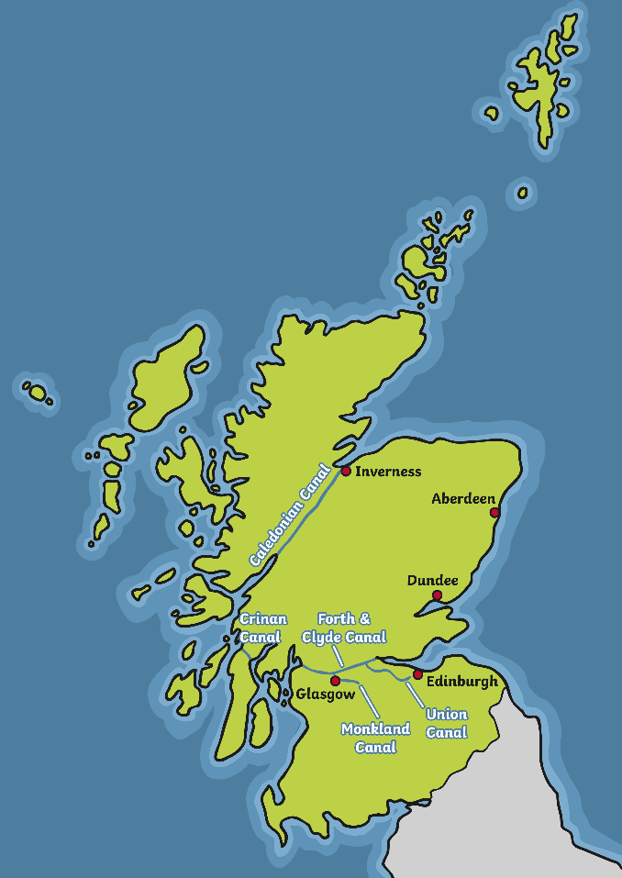

Canals in Scotland
The canals in Scotland can be seen on this map.
These canals are:
the Forth and Clyde Canal;
the Union Canal;
the Caledonian Canal;
the Crinan Canal;
the Monkland Canal.
Scotland’s canal network
covers 137 miles.

Slide 8
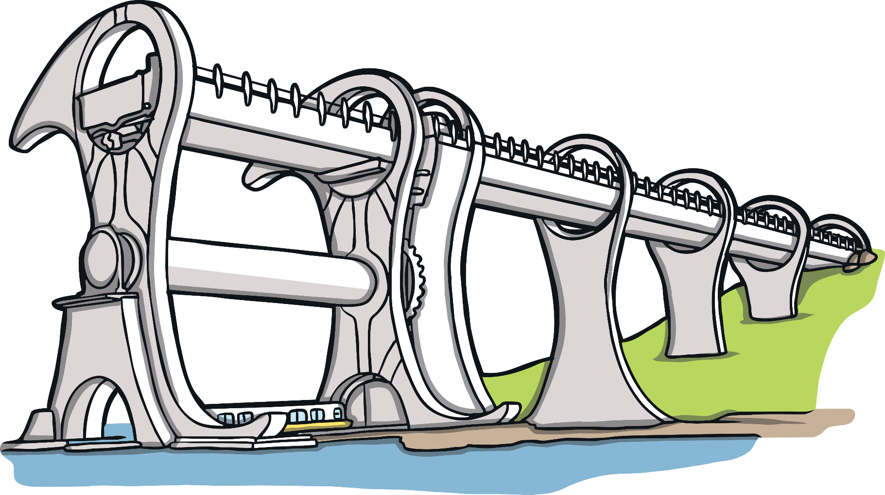
What Else Can You Find
out About Canals?

