Slide 1
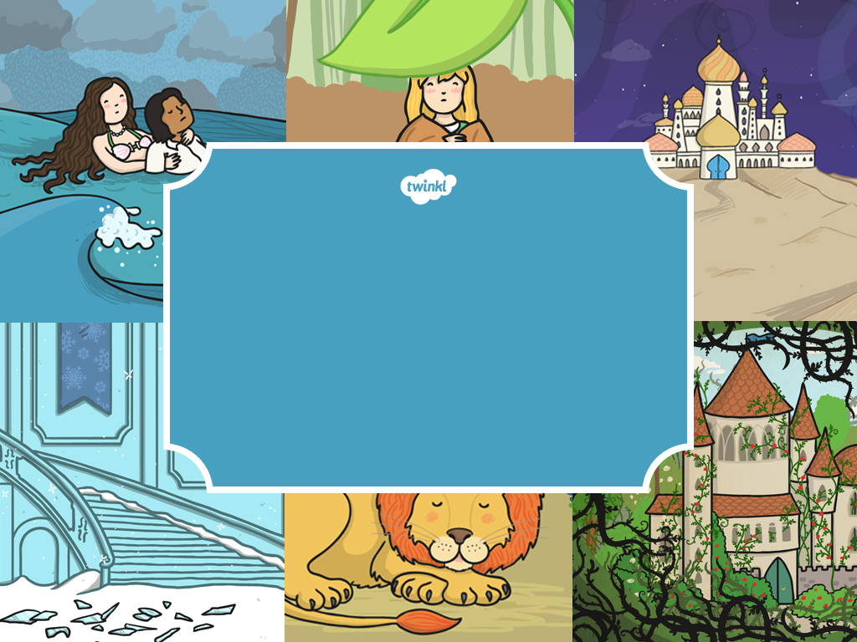
An Introduction to
Traditional
Tales

Slide 2
To understand what ‘traditional’ means and the main features of traditional tales.

Slide 3
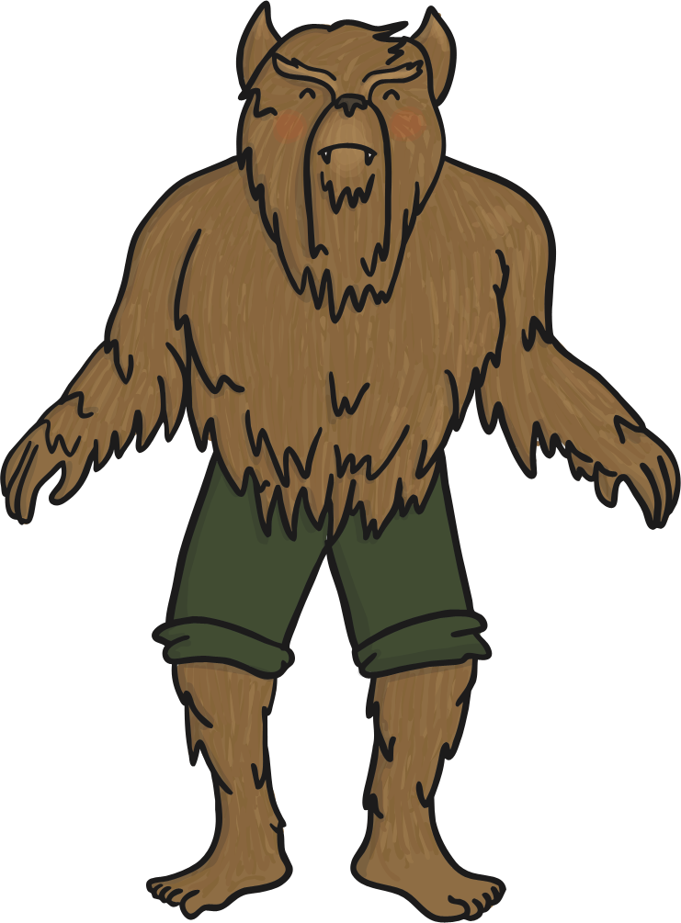
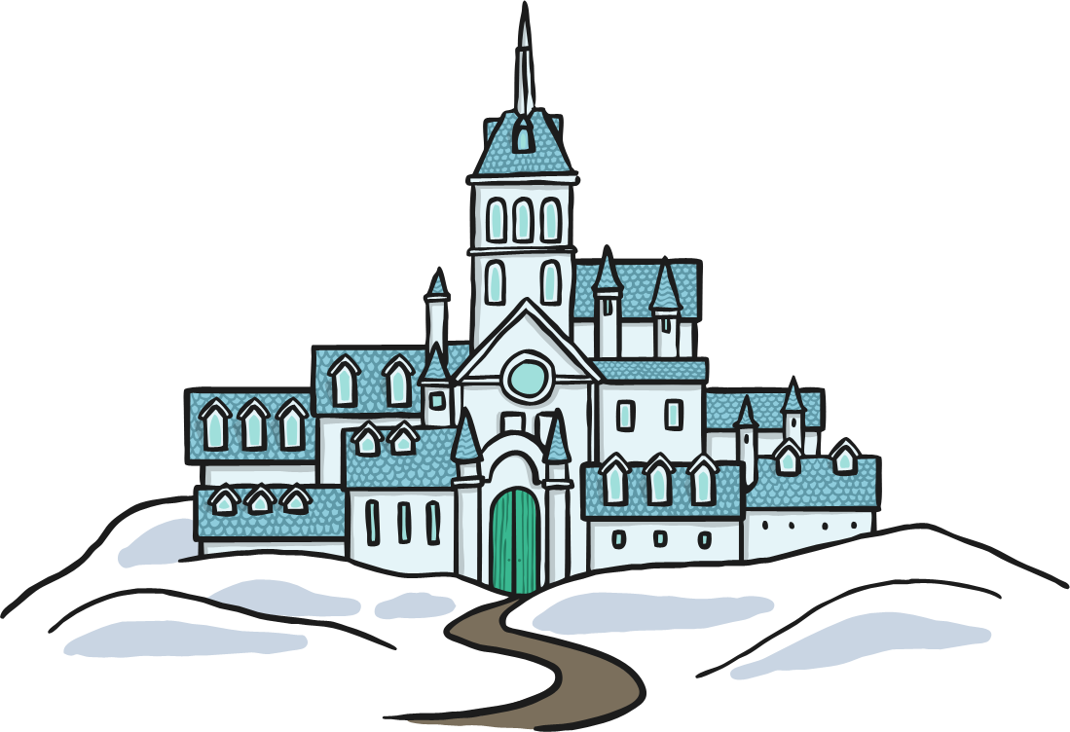
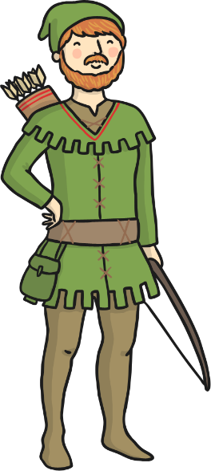
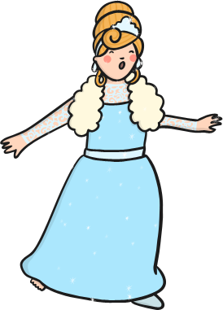
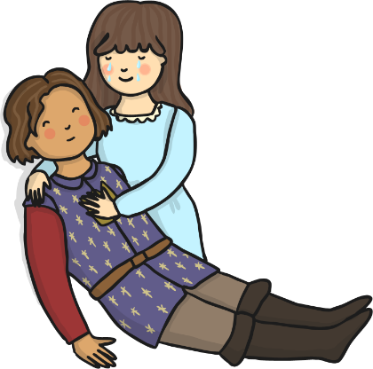
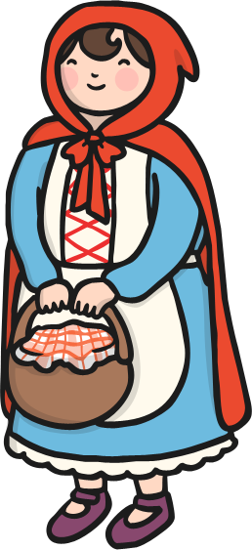
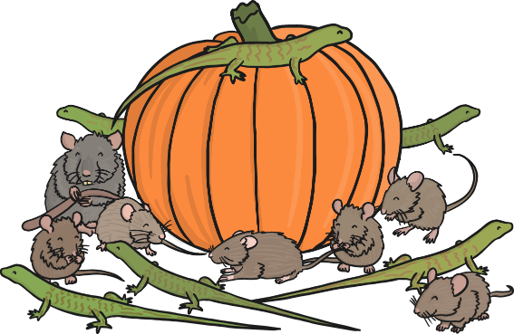
Traditional Tales
Traditional tales are stories that have been told and retold for many years. Often they are passed down through generations. Therefore, they become a story that many people know. There are often lots of different versions of the same story.
Traditional tales are also known as fairy stories or fairy tales.

Slide 4
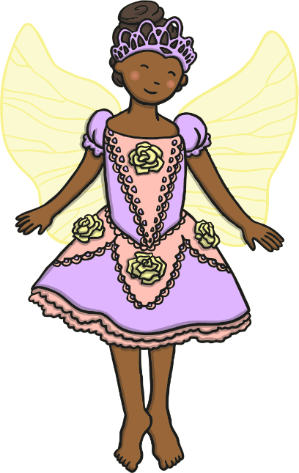
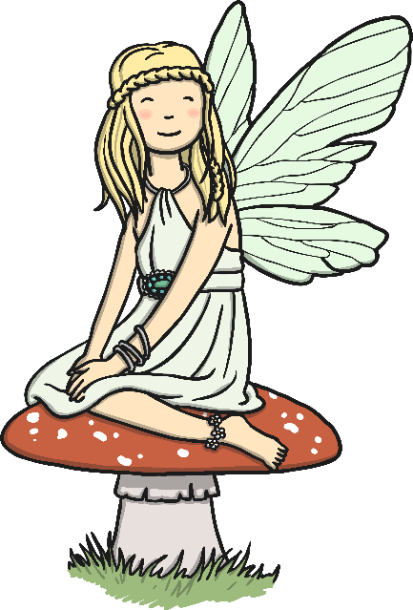
Can you name some story titles that are traditional tales?
Can you name any characters from a traditional tale?

Slide 5
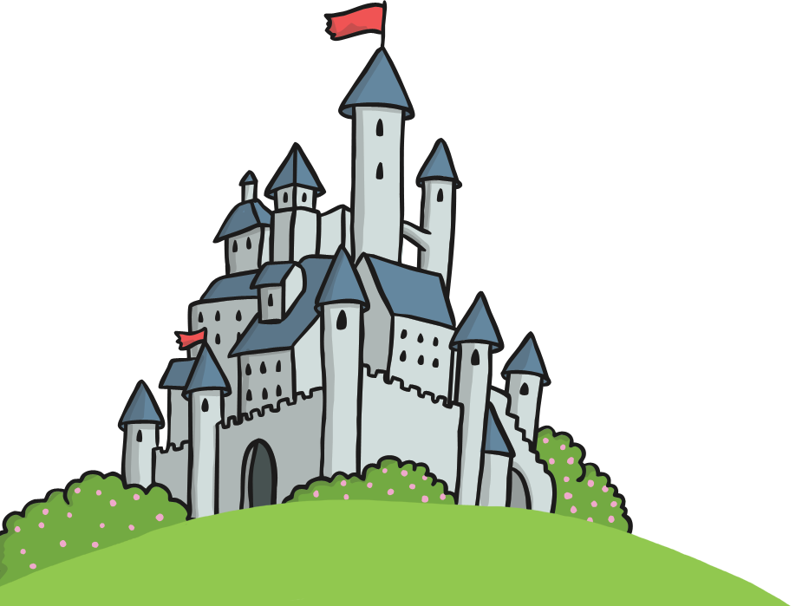
Traditional tales often begin with:
Once upon a time…
A long, long time ago…
In a land far, far away…
In a faraway kingdom…
One sunny day…
Did you ever hear the story of…
Early one morning…

Slide 6
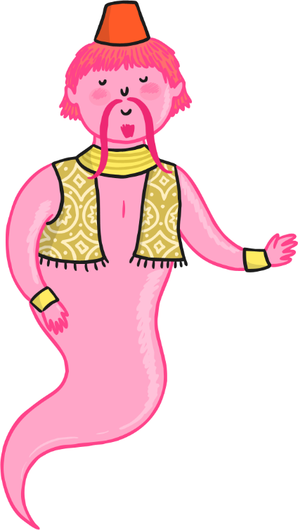
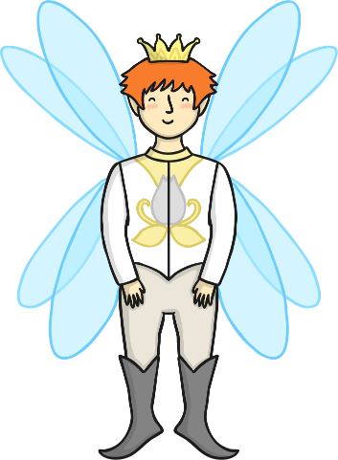
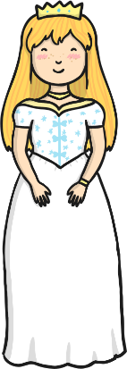
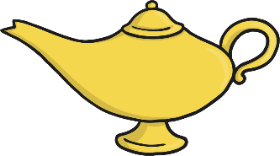
Common themes in traditional tales include…
Magic
Love
Talking animals
Good vs bad
A happy ending: “And they all lived happily ever after.”
Power of 3

Slide 7
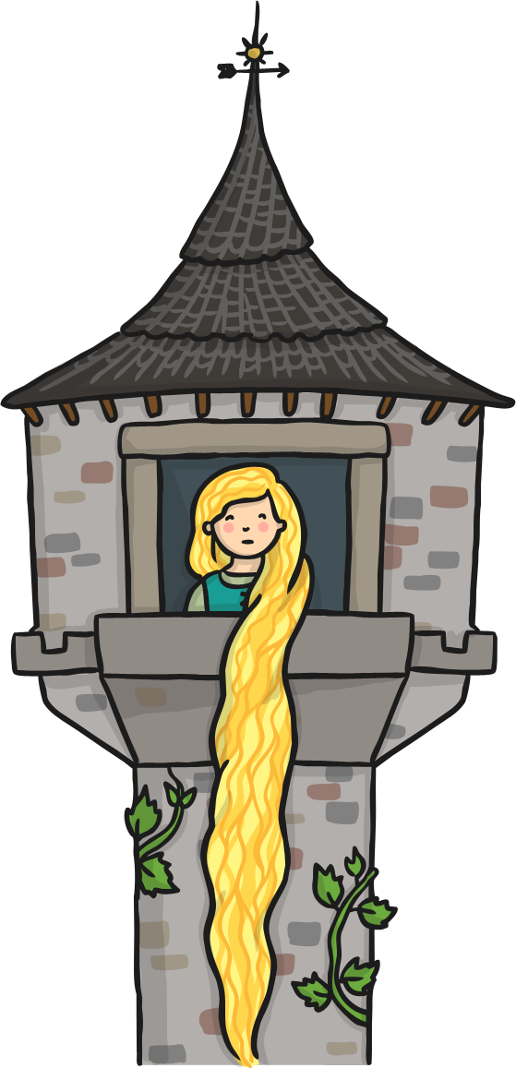
A setting is where the story takes place.
Popular Settings:
Magical kingdom
A land far, far away
A cottage
In the woods
In a forest
A castle

Slide 8
Popular Traditional Tale Titles
Jack and the Beanstalk
Cinderella
Goldilocks and the Three Bears
The Emperor's New Clothes
The Little Red Hen
The Ugly Duckling
The Frog Prince
Hansel and Gretel
Rapunzel
Little Red Riding Hood
Pinocchio
The Three Billy Goats Gruff
The Three Little Pigs
Rumpelstiltskin
Sleeping Beauty
Beauty and the Beast

Slide 9
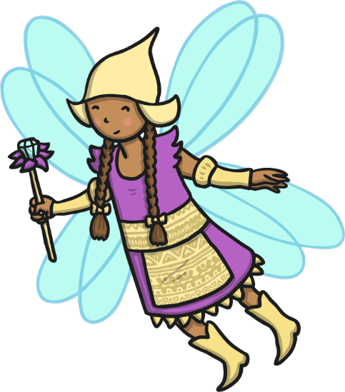
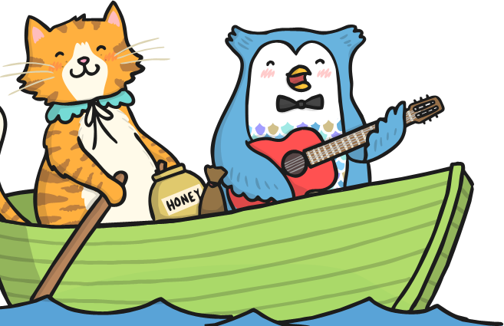
Let’s play a game…
Traditional Tales Game
Name the story!
First, try to guess with the clues, then by the picture!

Slide 10
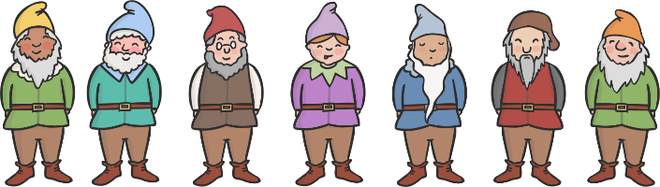
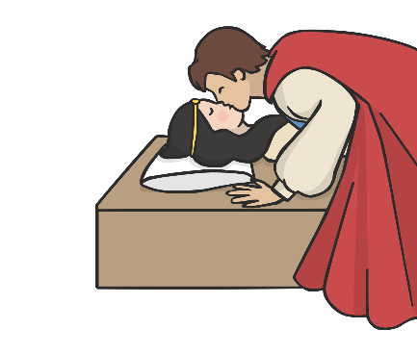
Name the story!
It’s a tale about a beautiful princess and her evil stepmother the Queen…
She went to live with 7 dwarves in a cottage…
She was poisoned by an apple but was woken up by a kiss from a handsome prince…
Click anywhere on screen for clues and click here for answer.
Snow White and the Seven Dwarfs!

Slide 11
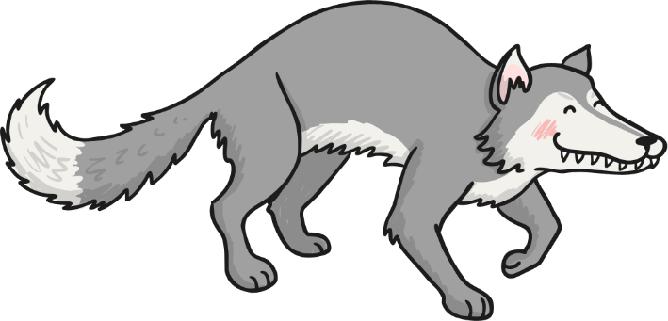
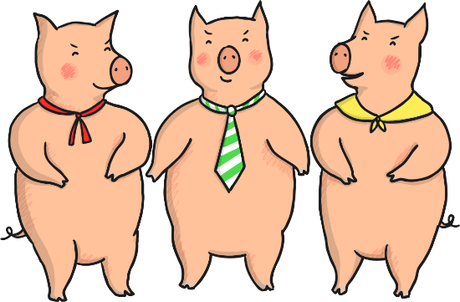
Name the story!
It’s a tale about 3 characters who were sent away to build houses of their own…
The first two found out that houses built with straw and sticks could be blown down…
The wolf huffed and he puffed but he couldn’t blow the brick house down…
Click anywhere on screen for clues and click here for answer.
The Three Little Pigs!

Slide 12
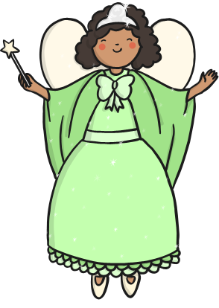
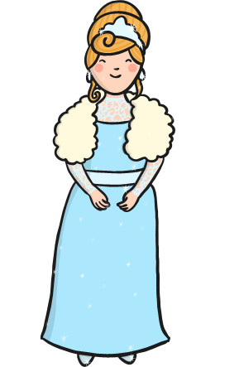
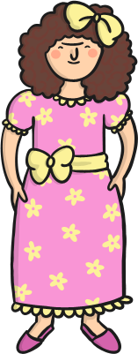
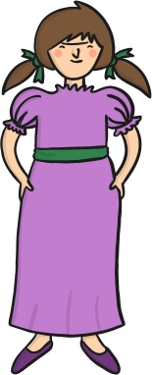
Name the story!
It’s a tale about a lovely girl who has to spend her days scrubbing and cleaning…
She has an evil stepmother and two ugly sisters, but gets transformed by a fairy godmother…
A handsome prince finds her glass slipper at a ball and doesn’t stop until he finds her…
Click anywhere on screen for clues and click here for answer.
Cinderella!

Slide 13
Let’s play a game…
Traditional Tales Characters
Can you name all these characters?
Can you name the traditional tales they are from?

Slide 14
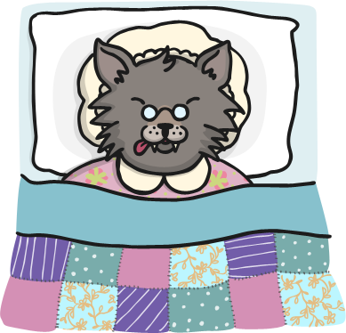
Name that character!
It’s an animal…
He’s got sharp teeth…
He’s got big eyes…
He likes to eat grandmas and little girls…
Click anywhere on screen for clues and click here for answer.
The Big Bad Wolf!
(from Little Red Riding Hood)

Slide 15
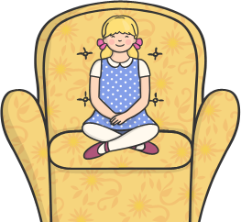
Name that character!
She’s a girl with blonde (golden) hair…
She likes to eat porridge…
She sits in other people’s chairs until she finds the one that’s just right.
She even gets caught sleeping in a bear’s bed!
Click anywhere on screen for clues and click here for answer.
Goldilocks!

Slide 16
Name that character!
They like to build houses…
They are animals that live on a farm…
They like to eat wolf stew!
There’s three of them…
Click anywhere on screen for clues and click here for answer.
The 3 Little Pigs!

Slide 17
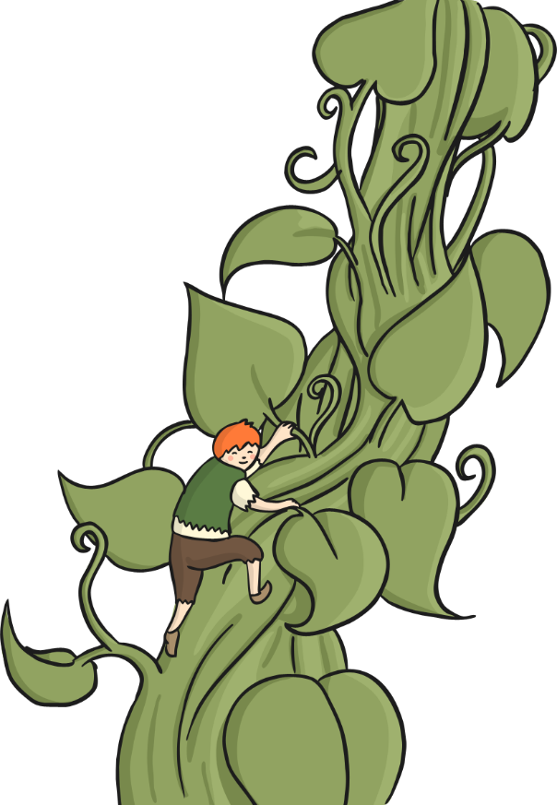
Name that character!
He meets a giant…
He gave away his family cow for some magic beans…
He climbs a very, very big beanstalk…
Click anywhere on screen for clues and click here for answer.
Jack!
(from Jack and the Beanstalk)

Slide 18
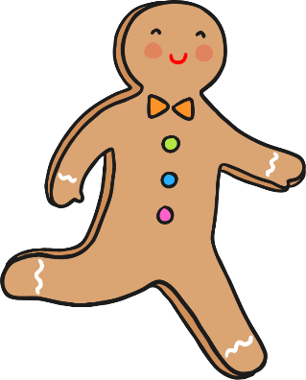
Name that character!
He runs and shouts, “run, run as fast as you can…”
He runs away from many people and animals that want to eat him…
He stupidly trusts a fox, who eats him… yum!
Click anywhere on screen for clues and click here for answer.
The Gingerbread Man!

Slide 19

Name that character!
She was a princess and had a wicked stepmother…
Her hair was black as coal, her lips red as a rose, and her skin as white as snow…
She had a magic mirror and 7 little friends…
Snow White!
Click anywhere on screen for clues and click here for answer.

