Slide 1
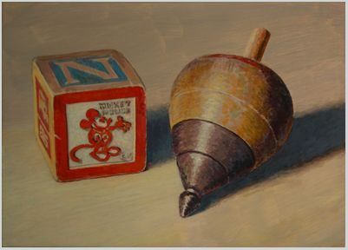



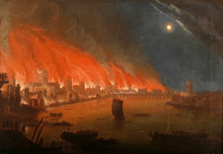
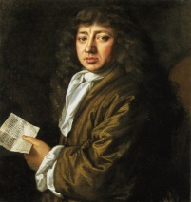
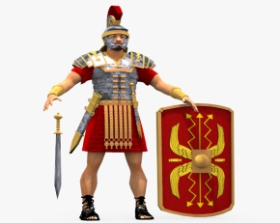
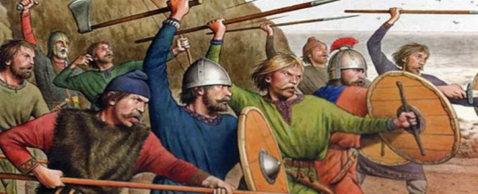

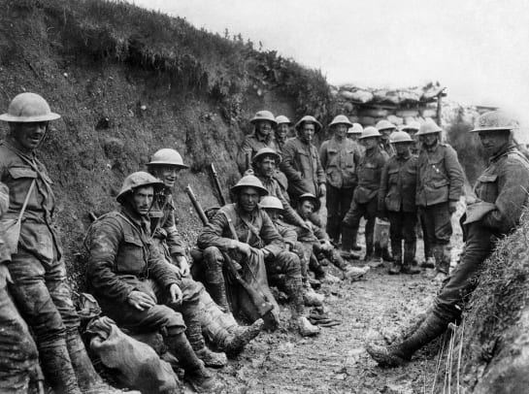
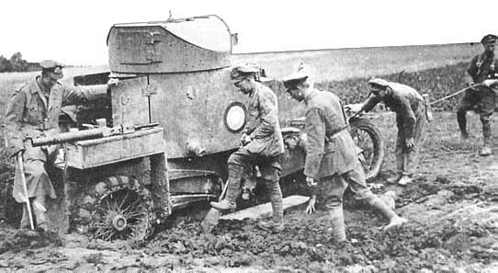
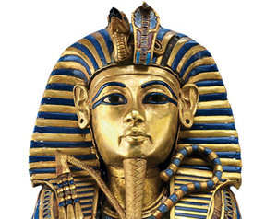
Overview for HISTORY
Culture/Change:
Events beyond living memory that are significant nationally or globally - The Great Fire of London. Samuel Pepys.
Achievements:
Fire service and fire engines
Leaders:
The lives of significant individuals: Elizabeth I and Queen Victoria.
Respect, Inspire, Achieve
Leaders: Pirates as captains
Culture/Change:
Culture – Pirates lives
Changes within living memory. Where appropriate, these should be used to reveal aspects of change in national life – how transport on water has changed and developed.
Toys - Change:
Interview parents/grandparents etc
How toys have changed over time – toys through time loan box
Production of toys
Class Two
Term 2
Subject or image
Anglo Saxons
Leaders/Achievements
Anglo Saxon kings through to Norman Conquest 1066.
Forging of England as a country
Class Three
The Roman Empire
Society/Culture
The impact that it had on Britain and the key events.
Leaders:
Julias Caesar and the Roman Empire
Achievements:
Legacy: Roads, armies, sheilds
Ancient Egypt
Society/Culture:
A study of ancient Egypt
People/places
Life/farming
Artefacts
Leaders:
Empire – Alexander the Great
Achievement/Legacy:
Writing, Hippocrates, Archimedes, democracy and laws, Olympic games.
World War One:
Society /culture:
A study of an aspect or theme in British history that extends pupils’ chronological knowledge beyond 1066
Change:
A significant turning point in British history - World War One
Class Four
Year A
Aston By Sutton Primary School Road Map- HISTORY

