Slide 1

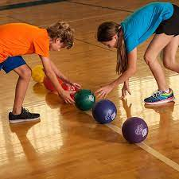

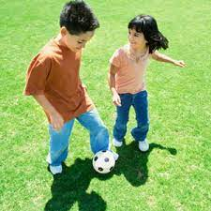

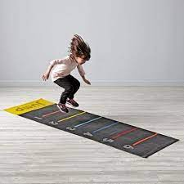
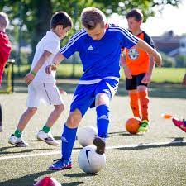
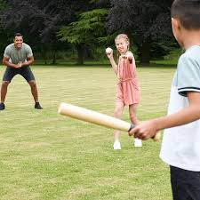
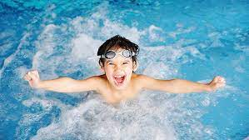
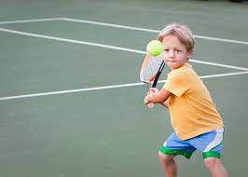

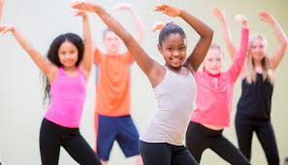
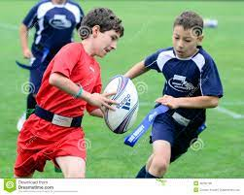



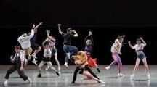
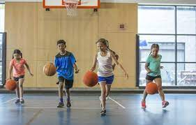
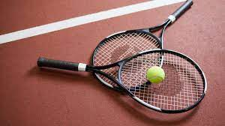
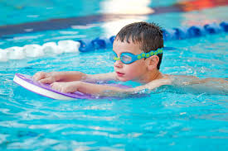
Overview for PE
Respect, Inspire, Achieve
Term 1: Games / Gymnastics
Link actions to make a sequence.
Travel in a variety of ways.. Send/ receive skills, know different ways to pass a ball. Catch and bounce a ball. Use rolling skills in a game
Term 2: Ball skills / Dance
Use different transitions within a dance motive in time to music. Improve the timing of their actions. Know how to pass the ball in different ways. Use kicking skills in a game.
.
Term 3: Games /Attacking & Defending
Use a variety of different stride lengths. Travel at different speeds. Begin to select the most suitable pace and speed for distance.
Class Two
Term 3: OAA, Swimming, Football
Try a range of equipment for creating and completing an activity. Make an informed decision on the best equipment to use for an activity. Plan and organise a trail that others can follow.
Term 2: Basketball / Tennis
Play competitive games and modify. Apply basic principles for attacking and defending
Use throwing and catching in isolation and in combination
Term 1:Tag Rugby / Dance
Vary the tactics they use in a game. Adapt rules to alter games. Perform and apply skills and techniques with control and accuracy.
Class Three
Term 1: Tag Rugby/ Dance
Develop flexibility, strength, technique, control and balance. compare their performances with previous ones and demonstrate improvement to achieve their personal best.
Term 2: Basketball / Tennis
Play competitive games, and apply basic principles suitable for attacking and defending. Play competitive games. Using running, jumping, throwing etc in isolation and in combination.
Term 3: OAA, Swimming, Football
Take part in outdoor and adventurous activity challenges both individually and within a team. Swim competently, confidently and proficiently over a distance of at least 25 metres
Class Four
,
Year B
Aston By Sutton Primary School Road Map- PE

