Slide 1

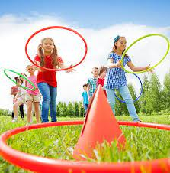
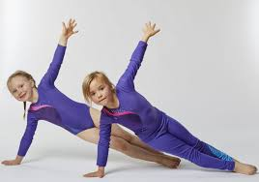
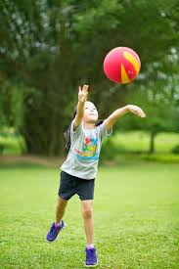
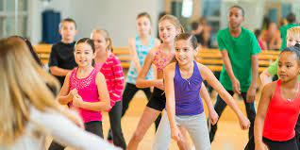
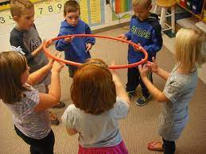
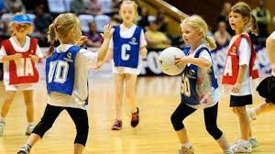

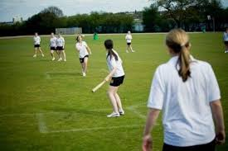
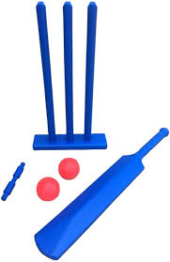
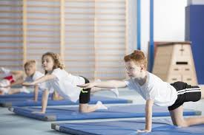
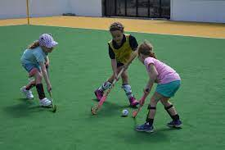
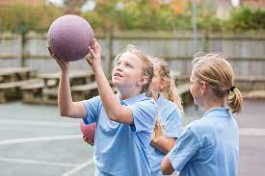


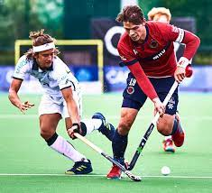
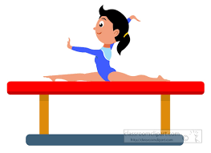
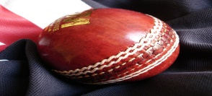
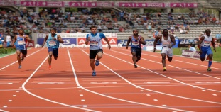
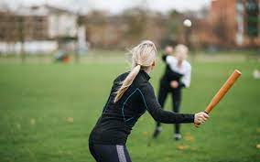
Overview for PE
Respect, Inspire, Achieve
Term 1: Games / Gymnastics
Master basic movements including running, jumping, throwing and catching, as well as developing balance, agility and coordination, and begin to apply these in a range of activities.
Term 2: Ball skills / Dance
Link actions to make a sequence.
Travel in a variety of ways, including rolling. Hold a still shape whilst balancing on different points of the body.
Term 3: Games /Attacking & Defending
Begin to use and understand the terms attacking and defending.
Use at least one technique to attack or defend to play a game successfully.
Class Two
Term 3: Swimming, Athletics, Rounders:
Focus on arm and leg action to improve their sprinting technique. Show increasing control in overarm throw. Begin to use a range of strokes effectively e.g., front crawl, backstroke and breaststroke
Term 2: Gymnastics / Cricket
Pass the ball with increasing speed, accuracy and success in a game situation. Know how to play a striking and fielding game fairly. Take part in a range of competitive games and activities.
Term 1: Netball / Hockey
Demonstrate successful hitting and striking skills. Use a hockey stick to hit a ball with accuracy and control. Use a range of attacking and defending skills and techniques in a game. Perform a push throw
Class Three
Term 1: Netball / Hockey
Perform and apply a variety of skills and techniques confidently, consistently and with precision.
Take part in competitive games with a strong understanding of tactics and composition.
Term 2: Gymnastics / Cricket
Create their own complex sequences involving the full range of actions and movements: travelling, balancing, holding shapes, jumping, leaping, swinging, vaulting and stretching. Use running, jumping, throwing and catching in isolation & in combination. Develop flexibility, strength, technique, control and balance
Term 3: Swimming, Athletics, Rounders
Take part in outdoor and adventurous activity challenges both individually and within a team. Swim competently, confidently and proficiently over a distance of at least 25 metres
Class Four
Year A
Aston By Sutton Primary School Road Map- PE

