Slide 1
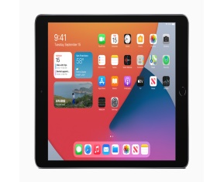

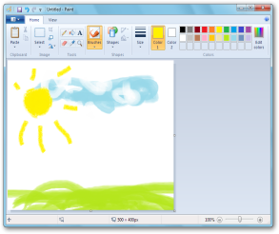
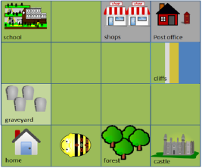
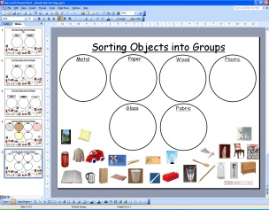

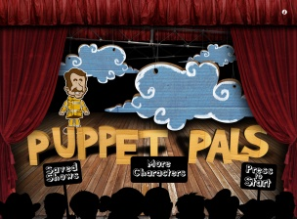

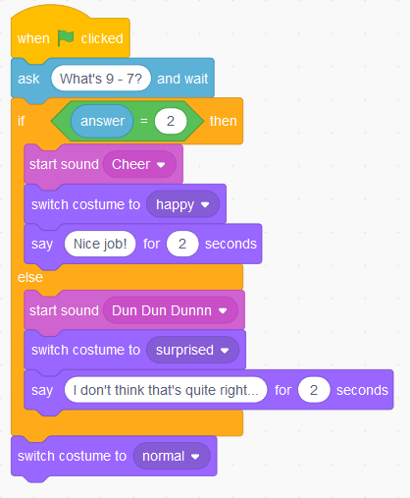

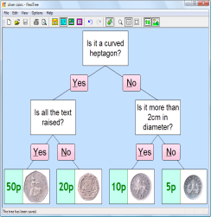
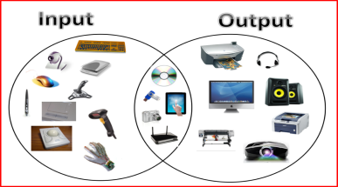
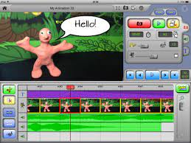


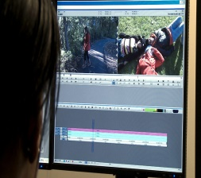
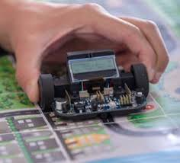
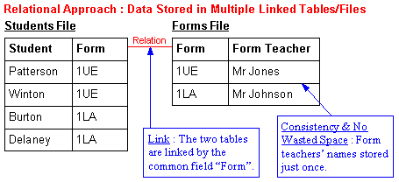
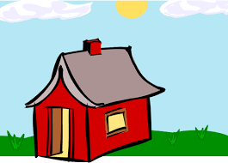
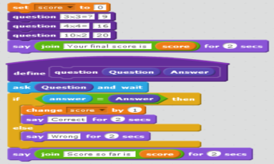
Overview for COMPUTING
Technology around us
Recognising technology in school and using it responsibly
Digital Painting
Choosing appropriate tools in a program to create art, and making comparisons with working non-digitally.
Moving a robot
Writing short algorithms and programs for floor robots, and predicting program outcomes.
Grouping data
Exploring object labels, then using them to sort and group objects by properties.
Respect, Inspire, Achieve
Digital Writing –
Using a computer to create and format text, before comparing to writing non-digitally.
Programming animations
Designing and programming the movement of a character on screen to tell stories.
Class Two
Sequencing sounds
Creating sequences in a block-based programming language to make music.
Branching databases
Building and using branching
databases to group
objects using yes/no questions.
Connecting computers
Identifying that digital
devices have inputs,
processes, and outputs,
and how devices can be connected to make networks.
Stop-frame animation
Capturing and editing
digital still images to
produce a stop-frame animation to tell a story.
Class Three
Desktop publishing
Creating documents by modifying text, images, and page layouts for a specified purpose.
Events and actions in programs
Writing algorithms and programs that use a range of events
to trigger sequences of actions.
Selection in physical computing
Exploring conditions and selection using a programmable
microcontroller.
Flat-file databases
Using a database to order data and create charts to answer questions.
Vector drawing
Creating images in a drawing program by using layers and
groups of objects.
Selection in quizzes
Exploring selection in programming to design and code an interactive quiz.
Sharing information
Identifying and exploring how information is shared between
digital systems.
Video editing
Planning, capturing, and editing video to produce a short film.
Class Four
Year B
Aston By Sutton Primary School Road Map- COMPUTING

