Slide 1
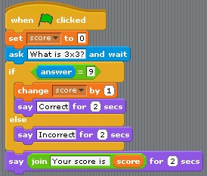

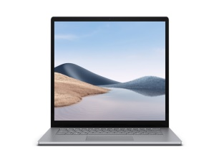
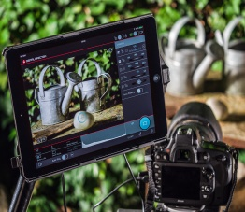
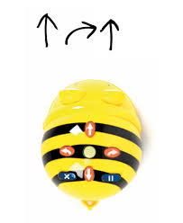
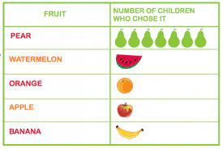

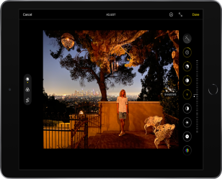
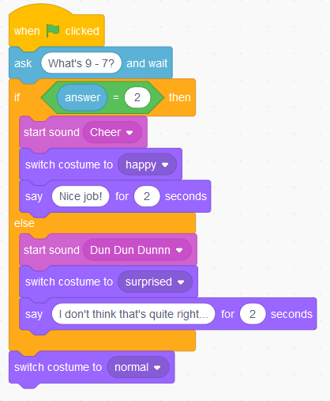
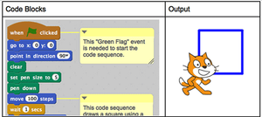
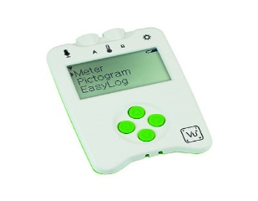

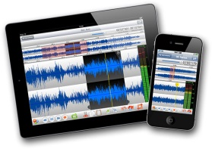


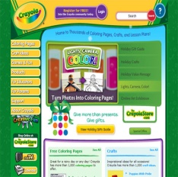
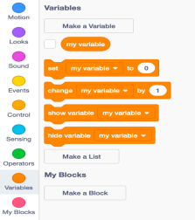
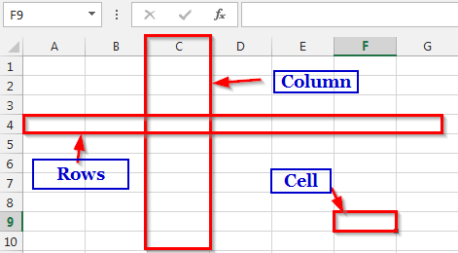
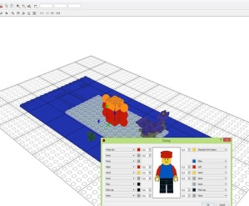
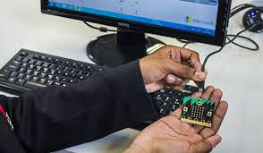
Overview for COMPUTING
Information technology around us - Identifying IT and how its responsible use improves our world in school and beyond.
Digital photography -
Capturing and changing digital photographs for different purposes.
Robot Algorithms
Creating and debugging programs, and using logical reasoning to make predictions.
Pictograms
Collecting data in tally charts and presenting data on the computer.
Respect, Inspire, Achieve
Making Music
Using a computer as a tool to explore rhythms and melodies, before creating a musical composition.
Programming Quizzes
Designing algorithms and programs that use events to trigger a sequence of code to make an interactive quiz.
Class Two
Repetition in shapes
Using a text-based
programming language to explore shapes.
Data logging
Recognising how
and why data is
collected over time, including an investigation.
The internet
Recognising the internet
as a network of networks
including the WWW, and
why we should evaluate online content.
Audio Editing
Capturing and editing
audio – considering copyright.
Internet Safety Day – February
Class Three
Photo editing
Manipulating digital
images.
Repetition in games
Using a block-based programming when creating a game.
Term 1
Subject or image
Internet communication
Recognising how the
WWW can be used
to communicate and
be searched.
Webpage creation
Designing and creating webpages, considering copyright/aesthetics/navigation
3D modelling
Planning, developing, and evaluating 3D computer models of physical objects.
Sensing
Designing and coding a project that captures inputs from
a physical device.
Variables in games
Exploring variables when designing and coding a game.
Introduction to spreadsheets
Answering questions by using
spreadsheets to organise and
calculate data.
Class Four
Term 1
Subject or image
Term 2
Subject or image
Year A
Aston By Sutton Primary School Road Map- COMPUTING

