Slide 1






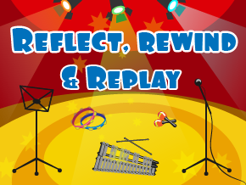
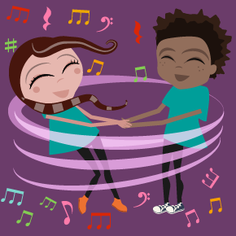

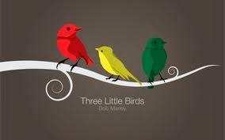
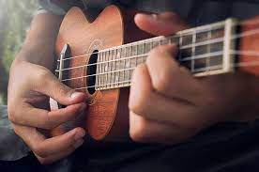

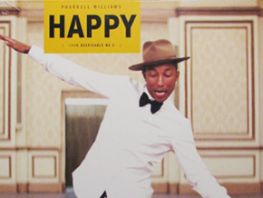
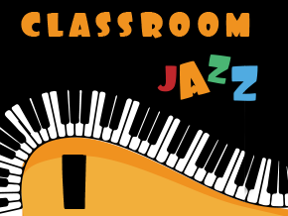

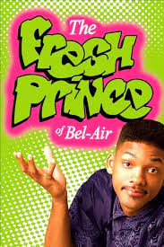
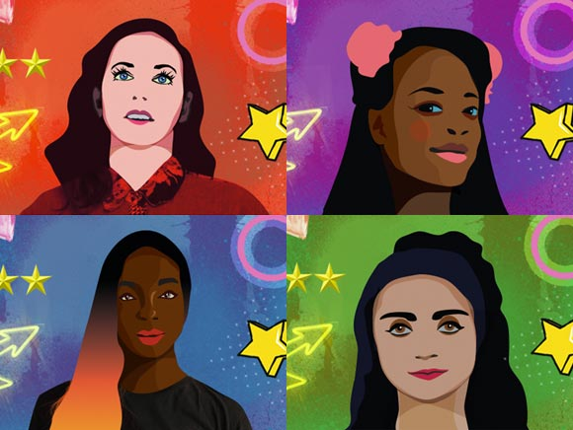
Overview for MUSIC
Respect, Inspire, Achieve
Term 1: Hey you / Hands, feet and heart
Learn about the differences between pulse, rhythm and pitch and to learn how to rap and enjoy it in its original form. As well as learning to sing, play, improvise and compose with this song, children will listen and appraise other Old-School Hip Hop tunes
Term 2: In the groove / I wanna play in your band
Explore pitch through singing games. Develop their singing voices, expression and using their voices as an instrument, Learn about breathing. Learn about singing and playing together in ensemble
Term 3: Your imagination / Reflect, Rewind and Replay
Listen and appraise classical music, learn chants and songs. Find the pulse in music.
Clap the rhythm of music. Improvise using voice and instruments. Choose instruments and learn to follow symbols as a score.
Class Two
Term 3: Bringing us together / Reflect, Rewind and Replay
Children can contribute to the performance by singing, playing an instrumental part, improvising or performing their composition
Appraise, listen, review, compare to other disco songs. Talk about the words telling a story
Term 2: Three little birds / Stop
Listen and appraise – structure, voices, instruments and pulse. Play, compose, improvise and share.. Sing in unison to Three Little Birds. Games, elements of music (pulse, rhythm, pitch etc.), singing and playing instruments are all linked. Listen and appraise other Reggae songs
Term 1: Ukelele
Introduce the children to learning about the language of music through playing the ukulele. The learning is focused around exploring and developing playing skills through the ukulele. Begin to look at scores.
Class Three
Term 1: Happy / Classroom jazz 1
Improvise and compose music, describe the style indicators and style of the songs. Understand the musical dimensions of music. Listen with attention to detail and recall sounds with increasing aural ability to talk about the performance discussing thoughts and feelings
Term 2: A new year carol / Fresh Prince of Bel Air
Sing in unison. Sing the song in its original style and the Urban Gospel version. Know the pulse, rhythm, pitch, tempo, dynamics, texture and structure work together to make a song sound interesting. Be able to keep the internal pulse. Know style indicators of hip hop
Term 3: Music & me / Reflect, rewind and replay
Explore the concept of ‘identity’ – the various elements that shape us. Focusing on gender, with reference to social and cultural differences. try out different ways of making their own music, while exploring the work of some of the most influential women in music over the last 100 years.
Class Four
Year B
Aston By Sutton Primary School Road Map- MUSIC

