Slide 1

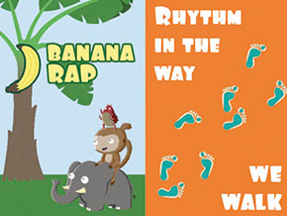


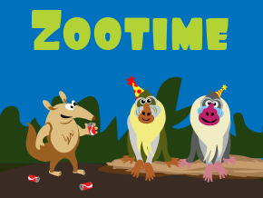









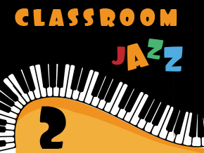

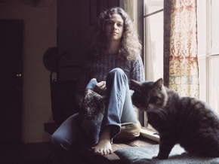

Overview for MUSIC
Respect, Inspire, Achieve
Term 1: Rhythm in the way we walk / Banana Wrap/Ho Ho Ho
All the learning is focused around two songs: Reggae style & Hip Hop style. Listen & appraise other styles of music and continue to embed the interrelated dimensions of music through games and singing.
Term 2: Round and Round / Zootime
Find the pulse and understand it’s the heartbeat of the music. Recognise and name 2 instruments. Begin to create own rhythms. Compare to reggae heard before.
Term 3: Friendship song / Reflect, Rewind and Replay
Know that songs have different styles. Develop playing of instruments. Continue to embed the foundations of the interrelated dimensions of music using voices and instrument
Class Two
Term 3: Blackbird / Reflect, Rewind and Replay
Understand about equality and civil rights – the songs / music will support and enrich the children’s understanding of its theme, while deepening their musical knowledge and experience.
Term 2: The Dragon song / Lean on me
Traditional Folk tunes from around the world, celebrating our differences and being kind to one another. Listen to soul/ gospel songs. To know the difference between pulse & rhythm & be able to keep the internal pulse
Term 1: Let your spirit fly/ Mama Mia
Begin to understand what the words of the song mean. Identify and move to the pulse
Listen to and appraise more Abba hits
Class Three
Term 1: Living on a prayer / Classroom jazz 2
Listening and appraising – identifying the structure, instruments and voices and appraising other rock songs
Learning is focused around two tunes and improvising: Bacharach Anorak and Meet The Blues
Term 2: Make you feel my love/ You’ve got a friend in me
Learn to sing, play, improvise and compose. Listen to and appraise pop ballads.
Integrated approach to music this term where games, the dimensions of music (pulse, rhythm, pitch etc), singing and playing instruments are linked
Term 3: Dancing in the street / Reflect, Rewind and Replay
Focus on inspirational women in music, use of pioneering gender equality initiative,
discover that music offers a perfect way of exploring and expressing our identity, giving us confidence, power and purpose
Class Four
Year A
Aston By Sutton Primary School Road Map- MUSIC

