Slide 1
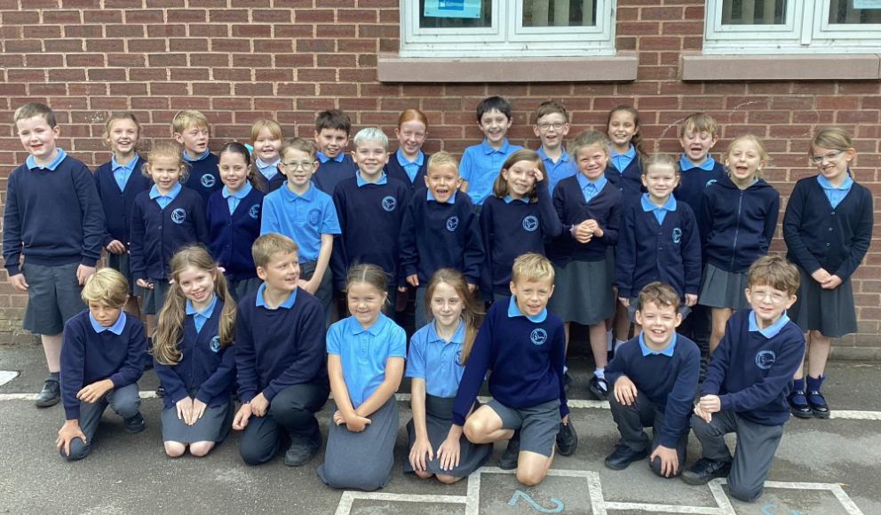
Meet the Teacher
Class 3

Slide 2
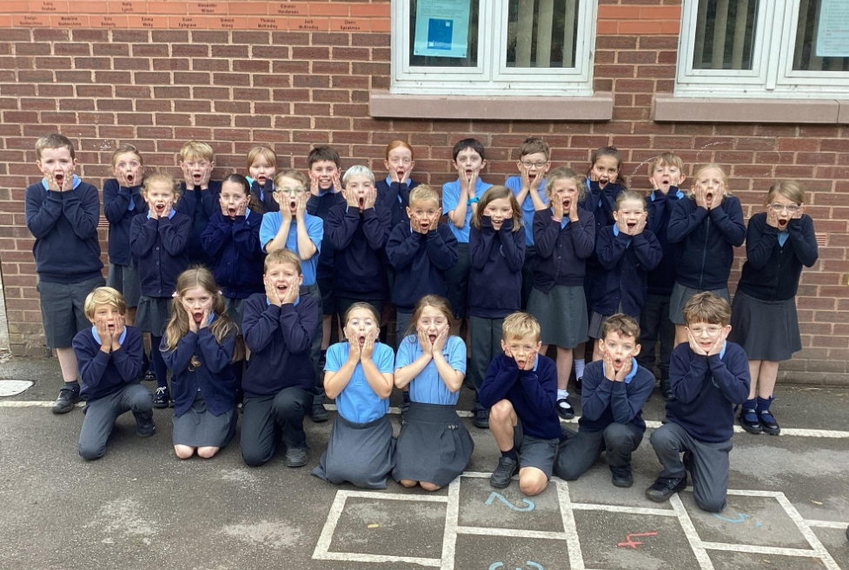
Mr Pritchard
Mrs Horsefield

Slide 3
Our school day
Morning:
8:30 Doors open -
Starter activity/grammar skills
8:40 Register
8:50 Handwriting
9:00 Assembly
9.15 English
10:15 Break
10:35 Times Tables Practice
10:50 Fluent Five (Maths skills)
11:00 Maths No Problem
12:00 Lunch
Afternoon:
13:00 Register/Quiet Reading
Monday – P.E / R.E / French
Tuesday –P.S.H.E / Music / Science
Wednesday – Guided Reading / Computing
Thursday – Guided Reading / Topic
Friday
– Art / D.T / P.E

Slide 4



English - Texts

Slide 5




Reading – In class and at home

Slide 6



Maths
Autumn Term:
Place Value
Addition and Subtraction
Multiplication and Division
Year 4 MTC prep

Slide 7


Science
- Autumn 1
Living Things and their Habitats
- Autumn 2 Electricity

Slide 8
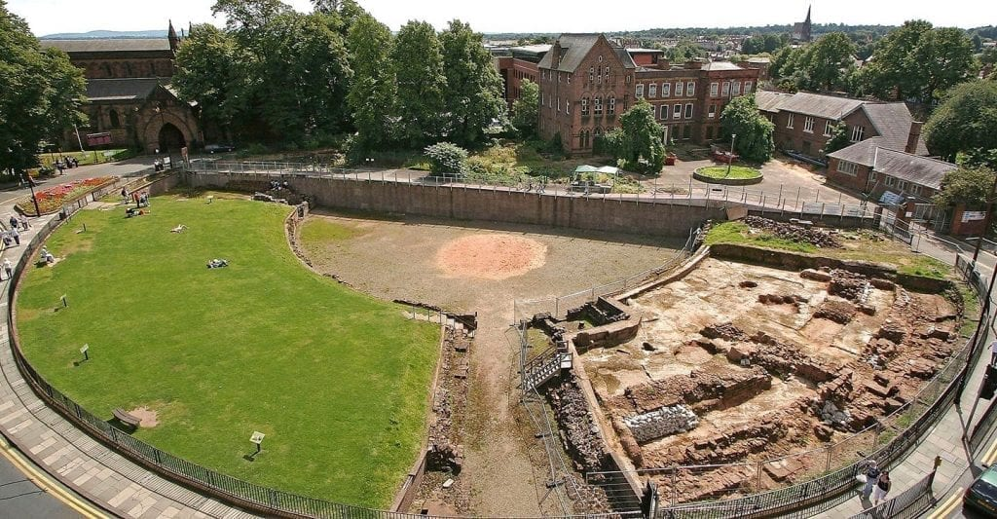
Topic – History/Geography:
The Romans

Slide 9
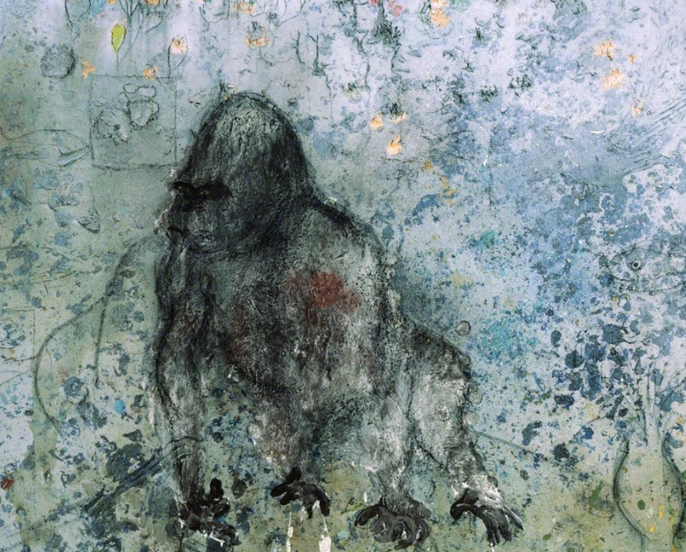
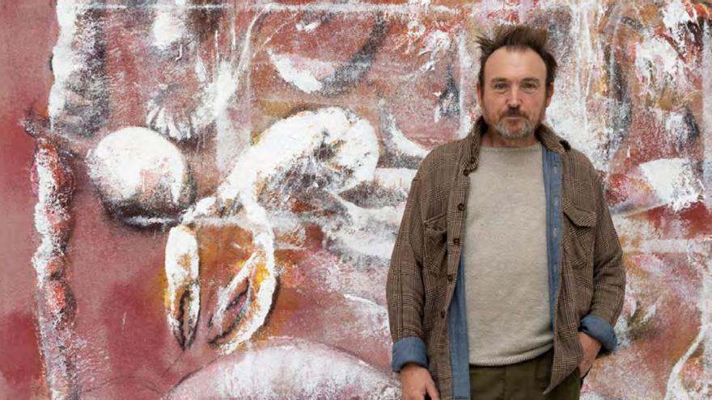
Art: Gorilla Paintings
– Miquel Barcelo

Slide 10
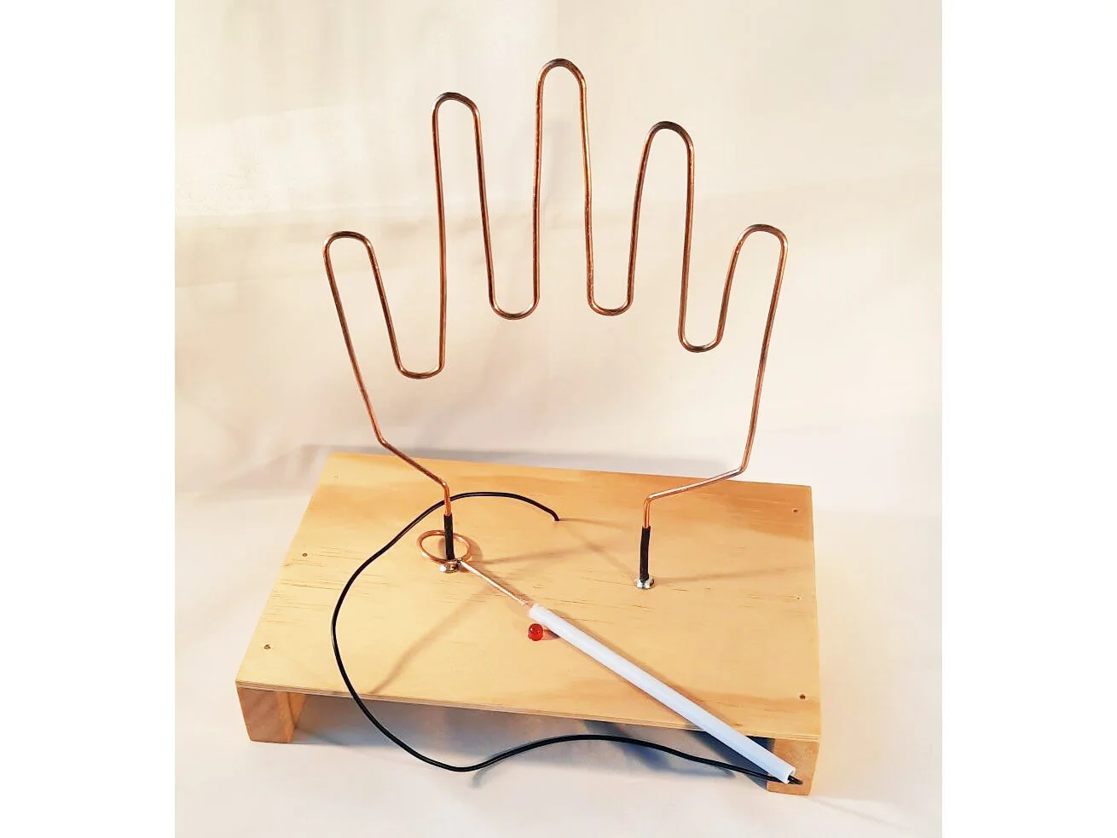
DT:
Simple Circuits
Design, make and evaluate a steady hand game.

Slide 11


Computing:
Autumn 1: Connecting Computers
Autumn 2: Audio Editing

Slide 12
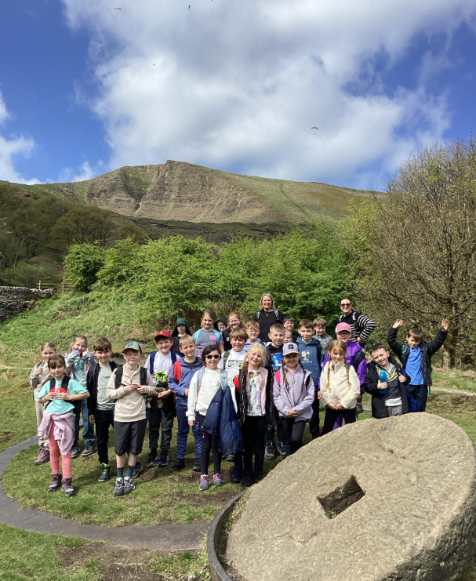
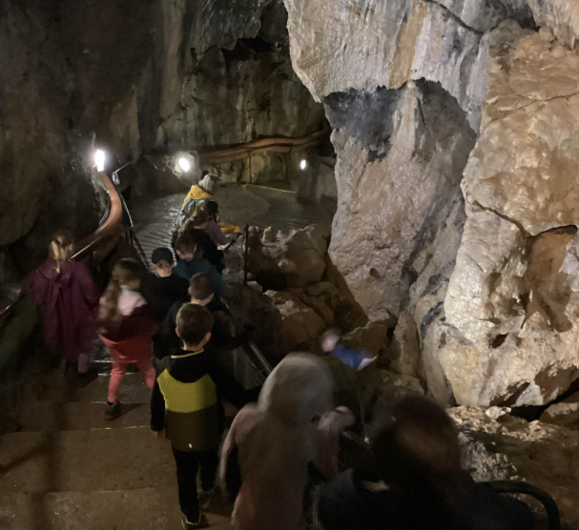
Residential – Castleton

Slide 13



Homework
Reading TTRS Spelling

Slide 14
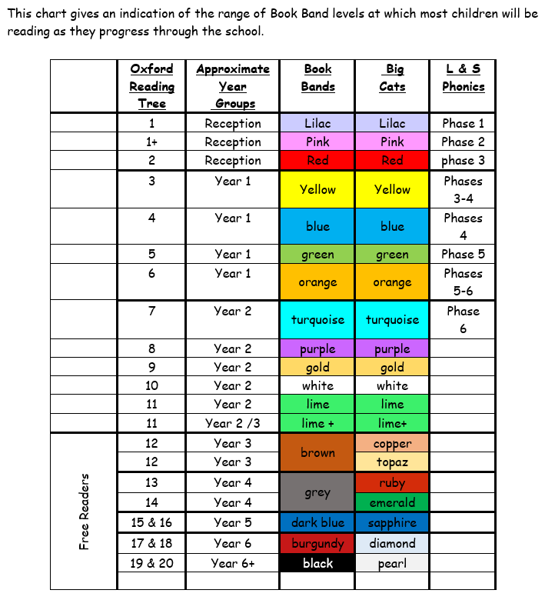
Reading

Slide 15
Spelling Homework
Blue book
Practice spellings
Look – cover – write
Bring in everyday
Pink book
5 Sentences
Find definition and use
Bring in Wednesday

Slide 16

Important information
PE day – Monday/Friday
Ukuleles
Swimming after Christmas
Class Dojo

Slide 17

Any Questions?

