Slide 1
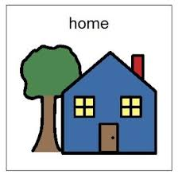

When will I be at home?
When will I be in school?
Monday Date: | Tuesday Date: | Wednesday Date: | Thursday Date: | Friday Date:
Drag and drop these into the slots for each day of the week to make a personalised timetable for your child.

