Slide 1
Assembly
Friday 11th September 2026

Slide 2


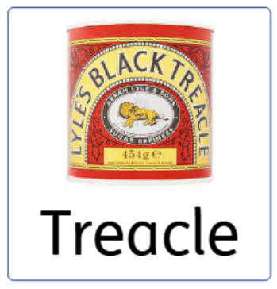
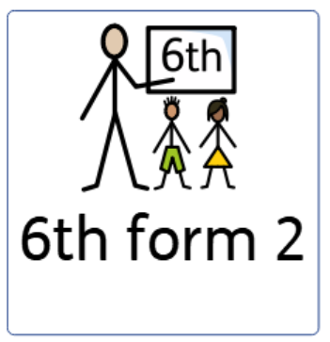

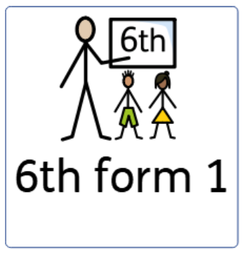



Who is here today?

Slide 3


Slide 4
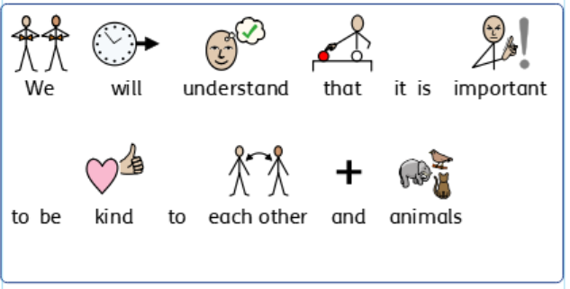
Learning Objective

Slide 5
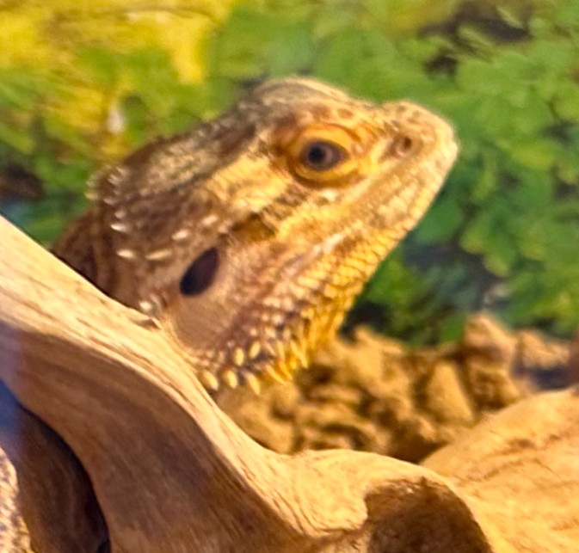
We have brought a visitor to assembly
Marbles

Slide 6

What is Marbles?

Slide 7
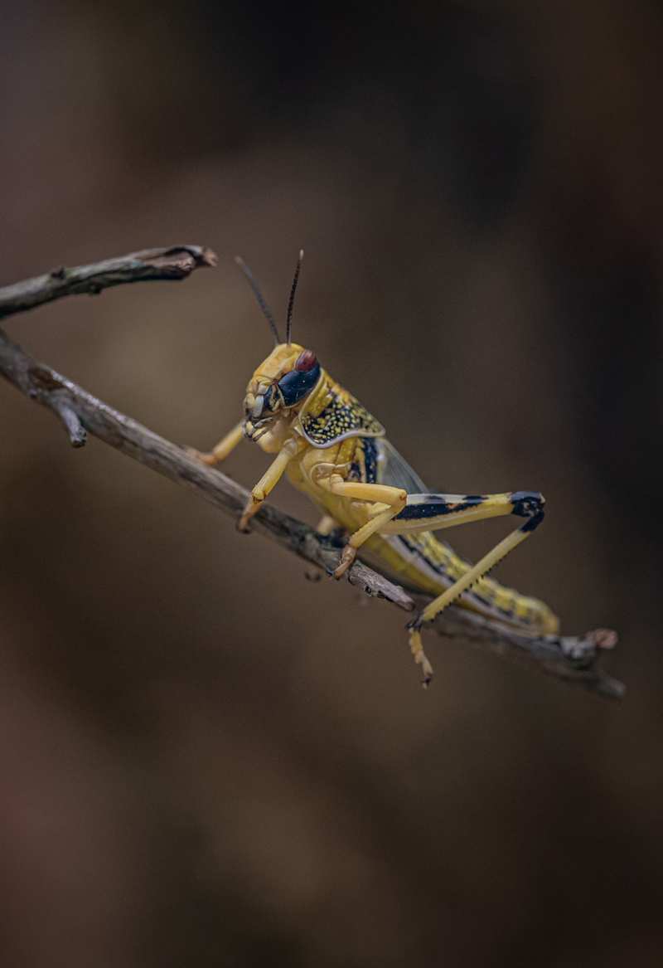

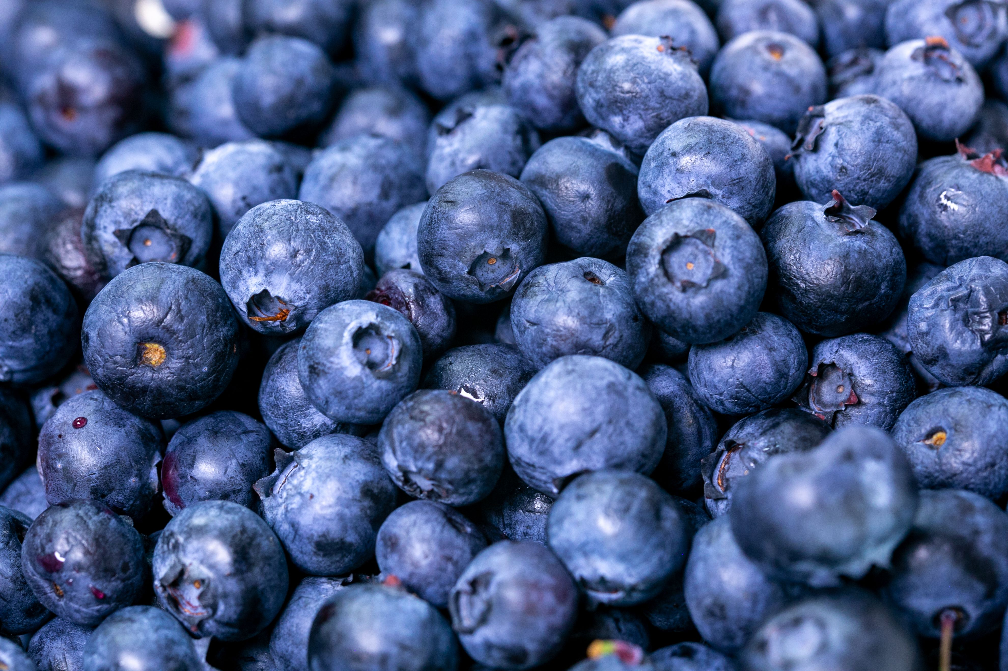



What does Marbles need to stay happy?

Slide 8
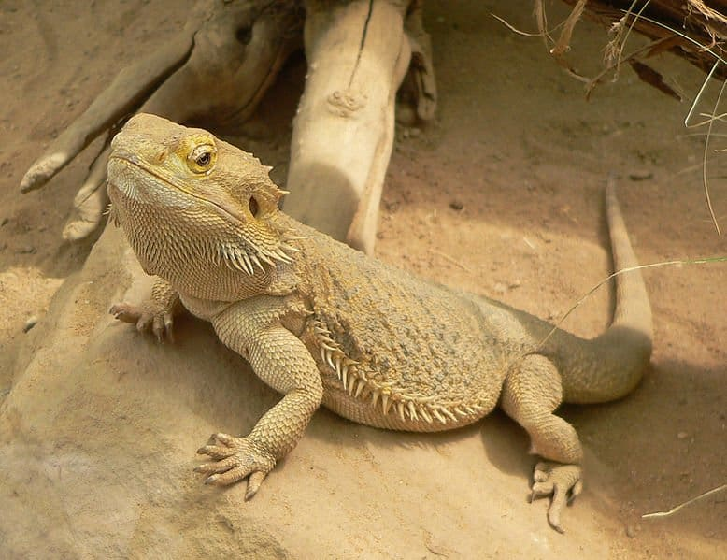
Marbles teaches us to care and be kind

Slide 9
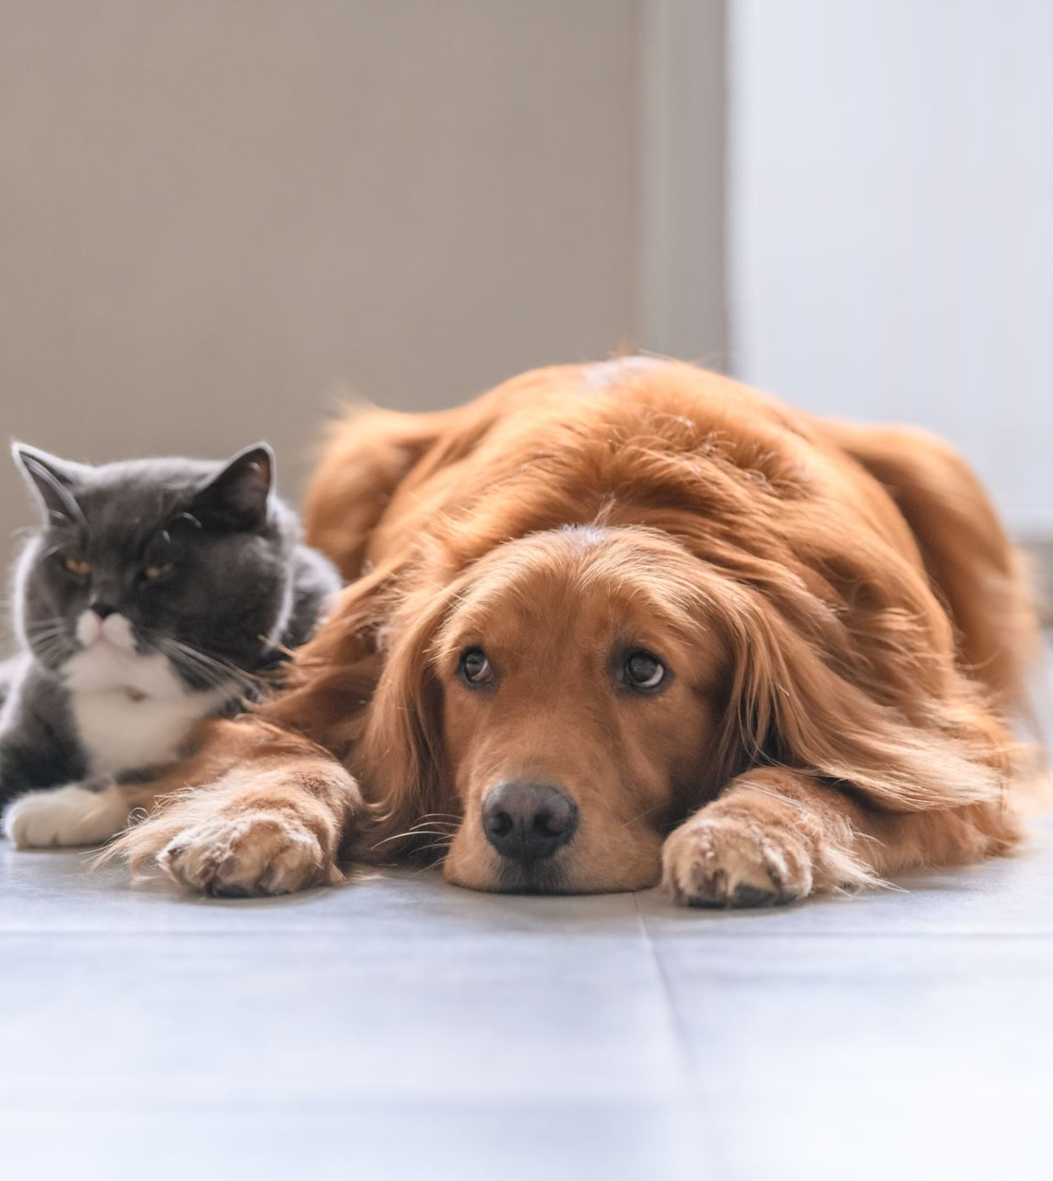
Does anyone have any other pets?
What do your pets need?
Are you kind and caring to your pets?

Slide 10

School Choir
The choir will sing their favourite songs

Slide 11

Certificates
Let’s celebrate the achievements of the week

Slide 12
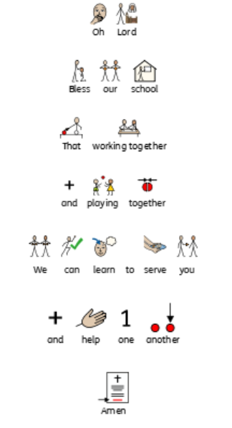

Reflection
Please put your hands together
for the school prayer

