Slide 1



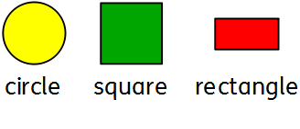

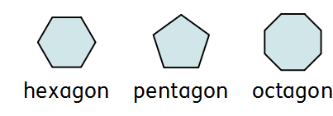

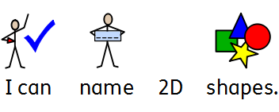





0
Maths
2D shape
Learning Outcome:
Student comment
Staff comment:

Slide 2
0
Maths
2D shape
Learning Outcome:
I can draw and label 2D shapes.
Student comment
Staff comment:

Slide 3
0
Maths
3D shape
Learning Outcome:
I can label and describe 3D shapes.
Student comment
Staff comment:

Slide 4
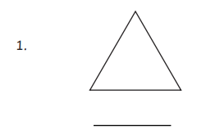
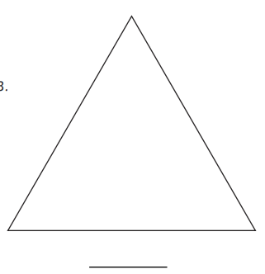
0
Maths
Perimeter
Learning Outcome:
I can measure perimeter.
Student comment
Staff comment:

Slide 5


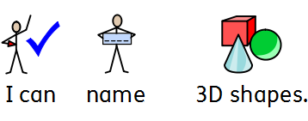
0
Maths : 3D shapes
Prism
Cube
Sphere
Cylinder
Cone
Learning Outcome:.
Student comment
Staff comment:

Slide 6
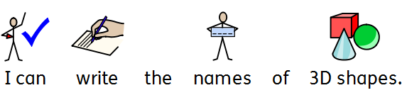
0
Maths : 3D shapes
Learning Outcome:.
Student comment
Staff comment:

