Slide 2
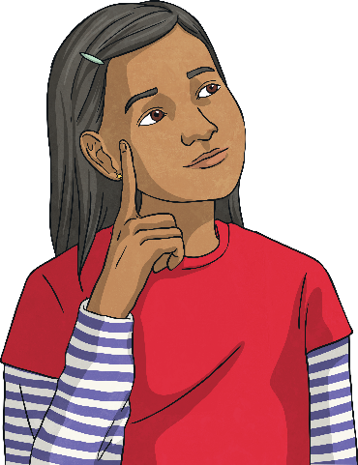







Mmmm…Chocolate!
Chocolate is one of the world’s most popular foods.
How many foods can you think of that include chocolate?
Despite the high demand for cocoa products, many cocoa farmers struggle to make ends meet.

Slide 3
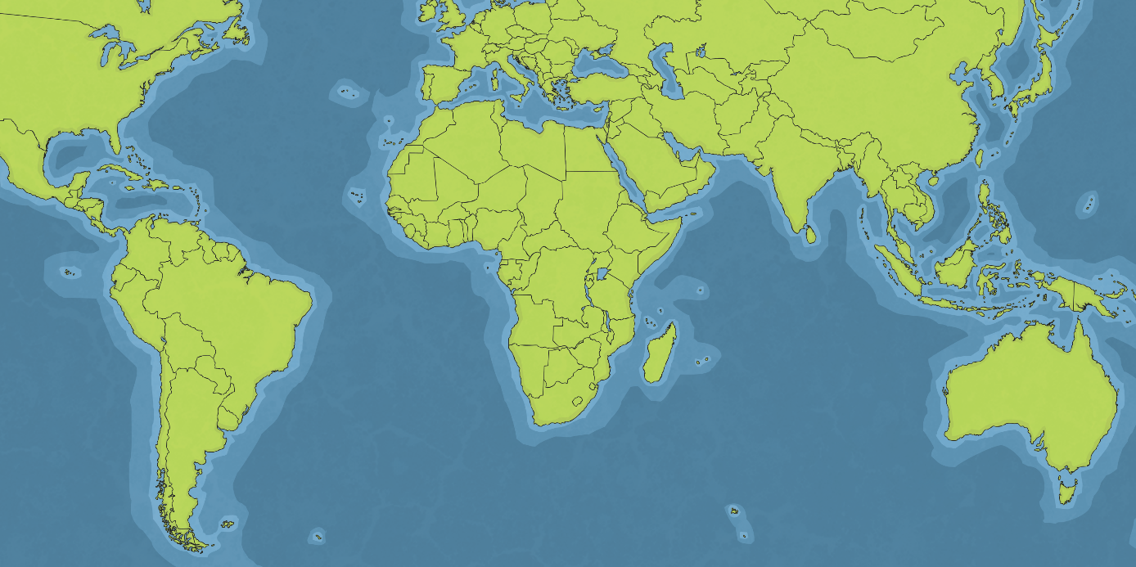
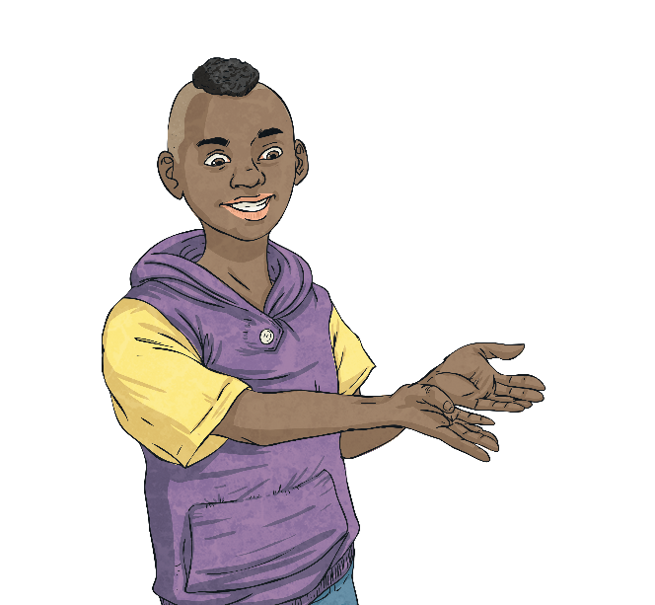
Where is Chocolate Grown?
90% of all cocoa is grown by 6 million farmers on small family farms. These farms are located in tropical climates, within 15 and 20 degrees latitude of the equator. The hot, rainy climate favours lush vegetation, which gives shade to the cocoa trees and creates perfect growing conditions.
Use an atlas to identify the main cocoa growing countries.
Papua
New Guinea
Colombia
Cote D’Ivoire
Equador
Ghana
Malaysia
Nigeria
Indonesia
Cameroon
Brazil

Slide 4
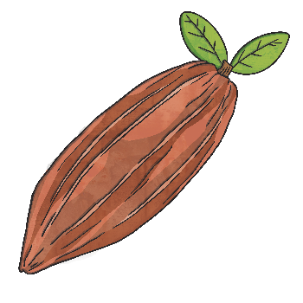



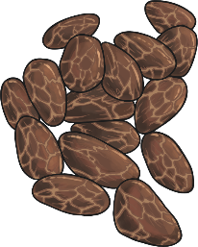
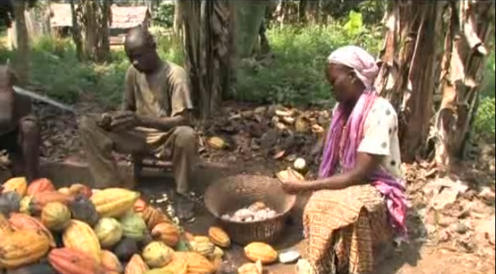

Growing Cocoa
Growing cocoa is a hard job. The trees must be protected from wind, sun and pests. It takes five years before the cocoa trees produce the maximum number of cocoa pods. The trees can be farmed for about ten years.
Harvesting the cocoa beans from the pods is also very labour intensive.
Remove the cocoa beans by hand.
Wrap the beans in a banana leaf and leave to ferment in the shade.
Compost the pods or burn them and use the ash to make soap.
After weeks of fermenting, spread the beans to dry in the sun for up to ten days.
Turn the cocoa beans regularly by hand, discarding those of poor quality.
Watch this video clip of the Kuapa Kokoo farmers in Ghana harvesting the cocoa beans.

Slide 5



A Fair Trade?
The international price of cocoa is rising because of the high demand for cocoa products.
However, this benefit is not passed on to the farmers. The benefits of farming the cocoa are very poor, with few young people wanting to stay on their family farms. Their income does not rise in line with the international cocoa price, despite the cost of maintaining the cocoa crop remaining high. Often, big companies buy the cocoa at a low price. Sometimes, these companies have been known to cheat when it comes to weighing the farmers’ crops, just so that they can pay them less.
Can you think of ways that would help farming communities make cocoa farming more successful? What would farmers need for support?

Slide 6
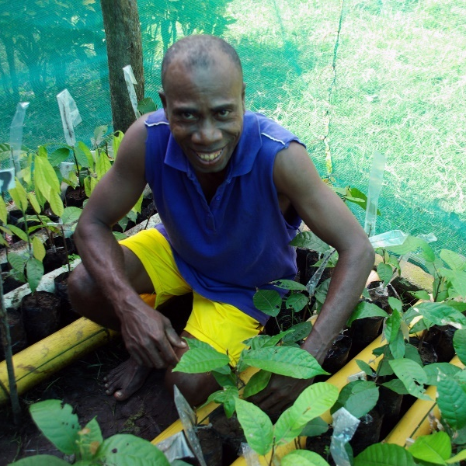
What is Fairtrade?
Fairtrade is a global organisation that helps farmers in countries such as Ghana. The aim of Fairtrade is to give a guaranteed, fair price for the products that they grow. An extra Fairtrade premium means that farmers can invest in their farm and community.
My community worked together to build a fresh water well.
Fairtrade means I have a guaranteed income so I can invest in my farm. I can protect my crop from pests and disease.
With the Fairtrade Premium, our children can go to school for a better education.
FACT: In 2013-14, cocoa farmers earned more than £8.4 million in Fairtrade premiums. Almost a quarter was invested to support families in their daily routines. Examples include schools, water and housing.
Photo courtesy of (DFAT@flickr.com) - granted under creative commons licence – attribution

Slide 7
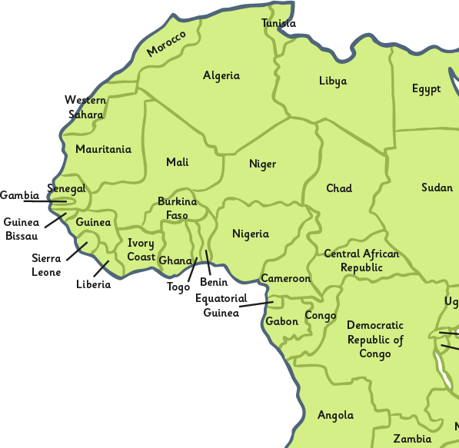
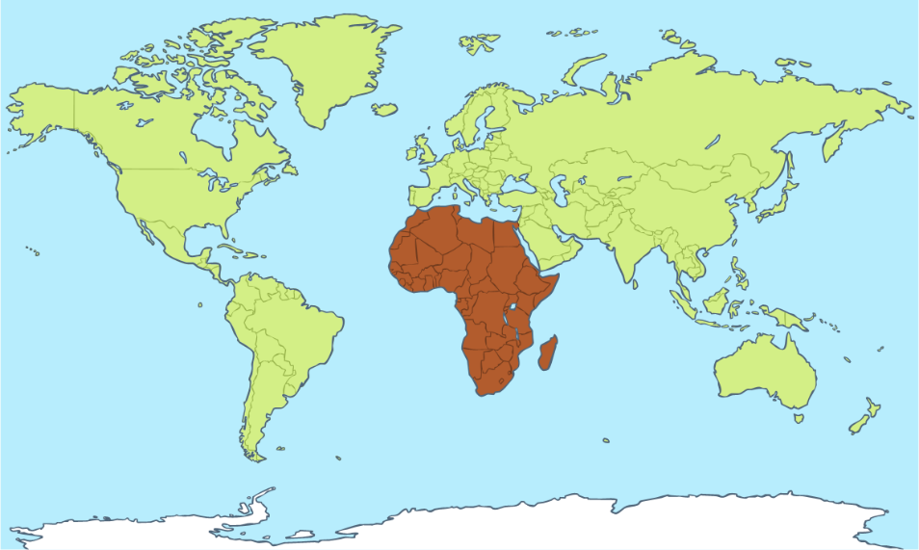
Fairtrade Farms
Kuapa Kokoo is located in Kumasi, at the centre of the cocoa-growing region in the west of Ghana.
Did You Know?
The quality of cocoa beans from Ghana is ranked number one in the world!
Almost all cocoa produced in Ghana is exported around the world. This makes cocoa Ghana’s second most important product after gold!

Slide 8



Kuapa Kokoo
Kuapa Kokoo is a farming cooperative in Ghana with 85,000 farmers as members. What effects has the Fairtrade Premium had here?
Purchase of mosquito nets, which have helped to improve health.
New schools have been built; links have been made between UK and Ghanaian schools to support learning.
Drinking wells have been dug; mobile doctor clinics have been brought to the area; special projects have been provided for women (32% of the farmers are women).
Scales have been provided to give truthful, accurate crop weights for fair payment; training for farmers and farm workers is given.
Looking at the ways Kuapa Kokoo farmers have spent their Fairtrade premium, what might life have been like before Fairtrade? How has Fairtrade made a difference? Have a go at hot-seating, taking it in turns to be a farmer before and after belonging to a fair trade cooperative.

Slide 9

Cocoa Life
Cocoa Life is a programme that has invested over £300 million to help Cocoa farmers and their communities in six key areas – Ghana, Côte d'Ivoire, Indonesia, India, the Dominican Republic and Brazil.
By 2022, they aim to help over 200,000 farmers through teaching them skills to improve their livelihoods and opportunities.

Slide 10
Cocoa Life
Cocoa Life has 5 key areas they want to improve.
Environment
Protecting the landscape and helping farmers improve crop conditions.
Livelihoods
Helping farmers find other ways to make money and helping them with their money.
Farming
Giving farmers better tools and improving the way they grow and farm crops.
Youth
Making sure children are educated properly, and inspiring children to become cocoa farmers.
Community
Empowering communities to take charge of their development.

Slide 11
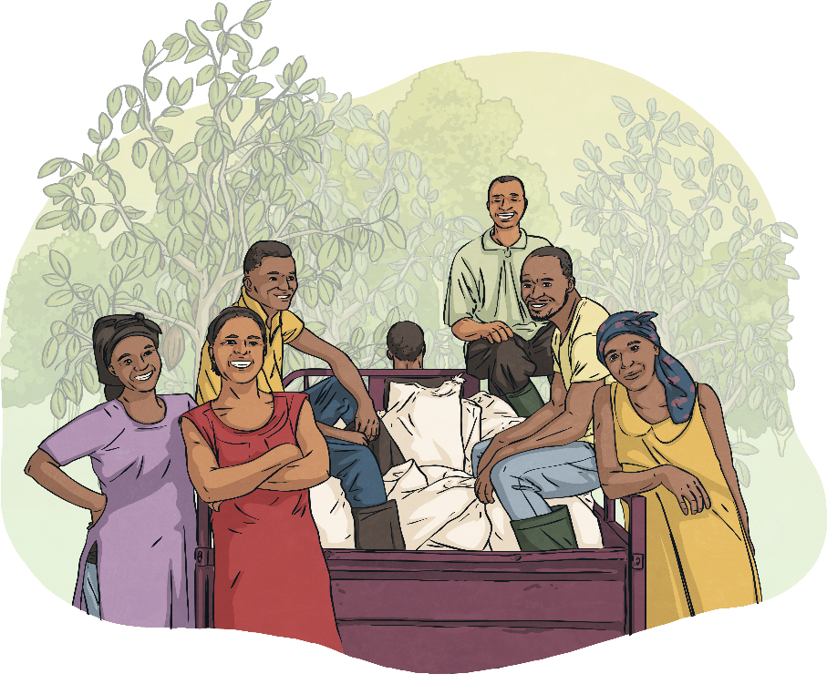
Cocoa Life
In 2016, Cocoa Life formed a new partnership with Fairtrade and as a result, all Cadbury products in the UK and Ireland in 2019 will be supporting the Cocoa Life Programme.
This means that if a product has the Cocoa Life logo
on it, you know the farmers who harvested the cocoa
are being paid fairly and are benefitting
from the cocoa life programme.

Slide 12
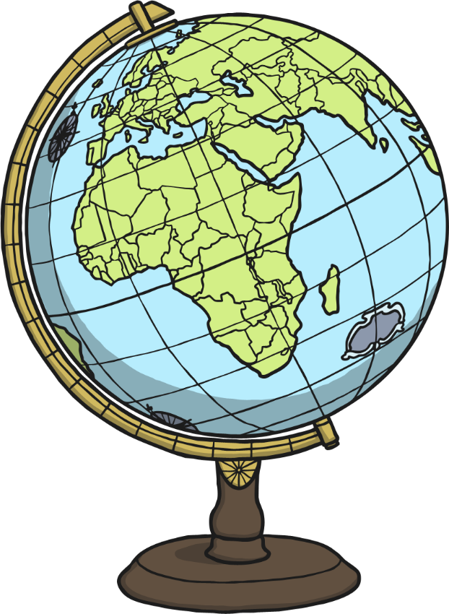
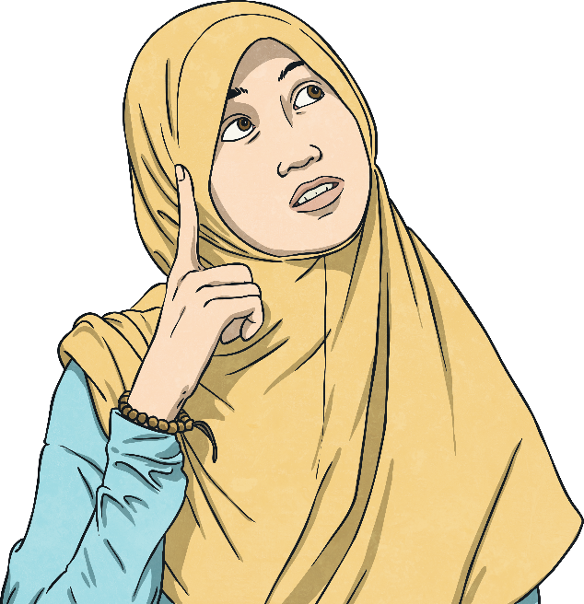
Fair Trade For Farmers
Cocoa is grown in some of the world’s poorest countries. Cocoa Life and fair trade aims to give a fair deal to farmers and farm workers so they can invest in and control their own future. By choosing Cocoa Life products, you are supporting cocoa farmers and their families.
What are your views?

