Slide 1


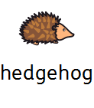
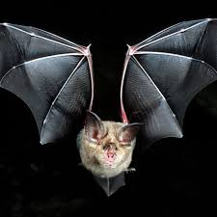


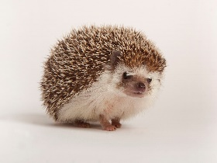

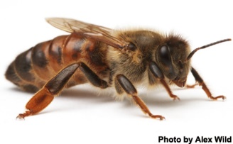
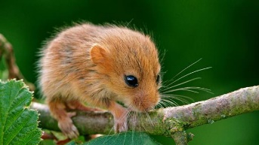
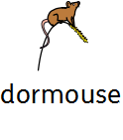

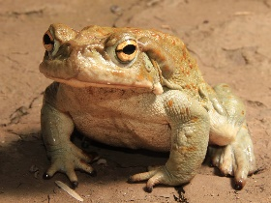





Literacy
Don’t Hog the Hedge
Learning outcome: I can match pictures and symbols from the story.
Student comment
Staff comment:

Slide 2
Literacy
Don’t Hog the Hedge
Learning outcome: I can make a stick puppet and control my pencil.
Student comment
Staff comment:

Slide 3
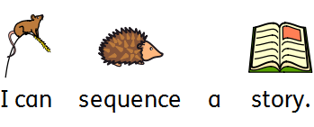
Literacy
Don’t Hog the Hedge
Learning outcome:
Student comment
Staff comment:

