Slide 1
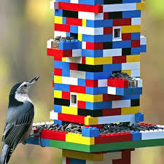
Building challenge Week beginning: 12.07.20
Task: Use your building blocks to build a bird feeder

