Slide 1

Tiny Seed sensory story
You will need:
Hairdryer, paper fan or balloon pump
Edible seeds (e.g. poppy , pumpkin, edible sunflower seeds)
( could substitute with sprinkles)
A torch
Ice cubes
A bowl of water
Sand
Switch with birdsong
Cotton wool
Water mister / sprayer
Herbs with long stems e.g. basil. Mint or chives
10 cut out leaves set 1 numbered 1-3 set 2 numbered 1-7
A flower that smells ( or car air freshener )
Folded paper for butterfly
Scraps of tissue paper or confetti
Seed head with seeds or sprinkles / hundreds and thousands in dispenser
or pepper pot
Squeaky plastic mouse cat toy

Slide 2
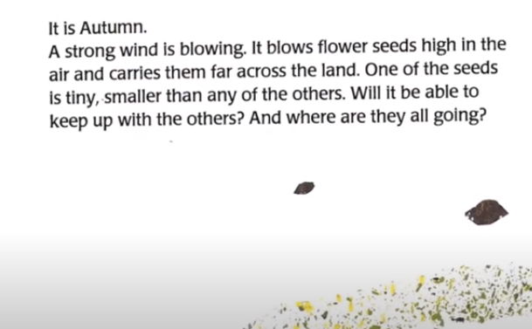
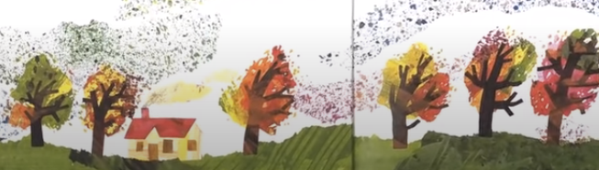
Use some poppy seeds, or sprinkles and use a fan. Hairdryer or balloon pump for the wind
Blow the ‘seeds’ from the student s hands or tray

Slide 3
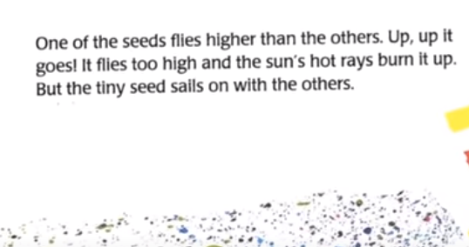
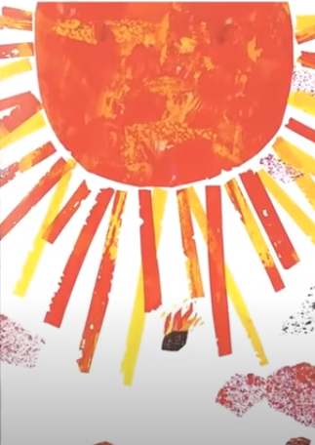
Shine a torch above the students head for the sun ( not allowing them to look directly at it)

Slide 4
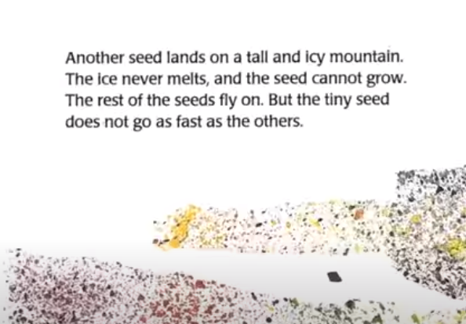
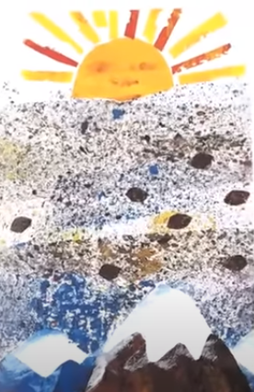
Feel some ice cubes

Slide 5
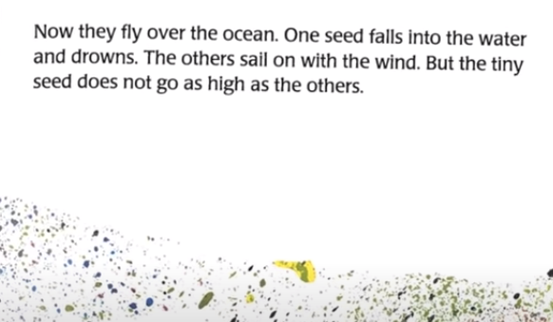
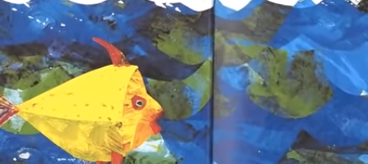
Swish hands in a bowl of water

Slide 6
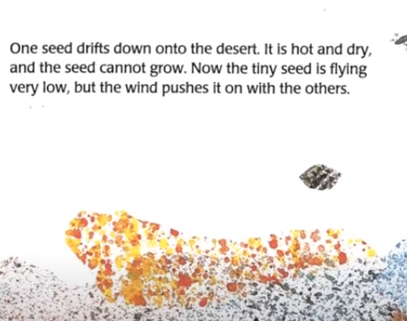
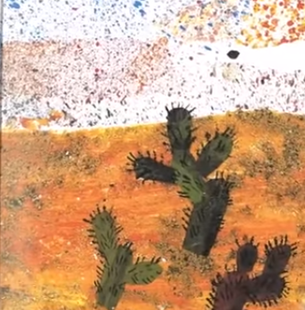
Feel sand
It can be warmed in the microwave first to make it warm

Slide 7
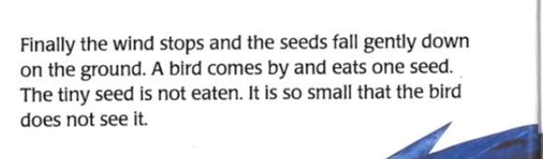
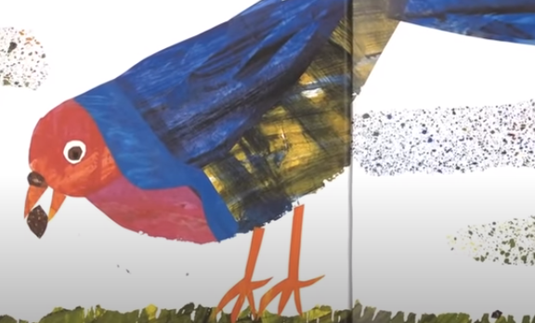
Use a switch for bird noise
Taste an edible seed
Pumpkin / pomegranite

Slide 8
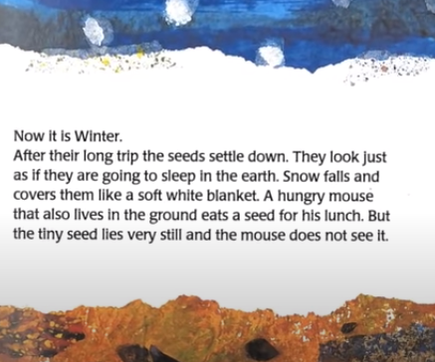
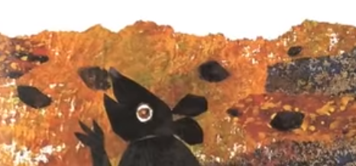
Place cotton wool over student’s hands
Use squeaky plastic cat toy mouse across students tray / table

Slide 9
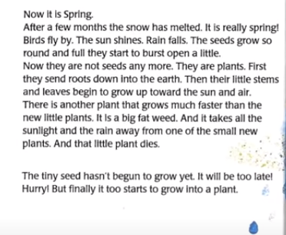
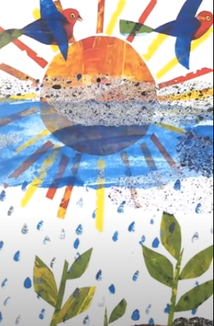
Use water sprayer for rain
Spray students hands or mist around their face

Slide 10
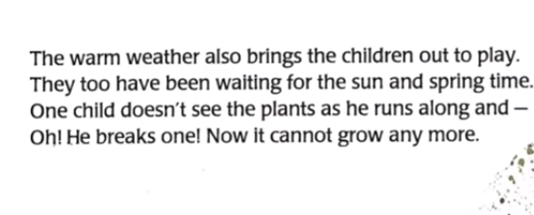
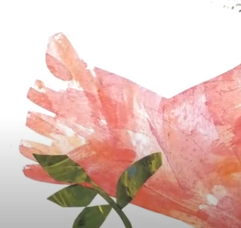
Use herbs with stems and break
Students feel and smell the broken stems
Use mint, rosemary chives etc

Slide 11
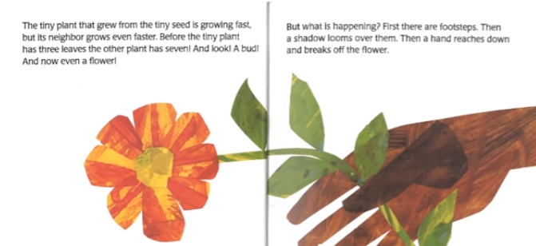
Have 10 leaves real or cut out
count 3
Then count 7

Slide 12
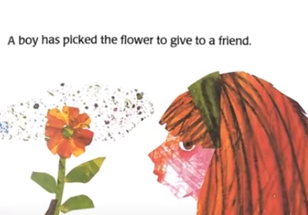
Have a flower to smell. Give it to the student

Slide 13
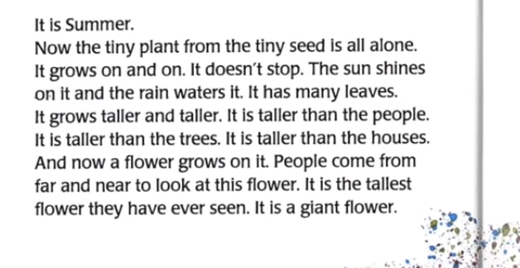
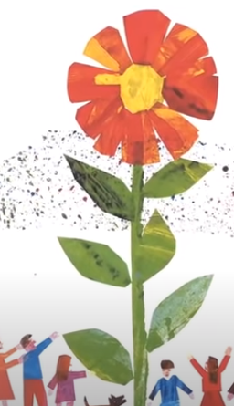
Encourage the students to stretch up as tall as they can

Slide 14
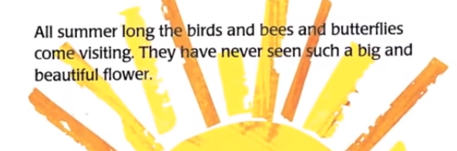
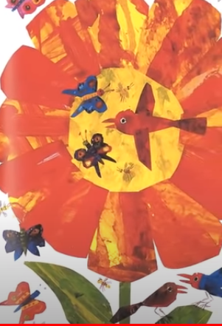
Waft a small piece of paper or ‘butterfly’ past the students face or hands
Encourage the student to buzz like a bee

Slide 15
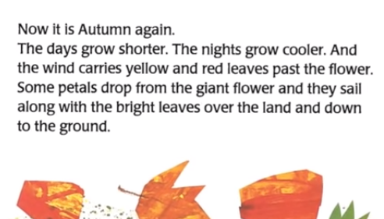
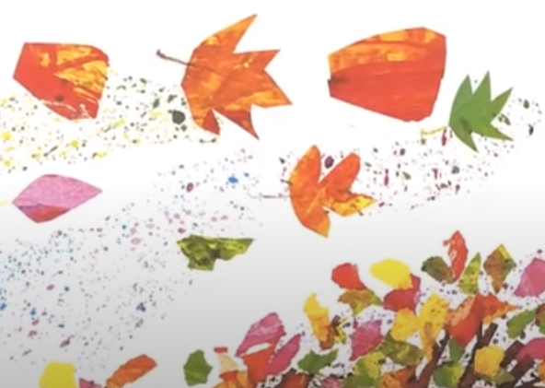
Use confetti or small pieces of tissue paper scraps to float down past the students face

Slide 16
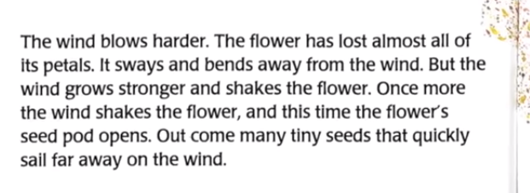
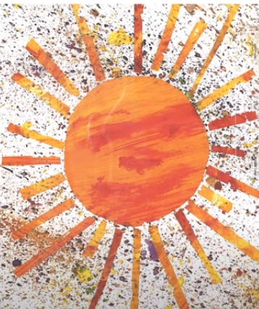
Shake seeds from a dried seed head or use hundreds and thousands or sprinkles from a pepper pot or dispenser
Blow the seeds across the table or tray
Allow the student to feel a blast of air from a fan, balloon pump or hairdryer for the wind

