Slide 1
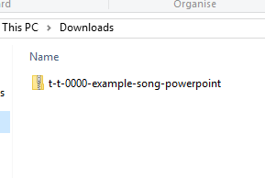
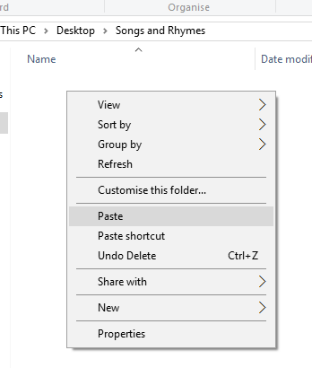

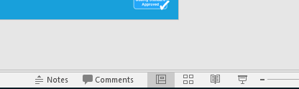
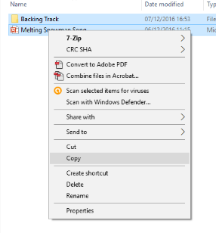
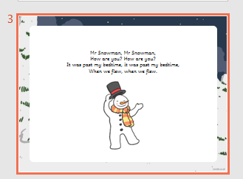
Guidance for Video/Audio in PowerPoints
1. Open the folder and copy all the files.
2. Paste the copied files into a new folder.
3. Open the PowerPoint file, enable editing and enter presentation mode (start the slide show). Go to slide 3 and the backing track will start automatically.
Please note the embedded audio may not be compatible with early versions of PowerPoint.
You may wish to delete this slide before beginning the presentation.

Slide 3



So, the zoo sent me an elephant, ‘Toot, toot’.
So, the zoo sent me an elephant, ‘Toot, toot’.
So, the zoo sent me an elephant,
So big he was magnificent.
The zoo sent me an elephant, ‘Toot, toot’.

Slide 4

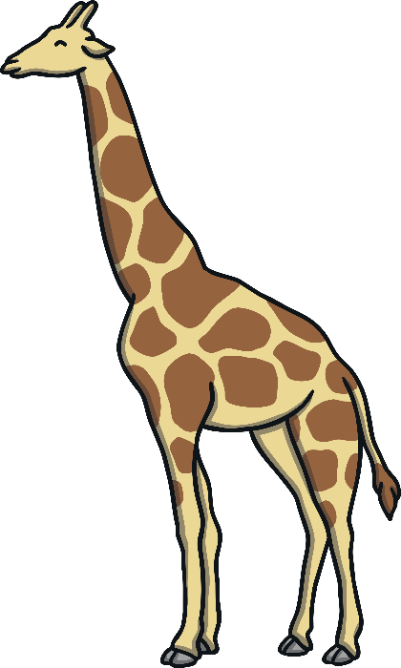
So, the zoo sent me a gi-raffe, it was tall.
So, the zoo sent me a gi-raffe, it was tall.
So, the zoo sent me a gi-raffe,
He’s so tall he made us all laugh.
So, the zoo sent me a gi-raffe, it was tall.

Slide 5

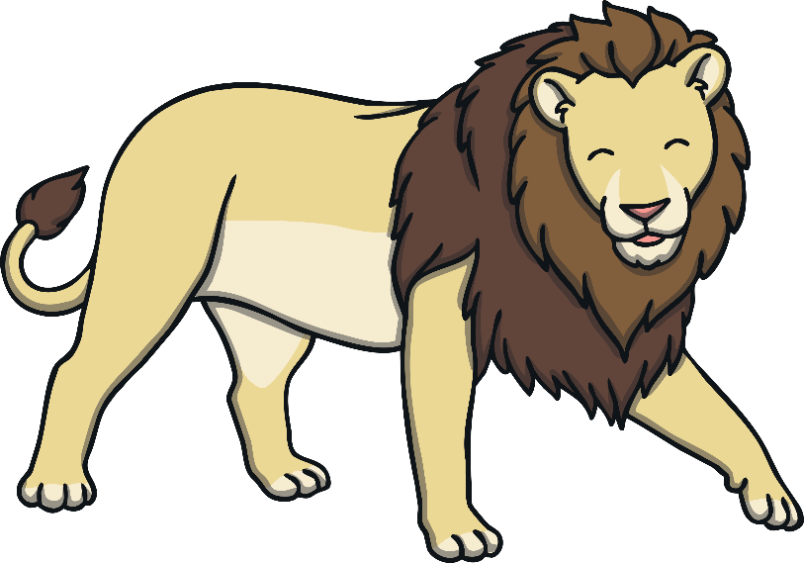
So, the zoo sent me a lion, it went, ‘Roar’.
So, the zoo sent me a lion, it went, ‘Roar’.
So, the zoo sent me a lion,
So, fie-rce we all were hidin’.
So, the zoo sent me a lion, it went, ‘Roar’.

Slide 6
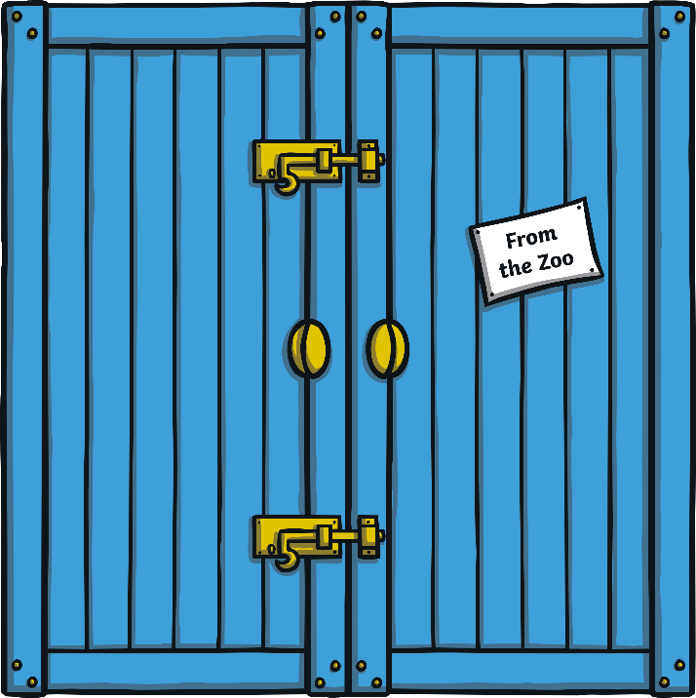

So, the zoo sent me a camel, see its hump.
So, the zoo sent me a camel, see its hump.
So, the zoo sent me a camel,
He’s the grumpiest of mammals.
So, the zoo sent me a camel, see its hump.

Slide 7


So, the zoo sent me a long snake, hear it ‘Hiss’.
So, the zoo sent me a long snake, hear it ‘Hiss’.
So, the zoo sent me a long snake,
Too scary it made us all quake.
So, the zoo sent me a long snake, hear it ‘Hiss’.

Slide 8
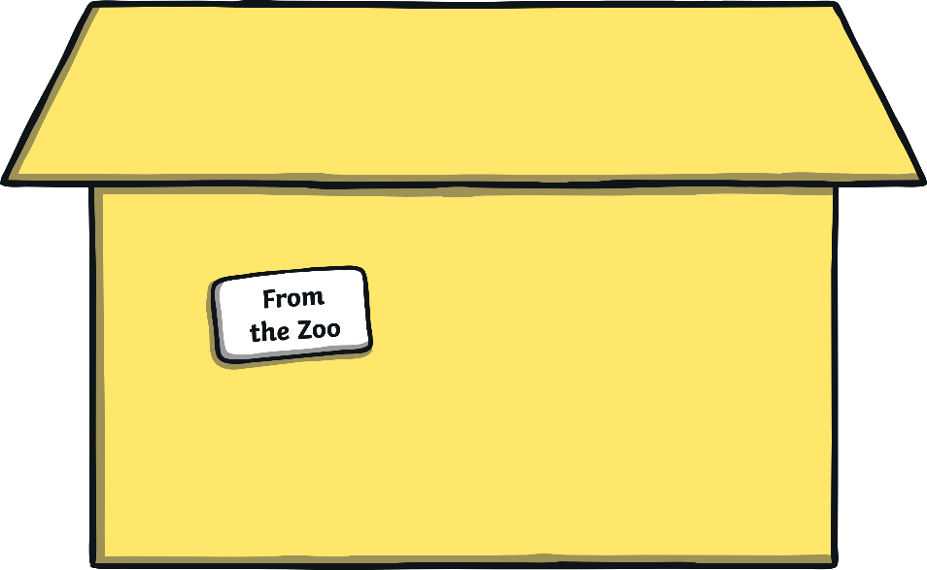
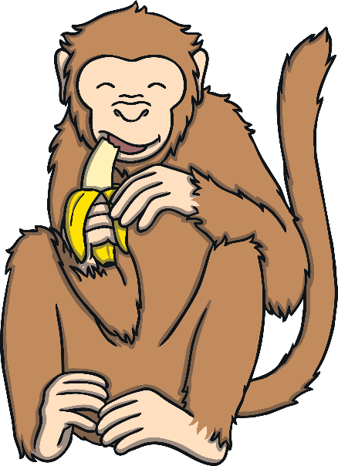
So, the zoo sent me a monkey, ‘Ooh, ooh, ooh’.
So, the zoo sent me a monkey, ‘Ooh, ooh, ooh’.
So, the zoo sent me a monkey,
Too naughty but it is funky.
So, the zoo sent me a monkey, ‘Ooh, ooh, ooh’.

Slide 9
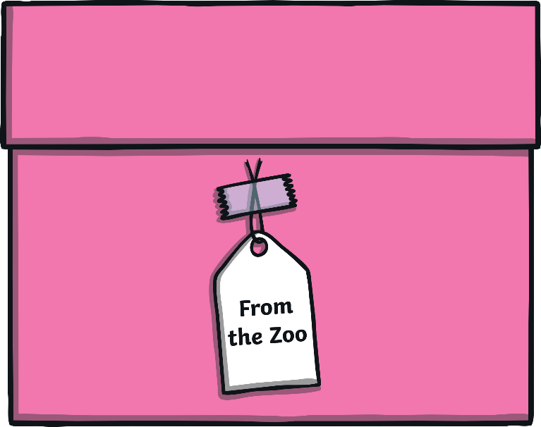

So, the zoo sent me a green frog, it went, ‘Croak’.
So, the zoo sent me a green frog, it went, ‘Croak’.
So, the zoo sent me a green frog,
Jumped so much we were all agog.
So, the zoo sent me a frog, it went, ‘Croak’.

Slide 10
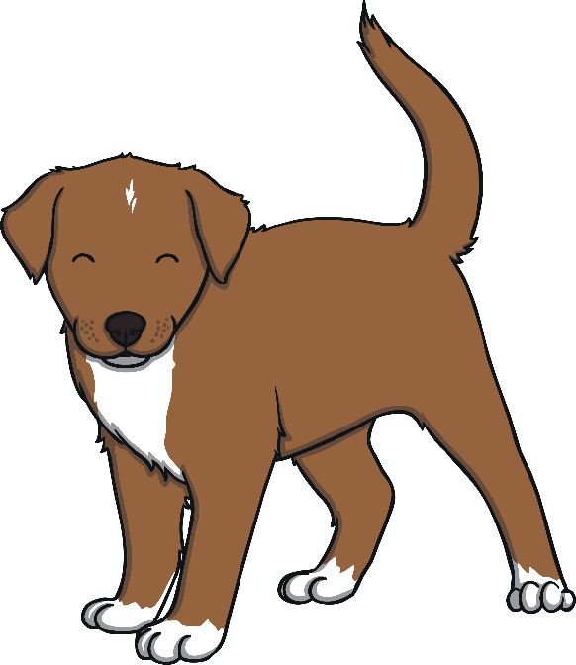

So, the zoo sent me a puppy, ‘Woof, woof, woof’.
So, the zoo sent me a puppy, ‘Woof, woof, woof’.
So, the zoo sent me a puppy,
He’s so cute and really fluffy.
So, the zoo sent me a puppy, ‘Woof, woof, woof’.

