Slide 1
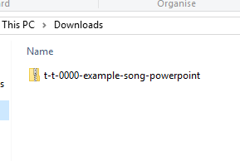
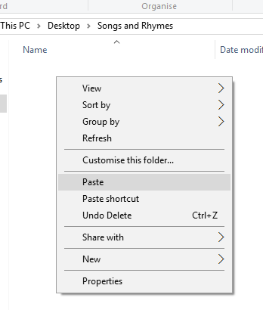

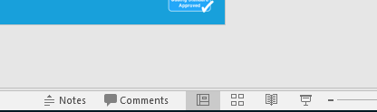
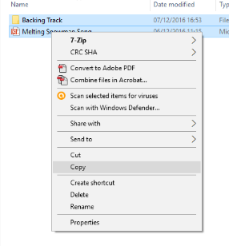
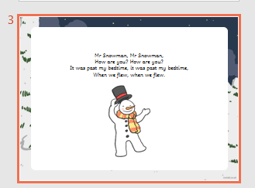
Guidance for Video/Audio in PowerPoints
1. Open the folder and copy all the files.
2. Paste the copied files into a new folder.
3. Open the PowerPoint file, enable editing and enter presentation mode (start the slide show). Go to slide 3 and the backing track will start automatically.
Please note the embedded audio may not be compatible with early versions of PowerPoint.
You may wish to delete this slide before beginning the presentation.

Slide 3

Will the zoo send me a pet,
Me a pet, me a pet?
Will the zoo send me a pet,
If I ask them?
?

Slide 4

Wrote a letter to the zoo,
To the zoo, to the zoo.
Wrote a letter to the zoo,
Then we’ll post it.

Slide 5







Then the zoo sent lots of pets,
Lots of pet, lots of pets.
Then the zoo sent lots of pets,
We can’t keep them.

Slide 6

Got a puppy, from the zoo,
From the zoo, from the zoo.
Got a puppy from the zoo,
And I kept him.

