Slide 1









Module :Safety
Rule | Why is this essential?
Learning outcome: I can identify rules to keep us safe. I can describe how to call 999 and explain why it is essential to follow instructions.
Student comment
Staff comment:

Slide 2
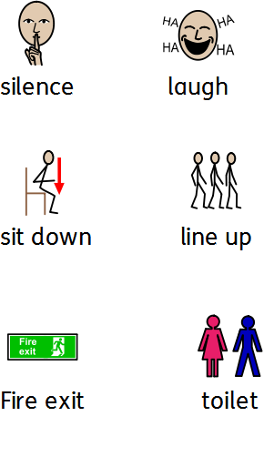
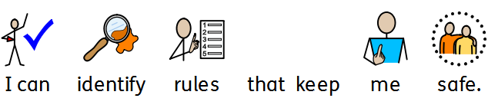
Module :Safety
Learning outcome:
.
Student comment
Staff comment:

Slide 3
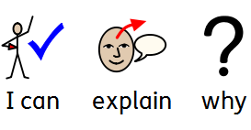
Module :Safety
Learning outcome:
.
Student comment
Staff comment:

