Slide 2
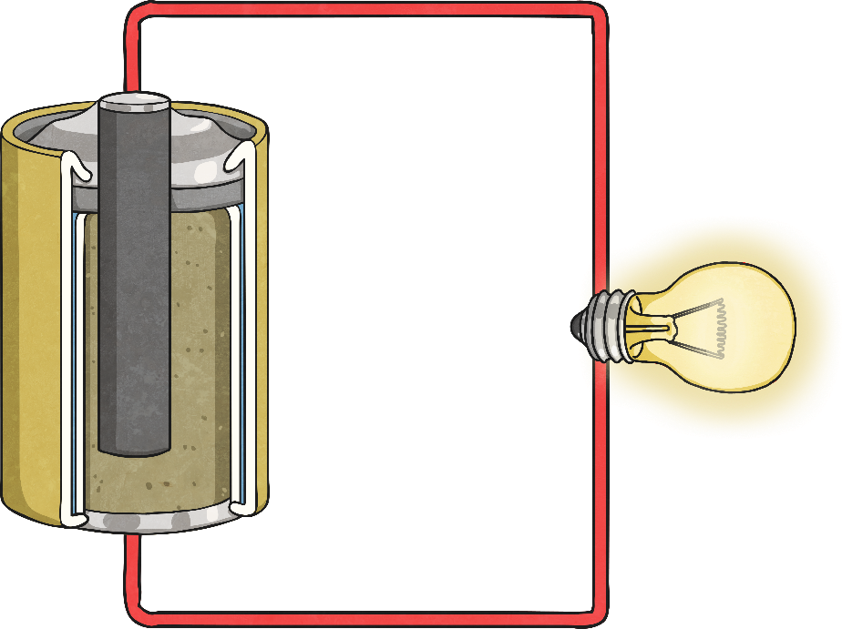
Circuits
A circuit is a path of electricity.
We use circuits everyday even though we might not be aware of it.

Slide 3
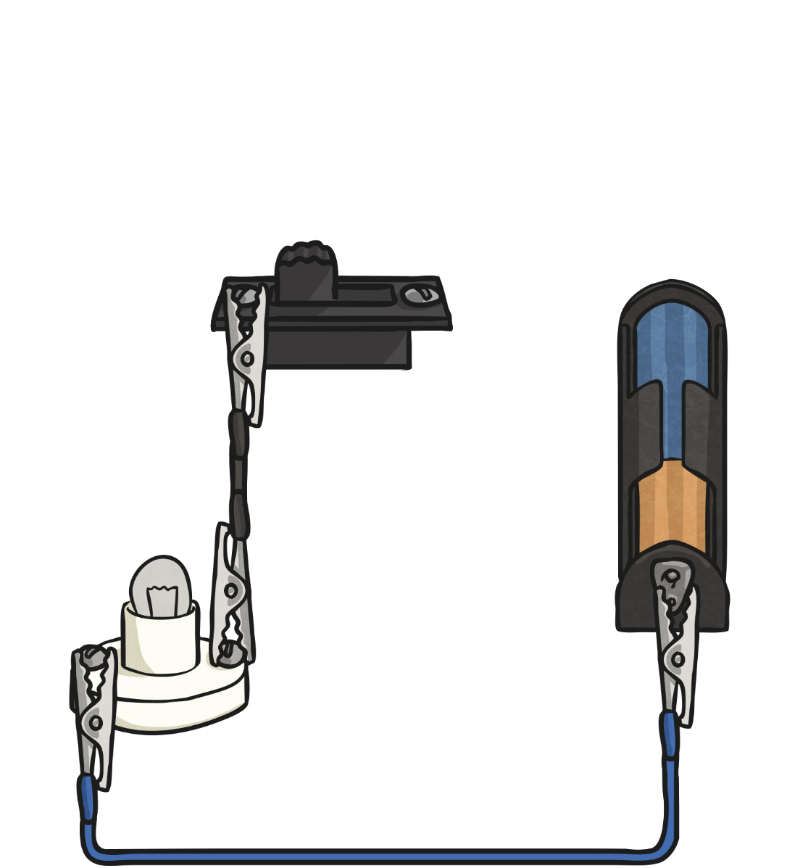
Circuits
A circuit has three basic components:
Most circuits also include a controller or switch.
An energy source
An electrical load
A conductor

Slide 4
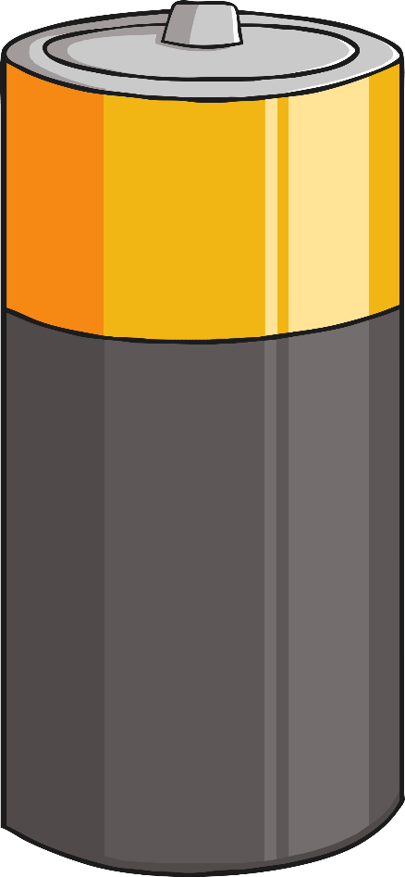
Energy Source
An energy source for a circuit can be a battery.
A battery has two poles:
+
positive
and
negative.
-

Slide 5
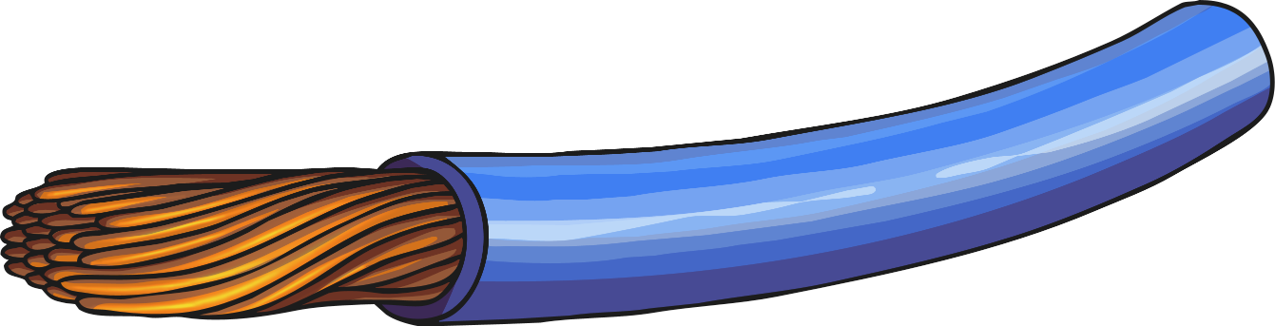
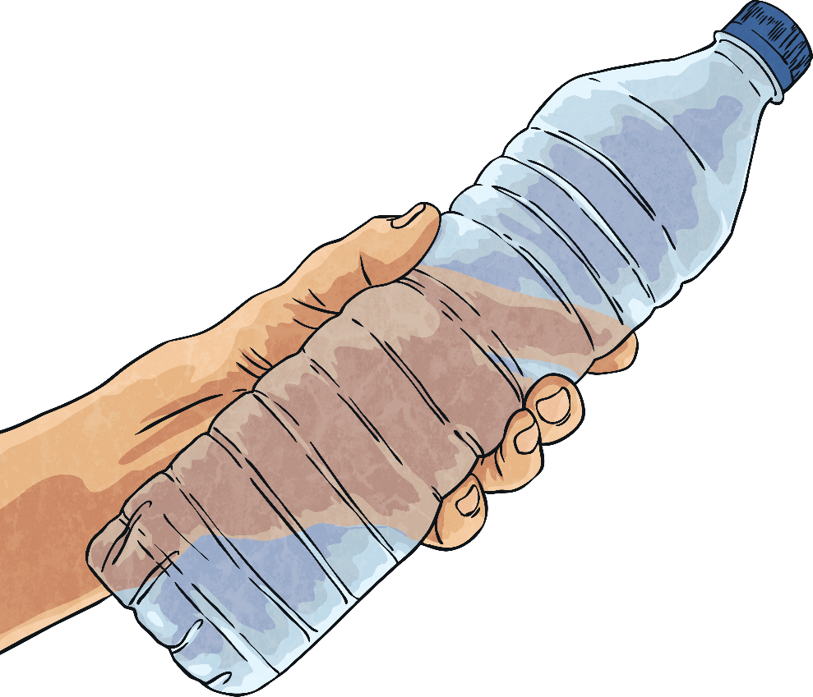
Conductor
A conductor is a material that electricity can pass through, such as certain types of wire.
The opposite of a conductor is an insulator. Insulators, such as plastic, do not allow electricity to freely move.

Slide 6
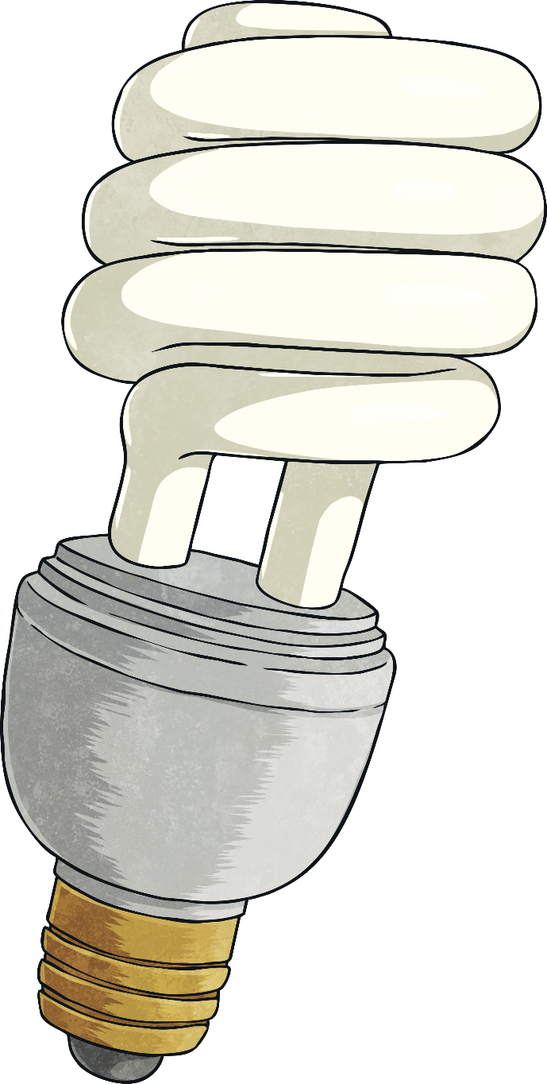
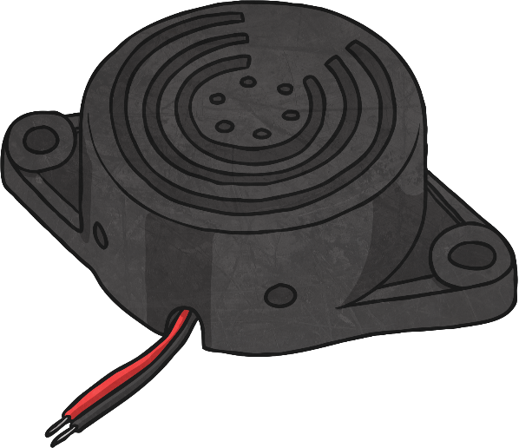
Electrical Load
An electrical load is a type of device to be powered by the circuit.
Some common electrical loads are light bulbs or buzzers.

Slide 7
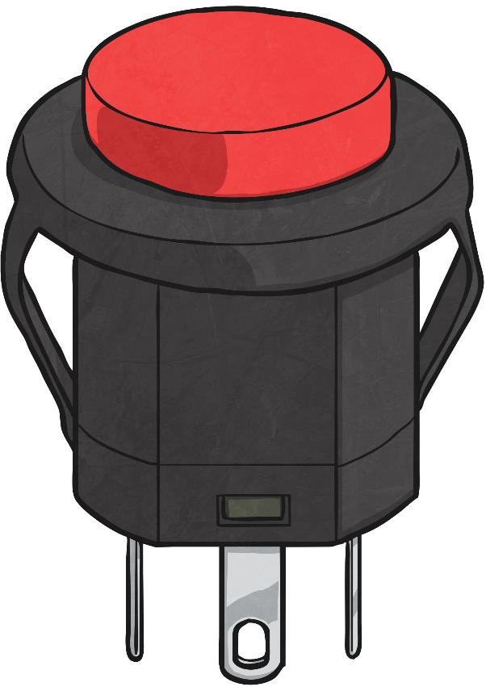
Controller
Most electrical circuits have a controller or switch to allow or to stop the flow of electricity.
When the controller stops the flow of electricity, it opens the circuit so it is not a closed path for electricity to flow through.
When the controller completes the circuit so electricity can pass through, it makes a closed circuit.

Slide 8
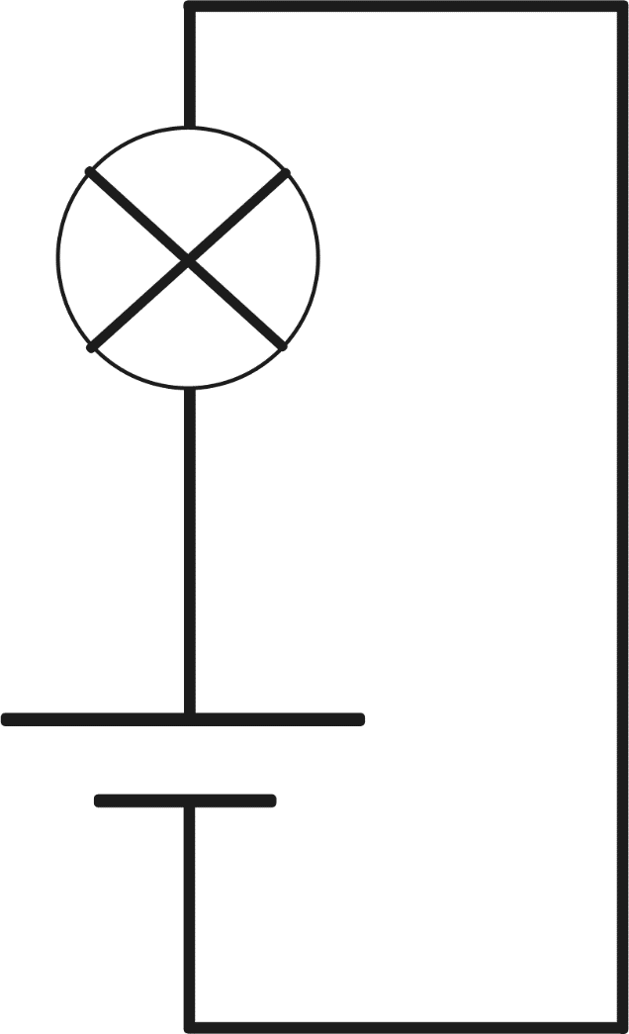
Simple Circuit
A simple circuit has the three basic parts of a circuit: an energy source, a conductor, and an electric load.

Slide 9
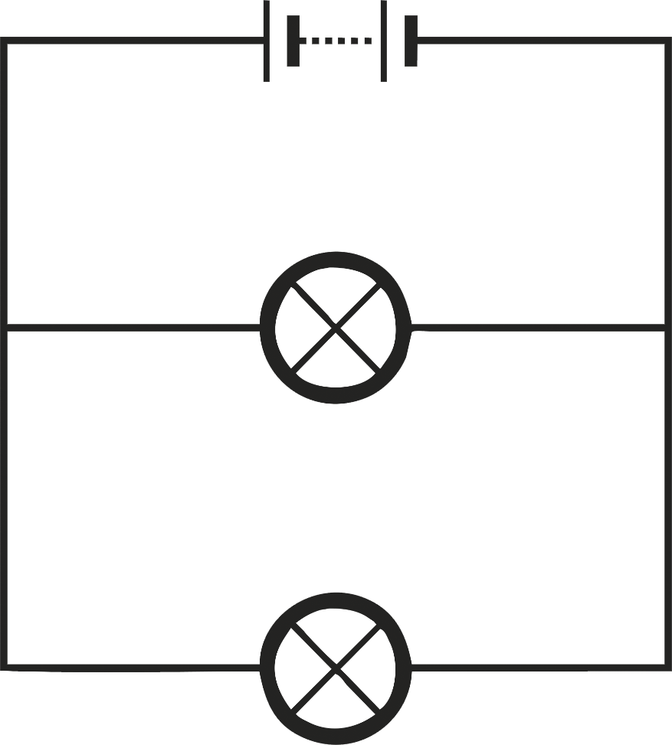
Parallel Circuit
A parallel circuit includes two paths for the electricity to flow through.

Slide 10
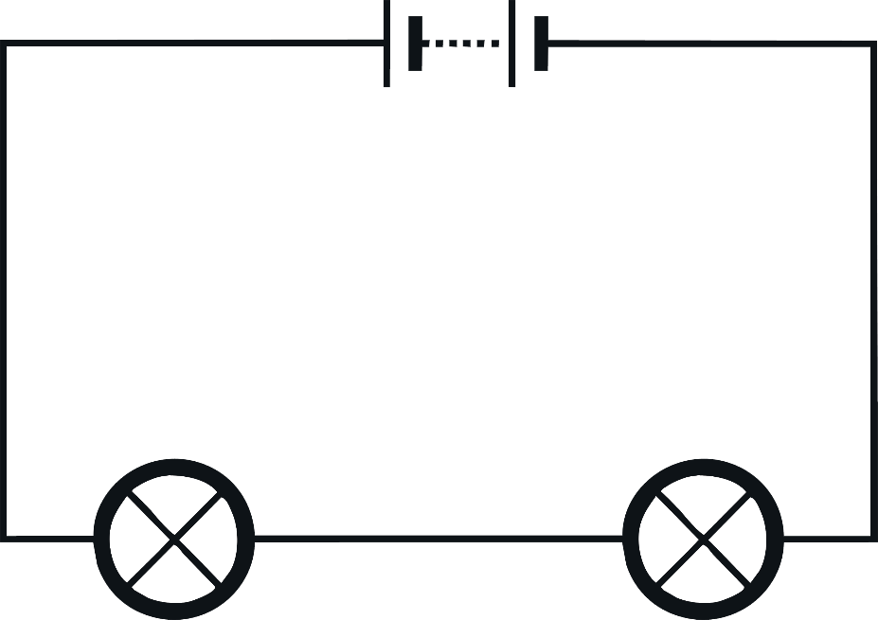
Series Circuit
A series circuit includes a series of electrical loads but has only one path in which the electricity can flow.

Slide 11
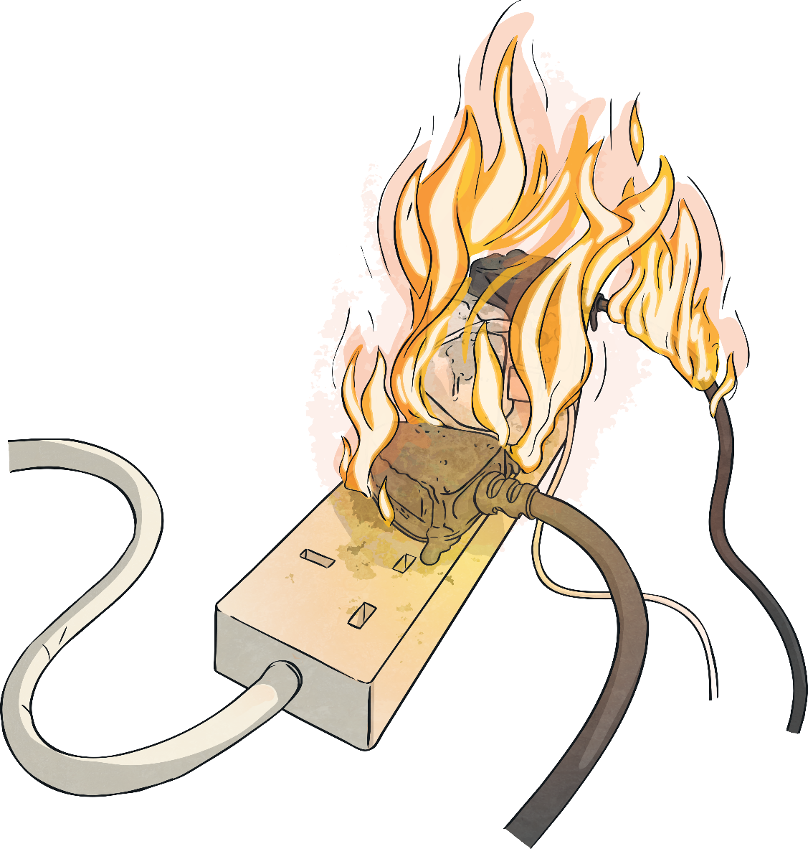
Circuit Safety
When working with circuits, we must be careful to follow safety guidelines for using electricity.
These rules include making sure that you are supervised by an adult, not touching electrical wires, not using electricity around water, and not interfering with outlets.

