Slide 1
National Numeracy
Schools & Families Programme
Notes:
Use this deck to introduce the Schools & Families Programme to parents and carers. You may also want to invite parents/carers to complete a Family Maths activity with their children to get an idea of how the activities work.
Explain that the school has been selected to participate in National Numeracy’s Schools & Families Programme for the next year. National Numeracy is an independent charity dedicated to helping everyone get on with numbers so they can get on with life. National Numeracy focus on empowering everyone to build their number confidence to fulfil their potential at work, home and school.

Slide 2
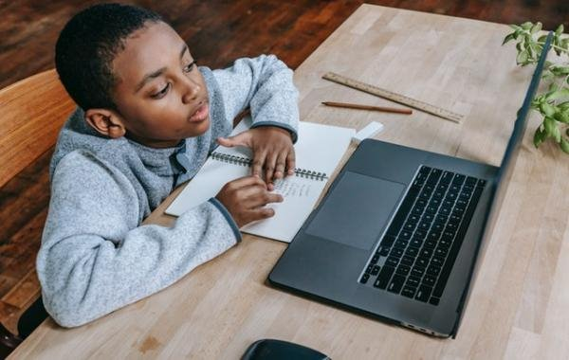
Aims of the Schools & Families Programme
To increase pupils’:
  confidence with numbers,
  positive feelings about maths,
  awareness of the value of maths outside the classroom.
To increase parents’, carers’ and school staff’s confidence in supporting children with maths.
To establish lasting approaches and strategies that will continue in schools beyond the end of the programme.
Notes:
Introduce the aims of the Schools & Families Programme.
Explain that there will be activities running through the year for staff, parents/carers and children. This is a whole school approach.

Slide 3
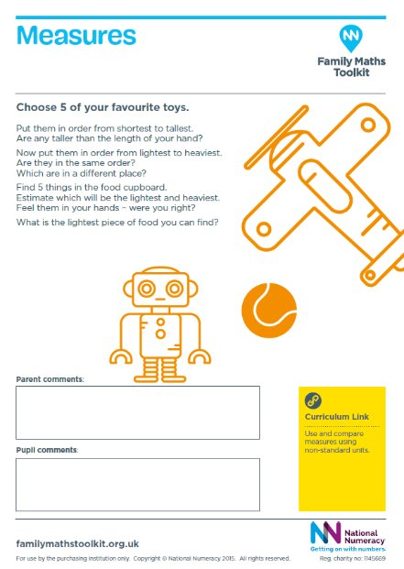
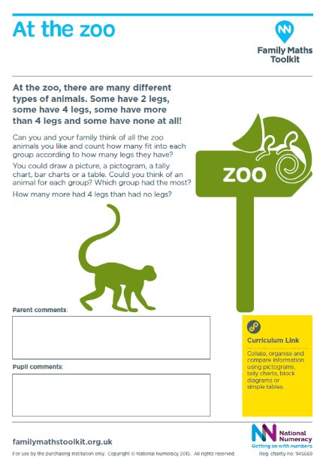
Family Maths Resources
Everyday maths activities
Encourage positive conversations at home
Complete as a family
Related to seasonal events, holidays and everyday maths
Open-ended investigations
Scrapbooks
Notes:
Explain which classes/year groups will be bringing home Family Maths scrapbooks and activities.
The activities will help children and families to explore everyday maths together. They link the maths that children are learning at school with life outside.
You don’t need any special knowledge or equipment to work on the activities. Just talking about everyday maths can help develop children’s maths confidence.
You might like to take photos, draw pictures, write sums, or create diagrams in the scrapbooks it’s up to you.
It would be useful to have some example Family Maths activities printed out for parents to look at. Perhaps they could visit their child and complete an activity together.
Explain the space for family and child comments.
Make sure you share with parents the expectations around the activities. When will they be set? How often? When should scrapbooks be brought to school? What should parents do if they would like some help?

Slide 4
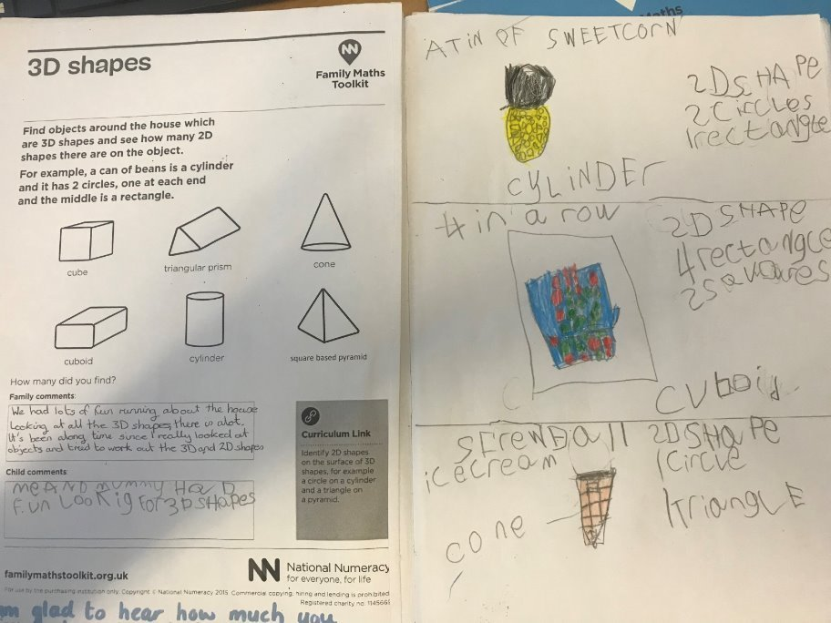
Family Maths Resources
Notes:
Share these completed examples with parents and carers

Slide 5
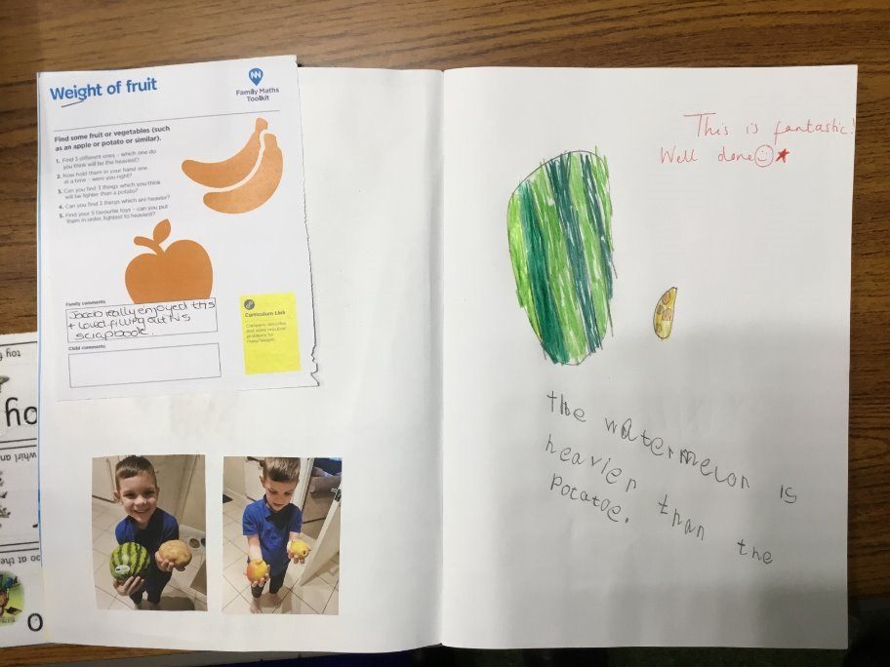
Family Maths Resources
Notes:
Share these completed examples with parents and carers

Slide 6
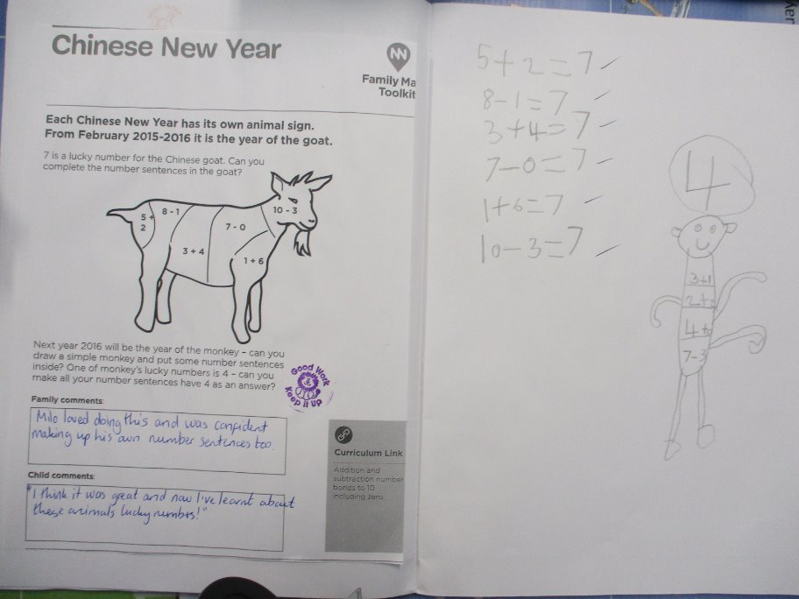
Family Maths Resources
Notes:
Share these completed examples with parents and carers

Slide 7
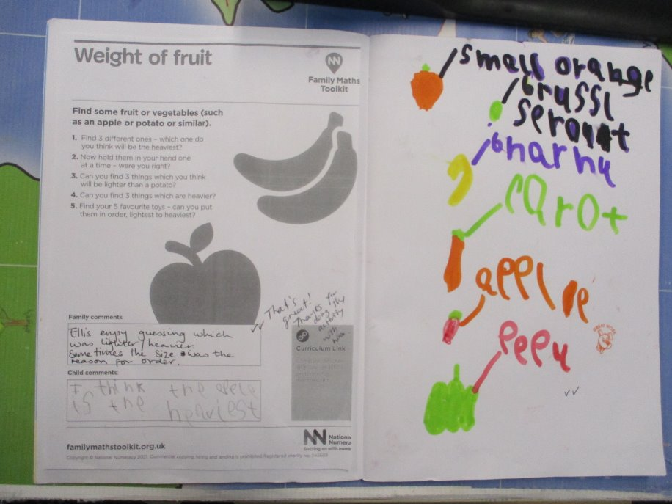
Family Maths Resources
Notes:
Share these completed examples with parents and carers

Slide 8

National Numeracy Challenge
Notes:
Share information about the National Numeracy Challenge with parents/carers as a tool to use if they would like to improve their own numeracy skills and confidence.
We recommend printing out the poster so parents/carers can scan the QR code and register if they would like.

