Slide 1
Foundation stage
Curriculum meeting
September 2025

Slide 2



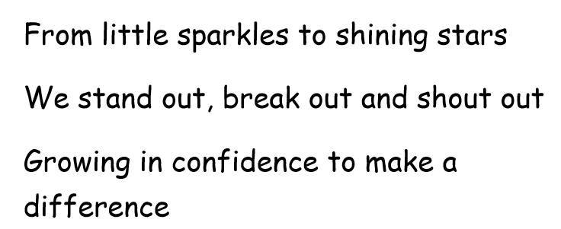

Slide 3
Our school vision
This is what we want for our children, to flourish and be the best they can be when they leave us at the end of Year 6
It is underpinned by the story of King David which the children will come to know
King David has humble beginnings as a shepherd and he was known for his creativity and courage
He achieved great things through courage, compassion, patience and determination
He had to STANDOUT, BREAKOUT and SHOUTOUT to do this

Slide 4
Welcome to Foundation Stage!
(What is it?)
We are known as many different names; Foundation Stage, Reception, Early Years, FS (Foundation Stage) and EYFS (Early Years Foundation Stage)
Transition between the nursery setting and formal school (Year 1 upwards)

Slide 5
EYFS areas of learning
Area of Learning | Subheadings
Communication and Language | - Listening and attention and understanding - Speaking
Personal, Social, Emotional development | Self-regulation Managing self Building relationships
Physical development | Gross motor skills Fine motor skills
Literacy | Comprehension Word reading Writing
Maths | Number Numerical patterns
Expressive Arts and Design | Creating with materials Being imaginative and expressive
Understanding the World | Past and present People and communities The Natural World

Slide 6
Prime areas of learning
This area consists of:
Communication and Language
Personal, social, emotional development
Physical development

Slide 7
Specific Areas of Learning
This area consists of:
Literacy
Mathematics
Expressive Arts and Design
Understanding the World

Slide 8
GLD
Good Level of Development
End of year summative assessment against all 17 ELG (Early Learning Goals)
Measures attainment, not progress!
Teacher’s professional judgement of:
1 = emerging or 2 = expected
We focus on your child’s progress throughout the year.

Slide 9
Learning through play
In Foundation Stage, children are taught both through play and adult-led activities and gradually move onto more formal styles of learning throughout KS1.
Areas of provision across both classrooms
Areas of provision outside in EYFS playground
Adult focus activities
Whole class teaching

Slide 10






Plan for EYFS
Long term plan and English breakdown is on our website: Parent information > curriculum
Autumn 1 | Autumn 2 | Spring 1 | Spring 2 | Summer 1 | Summer 2
Owl Babies / Autumn | We’re Going on a Bear Hunt / Celebrations | Chinese New Year / Traditional tales | New Life / On the farm | Minibeast / Life cycles / People who help us | People who help us / Character creations

Slide 11
How will your child be assessed?
We use Development Matters to guide our curriculum
Reception Baseline Assessment – Government baseline assessment
Phonics is tracked through Little Wandle assessments
Teacher judgement throughout the year
End of year summative assessment GLD

Slide 12

Phonics – what is phonics?
- We teach children phonics to help them learn to read and write.
Firstly, they learn one way to read the 40+ sounds of the English alphabet code. We teach them 4 sounds per week. Adults model using the shortest, purest sound.
Our scheme is Little Wandle from the DfE.

Slide 13
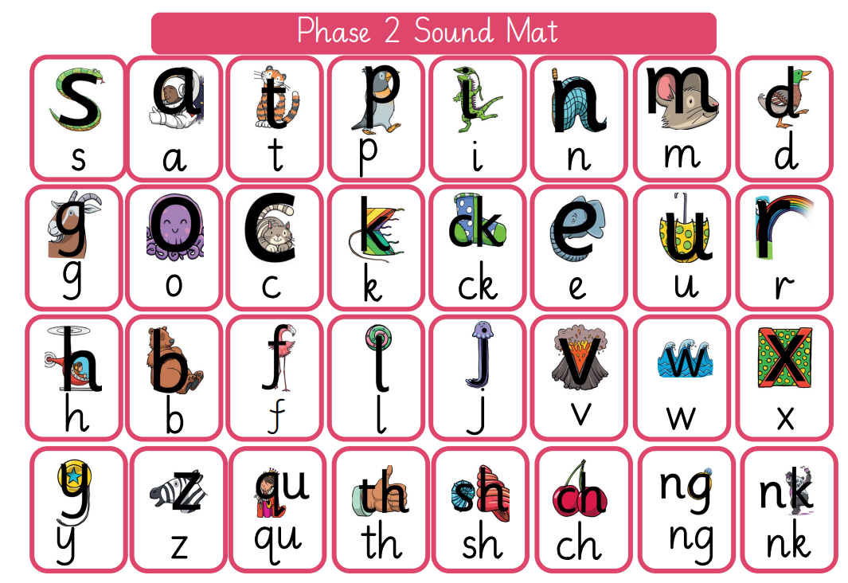
Little Wandle sound mats

Slide 14
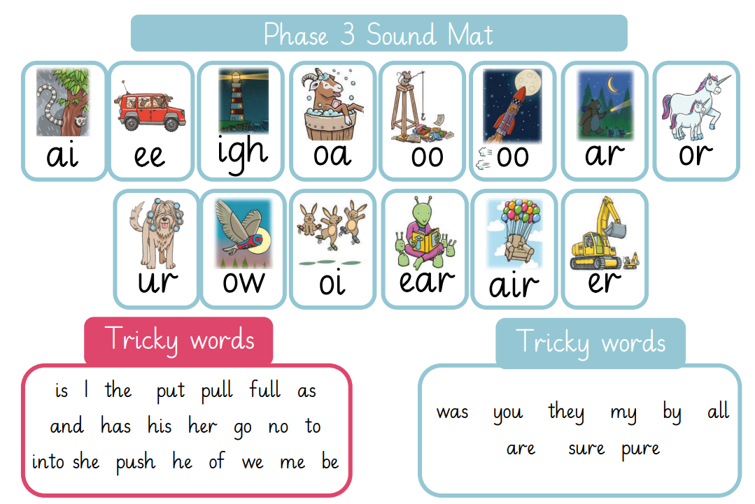
Little Wandle sound mats

Slide 15

Homework
Orange homework books
5 to 10 mins per day reading
This homework will mostly correspond with the sounds we will be learning each week in phonics
Homework tasks will differ as the year goes on
Email your class teacher a picture!

Slide 16
Reading books
Reading books will be sent home very soon!
Children will begin with a ‘Talk about book’
These are books without words! Please encourage your child to make up a story, talk about the pictures, make predictions, ask questions, write captions on Post It notes
Read with your child little and often (about 10 minutes daily) and record it in their yellow Home school reading diary.
This needs to include; name of book, date and a brief comment – ‘4.10.25 Olivia enjoyed this story and spotted lots of tricky words. Mum’
Please keep all reading books, reading diaries and Homework books in book bags every day so we can change books easily
We celebrate reading success within our celebrations assemblies – special reading certificates which promotes both reading in school and at home. This is in instead of Reading champions.

Slide 17
Helping your child to write
Encourage children to mark make write, colour, paint!
Label everything – draw pictures of models and label them, write shopping lists, thank you cards. Encourage children to sound out the words they are trying to spell.
Fine motor control – Lego, threading, pegging, Hama beads, loom bands, playdoh etc.

Slide 18
Mathematics
Whole class teaching
Follow White Rose maths Scheme of work
Focus activities led by an adult
Maths area in provision

Slide 19
Website documents
Parent information > Documents > Foundation Stage documents
How to support your child with maths
How to support your child with reading
Termly newsletters

Slide 20
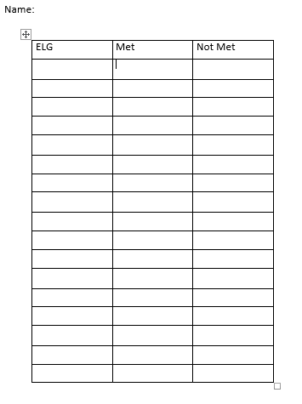
What to expect at the end of Foundation Stage:

Slide 21
School uniform reminder
Please, please, please name every piece of
school uniform and PE kit!
Wellies are useful to have for the ever changing weather. If you have a spare pair that can be left at school (named) please leave them under your child’s peg in the cloak room.
Water bottles must contain just water and need to be taken home and refilled for the next day.
PE kits must be plain navy blue or black.
A filled ‘Just in case’ bag

Slide 22
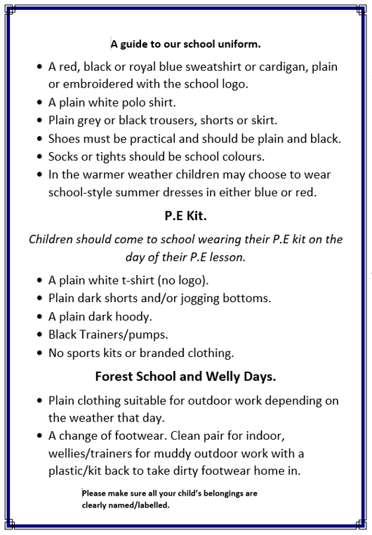
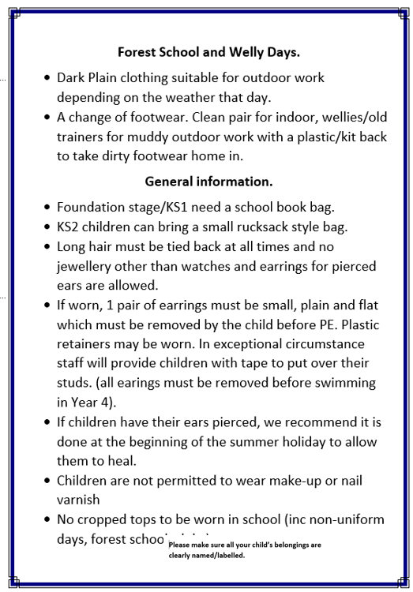

Slide 23
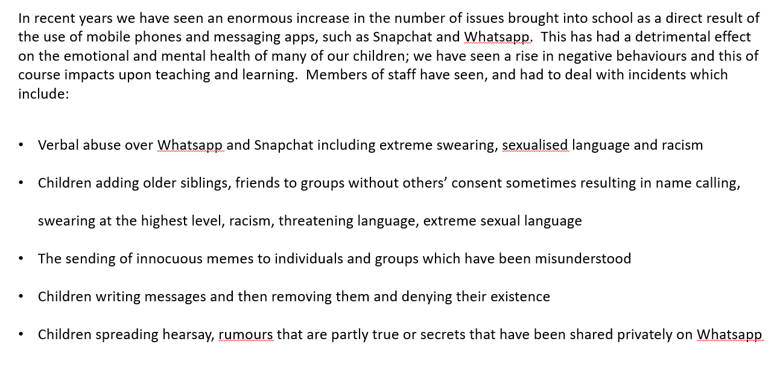
Smart phones and WhatsApp

Slide 24
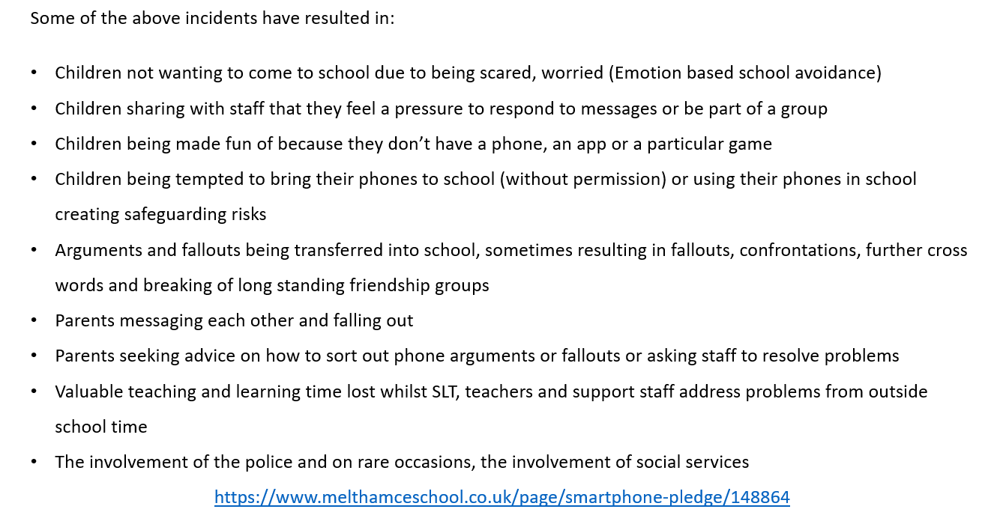

Slide 25
Reminders
Homework books will go home on Thursday – to be completed at home and will be collected in every Thursday
Keep up to date with emails on School Spider and photos on Instagram
Signs on the classroom windows and occasionally letters in book bags

Slide 26
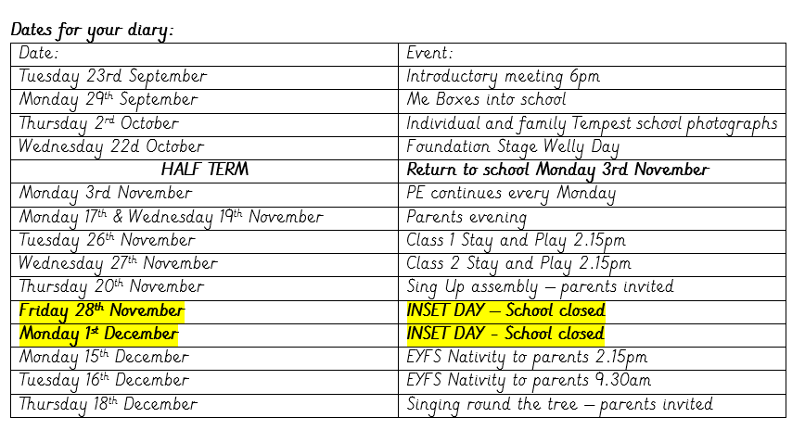
Important dates for your diary

Slide 27
Thank you for your continued support
The Foundation Stage team

