Slide 1
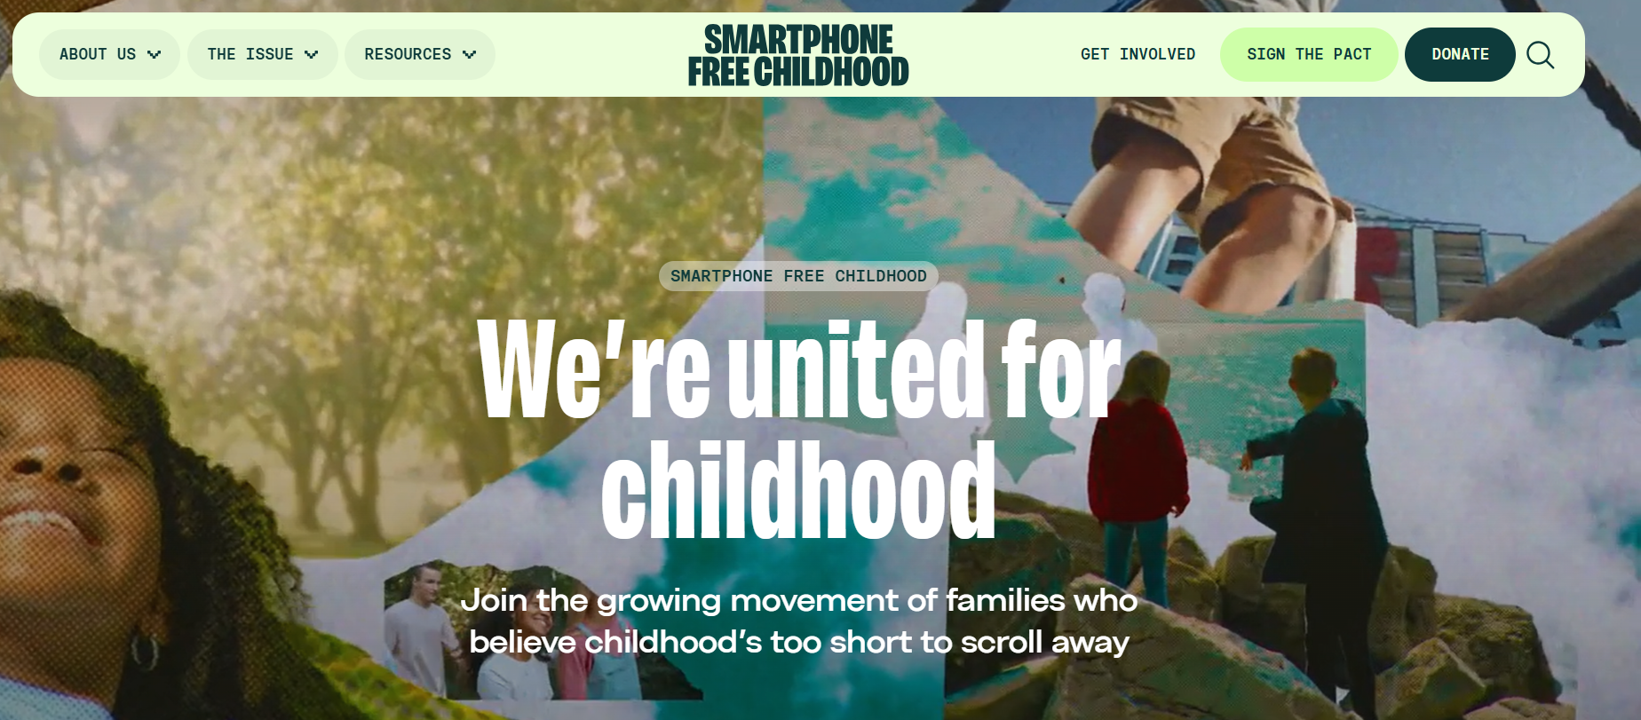

Slide 2

Online Safety
Parent Coffee Morning
Digital Citizenship Week
2025

Slide 3


What are you most WORRIED about when your child is ONLINE?
Notes:
ASK: Find out what parents are currently worried about
TELL: Despite the positive finding that over seven in ten (72%) 8-17-year-olds who use messaging/social media sites or apps feel safe when using these apps/online sites, either all or most of the time, the online space is a risky environment for children.

Slide 4
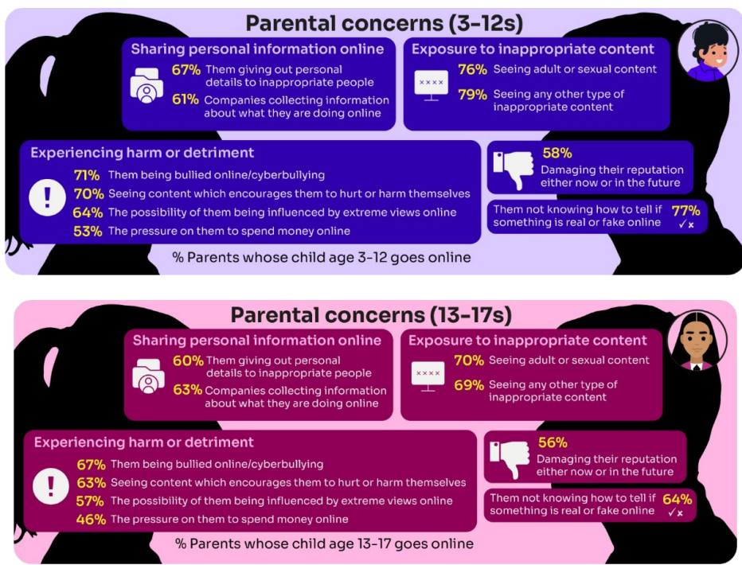
Summary of parental concerns (3 – 17 yr-olds)
Source: Children and parents: media use and attitudes report 2025
Notes:
Many parents indicate that they have concerns around various aspects of their children’s online activities.
The primary worry of all parents of online 3-17s continues to be potential exposure to age inappropriate content - three-quarters of parents said they were either fairly or very concerned about their child seeing content which is not appropriate for their age (76%) and the same proportion were concerned about them seeing ‘adult’ or sexual content (74%).
72% were concerned their child not knowing how to tell if something is real or fake online.
Seven in ten (69%) parents fear their child might be bullied online,
A similar proportion (68%) are worried about them seeing content that encourages them to hurt themselves.
61% of parents are concerned about their child being influenced by extreme views,
51% worry about the pressure to spend money online.
Unsurprisingly, there are many concerns which are more prominent among parents of younger (3- 12-year-old) children who go online.:
For example, a higher proportion of these parents compared to their counterparts (parents of teenagers) are concerned about their child being exposed to age inappropriate content (79% vs 69%), their child not being able to tell what is real or fake online (77% vs 64%), their child seeing content which encourages them to harm themselves (70% vs 63%), the 36 child giving out personal details to inappropriate people (67% vs 60%) and the possibility of their child being influenced by extreme views online (64% vs 57%).

Slide 5
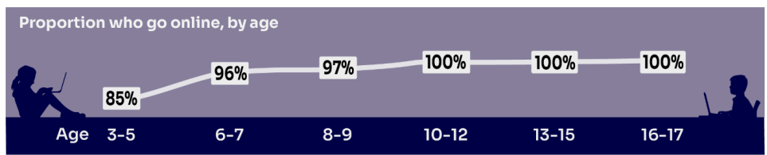

HOW MUCH DO YOU KNOW about your child’s life online?
Almost all children (96%) aged 3 – 17 went online in 2024, highlighting the centrality of the internet in their lives:
    Younger children commonly use tablets to go online
    Older children are more likely to use mobile phones
Source: Children and parents: media use and attitudes report 2025
Notes:
TELL:
We will be looking at 3–17-year-olds patterns of media use, how they access different sources of media online, and the types of online activities they are participating in. This includes their behaviours and habits in terms of viewing, playing, learning, and interacting
Almost all children from aged 5yrs (96%) went online in 2023, highlighting the centrality of the internet in children’s lives.
And we mustn’t forget that being online does create a lot of opportunity and joy for most of us. So, let’s think about how we can minimise risk and reduce their exposure to harm.

Slide 6
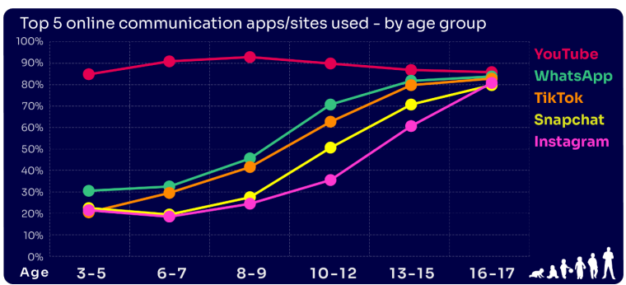
Are you FAMILIAR WITH THE APPS and GAMES your child is on?
YouTube is the most popular, but the appeal of many social media platforms varies by age
The two most popular apps for 3 – 7 yr-olds are WhatsApp (2 in 10) and Snapchat (3 in 10)
The proportion of 8-9s with an Instagram profile increased from 8% in 2023 to 14% in 2024
13-17s are most likely to have profiles on WhatsApp
(62%), Snapchat (62%) or TikTok (61%)
Go to apps.lgfl.net for guidance on apps and social media sites
Source: Children and parents: media use and attitudes report 2025
Notes:
YouTube continues to be universally popular, and the appeal of other social media platforms increases with age . nearly half (48%) of 16-17s use all of the top five apps/ sites that we asked about (YouTube, WhatsApp, TikTok, Snapchat and Instagram).
REMIND – your children need to be 13+ to use these platforms (See slide 39)

Slide 7
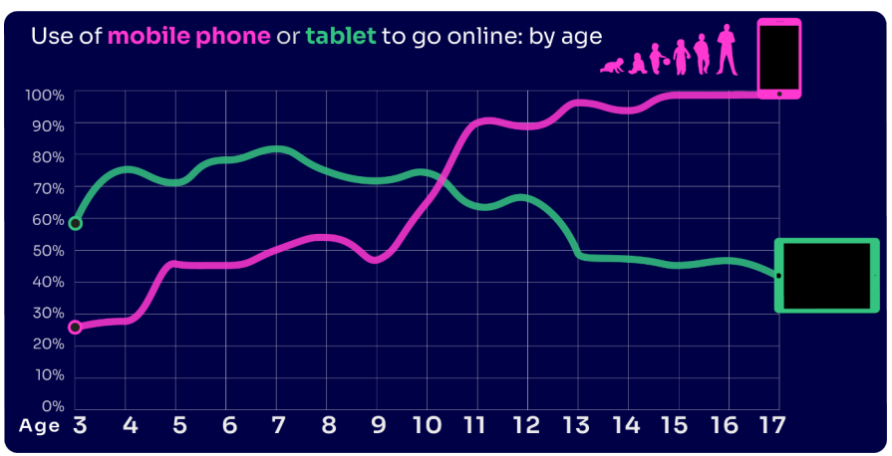
By age 11, nine in ten children own their own mobile phone, distinct from using a family device
This correlates with transition from primary to secondary school.
Source: Children and parents: media use and attitudes report 2025
Notes:
As in previous years, the point at which it becomes more likely that a child will go online using a mobile rather than a tablet closely correlates with the age at which mobile phone ownership among children becomes almost universal.

Slide 8

WHY DOES THIS MATTER?
Young people can get around age restrictions on apps and websites, increasing the risk of them coming to harm online
Addictive algorithms can make it harder to take a break and maintain a healthy balance between time on and offline
Algorithms can also target content similar to what you’ve already selected/liked/shared
This can prevent you from finding new ideas and perspectives, create misinformation and reinforce stereotypes
Notes:
ASK – What kinds of risks do you think children could be exposed to? Can you give examples? (See slide 48 for a summary of related risks)

Slide 9
What might they NOT BE TELLING YOU?
Nearly six in ten (56%) 8-17s use multiple profiles on at least one social media platform:
(23%) said it was because one account was just for parents/family to see
15% said one account was for the ‘real me’ and another contained edited/filtered posts or photos
Source: Children and parents: media use and attitudes report 2025
Notes:
TELL - This demonstrates that at least some children feel the need to present distinct aspects of themselves on social media, depending on the audience.

Slide 10
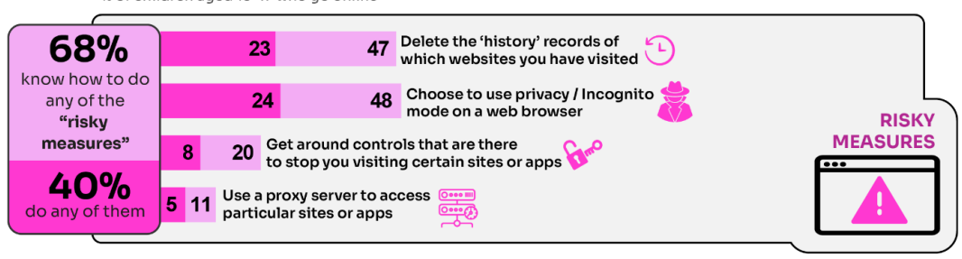
WHY is this ‘RISKY’?
40% had engaged in ‘risky’ behaviour!
Source: Children and parents: media use and attitudes report 2025
Notes:
TELL - This behaviour is considered ‘risky’ because they enable the child to conceal their online activity, preventing a parent or appropriate adult to ensure they are keeping safe online.

Slide 11

Four in ten under-13s have a profile on social media apps or sites…
YouTube/YouTube Kids (44%)
WhatsApp (23%)
TikTok (23%)
The proportion of 8-9s with an Instagram profile increased from 8% in 2023 to 14% in 2024
Despite there being a minimum age requirement of 13 for using most social media apps, over half of
3-12-year olds (55%) were reported as using at least one social media app or site, an increase on last
year, when 51% of these children did so.
Source: Children and parents: media use and attitudes report 2025

Slide 12
Does your child have their OWN MOBILE PHONE? If so, is it a SMART PHONE?
What AGE do you think is appropriate?
Source: Children and parents: media use and attitudes report 2025
Notes:
By the age of 11 nine in ten (91%) children aged 3-17 own their own mobile phone. in the period before they progress to secondary school, children become more likely to use a mobile phone to go online, while younger children (those aged 10 and under) are more likely to use a tablet.
TELL - A common debate is about the age at which children should be able to use smartphones. These are mobile phones that can access the internet and have apps installed on them. Some parents have opted for non-smart’ phones, which are mobiles that usually only have text and call capabilities.

Slide 13


SMARTPHONE or ‘NON’-SMART / BRICK phone?
REMEMBER IT’S YOUR CHOICE
Every child and situation is unique,
and you are best placed to know their needs
Internet access
Social media, apps and games
Notifications
Anytime connection
Parental controls
NO internet access
Some games
Anytime phone calls and texts
Limited parental controls
Notes:
ASK THEM TO CONSIDER:
How will they reduce any risks?
What does their child need the mobile for? Is it simply to stay in touch with you - then a ‘non-smart’ phone might be enough. But if you want them to access homework or learning on their mobile, then a smartphone might be better.
How you can help them child learn the basic skills to use it safely e.g. to send a message, take part in a group chat, manage their timings etc. Children need our support with developing these skills. You wouldn’t give your child a knife without guidance and support, similarly a phone can cause harm and so need to think about this.
Whatever they decide, communication is key - involve the child in the process to establish shared expectations.
Remember to set up parental control settings or use a parental controls app to help them stay safe.

Slide 14

32% of 8-17s had seen something they found worrying or nasty online in the past 12 months
59% of parents were concerned about them being influenced by extremist content
Visit goingtoofar.lgfl.net to find out how to help children:
  recognise extremist behaviour and content on social media/apps/games
  understand actions likely to attract police investigation
  get help
  report concerns
Source: Children and parents: media use and attitudes report
Notes:
Last year, just under one in ten 12-15s said they often saw ‘hateful content’ online For the purposes of our survey, ‘hateful content’ was described as anything that had been directed at a particular group of people based on, for instance, their gender, religion, disability, sexuality, or gender identity. Overall, half of 12-15s said they had encountered this type of content online in the past year, with 8% saying that they had seen it often.

Slide 16


Slide 17
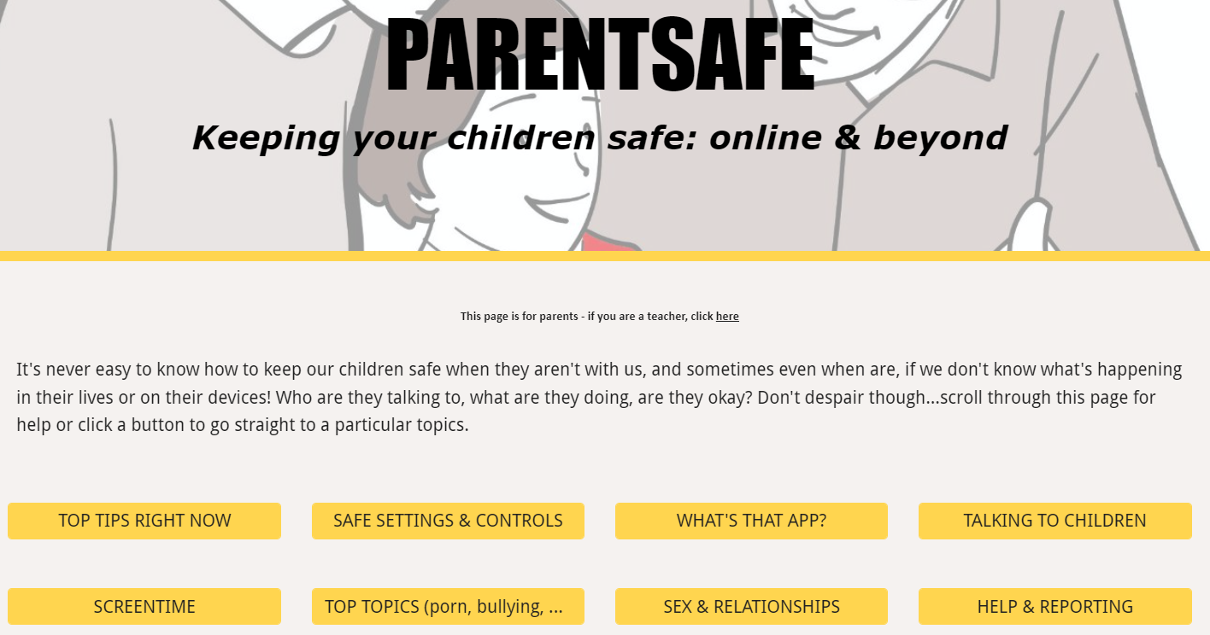
parentsafe.lgfl.net
Notes:
TELL - It's never easy to know how to keep our children safe, especially if we don't know what's happening in their lives or on their devices! Who are they talking to, what are they doing, are they okay? Don't despair though... We’ve created a dedicated website for parents and carers - simply scroll through ParentSafe for help or click a button to go straight to a particular topics. We will look at some of these resources and tips shortly

Slide 18
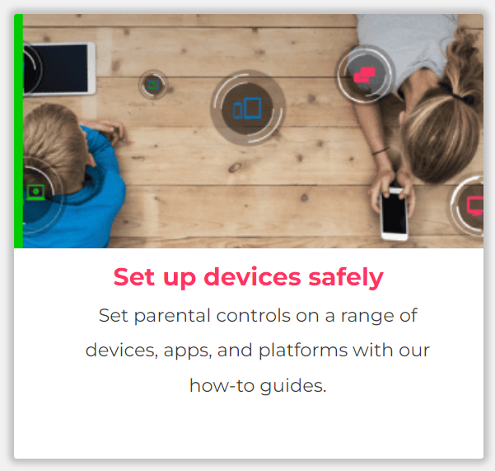
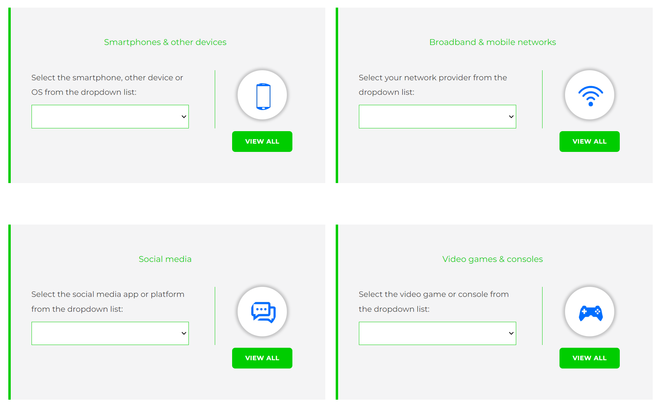
Visit internetmatters.org/parental-controls to find out how to set controls on devices:
Notes:
TELL – They can use this great page to find out how to set up controls on any smartphone, broadband, social media site/app and games console
REMIND - They need to set up parental controls on each of these individually

Slide 19
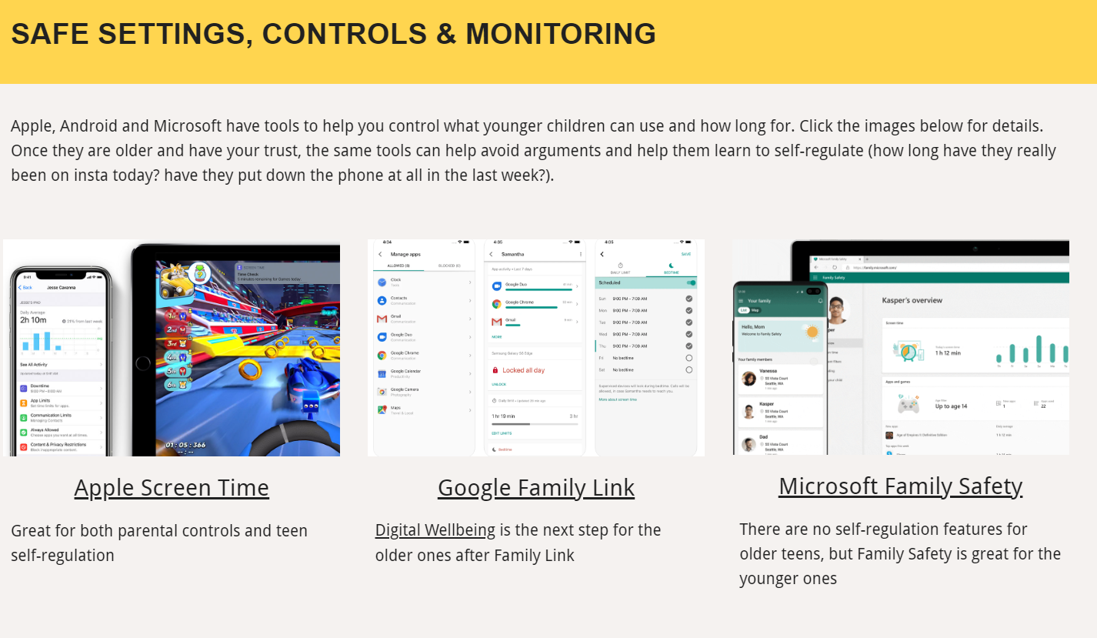
Parental control apps like Google Family Link, Screen Time and Microsoft Family can let you set limits across devices, apps and platforms
Visit parentsafe.lgfl.net/ for additional advice and tips on settings and controls for all devices
Notes:
EXPLAIN - As well as setting controls on your broadband, device, apps, games etc, Parental Control Apps like Google Family Link, Screen Time and Microsoft Family can further enhance safety by letting you set limits across devices, apps and platforms without needing to access these spaces separately. You can manage screen time, app access, inappropriate content restrictions and more.
Screen Time shows you how much time you spend on apps, websites and more. You can also set limits and restrictions for what you want to manage – on your own device or a child's device.
Family link can run on Android devices, e.g. Samsung… Parents can access and manage their child’s account and settings, and delete it if necessary
TIP – Why not run a ‘Bring your device and we’ll show you….’ pupil-led workshop to help parents with this at school?

Slide 20
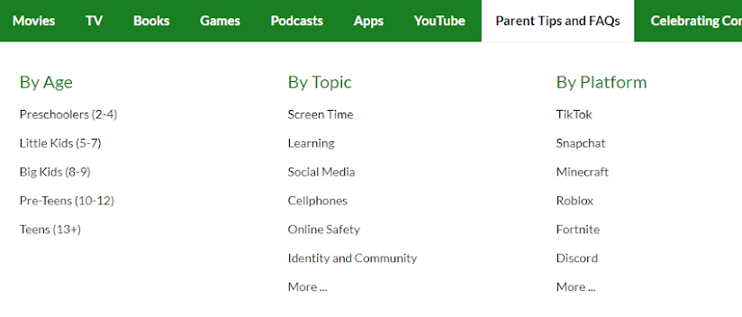
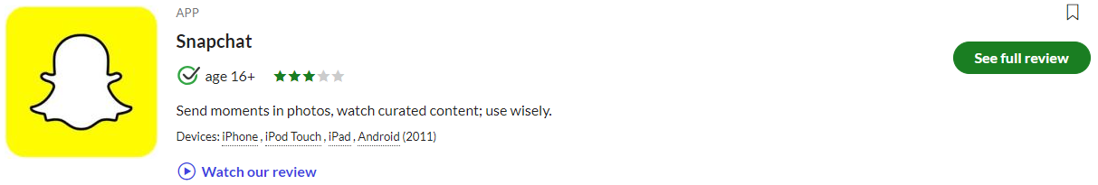


Find ratings and reviews for parents on apps, games and social media at commonsensemedia.org
Notes:
REMIND – they don’t need to be experts, but they can empower themselves by finding out about the suitability of the games/apps their child uses
SHOW – the Common Sense Media page and pick an app or game to show how easy it is to find a review

Slide 21
